Slide 1

Goal: Pretrain the RL
Recap
30 July 2025
Validity test for datasets
Generated logical constraint to train the RL: 5 different sets for grid buy/sell, FR band
(Set 1: tight, Set 2: normal, Set 3: loose, Set 4: medium noise, Set 5: high noise)
Training Strategy
3 Phase training
Warm up over Set 2
Random sample over all the 5 constraints set
Evaluate the best policy over Set 4
GSP & Actor Critic (DDPG)

Slide 2
Predefined constraint sets Update
FR incentive | FR signal | FR band (MW)
 |  | set 1 | set 2 | set 3
high | high | 7.0 | 8.0 | 9.0
high | low | 4.0 | 5.0 | 6.0
medium | medium | 2.0 | 3.0 | 4.0
low | high | 1.0 | 1.5 | 2.0
low | low | 0.1 | 0.5 | 1.0
grid price | FR incentive | Grid buy (MW)
 |  | set 1 | set 2 | set 3
low | high | 5.0 | 6.0 | 7.0
low | low | 3.0 | 4.0 | 5.0
medium | medium | 2.0 | 2.5 | 3.0
high | high | 0.5 | 1.0 | 1.5
high | low | 0.1 | 0.3 | 0.5
New:
grid price | FR incentive | Grid sell (MW)
 |  | set 1 | set 2 | set 3
high | high | -5.0 | -6.0 | -7.0
high | low | -3.0 | -4.0 | -5.0
medium | medium | -2.0 | -2.5 | -3.0
low | high | -0.5 | -1.0 | -1.5
low | low | -0.1 | -0.3 | -0.5
The FR signal, FR incentive, and grid price are each classified as high, medium, or low depending on whether the one-hour average (time horizon) is above, equal to, or below the 24-hour moving average.
Generate two other constraint sets from set 2:
medium noise = ±25%
high noise = absolute noise = ± 3.0

Slide 3
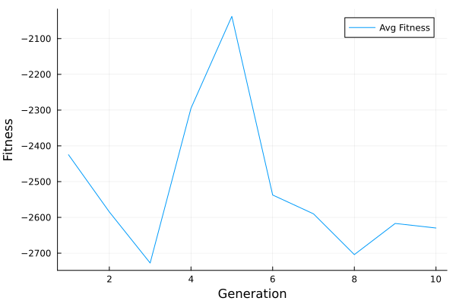
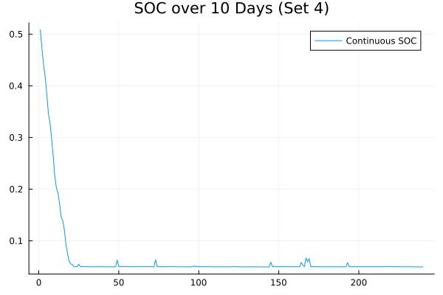
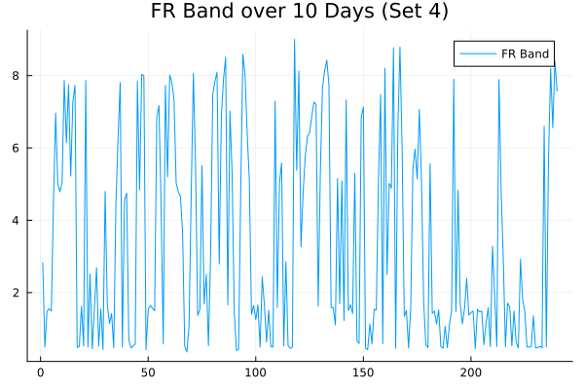
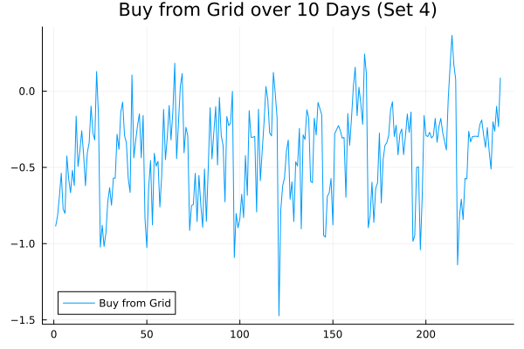
RL – GSP+NN
NN weights are optimized using Evolution Strategy
Perturbed copies by adding Gaussian noise
Observation:
No consistent learning trend:
high noise in reward signals
high-dimensional search space

Slide 4
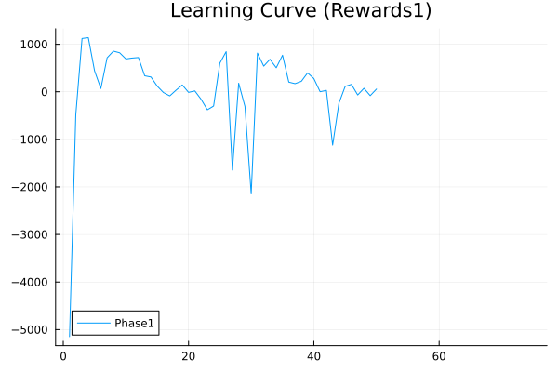
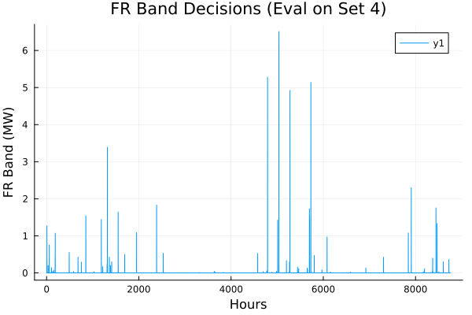
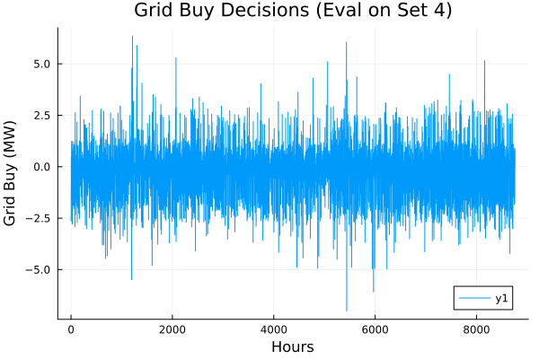
RL – Actor Critic (DDPG)
Test (50 epochs)
gradient-based
Replay buffer for off-policy training
tanh-bounded actor network- 64,32
Q-function critic- 64,32
Ornstein-Uhlenbeck noise for exploration
Reward function:
Revenue: based on FR and grid prices
SoC deviation penalty (Center at 0.5)
FR band smoothness actions
Target FR band regularization toward 3 MW
Grid usage penalty
Test Results: $137550/y

Slide 5
DAE simulator
Needed for calculating SEI growth for benchmarking
using original setup.jl file (HF)
Ready to use
Hierarchical scheme concern
What if MPC decides on FR band & grid buy/sell = 0 ? No participation in FR market No Revenue
Possible solutions:
Set minimum on FR band & grid buy/sell
Add revenue term into MPC obj. fun.
... ?

