Slide 1
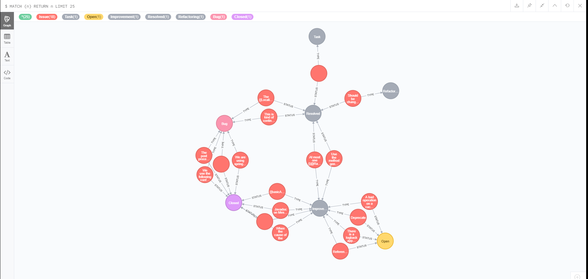
Status of the JIRA tickets

Slide 2
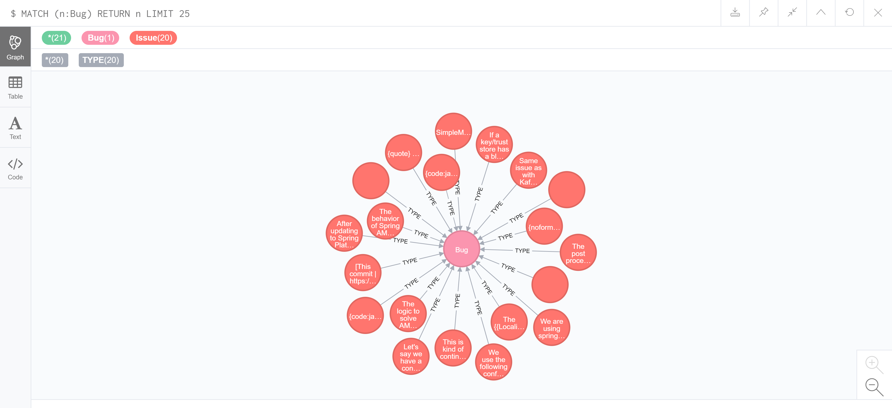
List of Bugs

Slide 3
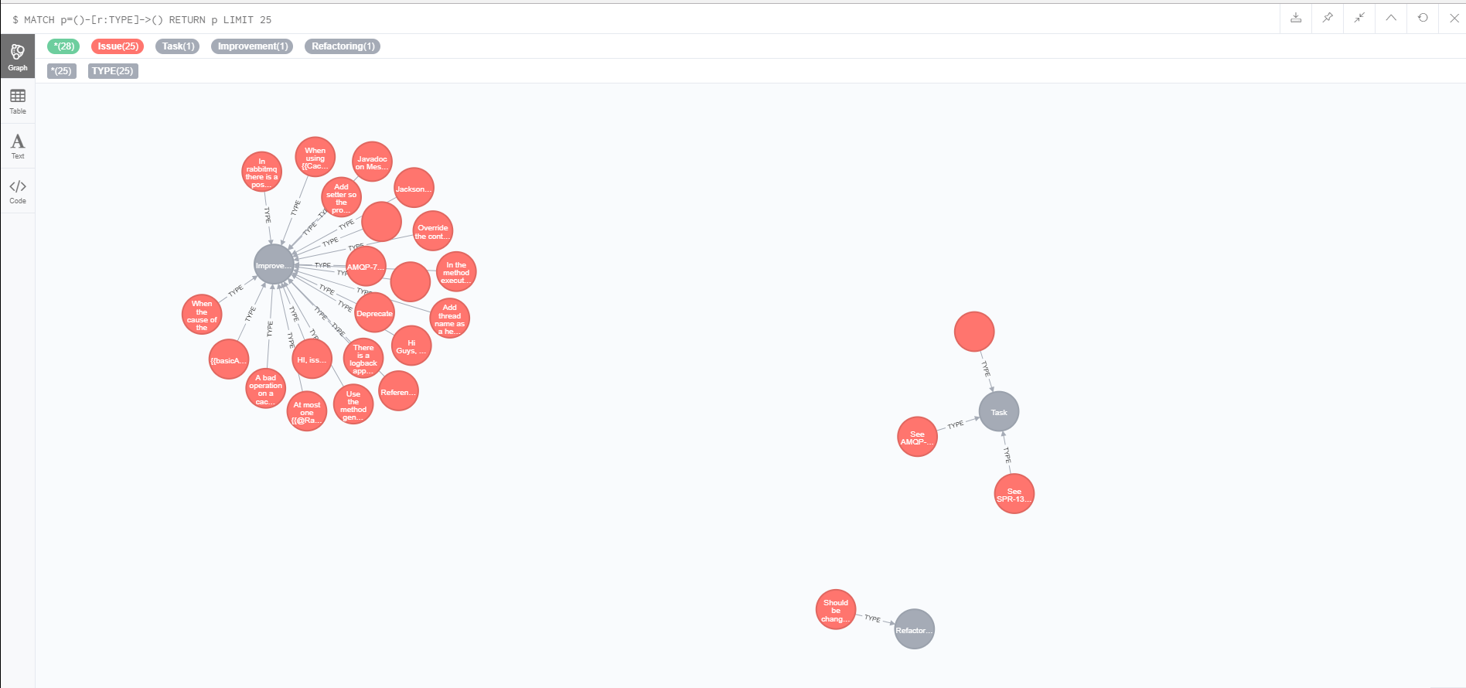
Type of JIRA Tickets

Slide 4
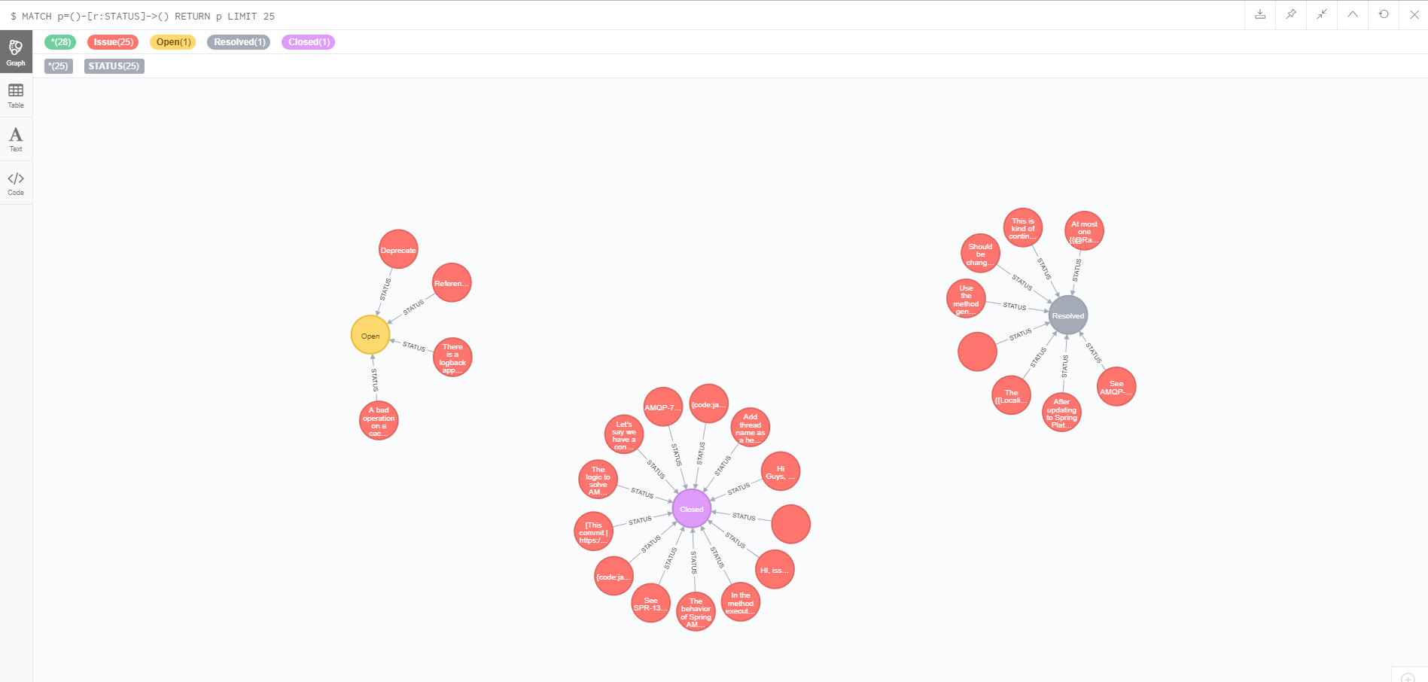
List of JIRA Status

