Slide 1





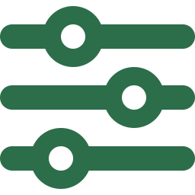


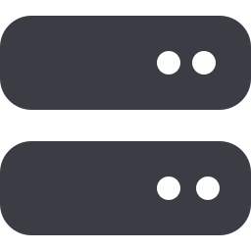


























✳ CLAUDE HARNESS ENGINE v5
The Agentic Engineering Harness
Scaffold + Skills + Hooks + GAN Agents + Ratchet Control System
Agent = Model + Harness · GAN generator/evaluator loop + Karpathy monotonic ratchet · scaffold once, ship safely
1
SCAFFOLD & MEMORY The Constitution Layer
MCP & EXTERNAL
/scaffold writes it once. Always loaded, always active — the project's constitution.
RUNTIMES & DELIVERY
CLAUDE.md
always-on agent rules
project-manifest
quality · arch · budget knobs
State files
learned + process rules
harness-nav MCP
.mcp.json navigation server
Two runtimes
Local · Agent-Factory (symphony)
▼
2
SKILLS & LANES The Workflow Layer
On-demand skills; the harness classifies scope and picks the lane for you.
LSP servers
pyright · tsserver · gopls
/build /feature
small public surface
26+ skill lanes
brd→…→auto · change · vibe
Z/L routing
scope → lane + review plan
SKUs
harness-core · full · lite
▼
3
HOOKS & GATES The Guardrail Layer
Deterministic, not AI — fires on every write, tool call, and commit.
GitHub
PRs · issues · CI checks
Lifecycle hooks
pre/post-tool · stop
Deterministic gates
no rm-rf · no stub-to-green
Git pre-commit
ratchet + prompt-cache lock
Token Governor
DeepWiki · code-graph · CCR
▼
4
AGENTS & GAN LOOP The Delegation Layer
Trackers
Linear / Jira boards
Adversarial generate→evaluate loop, self-heal ×3; agent teams ≤5 parallel.
Human review
PR + proof; never auto-merges
10 subagents
planner → reviewers
Generator ⟷ Evaluator
no self-grading
Model tiers
Opus · Sonnet · Haiku
▼
Official plugins
superpowers · code-review · playwright
5
CONTROL SYSTEM & RATCHET The Quality Layer
Telemetry
Prometheus · Grafana · OTEL
Quality only moves forward. Cadence: planning → session → commit → integration → drift.
4 quality axes
maintain · arch · behav · trace
Guides × Sensors
HARNESS.md registry
Monotonic ratchet
coverage · cycles · perf
Scaffold
→
Route lane
→
Enforce gates
→
Build & judge
→
Ratchet quality
→
Human merges

