Slide 1
Federated Learning (MTL-782)
Prof. Niladri Chatterjee
Ryan Azim Shaikh (2022MT11923) Kamal Nehra (2022MT61979) Keshav Rai (2022MT61968) Hemant Ramgarhia (2022MT11854)

Slide 2
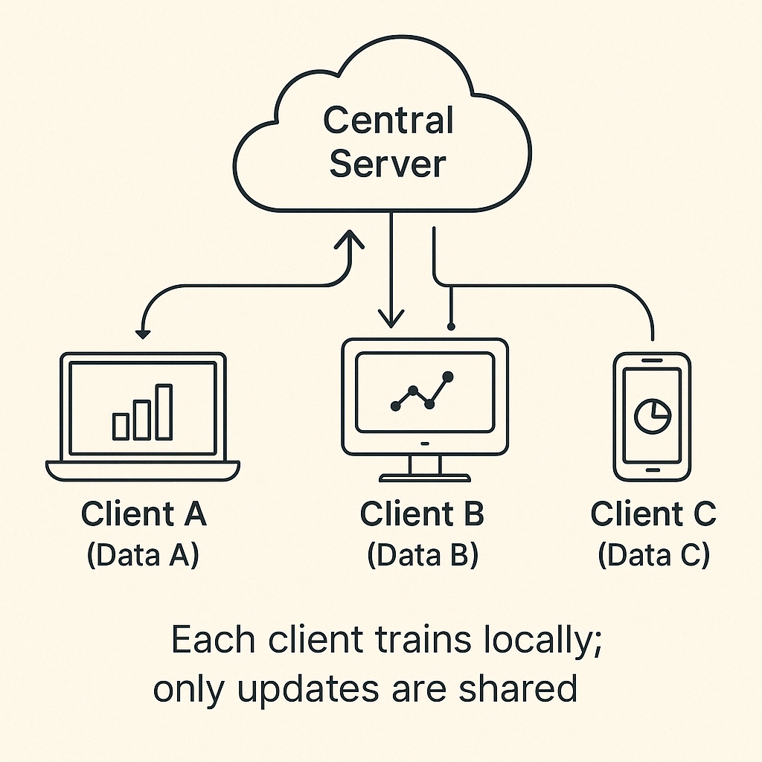
Introduction to Federated Learning
Federated Learning (FL) is a privacy-preserving, decentralized machine learning framework where multiple clients (like smartphones or hospitals) collaboratively train a model without sharing their raw data. Instead, each client computes updates on its local data and shares only the model parameters with a central server.

Slide 3
How FL Works:
A central server sends the current model to a selected set of clients.
Clients perform local training using their private data (e.g., several SGD steps).
Clients send their updated model weights back to the server.
The server performs aggregation (usually weighted averaging).
Steps 1– 4 repeat until the model converges.

Slide 4
Key Motivation Behind FL
Traditional ML requires aggregating all data at a central location, which raises privacy concerns and logistical challenges.
With the rise of edge computing (e.g., mobile phones, IoT devices), data is increasingly distributed and sensitive.
FL provides a solution by bringing the model to the data, not the data to the model.

Slide 5
Problem of Non-IID Data in Federated Learning
Why Non-IID Data Matters: One of the biggest challenges in Federated Learning is that client data is rarely independent and identically distributed (IID). Unlike centralized ML where the training data is uniformly mixed, FL clients generate data based on individual usage patterns, geography, or preferences. This leads to severe variations in both data distribution and volume, affecting model performance and training stability.
What is Non-IID? In FL, each client has a local distribution P​i​(x,y), which is often different from that of others (Pi≠Pj). As a result, the global model trained from these inconsistent updates can struggle to converge or generalize well.

Slide 6
Consequences of Non-IID Data:
Local updates become biased towards the client’s data.
Model aggregation becomes unstable due to divergent gradients.
Convergence slows down, and the global model may overfit to dominant patterns or perform poorly on underrepresented data.
Why This Problem is Hard: Classical SGD algorithms assume IID data, balanced class distributions, and uniform participation. None of these hold in FL. Clients may have just a few samples, some labels may be missing altogether, and participation may be sporadic. This makes it harder to align local objectives with the global objective.

Slide 7
Types of Non-IID Distributions in Federated Learning
In Federated Learning, each client typically collects its own data based on individual behaviors, geographic locations, devices, or time windows, resulting in statistically diverse data distributions. Formally, accessing a data point involves first sampling a client i∼Q, then sampling a data point (x, y)∼Pi(x, y) from that client’s local distribution. The key source of heterogeneity is that Pi not equal to Pj for different clients.
This non-identicalness can take various forms:
Feature Distribution Skew (Covariate Shift):- The marginal distributions Pi(x) differ across clients, even if P (y|x) remains consistent. E.g., in handwriting recognition, users may write the same letters but with different styles.
Label Distribution Skew (Prior Probability Shift):- The marginal label distributions Pi(y) vary even if the class-conditional P (x|y) is the same. For example, users in different regions may encounter different objects or use different emojis.

Slide 8
Concept Drift (Same Label, Different Features):- The conditional Pi(x|y) varies, meaning the same label may have different features on different clients (e.g., houses or fashion items vary across cultures).
Concept Shift (Same Features, Different Label):- The conditional Pi(y|x) varies implying the same features might be labeled differently due to personal preference or regional semantics (e.g., sentiment analysis).
Quantity Skew:- Clients may hold vastly different amounts of data, making client contributions highly imbalanced.

Slide 9
FedAvg vs Synchronous SGD: A Summary and Comparison
Synchronous Stochastic Gradient Descent (SGD) is a distributed optimization technique where all participating nodes compute gradients in parallel and then synchronize after each mini-batch to update the global model.
This requires all nodes to be online and synchronized , Frequent communication after every mini-batch and Assumes balanced and IID data. It is effective in data centers but not suitable for federated settings, where devices are often offline, data is non-IID, and communication is expensive.
FedAvg Vs Synchronous SGD
Property | Synchronous SGD | FedAvg
Data assumption | IID, balanced | Non-IID, unbalanced
Communication frequency | Every mini-batch | Every few local epochs
Participation | All workers every step | Partial client participation
Update type | Gradients | Model weights
Scalability | Limited (data centers) | High (edge devices)
Robustness to dropouts | Low | High

Slide 10
Experiments on Different Parameters
Model Architectures and Dataset Partitioning:-
Our initial study includes two model families applied to the MNIST digit recognition task:-
MNIST 2NN:- A simple multilayer perceptron (MLP) with two hidden layers, each containing 200 ReLU-activated units. This model contains a total of 199,210 parameters.
MNIST CNN:- A convolutional neural network with two convolutional layers using 5 ×5 kernels. The first layer has 32 channels and the second has 64 channels, each followed by 2 ×2 max pooling. This is followed by a fully connected layer with 512 ReLU-activated units and a final softmax output layer. The total parameter count is 1,663,370.
To study federated optimization, we explore two data partitioning strategies on the MNIST dataset across 100 simulated clients:
IID Partition:- The training data is randomly shuffled and divided evenly among 100 clients, with each client receiving 600 examples.
Non-IID Partition:- The data is sorted by digit labels and divided into 200 shards, each containing 300 examples. Each of the 100 clients is then assigned two shards, meaning most clients receive data from only two digit classes. This forms a pathological non-IID distribution designed to test the robustness of federated algorithms under extreme heterogeneity.

Slide 11
Comparison of FL Strategies on Spam/Non-Spam
Comparison of FedAvg, FedAdam, FedProx and FedYogi in a non-IID data distribution.
Simulated a Non-IID split using Dirichlet Distribution.
Simulated client server connection for Federated Learning using Flower
Created visualizations of various metrics for ease of analysis.

Slide 12
Our Journey as a Team
January: We learned the basics of Federated Learning and discussed various open issues and problems. We finally decided to study the issues of Non-IID Data in Federated Learning.
February: We studied papers regarding various proposed solutions for different classes of Non-IID Data. We decided to try various models over data that is label-skewed and quantity-skewed.
March/April: We applied various strategies of Model Aggregation over various Non-IID datasets and compared results.

Slide 13
Our Journey as Individuals: Ryan
Once I had a general idea about the basics of Federated Learning, I started looking for libraries and other code to implement federated learning strategies. Simultaneously I decided to study the MOCHA strategy (Federated Multi-Task Learning, Virgina Smith, et al.) but due to lack of documentation of code and due to very few implementations we scraped the strategy.
Come March I learned about Flower, a federated learning framework.
Using Flower I implemented FedAvg, FedAdam, FedProx and FedYogi strategies using a simple Logistic Regression model for a very famous ML problem- Spam/Not-Spam detection. I cleaned the data set extracted the features using a simple TFIDF vectoriser and then used a Dirichlet distribution to emulate Label Distibution Skew. I split the data over 4 sample clients and using Flower created a simulation to run the various strategies and plot and display log-loss, accuracy, f1-score, recall and precision.

Slide 14
Our Journey as Individuals: Kamal
Studied Google GBoard FL use-case to understand practical FL.
Investigated FedAvg convergence theory on Non-IID data.
Tested:
Varying client ratios
Impact of local epochs
Sampling and averaging techniques
Implemented a CNN in federated setup using Flower.
Studied distributed optimization and early development of FL.
Experimented on different parameters to check number of communications between server and clients. Used NN and CNN models (basic-experiments (2).ipynb).

Slide 15
Our Journey as Individuals: Keshav
Explored the historical development of Federated Learning.
Studied evolution from centralized to distributed and then to FL.
Studied about GBoard's Federated Learning pipeline.
Analyzed FedAvg convergence on MNIST dataset.
Worked on research papers on convergence of FedAvg.
Tried to independently verify the convergence result of FedAvg.

Slide 16
Our Journey as Individuals: Hemant
Explored infrastructure challenges in FL
Client sampling
Analyzed non-IID convergence challenges
Reviewed FedProx
Ran small-scale simulations to analyze performance variance under system heterogeneity

Slide 17
Thank You! ধন্যবাদ

