Slide 1

Science, Technology, Engineering and Math (STEM) for November 17, 2019

Slide 2
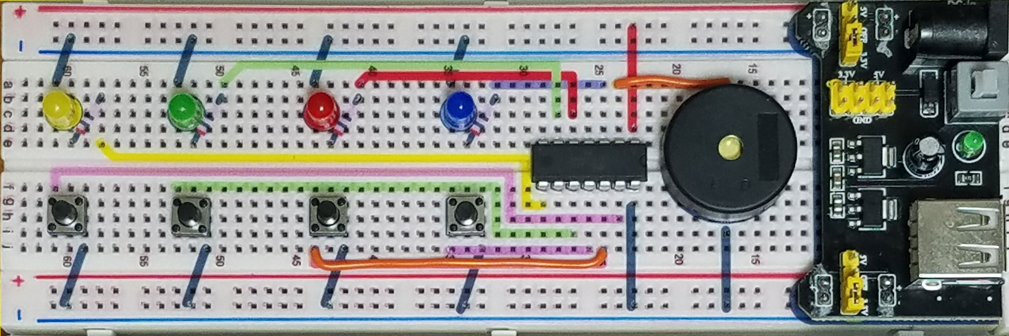
Do It Yourself (DIY) Electronics – It’s Fun!
Learn How to Build A Digital Simon Game.

Slide 3
Do It Yourself (DIY) Electronics – It’s Fun!
Learn About Basic Electronics
Schematic
Prototyping Using Proto Boards
Direct Current (DC)
Components
Learn About Microcontrollers
Inputs
Outputs
Programming
Assemble A Simon Says Game
Play With It!

Slide 4
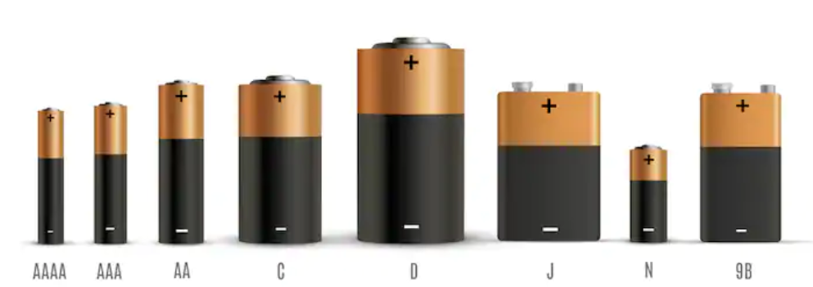
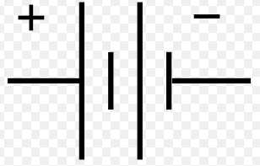

Schematic
A schematic or schematic diagram is a representation of components in a system. The components are drawn as graphic symbols rather than actual pictures of objects.
For example, there are numerous types of batteries. You could draw one of these for your power source. But you really only need to know that you have a power source and the voltage for it.
So on a schematic you may see the power drawn like these or a few others:
Battery
Power (+)
Ground (-)

Slide 5
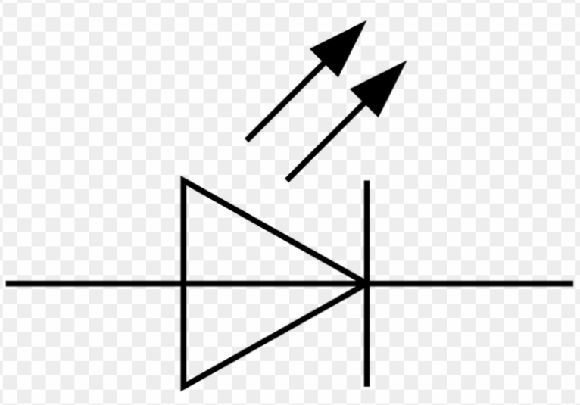
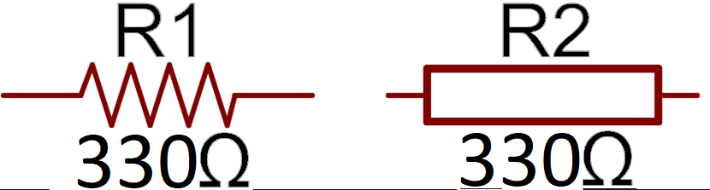
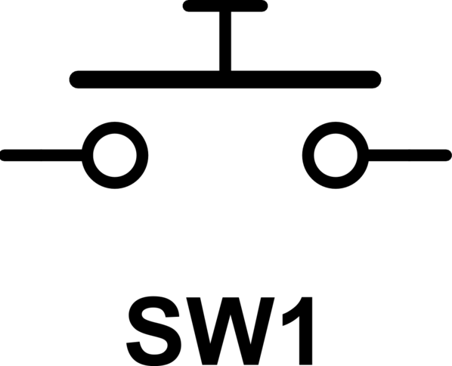
Schematic
Here is a summary of the symbols you will encounter:
Battery:
Light Emitting Diode:
Resistor
Push Button
Power:
Battery
Power (+)
Ground (-)

Slide 6
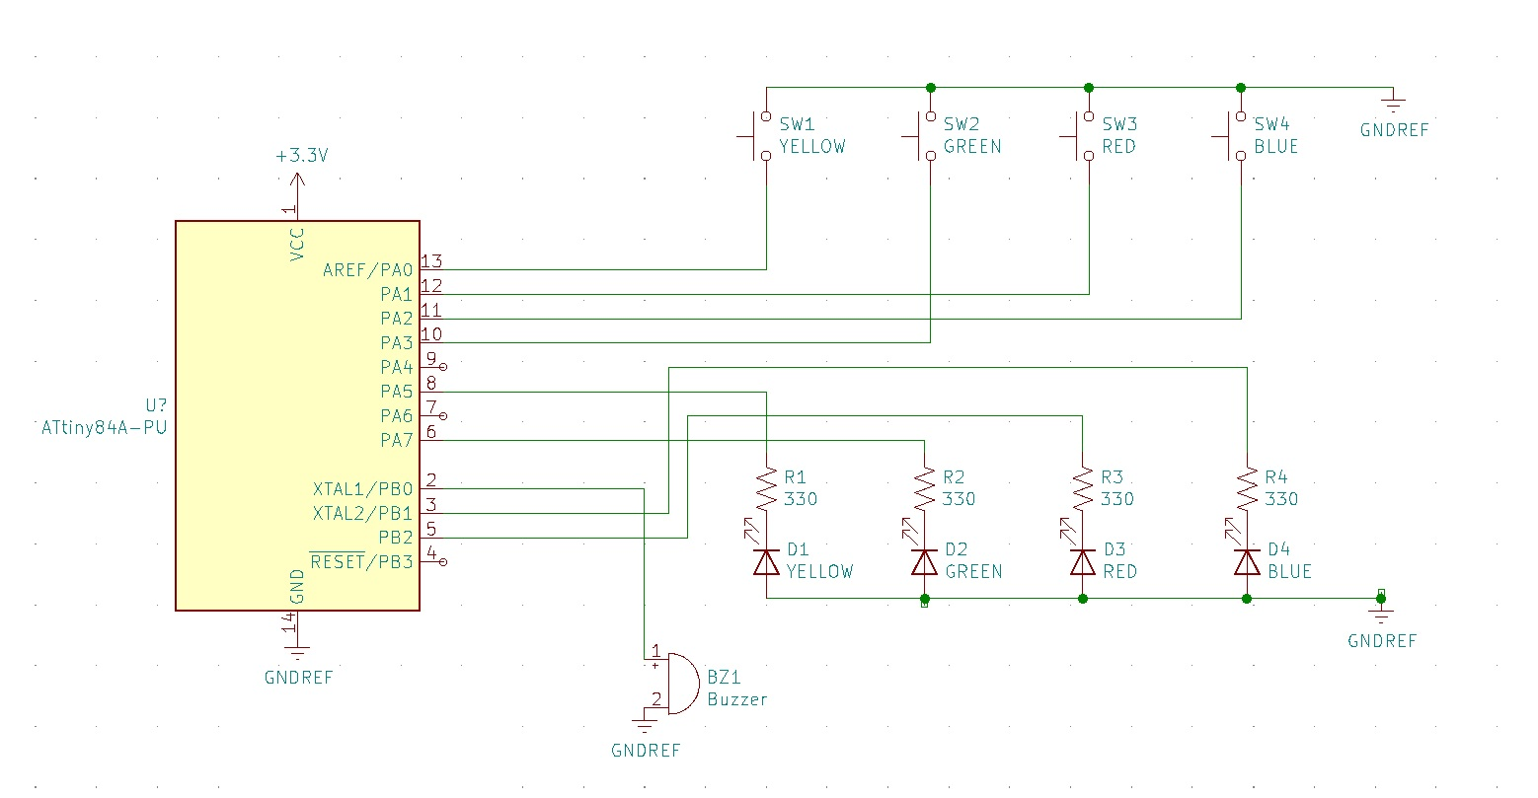
Simon Demo Schematic
This schematic was created using Free Open Source Software (FOSS) called Kicad. Visit kicad-pcb.org for more information. The files for this schematic are posted on github. https://github.com/rascheri/RaytheonSimon

Slide 7
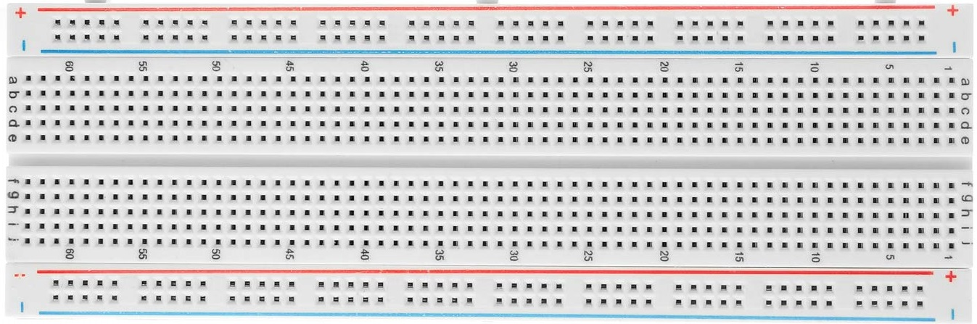
Prototyping Using Proto Boards
A
B
E
F
A
B
C
D
A) The holes below the RED line are all connected together. This is positive (+).
- Some of these may require jumpers in the middle as shown with red lines.
B) The holes above the BLUE line are all connected together. This is the negative (-).
- Some of these may require jumpers in the middle as shown with red lines.
C) The vertical holes (abcde) are all connected together for a single column. Each column has its own (abcde) set of pins.
D) The vertical holes (fghij) are all connected together for a single column. Each column here has its own (fghij) set of pins.
E) The GREEN part above has two black pins. The pin on the left is in one column and the pin on the right is in another column. The columns are NOT connected together, except through the GREEN part. This is CORRECT.
F) The ORANGE part above has two black pins. The pins are placed in the same column so they are connected together. This IS NOT CORRECT.

Slide 8
Direct Current (DC)
Direct Current is the flow of an electric charge in one direction.
A battery is a great example of DC power.
A battery has a positive (+) side and a negative (-) side.
To apply power to an electric circuit you would connect the positive (+) side to the positive side of the electric circuit and the negative (-) side to the negative side of the electric circuit.
If you connect the wires wrong then the power will NOT flow in the correct direction so nothing works.
Have you ever put a battery in upside down?
In our experiments today we will use low voltage direct current (3.3 volts) to power our electric circuit that we assemble.

Slide 9
Light Emitting Diode (LED)
Anode (+)
Cathode (-)
A diode allows the flow of current in one direction from Anode to Cathode.
The LED will light up if the flow of current is correct.
LEDs will light up when they are provided the right about of current (usually in milliamps (mA).
An LED will burn out quickly when it is given too much current.
A resistor is usually wired in series with the LED to limit the amount of current flow through the LED. This keeps the LED from burning out when your power source provides more current than the LED can handle.
Here is an example of how an LED is wired:

Slide 10
Resistor
A resistor limits the flow of current through a circuit.
There is no polarity to a resistor. You can connect it in either direction.
We use resistors to limit the amount of current that is provided to an LED. This prevents the LED from getting too much power and burning up immediately.
So when wiring up an LED, always connect the cathode side to a resistor. The size of the resistor depends upon the specifications of the LED.
A data sheet is a specification from the manufacturer about the part in question. You can refer to the data sheet for an LED to determine how big a resistor needs to be to provide the brightest output without burning up the LED.

Slide 11
Push Button (Switch)
Our push buttons have two pins.
When you press the button the two pins are connected together.
When you release the button the two pins are DISCONNECTED.
When you insert the button into the proto board you must ensure that the pins are side by side (horizontal).
Horizontal Pins
Vertical Pins Hidden Behind

Slide 12
Microcontrollers
A microcontroller is a small computer that performs a specific task.
Microcontrollers have the following features:
A central processing unit (CPU).
Random Access Memory (RAM) –
Volatile Memory (The information in RAM is lost when power is removed.)
Read Only Memory (ROM)
Non-Volatile Memory. You cannot change the information in a ROM. However, the information is retained even after power is removed.
Flash Memory
Non-Volatile Memory that can be read and written. The information is retained after power is removed.
Input Pins
Output Pins

Slide 13
Microcontrollers - CPU
The Central Processing Unit (CPU) is the brain behind the Microcontroller.
The CPU executes the instructions that are placed in the program memory. The program memory can be Read Only Memory (ROM), Flash or Random Access Memory (RAM).
Most microcontrollers execute one instruction at a time. They are designed to be used as a building block for a bigger system. For example a keyboard could contain a small microcontroller to handle converting the key strokes into a Universal Serial Bus (USB) message that could be read by a personal computer.

Slide 14
Microcontrollers – Input/Output Pins
All microcontrollers have multiple input and output pins. The microcontrollers are smart enough that you can program a pin to be an input (receive a signal (high (3.3v) or low (ground)) or an output (turn on (high (3.3v)) or off (low (ground)).
This exercise will configure the AT Tiny 84A microcontroller to have four (4) input pins for four (4) buttons and five (5) output pins, four (4) pins to control turning on/off four (4) LEDs and one (1) pin to control a buzzer.
Turn turn on an LED we make the pin go high (3.3v).
Turn turn off the LED we make the pin go low (ground, 0v).
To make a buzzer sound we make the buzzer pin go high and low really fast to generate a sound sequence or tone. The frequency of the high and low cause the buzzer sounds to vary (different tones).

Slide 15
Microcontrollers – Programming
All microcontrollers require the operator to program the integrated circuit (IC) chip with the set of instructions needed to make the microcontroller do something.
The microcontrollers have a machine language that is used to program the microcontroller.
High level languages like C, C++ and Sketch are used to make programming the microcontrollers much easier. In fact Sketch programming is very easy to learn and it is a great step into learning C or C++.
Sketch is the language that is used to program the Atmel microcontrollers. The AT Tiny 84A is an Atmel microcontroller.
You can use an Arduino UNO or ATMEGA board to program the AT Tiny 84A microcontrollers. Visit https://www.arduino.cc for more information.
The Arduino Integrated Development Environment (IDE) will be used to compile the sketch program and then load the compiled program into the AT Tiny 84A microcontroller.
The Arduino IDE is Free Open Source Software (FOSS) provided by Arduino AG. Arduino AG is an open source hardware and software company. They want people to learn so they provide free open source hardware schematics and software. They are make a number of very good Arduino boards so that you can learn quickly.

Slide 16
Girl Scouts STEM Expo 2019 - CSUF Assemble the Simon Game!
You received a solderless breadboard (white board with components on it).
You have four (4) Light Emitting Diodes (LED)s, Red, Green, Blue, Yellow
You have four (4) push buttons, one for each LED position.
You have some number of wires, each with a different color.
1. Insert the colored LED’s into the LED position on the proto board.
2. Insert the push buttons (one per LED color) in the square push button spot.
3. Insert the missing wiring (match the color on the board to the wire).
4. Have the helper check your work.
5. Power on the proto board by pushing the on/off button.
6. If some of the LED’s do not light up then that means they are in backwards.
7. So pull out the LED’s and turn them around 180 degrees and insert again.
8. Turn the power on/off again.
9. You should hear a beep sound and all four LEDs should light up.
10. Press one of the buttons. The microcontroller will stop blinking the LEDs.
11. The microcontroller will make a BEEP sound and light up one of the LEDs.
12. Press the button that lights up. Repeat this step for as many as you can remember.
13. Have Fun! How many button presses can you remember?

Slide 17
Simon Says Game Completed
Power (On/Off)
Line
Power

Slide 18
Simon Bill Of Materials (Parts List)
ELEGOO Upgraded Electronics Fun Kit (Cost $18.00)
This kit has the proto board, power supply module, LEDs, resistors, buzzer, buttons and jumper wires. The only thing missing is the AT Tiny 84A microcontroller and an Arduino UNO to program the AT Tiny84A. You can also run the game directly from the Arduino instead of programming the AT Tiny 84A microcontroller.
https://www.amazon.com/ELEGOO-Electronics-Potentiometer-tie-Points-Breadboard/dp/B01ERPEMAC/ref=sxbs_sxwds-stvp?keywords=arduino%2Buno&pd_rd_i=B01ERPEMAC&pd_rd_r=ceb4f50d-5ba9-4df5-9571-e80c93fbadab&pd_rd_w=8HTdR&pd_rd_wg=eOn4G&pf_rd_p=a6d018ad-f20b-46c9-8920-433972c7d9b7&pf_rd_r=TCHDT9EA5C7QQFJE2QXH&qid=1573792495&s=electronics&th=1
ELEGOO UNO R3 Board ATmega328P ATMEGA16U2 with USB Cable (Cost $12.00)
https://www.amazon.com/ELEGOO-Board-ATmega328P-ATMEGA16U2-Compliant/dp/B01EWOE0UU/ref=sr_1_3?keywords=arduino+uno&qid=1573792867&s=electronics&sr=1-3
ATMEL AT Tiny 84A Microcontroller (Cost $1.16 each + shipping)
https://www.digikey.com/product-detail/en/microchip-technology/ATTINY84A-PU/ATTINY84A-PU-ND/2774082

Slide 19
Arduino Information
Arduino Integrated Development Environment (IDE)
This is what you use to compile and load the Arduino UNO. You can also use this to program the AT Tiny84A Microcontroller.
https://www.microsoft.com/en-us/p/arduino-ide/9nblggh4rsd8?ocid=badge&rtc=1#activetab=pivot:overviewtab
Getting Started with Ardiuno Products
https://www.arduino.cc/en/Guide/HomePage
Simple Simon Says Game Using Ardiuno
https://www.instructables.com/id/Arduino-Simple-Simon-Says-Game/
Program AT Tiny84A Using Arduino
https://www.instructables.com/id/Using-the-Arduino-Uno-to-program-ATTINY84-20PU/
Raytheon Simon Demo Software
The software for this demonstration is located on github.com. https://github.com/rascheri/RaytheonSimon

Slide 20
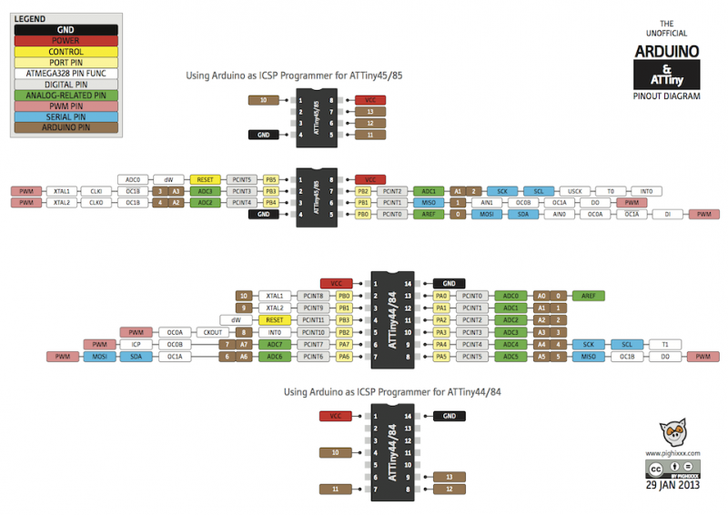
AT TINY 84A Microcontroller Pinouts

Slide 21
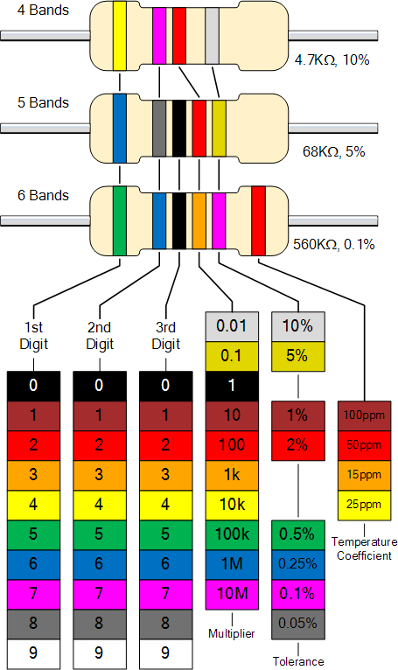
RESISTOR COLOR CODES

Slide 22
WIRE LENGTHS
BLACK#1 (20mm)
BLACK#2 (21mm)
BLACK#3 (27mm)
BLACK#4 (31mm)
RED#1 (30mm)
RED#2 (56mm)
GREEN#1 (80mm)
GREEN#2 (91mm)
BLUE#1 (36mm)
BLUE#2 (120mm)
YELLOW (97mm)
PURPLE (36mm)
ORANGE#1 (31mm)
ORANGE#2 (65mm)

Slide 23
This is a wiring diagram for the Simon Proto Board Game. You can print this image onto a clear laser or inkjet label. Carefully place the clear sticker onto the proto boards. You will need to do some testing to scale the print out to match the actual proto board. The holes should line up as close as possible. Online Labels (onlinelabels.com) has a 100 sheet pack of clear sticker laser and inkjet labels. Part number OL175CK. There is an Adobe PDF file that contains four (4) stickers on each sheet included in the documentation.

