Slide 1
Bootstrapping
Pulling yourself up through your Assumptions!

Slide 2
Psych Science (Journal)
http://www.psychologicalscience.org/index.php/news/releases/psychological-science-sets-new-standards-for-research-reporting.html
In addition, the journal will encourage authors to use the “new statistics” of effect sizes, confidence intervals, and meta-analyses in an effort to avoid problems typically associated with null-hypothesis significance testing. To support this approach, the journal has published a statistics tutorial by Geoff Cumming of La Trobe University in Australia. “The New Statistics: Why and How” is freely available online.
What do they mean, “new statistics”?
1) Data exploration: John Tukey’s (1977) book Exploratory Data Analysis legitimated data exploration and also provides a wealth of practical guidance. There is great scope to bring Tukey’s approach into the era of powerful interactive software for data mining and representation.
2) Bayesian methods: These are becoming commonly used in some disciplines, for example, ecology (McCarthy, 2007). Bayesian approaches to estimation based on credible intervals, to model assessment and selection, and to meta-analysis are highly valuable (Kruschke, 2010). I would be wary, however, of Bayesian hypothesis testing, if it does not escape the limitations of dichotomous thinking.
3) Robust methods: The common assumption of normally distributed populations is often unrealistic, and conventional methods are not as robust to typical departures from normality as is often assumed. Robust methods largely sidestep such problems and deserve to be more widely used (Erceg-Hurn & Mirosevich, 2008; Wilcox, 2011).
4) Resampling and bootstrapping methods: These are attractive in many situations. They often require few assumptions and can be used to estimate Cis (Kirby & Gerlanc, 2013).

Slide 3
“Modern” Statistics
Classical Period:
Classical Statistics
[Z, t, F & Chi, etc]
Robust Statistics
Data exploration
Resampling methods
[Bootstrapping]
Early Modern Era:
Modern Era:
Mixed/HLM
Path: SEM &
Mediation/
Moderation
Bayesian methods

Slide 4
Resampling Methods
Resample your observed data in ways to estimate the underlying distribution & error terms
Resampling methods have:
Been a salvation to classical statistics
The are work around to classical assumptions for generating pvalues and confidence intervals
Opened the door to questions we never could ask before!
Directly assess the difference between:
Medians
Variance
Constructed indexes

Slide 5
History of the assumptions regarding Pvalues
Late 1800s – Probability values can only derived from population parameters
Independent sampling with replacement
Gaussian (normal) distributions (e.g., Z-tests)
1908 – Probability values can be approximated based on samples parameters
Independent sampling with replacement
Gaussian (normal) distributions,
Corrected for the sample size (e.g., t-distribution)
Reliance on the central limit theorem!
Mean + SD
1918/21/25 – Probability values can be corrected for the number of conditions
Independent sampling with replacement
Gaussian (normal) distributions, but corrected for number of conditions (e.g., F-distribution)
Rucci & Tweney (1980)

Slide 6
Expansions of ANOVA into psychology
1930-50 – Expansions of ANOVA into psychology
1941: t² = F
1946: RM ANOVA, ANOVA with unequal sample sizes
1950: Homogeneity tests!
Psychologists are pushing the ANOVA well past it design parameters and pushing its update
Humans are messy
Variance is not stable
Distributions are not always perfectly normal
Measurements are correlated
Result: Reliance on assumptions are problematic (but solutions are not readily apparent)
Error terms -> Pvalues
[1951 – UNIVAC is invented]

Slide 7


“Boy scout’s” Jackknife
1950s - Quenouille & Tukey: Invented a new ‘generalized’ method based on ‘resampling’ to better estimate specific statistic, i.e., theta - $θ.$
$where θ= μ; σ^{2};etc$
$$Estimate of μ;\overline{x_{i}} = \frac{1}{n−1} \sum_{j≠i}^{n}{x_{j}}$$
Recalculate mean ($\overline{x_{i}}$) for a set of scores where we skip every j x-score.
5 7 9 7 9 5 0 7 6 0 7 4 6 8 7
j=2
5 7 9 7 9 5 0 7 6 0 7 4 6 8 7
Sampling WITHOUT replacement!

Slide 8
Jackknife Mean [Large sample]
Simulation Parameters
Gaussian Distribution
N= 1000
True mean = 10
True SD = 1
mean = 9.93
SD = .98
Jackknifed Distribution of Means

Slide 9

Jackknife Bias
Bias = $θ$ for all observed data – $jackknifed θ$
When distribution of a $θ$ from set of observations is normal (i.e., the central limit theorem holds) than $bias ≈0$
When would bias be high and how might relate to how $θ$ is defined?

Slide 10
Bimodal Distribution
Simulation Parameters
Gaussian Distribution
N= 30
True mean = 10
True SD = 1
+
N= 30
True mean = 20
True SD = 1
Jackknifed Distribution of Means
What would be bias here: High or Low?

Slide 11
Jackknife Mean [Small sample]
Simulation Parameters
Gaussian Distribution
N= 10
True mean = 10
True SD = 1
arithmetic mean = 10.239
arithmetic SD = 1.007
Jackknife mean = 10.239
Jackknife SD = 1.005

Slide 12
Jackknife Advantages & Limitations
Advantages
Computationally cheap (could be done by hand)
Calculate bias!
This concept becomes useful in correcting other resampling methods
Limitations
Sampling without replacement
Results in non-normal distribution
The error term it calculates cannot always be used in significance testing
Cannot be used in calculating confidence intervals
Works well with mean and SD, but can fail with other statistics such the median

Slide 13
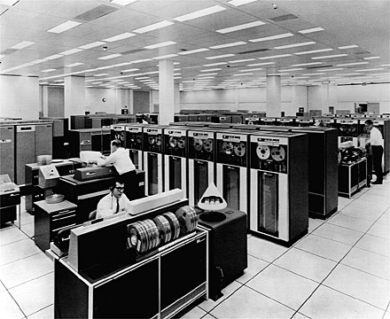
Birth of Modern Resampling Methods
1970 era Main Frame

Slide 14


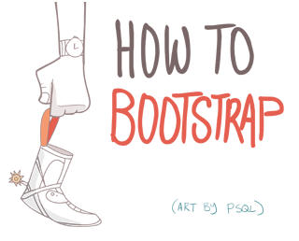
Bootstrapping
Bootstrapping – “get (oneself or something) into or out of a situation using existing resources”
“Pull yourself up by your bootstraps”!
1979 Efron
Computationally intensive (expensive) method
“Conceptually” do Resampling WITH replacement
[Actually do a Taylor expansion]

Slide 15

The solution is in the computer?!

Slide 16
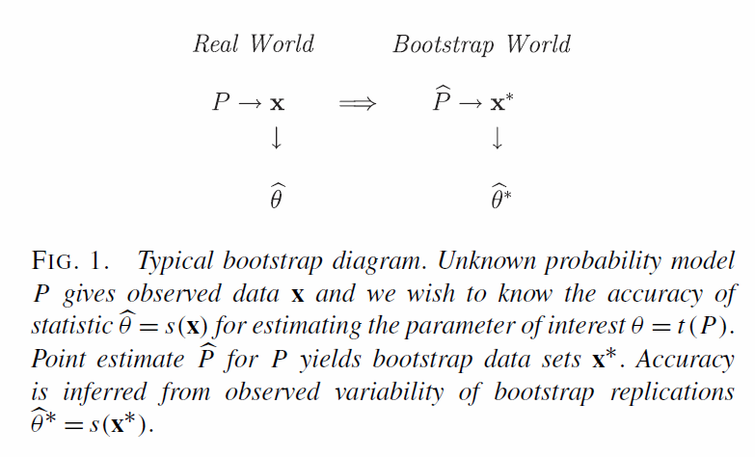
Bootstrap Logic

Slide 17
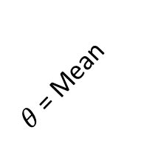
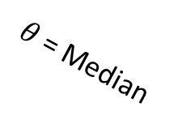

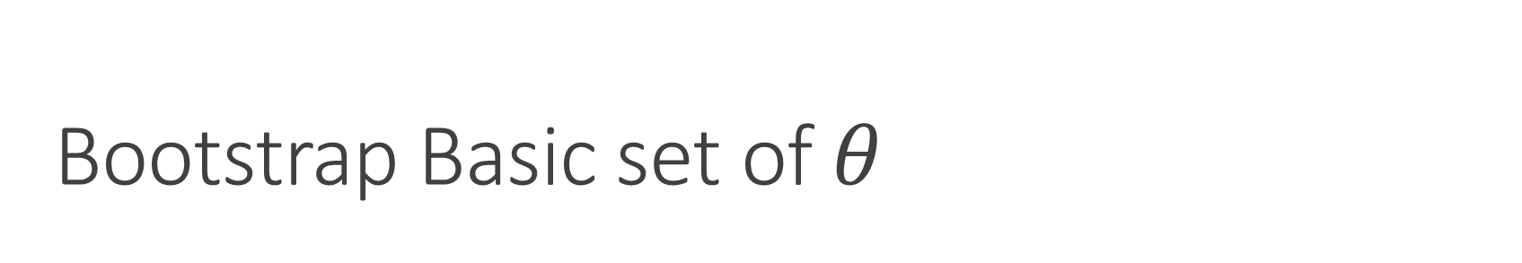
Bootstrap Basic set of $θ$
1000 bootstraps
[resampling's from original distribution]
$θ$ = Mean
Simulation Parameters
Gaussian Distribution
N= 20
True mean = 10
True SD = 1
mean = 10.27
SD = .81
median = 10.38
CI95 = [9.89, 10.65]
$θ$ = SD
$θ$ = Median

Slide 18
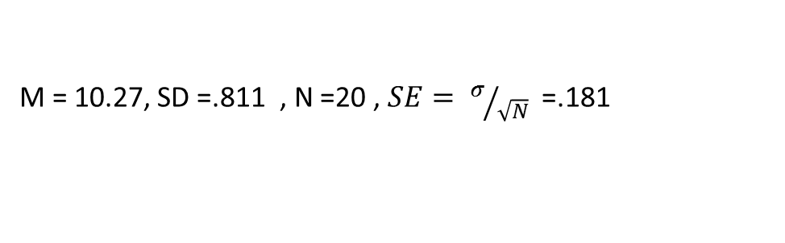
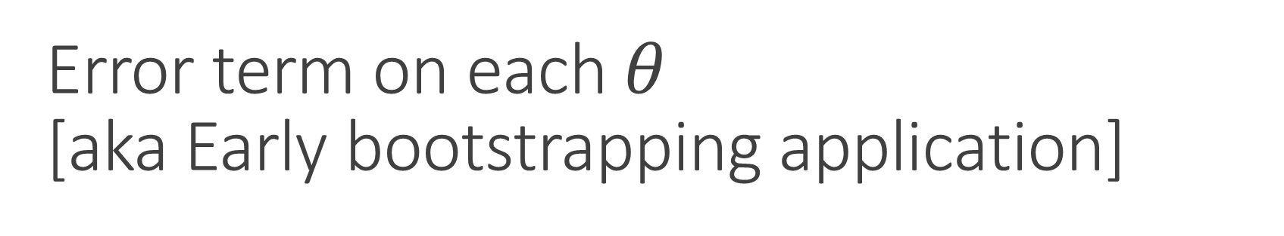
Error term on each $θ$ [aka Early bootstrapping application]
We can generate error terms for each statistic in which we are interested.
Classical methods we only had error on means!
Bootstrap we have an error on the Mean, SD value, median, kurtosis, anything
Based on the resampling of actual observed data and NOT our assumption of normal distribution of the means*
Mean
Classical
M = 10.27, SD =.811 , N =20 , $SE= σ/{\sqrt{N}}$ =.181
Bootstrapped:
M = 10.27, SE = SD(bootstrapped means) = .173*
*Standard approach to determining error applies in cases of normality

Slide 19
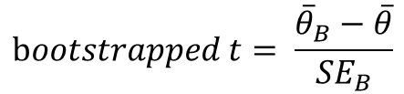

Construct custom bootstrapped “t” tests [aka Early bootstrapping application]
$$Classical t= \frac{\overline{x}−μ}{SE}$$
$$bootstrapped t= \frac{{\overline{θ}}_{B}−\overline{θ}}{{SE}_{B}}$$
Reflects mean and CLT assumption
$θ$ could be any point estimator (mean, SD, median, etc)

Slide 20
Example of a bootstrapped “t” tests [aka Early bootstrapping application]
Group 1, M = 2.36
Group 2,
M = 2.66
Is the mean of group 1 different from group 2?
Classical t-test on Means: t(198) = 1.921 , p = .057 (or .058 correcting for homogeneity of variance)

Slide 21
Example of a bootstrapped “t” tests [aka Early bootstrapping application]
Group 1, M = 2.36
Group 2,
M = 2.66
Is the mean of group 1 different from group 2?
Bootstrapped t-test on Means: p = .059

Slide 22
Example of a bootstrapped “t” tests [aka Early bootstrapping application]
Group 1, Median = 2.48
Group 2,
Median = 2.51
Is the median of group 1 different from group 2?
Bootstrapped t-test on MEDIAN: p = .99. The answer is clearly NO!

Slide 23
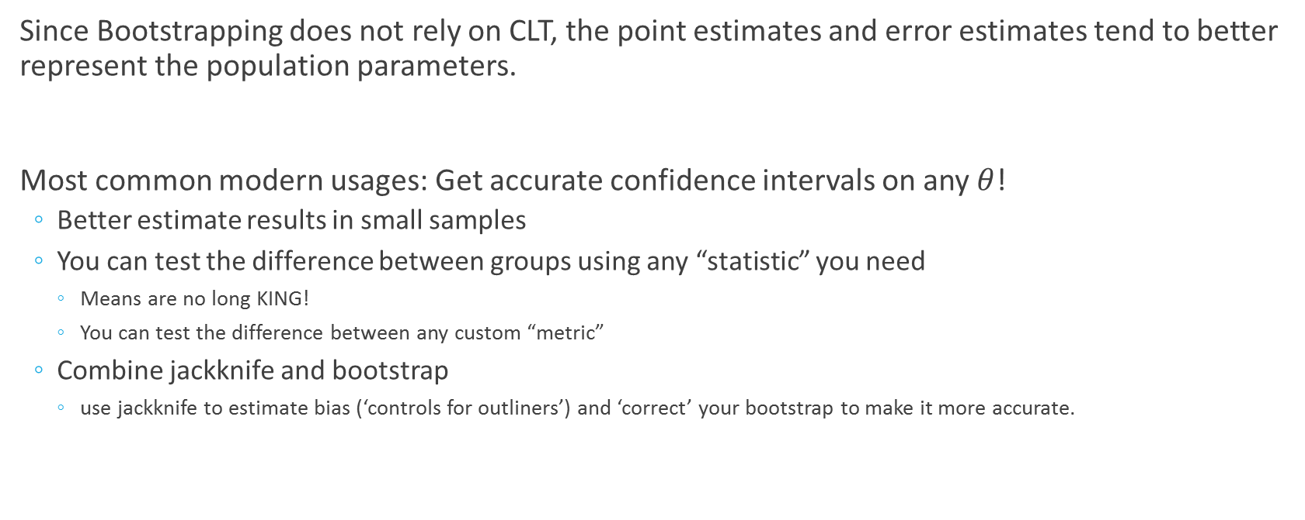
Advantage of Bootstrapping
Since Bootstrapping does not rely on CLT, the point estimates and error estimates tend to better represent the population parameters.
Most common modern usages: Get accurate confidence intervals on any $θ$!
Better estimate results in small samples
You can test the difference between groups using any “statistic” you need
Means are no long KING!
You can test the difference between any custom “metric”
Combine jackknife and bootstrap
use jackknife to estimate bias (‘controls for outliners’) and ‘correct’ your bootstrap to make it more accurate.

Slide 24

Confidence of each $θ$!
We can generate confidence interval for each statistic in which we are interested.
Classical methods we only had CIs on means!
Bootstrap we have an CIs on the Mean, SD value, median, kurtosis, anything
Based on the resampling of actual observed data and NOT our assumption of normal distribution of the means*
Mean
SD
Median
Classical
M = 10.27, CI95* = [9.89, 10.65]
SD = .811
Median = 10.38
Bootstrapped:
M = 10.27, CI95 = [9.92, 10.61]
SD = .777, CI95 = [.60, 1.11]
Median = 10.35, CI95 = [9.93, 10.54]

Slide 25
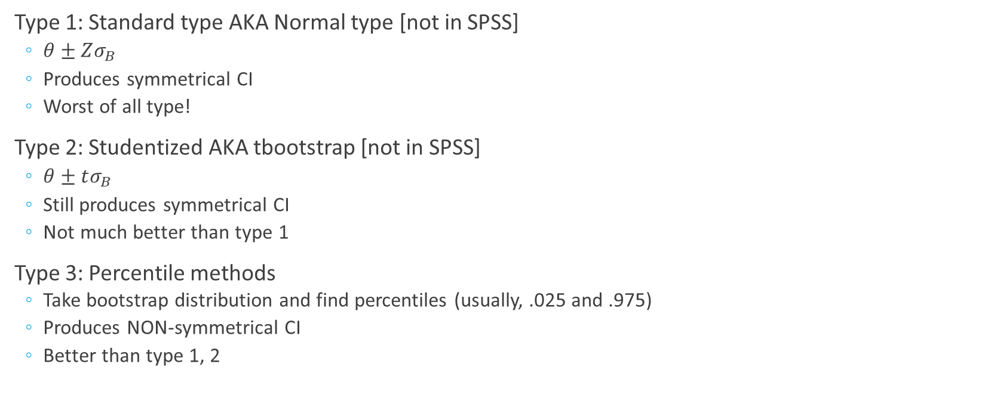
Types of Bootstrapped Confidence Intervals
Type 1: Standard type AKA Normal type [not in SPSS]
$θ±Zσ_{B}$
Produces symmetrical CI
Worst of all type!
Type 2: Studentized AKA tbootstrap [not in SPSS]
$θ±tσ_{B}$
Still produces symmetrical CI
Not much better than type 1
Type 3: Percentile methods
Take bootstrap distribution and find percentiles (usually, .025 and .975)
Produces NON-symmetrical CI
Better than type 1, 2

Slide 26
Types of Bootstrapped Confidence Intervals
Type 4: Bias corrected methods
Do type 3
Correct them for bias (jackknife) and for deviation from normality (‘accelerated’)
Bca method (in SPSS) [Bias corrected and accelerated]
Produces NON-symmetrical CI (that are narrower then non-parametric)
ABC method [Accelerated, Bias corrected, and nonlinearity Coefficient
(alterative form of correction that is newer then Bca – not in SPSS but in R)
Note: You can do ABC and Bca non-parametric bootstrap as well (but not in SPSS)
Type 4 is best when you can do the correction
Correction is not always possible, so best to do type 3.

Slide 27
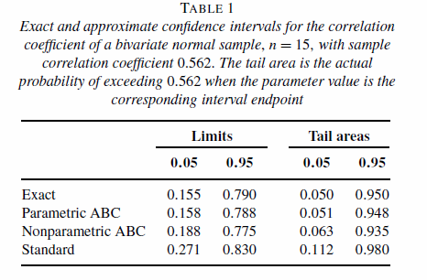
Types of Bootstrapped Confidence Intervals [Efron, 2003]

Slide 28
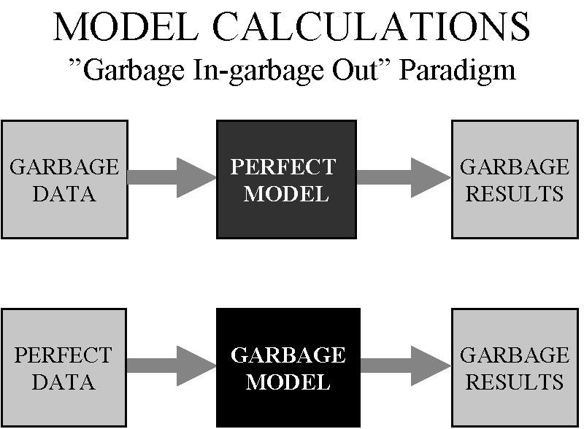

Slide 29
Other Resampling Methods
Monte-Carlo simulations (very computationally expensive)
Broad class of methods becoming used in advanced modern statistics
Parametric Bootstrapping – Assume the data follow a normal distribution given the parameters extracted from the data
Permutations– Used for calculating pvalues for non-parametric tests (chi-square, binomial tests)
Surrogate data analysis (very computationally expensive)
Common in time series analysis
What can we do with all these modern methods?
Option 1: Salvage classical statistics hypothesis testing (journals are requesting bootstrapping already!)
Option 2: Resampling methods as gate way drug: abandon classical methods and switch to Bayesian methods
Option 3: Ask questions no one has ever been able to ask people!
Dual brain synchronization during joint action! [merging EEG, bootstrapping, and surrogate methods]

Slide 30
Modern uses of Bootstrapping
Difference in Variances and Correlations:
With Bootstrapping you can check for differences between groups based on their variability!
CI around the point estimate of variance/correlation for a particular group and compare that to point estimate of variance/ variance/correlation for another group
Devise an question that you could not ask with classical stats, but you can with bootstrapping.
Regression-Based Approaches
Currently required for modern causal modeling (mediation and moderation, SEM)
Becoming required for getting pvalues in mixed models
Signal processing/Time-series
Already used heavy in:
neuroscience (single cell recordings, modern types of fMRI/EEG, and computation neuro)
motor control
Bayesian methods
Machine Learning

