Slide 1


Slide 2
Our Team
Riyadh
Suliman
Abdulaziz
Sultan
khalid
Raseel
Raghad

Slide 3
stakeholder

Slide 4
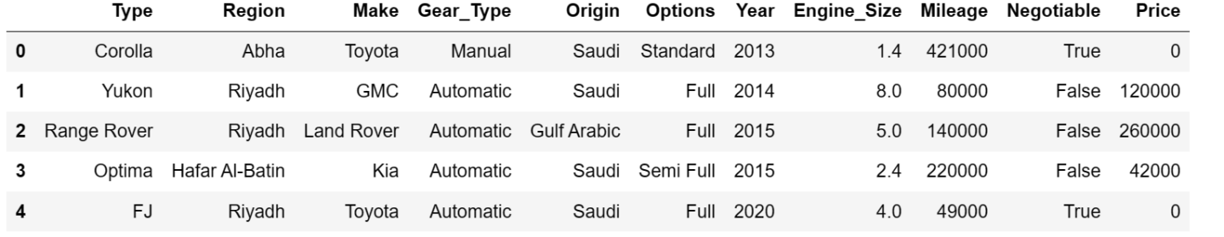
Dataset Overveiw

Slide 5
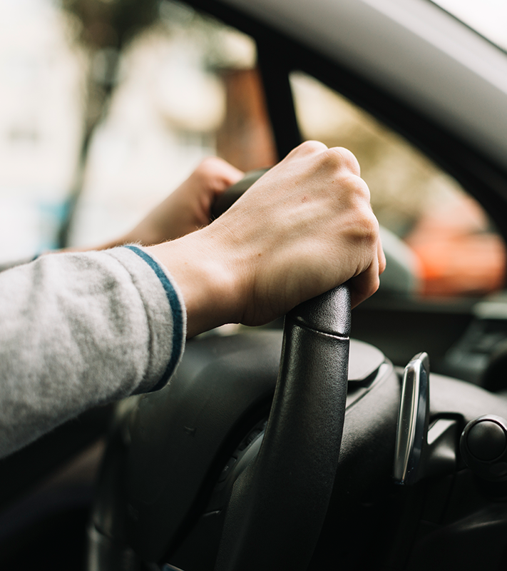
profiling

Slide 6
isuee of data
Zeros in price column
Duplicates
Mileage Range outlier
Engine size

Slide 7
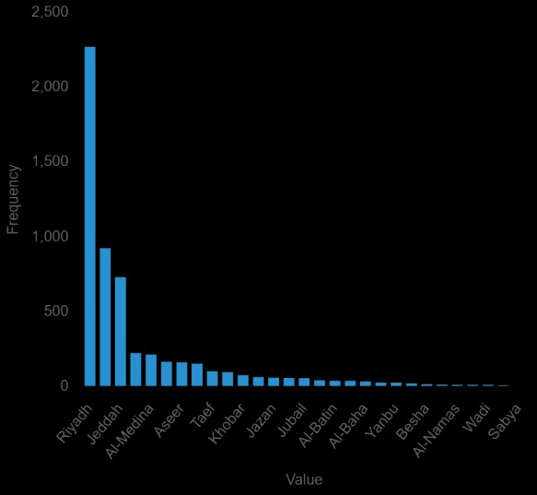
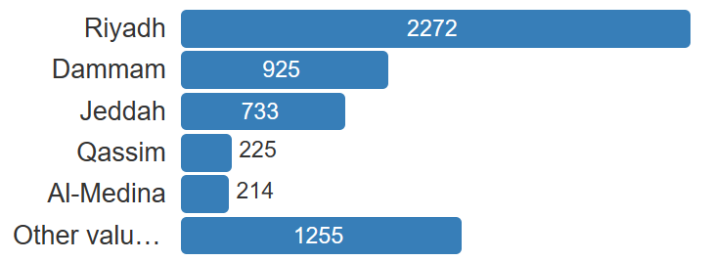
Riyadh is the largest market!!

Slide 8
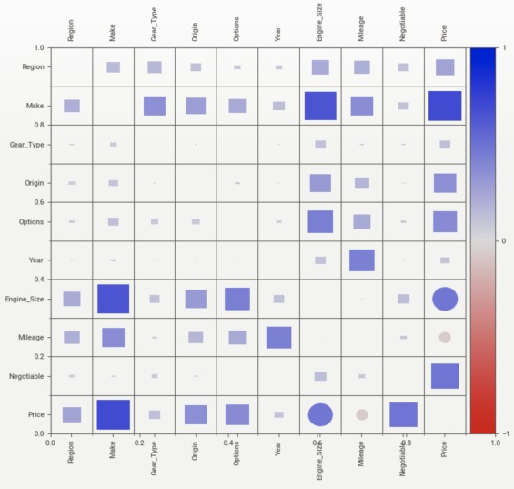
Most feauter

Slide 9
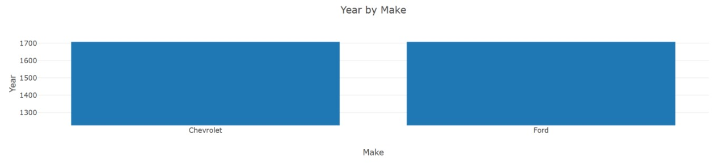
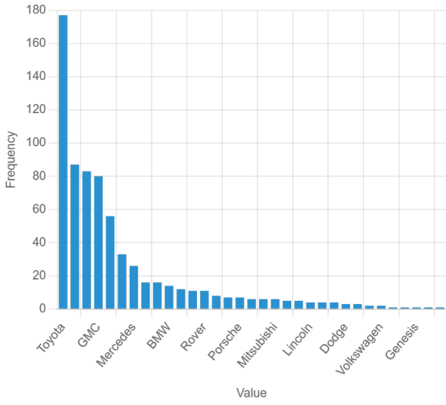
Chevorlet and Ford are the Most sale (1963-1993)
Toyota is the Most sale (2000-2022)

Slide 10
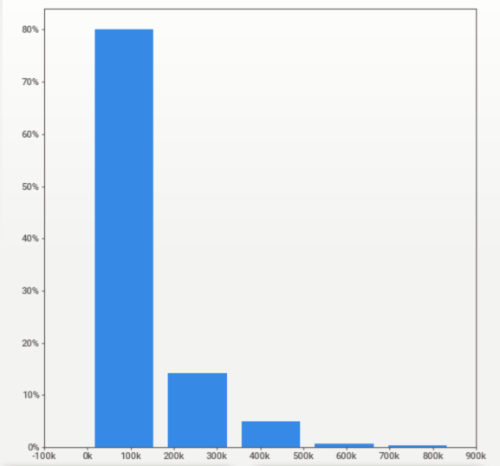
Range price for 4 years old!

Slide 11
—more info

Slide 12
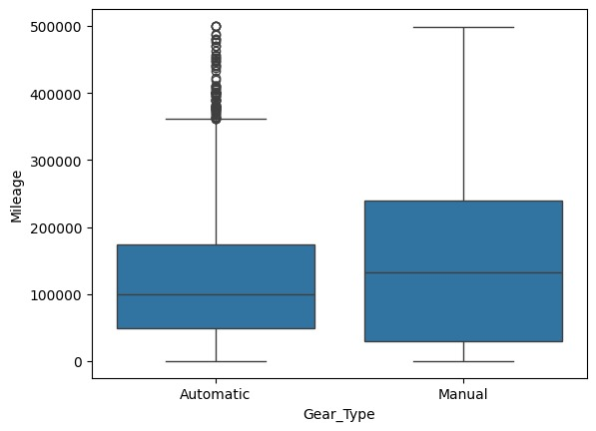
Manual cars are more reliable than Automatic cars!!

Slide 13
Thanks!

