Slide 1
World University Rankings
Team members:
Faisal, Tariq, Raseel, Rand, Saud

Slide 3
Datasets
THE World University Rankings.
Times Higher Educations.
Shanghai Ranking.

Slide 4
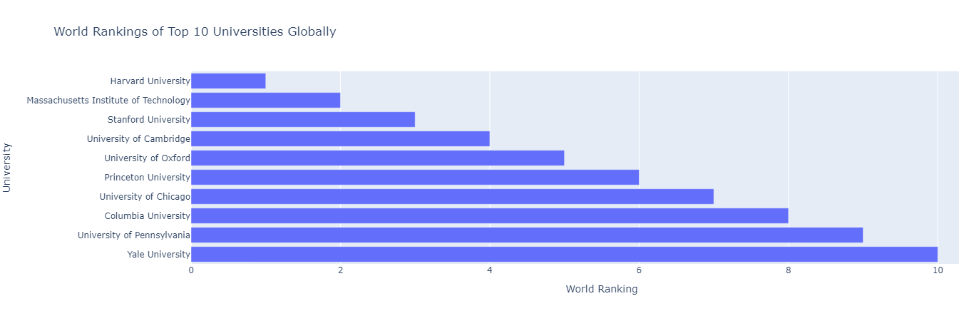
First Data: World Rank University
Which universities are ranked in the top 10 globally?

Slide 5
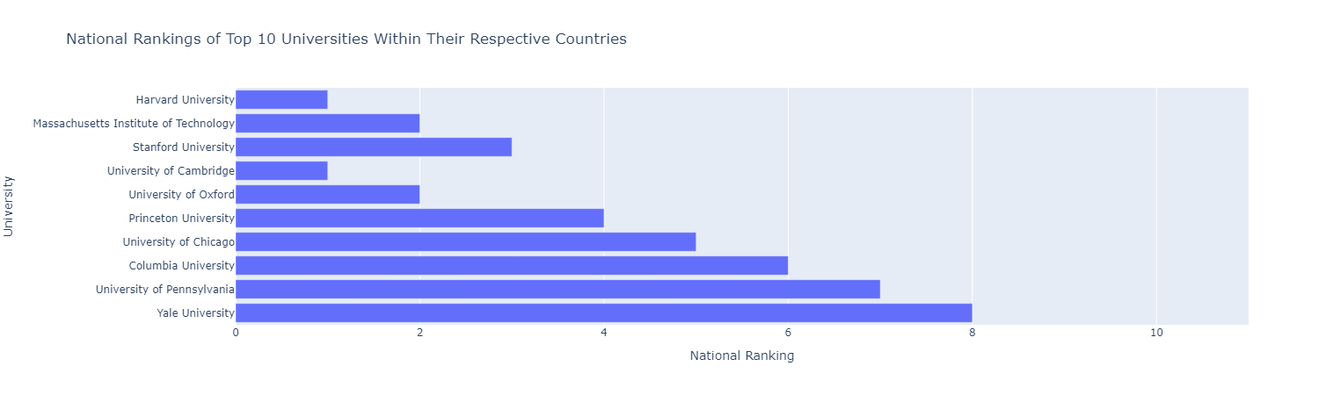
First Data: World Rank University
What are The National Rankings of Top 10 Universities Within Their Respective Countries ?

Slide 6
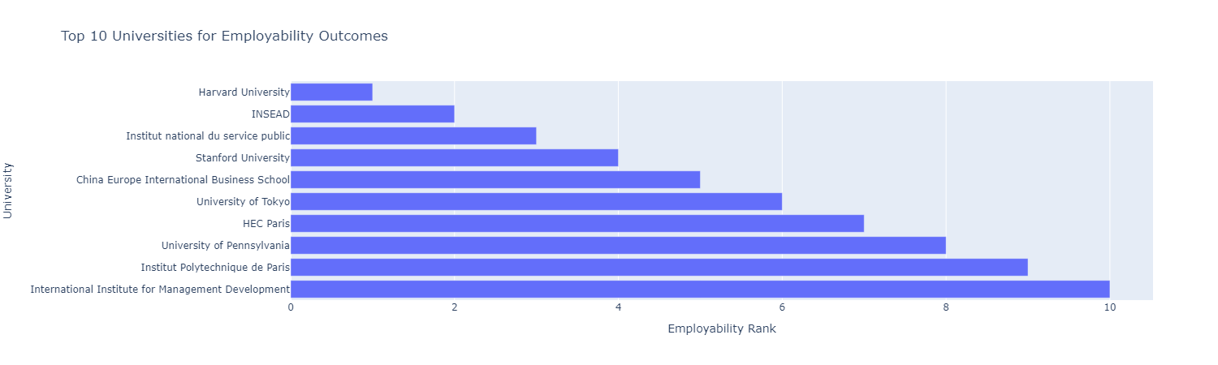
First Data: World Rank University
Which universities are ranked in the top 10 for employment outcomes?

Slide 7
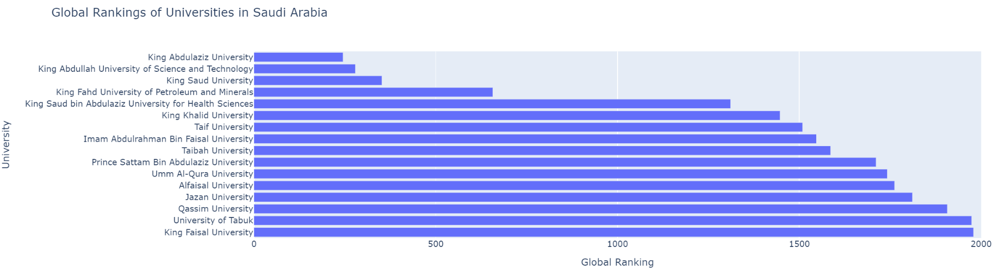
First Data: World Rank University
What positions do universities in Saudi Arabia hold within the global
rankings?

Slide 8
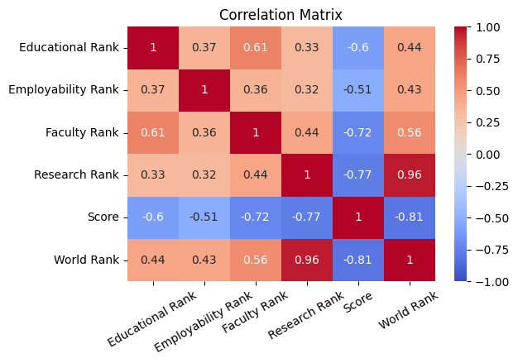
First Data: World Rank University
Considering various factors such as employment rankings, research rankings, and others, which has the most significant impact on a university's overall ranking?

Slide 9
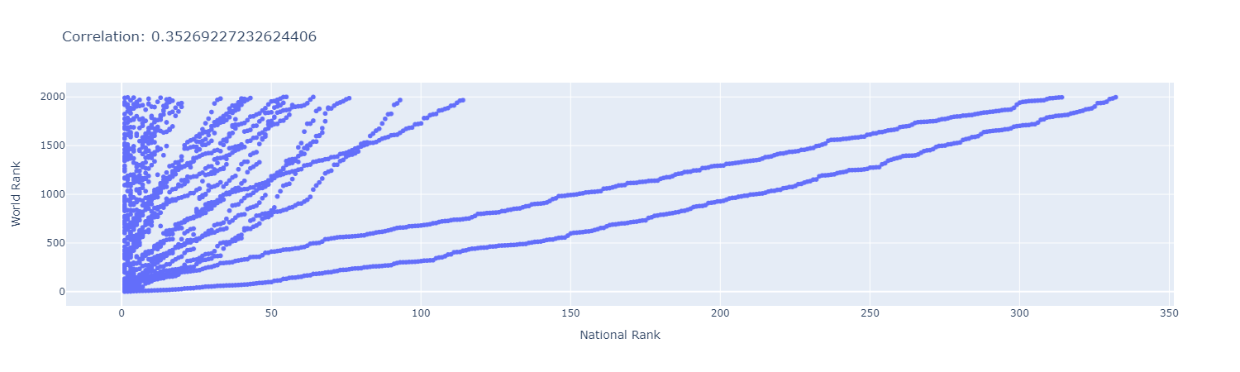
First Data: World Rank University
Is there a correlation between national and global university rankings, and based on this information, can you recommend a country that appears to have a high concentration of top-ranked universities?

Slide 10
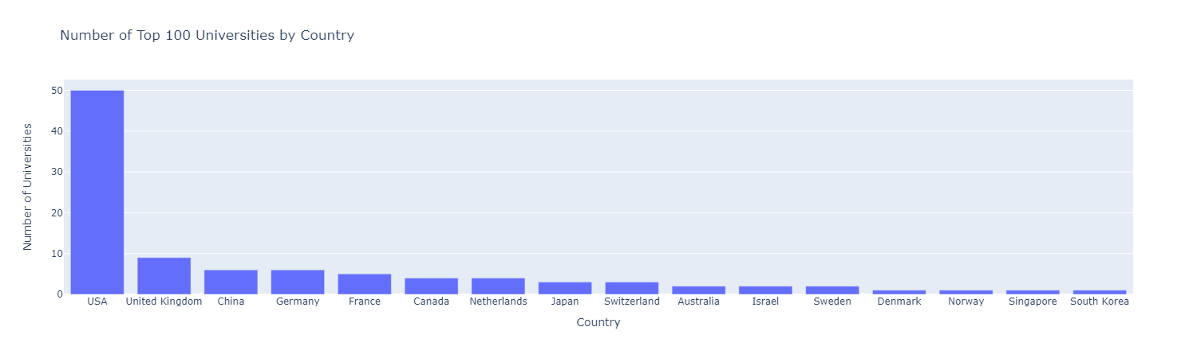
First Data: World Rank University
Which countries have the highest number of universities among the top 100 universities in the world?

Slide 11
Times Higher Education
Second Data:

Slide 12
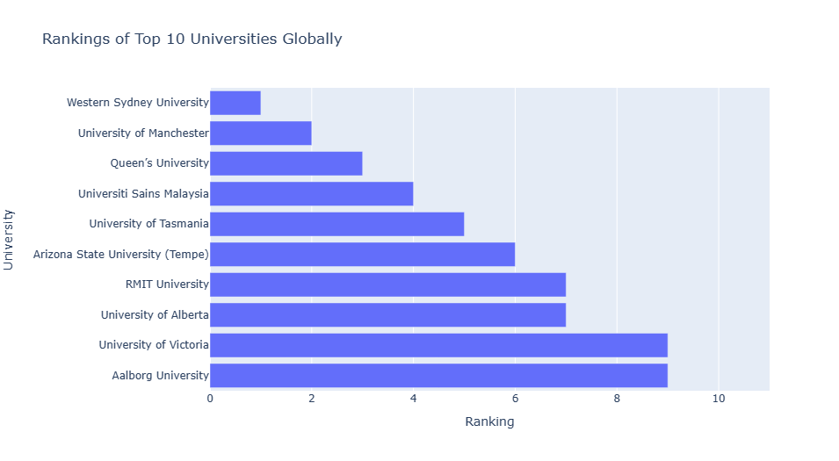
Second Data: Times Higher Education
Which universities are ranked in the top 10 globally?

Slide 13
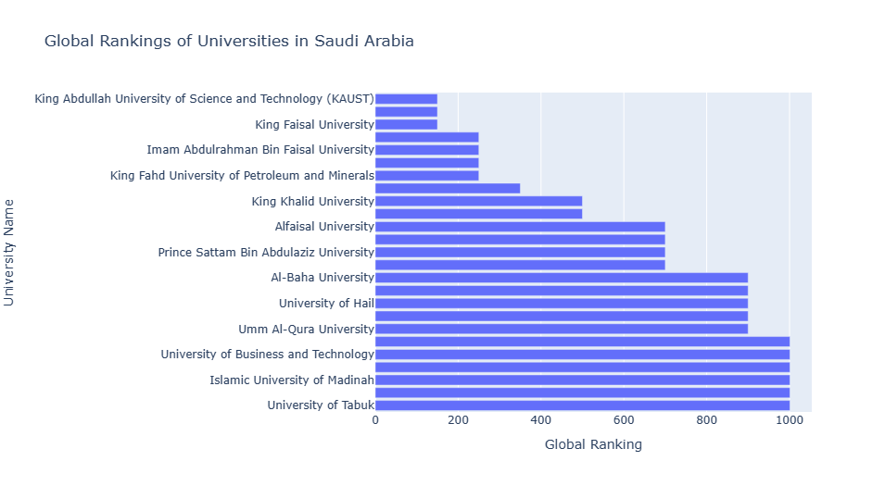
Second Data: Times Higher Education
What positions do universities in Saudi Arabia hold within the global rankings?

Slide 14
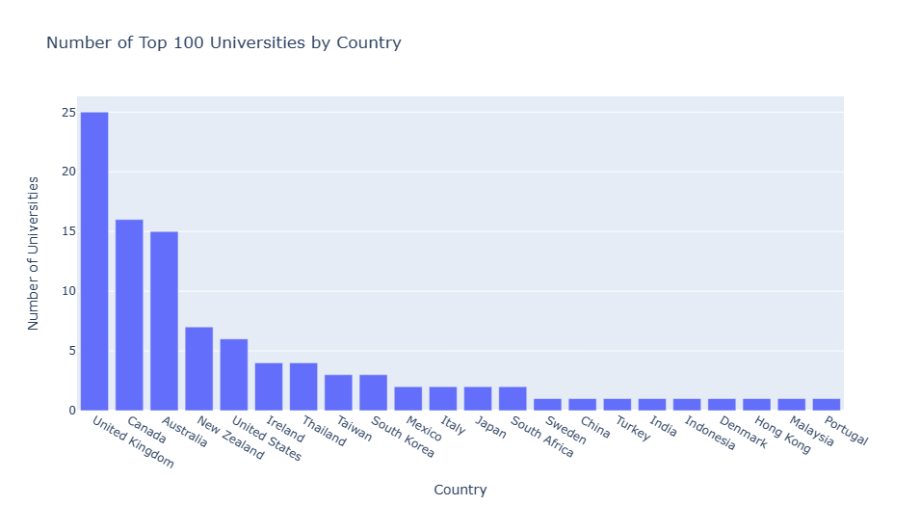
Second Data: Times Higher Education
Which countries have the highest number of universities among the top 100 universities in the world?

Slide 15
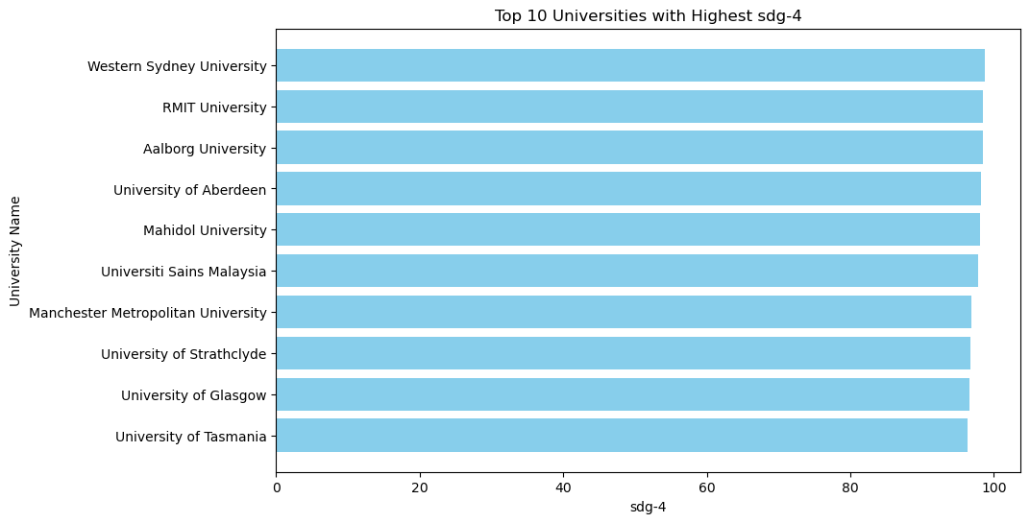
Second Data: Times Higher Education
What are the top 10 universities with the highest quality education (SDG-4)?

Slide 16
Shanghai Ranking!
Third Data:

Slide 17
Ranking System:
Nobel Prize (winner)
Field Medal (Mathematicians)
Highly Cited Researchers
Papers published in Nature/Science
Individual Academic Achievement of an institution

Slide 18
Which universities are ranked in the top 10 globally?

Slide 19
Top Universities:
University Name | Total Score | Global Rank
Harvard University | 100 | 1
Stanford University | 76.8 | 2
MIT | 70.1 | 3
University of Cambridge | 69.6 | 4
University of California, Berkeley | 65.3 | 5
Princeton University | 60 | 6
University of Oxford | 58.7 | 7
Columbia University | 57.2 | 8
California Institute of Technology | 56.1 | 9
University of Chicago | 55.1 | 10

Slide 20
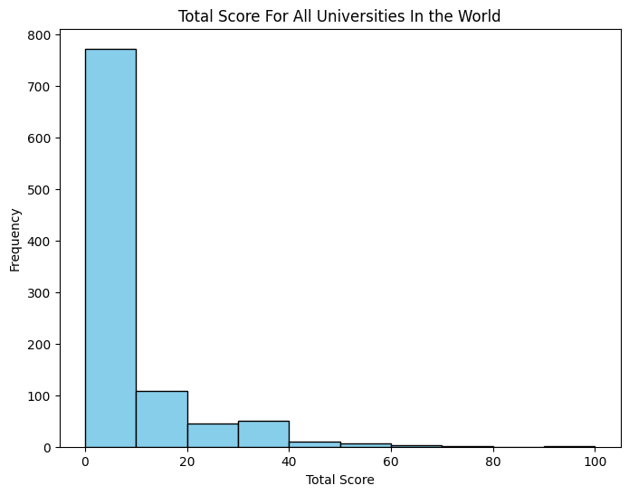

Slide 21
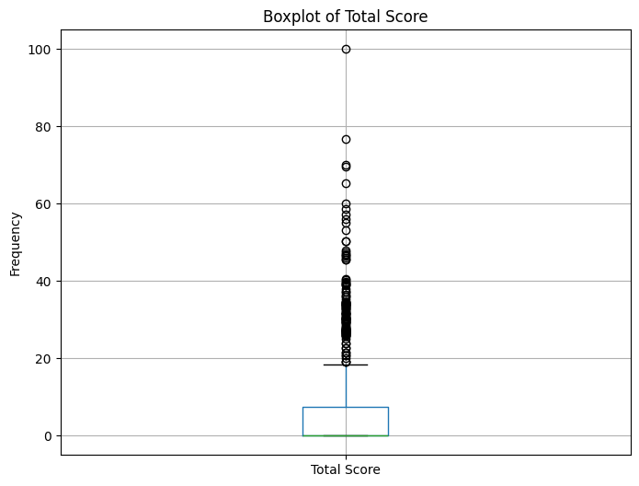
Outliers:
Mean: 5.9435
Median: 0.0
Mode: 0.0

Slide 22
What positions do universities in Saudi Arabia hold within the global rankings?
Position Rank | University Name | Global Rank Category | National Rank
109 | King Abdulaziz University | 101 - 150 | 1
110 | King Saud University | 101 - 150 | 1
222 | King Abdullah University (KAUST) | 201 - 300 | 3
423 | King Fahd University | 401 - 500 | 4
446 | Taif University | 401 - 500 | 4
631 | King Khalid University | 601 - 700 | 6
855 | Prince Sattam University | 801 - 900 | 7

Slide 23
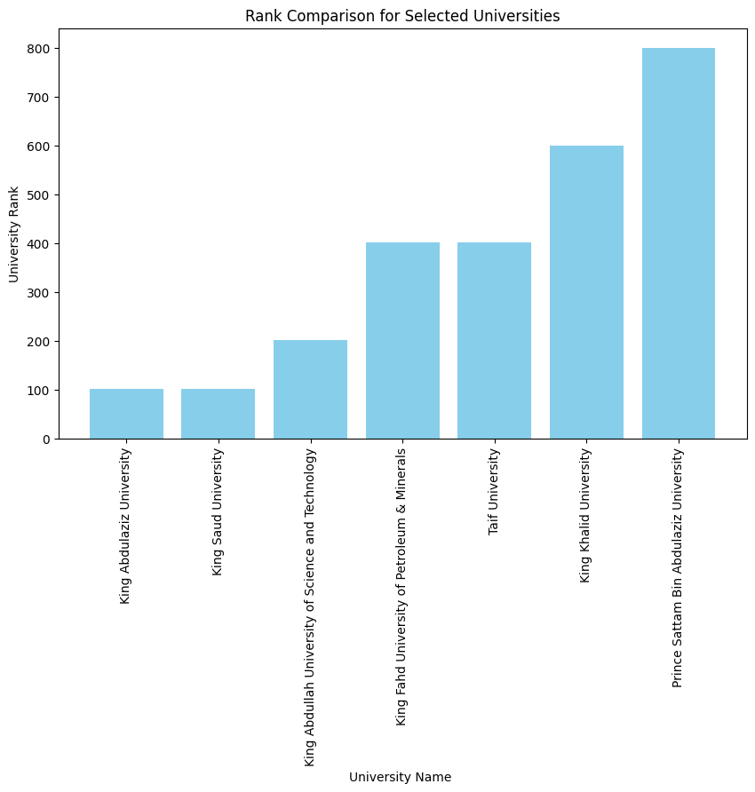

Slide 24
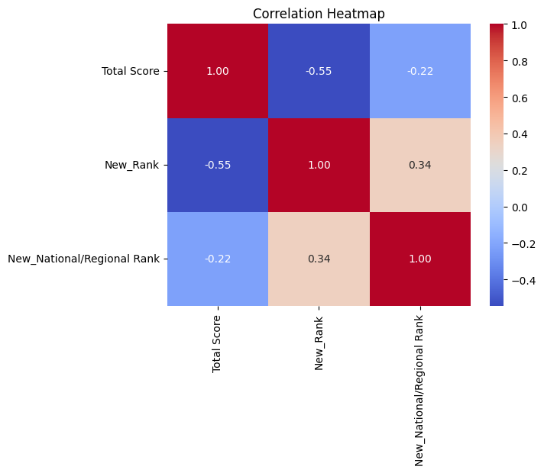
Is there a correlation between national and global university rankings ?

Slide 25
Bonus: Do the global universities hold the same ranking in the national rankings?
University Name | Global Rank | National Rank
Harvard University | 1 | 1
Stanford University | 2 | 2
MIT | 3 | 3
University of Cambridge | 4 | 1
University of California, Berkeley | 5 | 4
Princeton University | 6 | 5
University of Oxford | 7 | 2
Columbia University | 8 | 6
California Institute of Technology | 9 | 7
University of Chicago | 10 | 8

Slide 26
Conclusion :
Three universities appear in the top in different Ranking systems :
Harvard University
Stanford University
MIT
The Research Rank has the most impact on the overall rank.
Additional information in the project repo at GitHub

Slide 27
Thank You!

