Slide 1
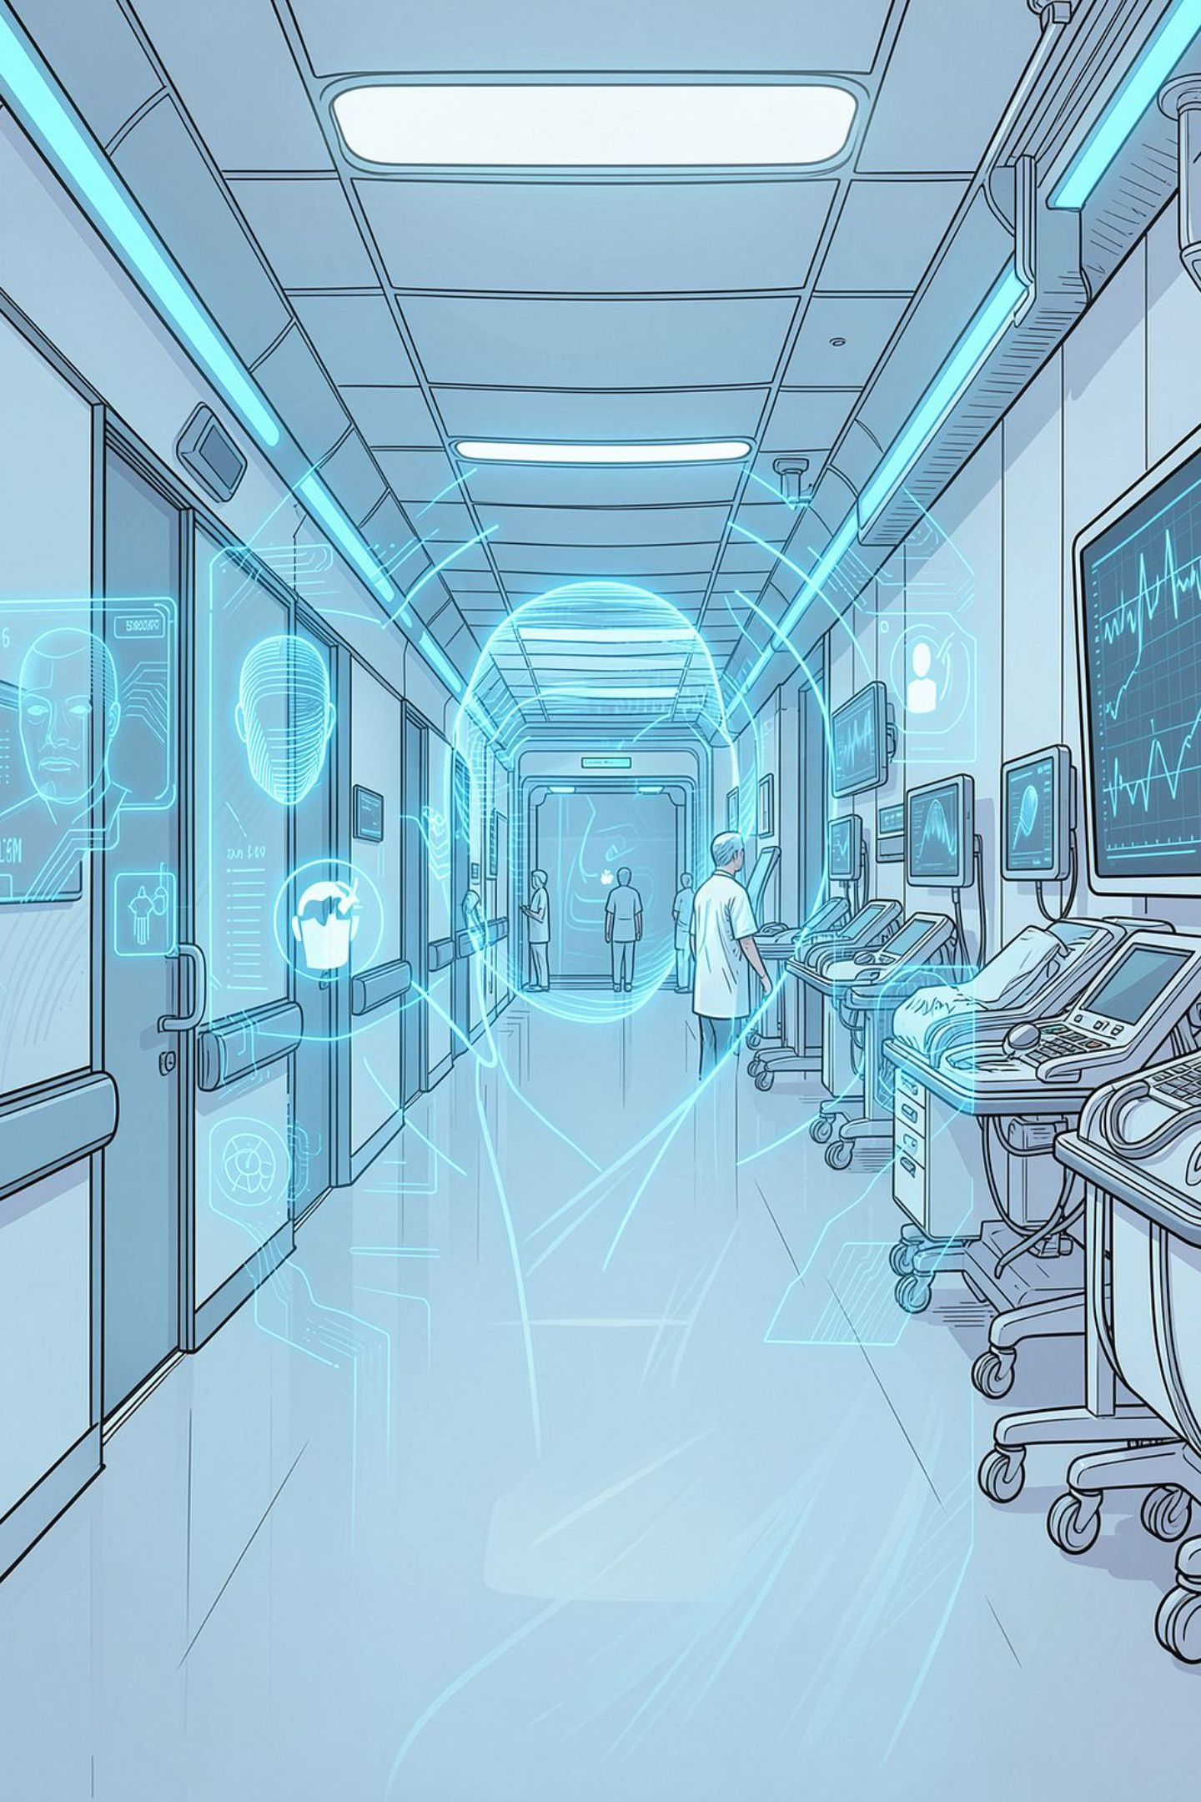
Healthcare Integration Platform with Facial Recognition (HIP-FR)
A Comprehensive Patient Management System
SOFTWARE ENGINEERING · HEALTHCARE AI

Slide 2

The Continuity-of-Care Problem
Fragmented Records
Patient data is distributed across providers, preventing a unified medical history view.
Repeated History Collection
Patients repeatedly provide the same medical history at every new visit.
Limited Provider Access
Physicians lack immediate access to prior treatment records from other facilities.
Patient Misidentification
Manual identification errors and incomplete records contribute to preventable medical mistakes.
Previous Treatment Errors:
Access to complete medical records allows new physicians to identify previous treatment mistakes and make safer, more informed decisions.

Slide 3

HIP-FR: The Proposed Solution
Problem
HIP‑FR Platform
Outcome
HIP-FR is a centralized healthcare integration platform that uses facial recognition for patient identification, integrates Electronic Health Records (EHR) across providers, and ensures authorized clinicians have secure, real-time access to complete medical histories.

Slide 4
Potential
Improved Continuity of Care
Ensures patient information follows them across different healthcare providers, leading to more informed treatment decisions
Reduced Medical Errors
Prevents misidentification of patients and gives doctors complete information to avoid prescribing contraindicated medications
Enhanced Efficiency
Streamlines patient check-in processes and eliminates the need for repeated medical history collection
The aggregated data could eventually support population health initiatives and medical research
Better Patient Experience
Data-Driven Healthcare
Patients don't need to repeatedly provide the same information to different providers or remember their entire medical history.
Doctor Collaboration & Medical Education
Enables doctors to consult each other on patient cases, reducing treatment errors while providing valuable learning opportunities for intern and junior doctors.

Slide 5
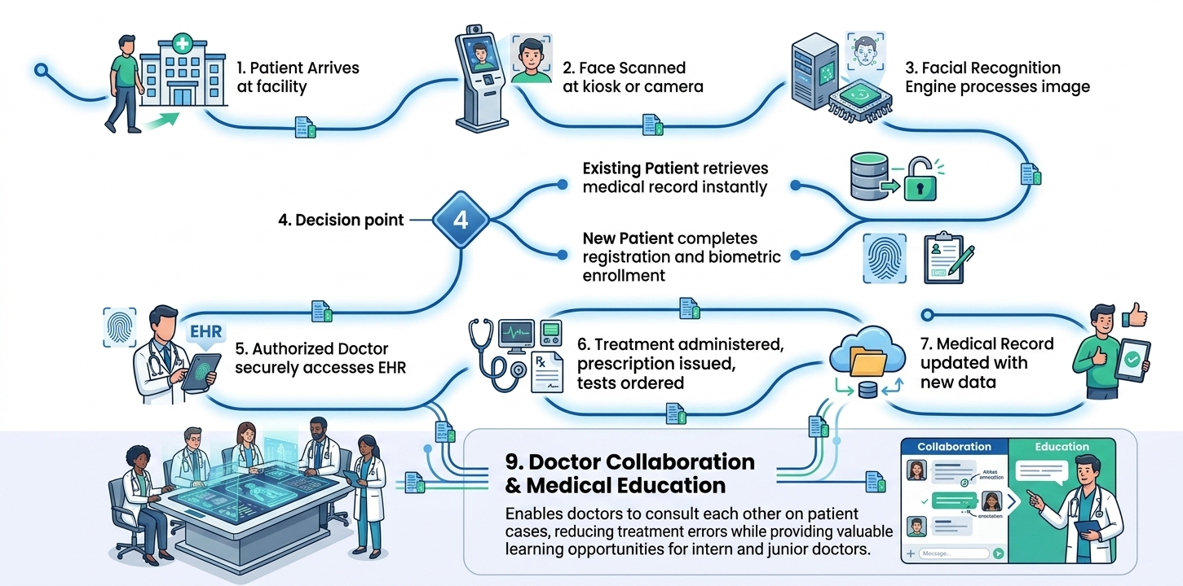
How HIP-FR Works: Patient Journey

Slide 6
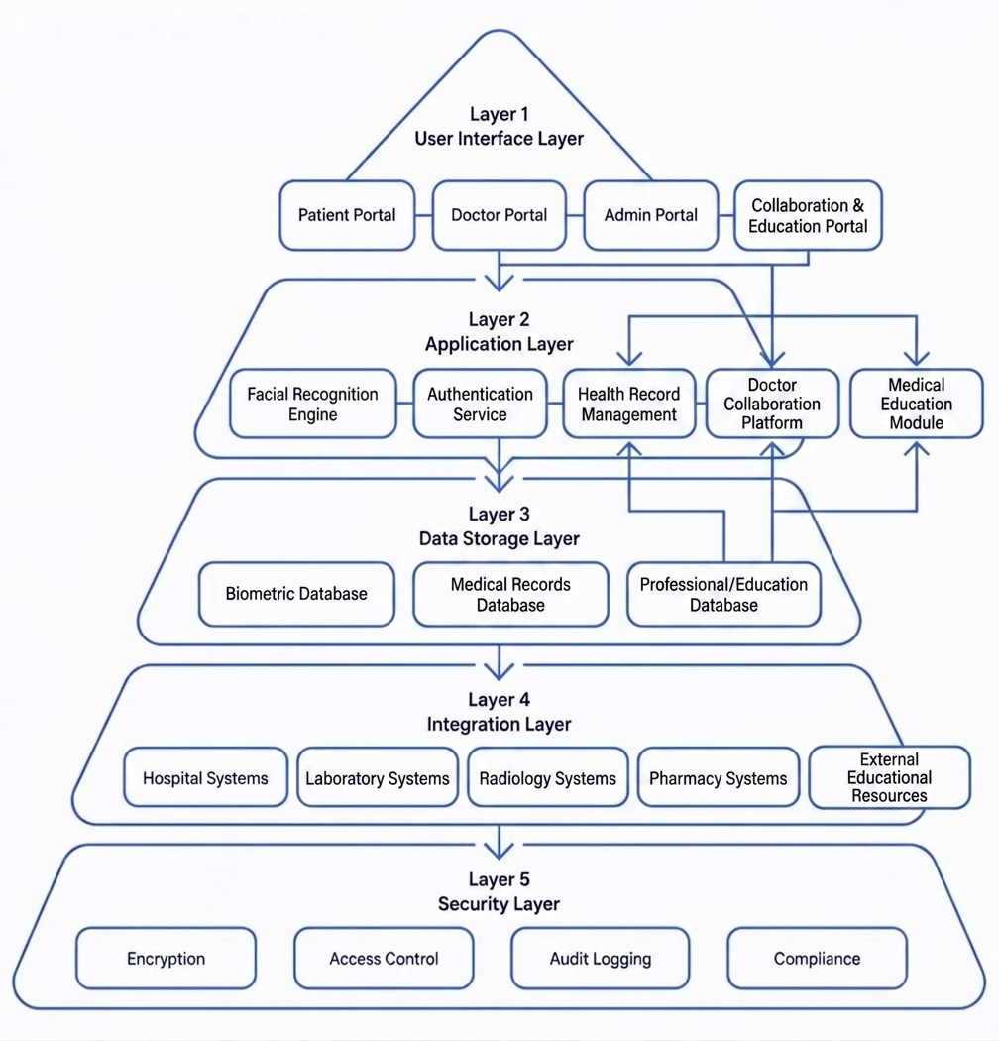
System Architecture
HIP-FR uses a five-layer architecture separating concerns across the full stack — from user-facing portals to secure external integrations — ensuring scalability, security, and interoperability.
User Interface Layer — Patient, Doctor, and Administrator portals
Application Layer — Facial Recognition Engine, Authentication Service, Health Record Management, Doctor collaboration platform, medical education Module
Data Storage Layer — Biometric database, Medical records database, Professional/Educational Database
Integration Layer — Hospital, Laboratory, Radiology, and Pharmacy systems
Security Layer — Encryption, Access control, Audit logging, Compliance

Slide 7

Registration, Biometric Enrollment & Facial Recognition
Biometric Enrollment
Facial image capture from multiple angles
Demographic data, medical history, allergies, and medications
Duplicate patient prevention via record matching
Patient consent and biometric-data handling protocols
Recognition Pipeline
Face detection → Feature extraction → Embedding generation
Database matching with confidence scoring
Multi-factor authentication for ambiguous or partial matches
Technologies: OpenCV, DLib, FaceNet, OpenFace

Slide 8

Electronic Health Records & Provider Connectivity
EHR Capabilities
Complete patient profile with diagnosis and treatment history
Medications, allergies, lab results, and imaging studies
Digital prescriptions, test ordering, and clinical alerts
Full treatment timeline with visit summaries
Provider Network
Secure doctor network with referral management
Automatic transfer of relevant patient information
Doctor-to-doctor communication and follow-up alerts
Continuity of care across specialists, hospitals, and labs

Slide 9
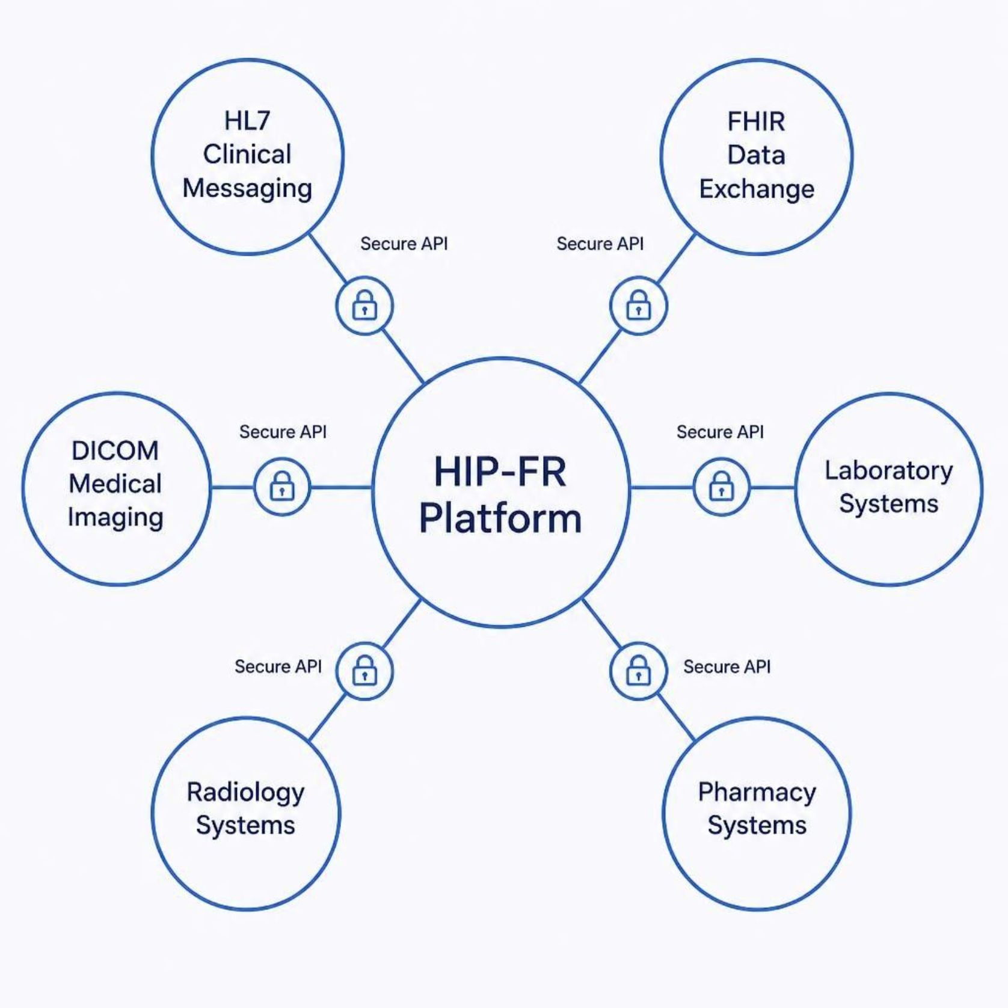
Security, Privacy & Healthcare Integration
Security & Privacy
Biometric and medical data stored separately
End-to-end encryption in transit and at rest
Role-based access control (RBAC)
Immutable audit trails and backup/recovery
Patient consent management
Healthcare Integration Standards
HL7 — Clinical messaging between systems
FHIR — Modern RESTful healthcare data exchange
DICOM — Medical imaging interoperability
Secure APIs connecting labs, radiology, and pharmacy

Slide 10








Benefits & Challenges
Key Benefits
Continuity of Care
Fewer Medical Errors
Unified records follow patients across all providers.
Accurate biometric ID reduces misidentification risks.
Faster Check-In
Less Redundant Data
Facial recognition eliminates manual registration delays.
Prior history auto-retrieved, reducing repeated collection.
Better Patient Experience
Data-Driven Healthcare
Streamlined visits and personalized care.
Aggregated records support research and population health.
Challenges & Risks
Privacy & Compliance
Recognition Accuracy
System Integration
Navigating HIPAA and biometric data regulations.
Ensuring reliability across diverse populations.
Connecting with legacy hospital infrastructure.
User Adoption
Infrastructure Requirements
Training staff and building patient trust.
Cameras, servers, and reliable network connectivity.

Slide 11
Implementation Roadmap & Conclusion
Phase 1 — Planning
Phase 3 — Integration
Stakeholder engagement, technical assessment, regulatory review
API development, security testing, pilot implementation
1
2
3
4
Phase 2 — Development
Phase 4 — Deployment
Database design, facial recognition engine, EHR functionality
Staff training, phased rollout, continuous improvement
Key Takeaways
HIP-FR combines biometric identification with EHR functionality for rapid, accurate patient identification
Enables seamless continuity of care across participating providers
Privacy, security, accuracy, and patient trust are critical to successful implementation
The system balances technological innovation with protection of patient rights
"Smart Healthcare Through Secure Identity, Connected Records, and Continuity of Care."

