Slide 1

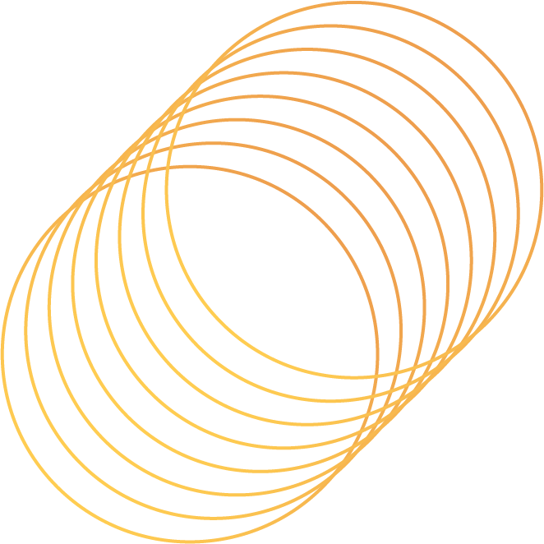
A Hybrid Pixel-Label Adaptation Framework for Robust Waste Detection
S.M.RASEL
Torikul Islam Munna
Susanta Roy Emon
22-48039-2
22-48307-3
22-49558-3
Submitted To
S M ABDULLAH SHAFI
Computer Vision & Pattern Recognition

Slide 2
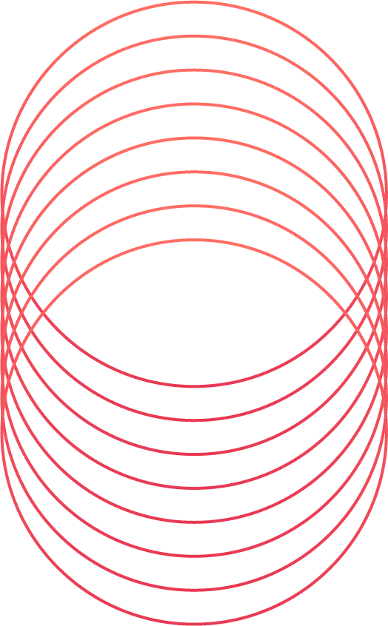
Introduction
The Global Waste Challenge
  Rapid urbanization → Municipal Solid Waste (MSW) crisis.
  By 2041, urban waste may reach 14 Lakhs tons/day.
The Technological Promise
  Manual sorting: slow (30–40 items/min) & unsafe.
  AI automation: faster (160 items/min) & safer.
.
.
Notes:
1.7.2013
‹#›

Slide 3
Problem Statement
Current AI models (YOLOv8, ResNet) fail under domain shift.
  Domain Shift: When a model trained on one dataset performs poorly on a different, unseen dataset due to differences in data distribution.
Why Current AI Models Fail in Real-World Waste Detection
  High accuracy in lab → poor generalization in industry.
  Domain shift causes accuracy drop to 10%.
  Existing methods focus on either pixel-level OR label-level adaptation.
Systemic Barriers
  Visual mismatch between datasets.
Notes:
1.7.2013
‹#›

Slide 4
Objectives
General Objective
  To propose a hybrid framework combining CycleGAN + YOLOv8 for robust waste detection.
Specific Objectives
  Quantify performance improvement under domain shift.
  Reduce false negatives in cluttered environments.
Notes:
1.7.2013
‹#›

Slide 5
Literature Review
  ResNet152: Good classification (~94%), but cannot show object location.
  YOLOv7 : Strong detection (~95.9%), but only in one dataset.
  YOLOv8 : Accurate in lab datasets, but fails in real-world domain shift.
  Gap : No study combines pixel-level adaptation (GAN style transfer) with label-level adaptation (self-training).
Notes:
1.7.2013
‹#›

Slide 6
Proposed Hypothesis
Hypothesis Statement
  Integrating CycleGAN (pixel-level style transfer) with YOLOv8 (self-training) will significantly improve detection robustness in unseen environments.
Core Components
  CycleGAN → aligns visual style .
  YOLOv8 → efficient real-time detection
Notes:
1.7.2013
‹#›

Slide 7
DATASET
Dataset Sources
This study employs two primary datasets to highlight the domain gap in waste detection.
TACO dataset : It contains approximately 1,500 images with 4,784 annotations across 60 waste categories, representing outdoor and street environments. It is used as the source domain for pixel-level adaptation.
ZeroWaste dataset : provides around 4,600 frames from industrial conveyor belt settings, where waste items are cluttered and overlapping. It serves as the target domain for label-level adaptation.
Notes:
1.7.2013
‹#›

Slide 8
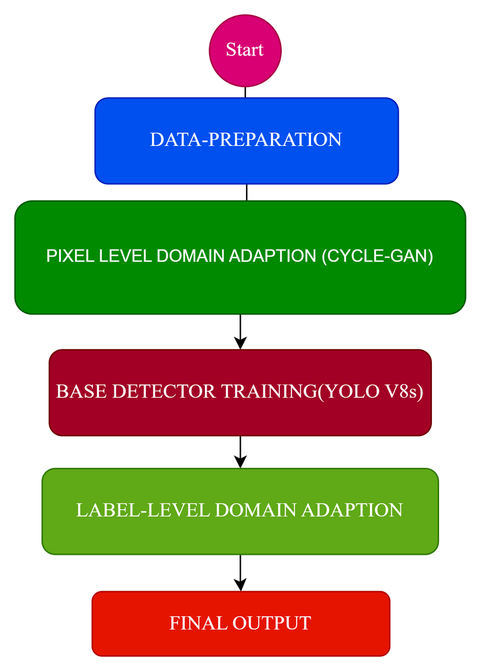
Methodology
Notes:
1.7.2013
‹#›

Slide 9
Contribution
  Hybrid Framework: First to combine CycleGAN (pixel-level style transfer) with YOLOv8 (label-level self-training) for waste detection.
  Domain Adaptation: Addresses the domain gap between outdoor datasets (TACO) and industrial datasets (ZeroWaste).
  Automation: Reduces the need for manual labeling in new environments by leveraging synthetic data and pseudo-labels.
  Robustness: Produces a detection model that works across unseen, cluttered, real-world environments.
Notes:
1.7.2013
‹#›

Slide 10
Conclusion
  Existing models (ResNet152, YOLOv7, YOLOv8) perform well in controlled datasets but fail under domain shift.
  This study proposes a hybrid CycleGAN + YOLOv8 framework to overcome those limitations.
  By combining pixel-level style transfer with label-level self-training, the model achieves robust detection in unseen environments without manual labeling.
  The approach demonstrates a pathway toward scalable, automated waste detection systems that can adapt to diverse real-world conditions.
Notes:
1.7.2013
‹#›

Slide 11
Reference
F. Fotovvatikhah, I. Ahmedy, R. M. Noor, and M. U.Munir, “A systematic review of ai-based techniques for automated waste classification,” Sensors, vol. 25, no. 10,
2025, doi: 10.3390/s25103181.
Here is dataset link :
1. https://github.com/pedropro/TACO
2. https://github.com/dbash/zerowaste

Slide 12
Thank you
Feel free to ask any questions
Notes:
1.7.2013
‹#›

