Slide 1





d
WELCOME
Engineering Ethics
Presentation
Section: [I] Group: 04
Supervised By:
ABU SHUFIAN
Ethical Considerations in User Privacy
Group Members
👤 MD Tanjil Tashrik Zim
🆔 22-48021-2
👤 S.M Rasel
🆔 23-48039-2
👤 MD. Abrar Rafid Shariar
🆔 22-48055-2
👤 Nafis Imtiaz Nur
🆔 22-48835-3
👤 Nawshin Anjum Prima
🆔 22-48839-3

Slide 2
Contents
Introduction
Case Study Overview
Violation of Engineering codes of ethics
Ethical Dilemmas
Analysis and Solution
Conclusion

Slide 3

What is Code of Ethics?
A Code of Ethics is a formal set of guidelines and principles that define the moral responsibilities, professional standards, expected from individuals within a profession or organization.
It tells professionals what is right and wrong in their work helping them act honestly and responsibly.
Notes:
Roles of the code of Ethics
Serving and Protecting the public
Providing Guidance
Offering Inspiration
Establishing Shared Standards
Supporting Responsible Professionals
Contributing to education
Deterring Wrongdoing
Strengthening a professions image

Slide 4

CASE STUDY
Marcus is a computer engineer who has recently developed an app which helps users keep track of medical information, doctor’s appointments, and prescriptions.
Information about the user is stored in this app, including what prescriptions they are taking and how frequently they schedule doctor’s appointments. As the developers of the app, Marcus and his company have access to this information.
The marketing department requests Marcus supply them with customer-specific information so they can better target ads and app suggestions to the users. Marcus understands that he is part of a company, but also feels that the privacy of the app users should be protected. Additionally, Marcus feels that as an engineer, he should be responsible to those who use his technology.
How does Marcus determine how much of the user’s information should be shared with marketing? Is this an ethical use of information or a violation of the user’s privacy?
**Clare Bartlett was a 2014-2015 Hackworth Fellow in Engineering Ethics at the Markkula Center for Applied Ethics at Santa Clara University.
August 2015

Slide 5

Case Study Overview
Background:
Marcus, a computer engineer, developed an app to help users track medical information, including doctor’s appointments, prescriptions, and other related data.
The app collects and stores sensitive information about the users.
Situation:
Marcus and his company have access to this sensitive data.
The marketing department requests that Marcus supply customer-specific information to better target ads and app suggestions

Slide 6
Case Study Overview
Ethical Dilemma:
While Marcus is part of a company that may benefit from sharing data, he believes in protecting the privacy of the app users.Marcus wrestles with the decision of how much of the user’s information should be shared with marketing.
Context Note:
This case study is inspired by the work of Clare Bartlett, a 2014-2015 Hackworth Fellow in Engineering Ethics at the Markkula Center for Applied Ethics, Santa Clara University (August 2015)

Slide 7
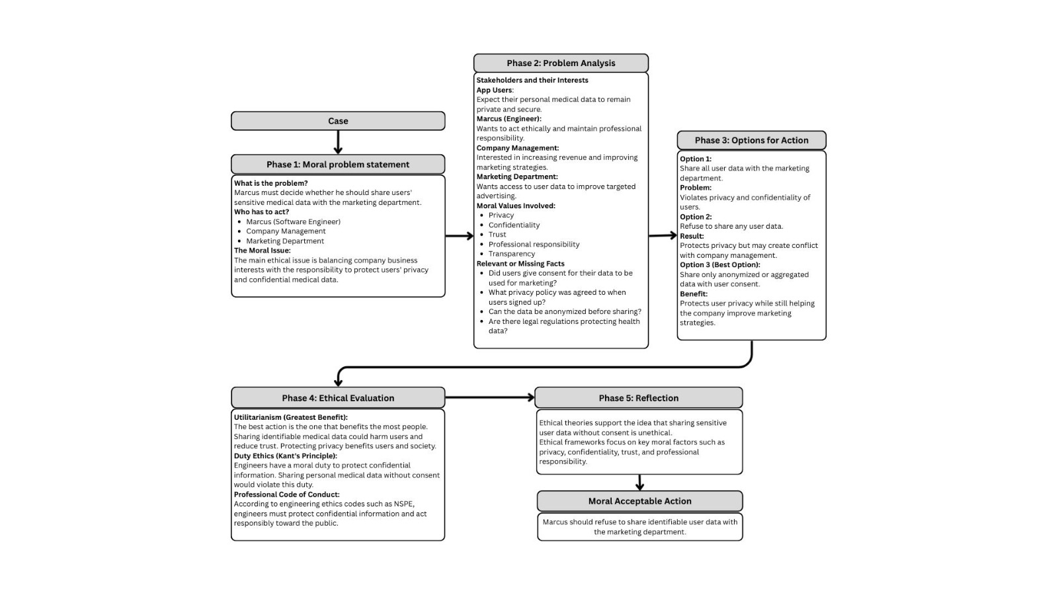
Ethical Cycle

Slide 8
Ethical Code
Violation 1

Slide 9

Violation 1:
NSPE III.4
Engineers shall not disclose, without consent, confidential information concerning the business affairs or technical processes of any present or former client or employer, or public body on which they serve.
a. Engineers shall not, without the consent of all interested parties, promote or arrange for new employment or practice in connection with a specific project for which the engineer has gained particular and specialized knowledge.

Slide 10
Implications for the Professional Field
Confidentiality and Trust:
Professional Integrity :Engineers should keep information private to stay ethical and earn trust
Data Protection: In the digital world, engineers must keep data safe, private, and clearly explain how it’s used
2. Boundaries of Disclosure:
Limited Sharing: Only non-sensitive or anonymous info should be shared ,sharing personal medical data without consent is a clear violation
Consent Requirement: Engineers must get clear consent before using anyone’s data, especially in sensitive areas like healthcare.​

Slide 11
Application Areas in the Professional Field
Software and App Development
Healthcare Technology
Data Analytics and Marketing
Application to Marcus’s Case Study
Ethical Use vs. Privacy Violation:
Ethical Decision Making
Potential Consequences if Violated:
Breach of Confidentiality
Organizational Impact
13

Slide 12
Ethical Code
Violation 2

Slide 13
Violation 2
IEEE I.1
To hold paramount the safety, health, and welfare of the public, to strive to comply with ethical design and sustainable development practices, to protect the privacy of others, and to disclose promptly factors that might endanger the public or the environment;

Slide 14
Implications for the Professional Field
Public Safety and Welfare:
Priority of Public Interest: Engineers must always put the public’s well-being before company profit or personal gain.
Disclosure Responsibilities: Any risks to users or their data must be disclosed promptly to prevent harm.
2. Privacy Protection:
Safeguarding User Data: Protect user data and privacy
Application Areas in the Professional Field
Software and App Development
Healthcare Technology
Environmental and Public Health Projects
Application to Marcus’s Case
Prioritize Safety and Welfare
Maintain Ethical Standards
Protect Privacy
Prompt Disclosure
16

Slide 15
Consequences of Violating the Code in the Case Study
Professional Repercussions:
Loss of Trust and Credibility
Disciplinary Action
2. Broader Impact on Public Welfare:
Harm to Users
Environmental and Social Risks

Slide 16
Ethical Dilemma

Slide 17

Overview
Marcus was asked to share personal user info with the marketing teams.
He was aware that user privacy should be protected.
He must choose between obeying his company or doing what is right.

Slide 18

Conflict of Interests
Sharing data helps the company but effects user trust.
Refusing might cause problems at work.
This creates a conflict between company requirements and ethical responsibility.

Slide 19
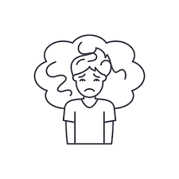
Stakeholders and Concerns
Affected parties: Marcus, the company, app users, and legal owners.
The biggest concern: protecting sensitive user information.
Engineers must follow ethical guidelines and prioritize privacy.

Slide 20
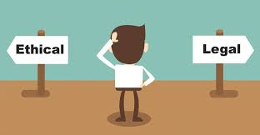
Ethical Responsibility
•Ethics require Marcus to act with honesty and integrity.
•He must carefully weigh the impact of his decisions on all stakeholders, including users and the company
•Balancing loyalty to the company with responsibility to the public creates a difficult ethical challenge.

Slide 21



RESOLVING ETHICAL DILEMMA
Protecting User Privacy vs. Company Interests
How Should Marcus Resolve This Dilemma

Slide 22


FOUR-STEP ANALYSIS METHOD :
1. Recognize the Dilemma
2. Gather Facts & Analyze
3. Consider Options & Evaluate
4. Make a Decision & Reflect

Slide 23


1. RECOGNIZE THE DILEMMA
The marketing department requests access to user data to better target ads.
However, sharing this data violates user privacy and ethical standards.
Marcus is torn between protecting user privacy and supporting company interests.
Marcus, a computer engineer is faced with an ethical conflict :

Slide 24


2. GATHER FACTS & ANALYZE
The app contains sensitive medical data about users, including prescriptions and doctor visits.
Ethical codes (IEEE Code 1, NSPE Rule III.4) state that engineers must protect user privacy and not share personal data without consent.
Sharing user data without consent could lead to legal and ethical violations, eroding public trust in the company.
The company has an interest in profitability and effective marketing, but it must balance this with ethical responsibility.

Slide 25



3. CONSIDER OPTIONS & EVALUATE
Possible Courses of Action:
Share user data with marketing
Unethical (violates privacy laws and professional ethics).
Deny the request completely
Ethical but may create conflicts with management.
Seek User Consent Before Sharing Data
Ensures Ethics, Transparency, and User Rights Protection
Propose an alternative, ethical marketing strategy
Balances business needs and privacy.

Slide 26


4. MAKE A DECISION & REFLECT
Make a Decision :
Marcus must prioritize user privacy by refusing to share identifiable user data, in
alignment with IEEE and NSPE ethical guidelines.
He should advocate for ethical data practices, such as using anonymized and aggregated data.
He should allow users to choose whether their data is shared, ensuring transparency and ethical responsibility.
He should propose alternative marketing strategies, like AI-driven insights and contextual advertising.

Slide 27

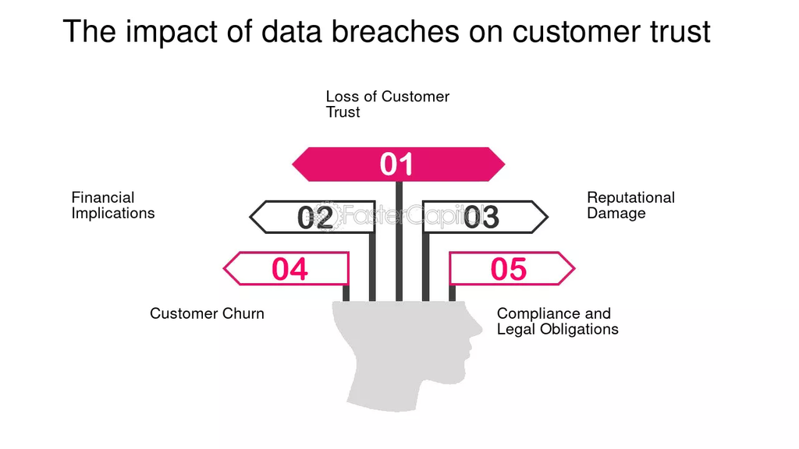
Reflect on the Impact :
Ethical Integrity
Legal Compliance
Public Trust
Business Success
Upholds IEEE and NSPE professional ethics, setting a standard for responsible engineering.
Avoids legal risks and ensures privacy regulation adherence.
Enhances user confidence and improves company reputation.
Enables data-driven marketing without violating privacy, ensuring a sustainable and ethical business model.

Slide 28
Sustainable Development Goal
SDG 3: Establish Good Health and Well-Being
Marcus's app handles sensitive medical prescriptions and doctor appointments. If users cannot trust the app with their privacy, they will stop using digital health tools, directly hindering advancements in public health tracking and well-being.
SDG 9: Increase Industry, Innovation, and Infrastructure
True technological innovation requires building secure and ethical software infrastructure. Exploiting user data for short-term profit undermines sustainable technological growth.
SDG 16: Guarantee Peace, Justice, and Strong Institutions
Protecting data privacy is a fundamental human right. By refusing to secretly share user data , Marcus upholds institutional justice, ensuring the company operates with integrity and transparency rather than exploiting the public.
.

Slide 29
Conclusion:
Marcus's case highlights the importance of engineering ethics in professional decision-making.
Corporate responsibility requires individuals within a company to act in accordance with their assigned responsibilities while maintaining ethical accountability.
Protecting user privacy upholds legal compliance, public trust, and professional integrity.
Ethical alternatives like anonymized data and user consent balance business interests with moral responsibility
Engineers must prioritize ethical standards over corporate pressure to ensure responsible and transparent technology use.

Slide 30

Reference
https://www.scu.edu/ethics/focus-areas/more-focus-areas/engineering-ethics/engineering-ethics-cases/a-violation-of-privacy/
https://www.ieee.org/about/corporate/governance/p7-8.html
https://www.nspe.org/sites/default/files/resources/pdfs/Ethics/CodeofEthics/NSPECodeofEthicsforEngineers.pdf

Slide 31



THANK YOU!
ANY QUESTIONS?

