Slide 1
Smart Aqua Refill Station
IoT-based Purified Water Refill Service
Location: Dhaka
Group: 5 Members

Slide 2
Introduction
Clean drinking water is essential.
Bottled water is expensive and wasteful.
We provide a refill-based sustainable solution.

Slide 3
Problem Statement
High cost of bottled water.
Plastic waste is increasing.
Public spaces lack clean water access.

Slide 4
Business Idea
Install automated water refill stations.
Customers refill bottles at low cost.
IoT monitors water purity in real time.

Slide 5
Objective
Provide affordable drinking water.
Reduce plastic waste.
Ensure public health and environmental sustainability.

Slide 6
Target Market
University students
Office workers
Bus/train passengers
Urban households

Slide 7
Value Proposition
Affordable refill price
Eco-friendly approach
Stable and monitored water purity

Slide 8
How the System Works
RO + UV purification
IoT quality monitoring
Touchless dispensing option

Slide 9
Technology Used
RO Filtering System
UV Purification
IoT Quality Sensors
Digital Display

Slide 10
Location Strategy
High foot-traffic areas:
Universities, Markets, Bus Stands, Office Zones

Slide 11
Operational Plan
Water Source: WASA
Filtration: On-site
Maintenance every 30–45 days

Slide 12
Cost Setup (Per Station)
Purification Unit: ৳18,000
IoT Sensors: ৳6,000
Dispensing System: ৳7,000
Total: ~৳38,000

Slide 13
Revenue Model
Average Refill Demand: 150 Liters/day
Price: ৳10 per liter
Monthly Profit ≈ ৳33,000

Slide 14
Financial Projection
Breakeven in ~2 months
High scalability and low running cost

Slide 15
Competitor Comparison
Lower price than bottled water
More accessible than distributors
Eco-friendly advantage

Slide 16
Risk & Challenges
Machine damage
Water contamination
Awareness gap

Slide 17
Risk Mitigation
Regular servicing
Quality monitoring display
Marketing campaigns

Slide 18
Sustainability Impact
Reduces plastic waste
Encourages refill culture
Environmentally responsible

Slide 19
Future Expansion
App-based refill credits
School & corporate partnerships
Mobile refill vans

Slide 20
Conclusion
Smart Aqua Refill Station is affordable, scalable, and eco-friendly.
Strong business and social value.

Slide 21
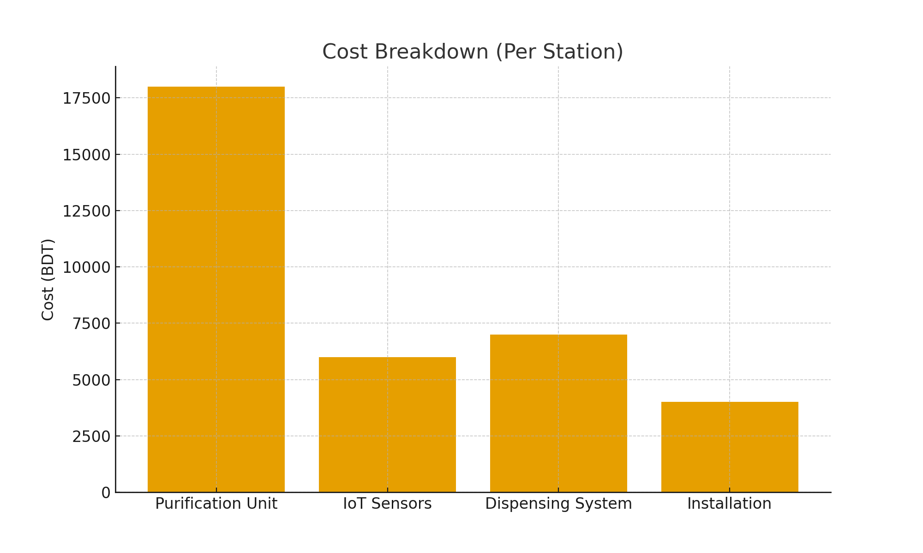
Cost Breakdown Chart

Slide 22
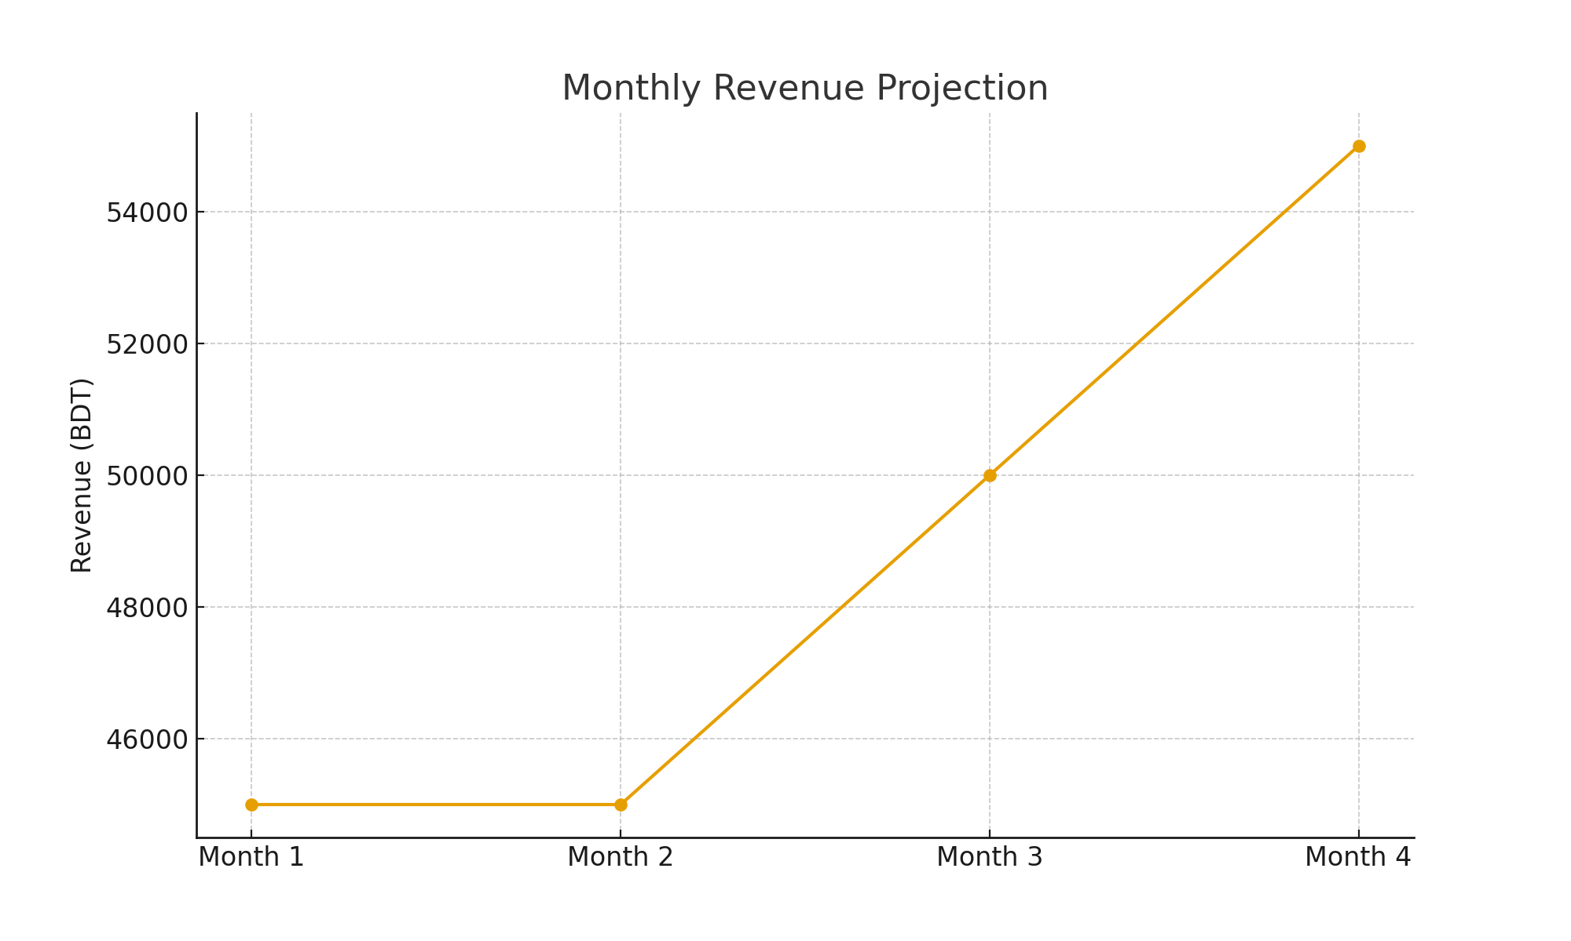
Revenue Projection Chart

