Slide 1

THE PEOPLE’S UNIVERSITY OF BANGLADESH
Department of Computer Science & Engineering
Online Social Networking for Blood (OSNB)
This Report Presented in Partial Fulfillment of the Requirements for the Degree of Computer Science & Engineering (CSE)
Supervised By
Md. Sohrab Ali
Lecturer, Department of CSE

Slide 2
Online Social Networking for Blood (OSNB)
Group Member
Student ID | Student Name | Batch
12322202017 | Mahabubur Rahman | NCC 22th (Evening)
12322202018 | Md. Hafizullah Sawon | NCC 22th (Evening)
12322202019 | Omar Fahad | NCC 22th (Evening)
12322202002 | Rasel Ahmmed | NCC 22th (Evening)

Slide 3

Our Aims/Objectives
Encourage people to donate blood
Provide facilities to get info about blood donor
Make easy to blood seeker to find their required blood donor within a short time.

Slide 4
Introduction
Everyday, hundreds of children and adults require blood to save their life. People like you donate blood to save these precious lives. In this importance, Online Social Networking for Blood (OSNB) is a web & browser based database application system that is that is designed to store, process, retrieve and analyze information concerned with the administrative and inventory management within a blood management system.

Slide 5
Aims of OSNB
This project aims at maintaining all the information pertaining to blood donors, different blood groups available and help them manage in a better way.
Aim is to provide transparency in this field, make the process of obtaining blood hassle free and corruption free and make the system of blood bank management effective.

Slide 6
Features of OSNB
Donor Management - Donor Registration, Managing donor database, recording their physical and medical details.
Inventory management for storage and issuance of blood.
Blood requisition and issuance of blood.
Being a web based system, can be implemented throughout the state. - - Separate user accounts can be created
List of Donors who are eligible for donation on a particular date with contact Number.
Blood Donation Camp & Camp Organizer Management

Slide 7
Why Join OSNB ?
Search for blood
Donate blood directly to patients
Create & Maintain your profile
Make a request for Blood.
Get info about nearest Donor.

Slide 8
Who need OSNB ?
Students (always ready to help people)
Blood donors (who donates blood voluntarily)
Young professionals (ready to donate)
Blood seekers (from any groups)
Medical Professional
Blood service agencie

Slide 9
Tools used for this project
Microsoft Visual Studio 2010 as Integrated Development Environment (IDE) tool
SQL Server Express edition for Database Management System (DBMS)
Server Container: MS IIS
Technology: ASP.Net 3.2, JQuery, XML, JavaScript, Ajax, HTML, CSS

Slide 10
Domain Model we used
Three Tire Technical Mode
Server side
Client Side
(Web Browser)
Web Server
Database Server

Slide 11
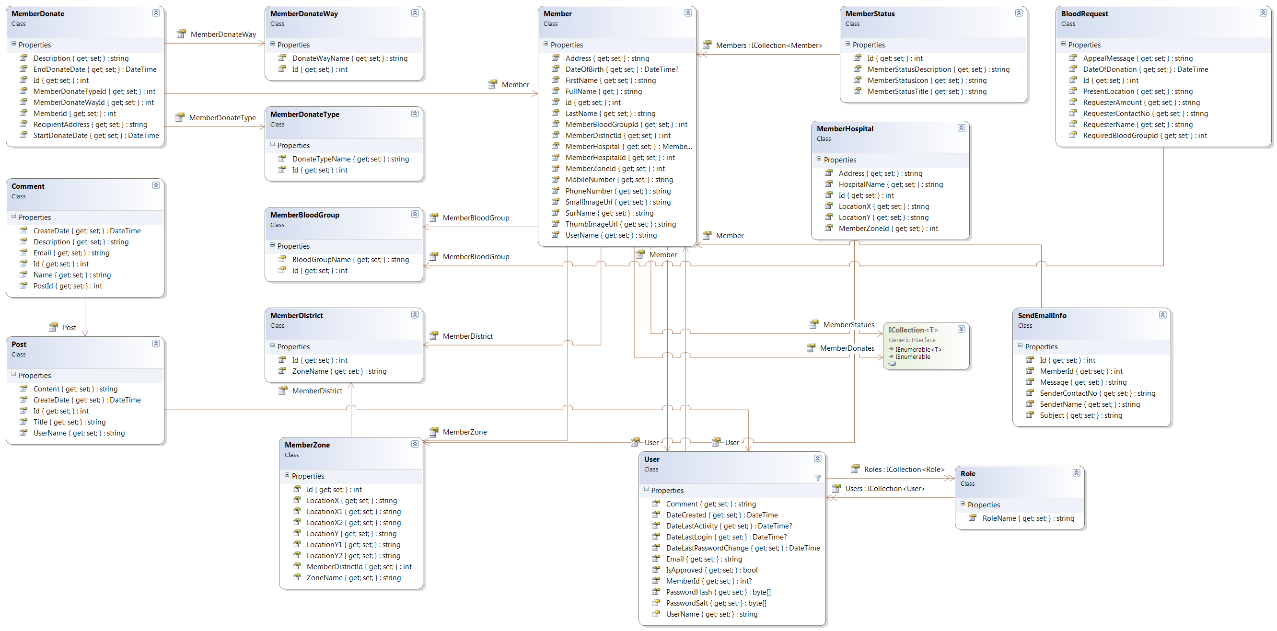
Class Diagram

Slide 12
User Benefits from this social networking site
Basically two types of user are Blood Donor & Blood Seeker
Can get efficient donor and blood stock management functions
Blood Donor can create profile for blood seeker to get info about them
Blood Donor can denote blood in request from blood seeker
Blood Seeker easily get details info about nearest blood donor.
Blood Seeker can make request on urgent & need basis.

Slide 13
Administrators Benefits from this social networking site
Can make a social network between blood donor & blood seeker
He can fulfull his social resposibility by this job
He can get financial facilities in future on basis of his site’s popularity
He can be a known person to everyone easily.

Slide 14
Admin Panel
Login with valid user name & Password
Add/Update/Delete Profile
Update status of Request
Add info blood donation events on site
Make Sure efficient donor and blood stock management functions

Slide 15
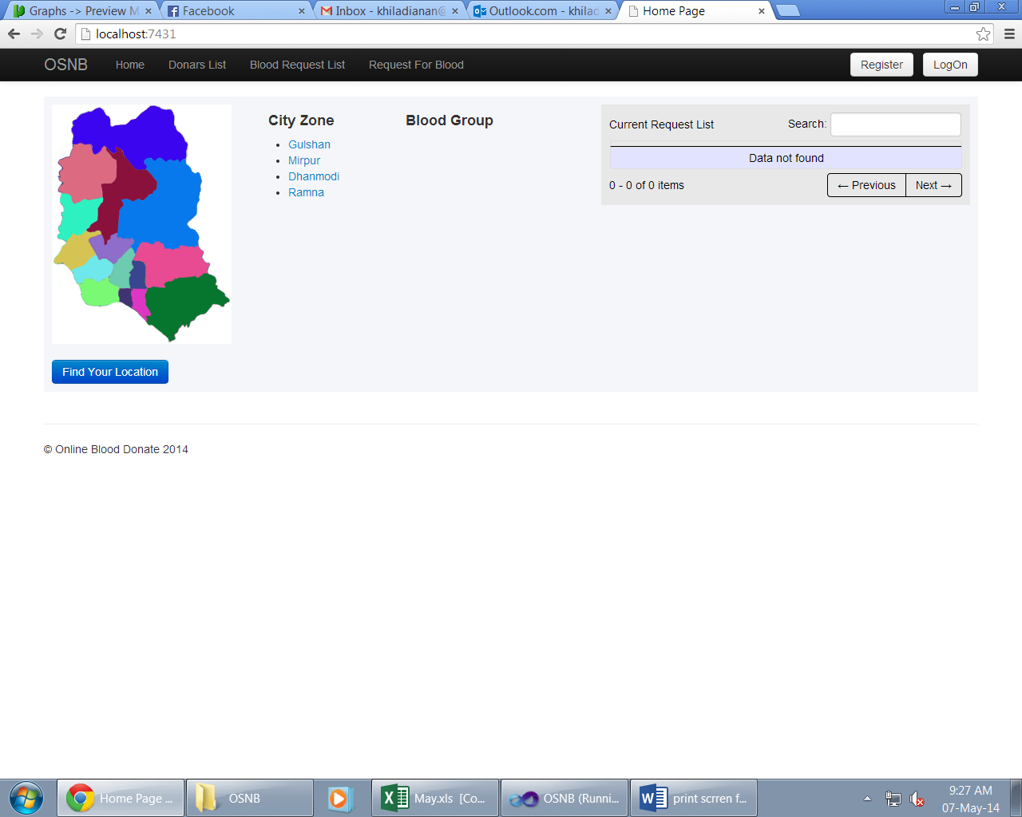
Home Page

Slide 16
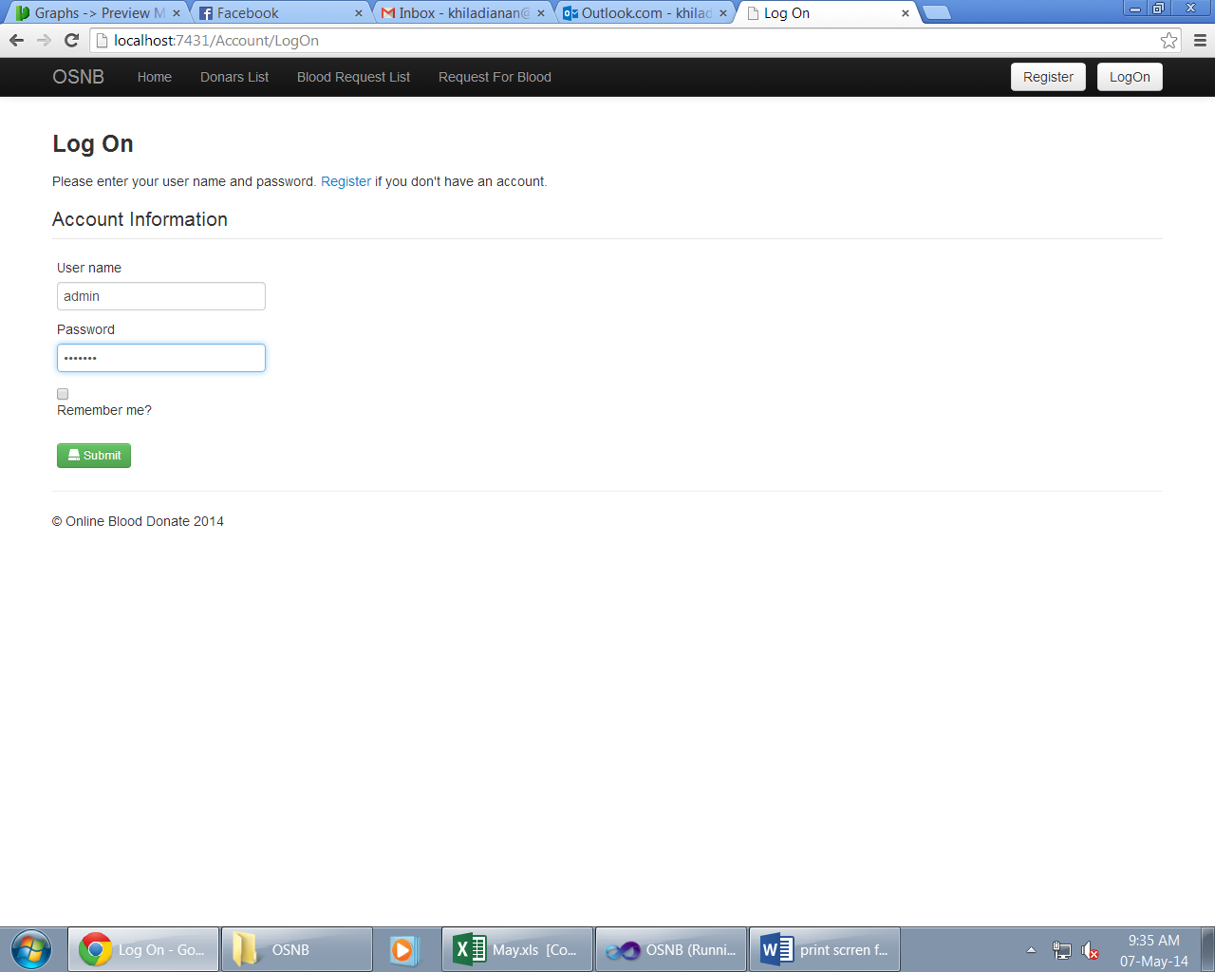
Login for Admin Panel

Slide 17
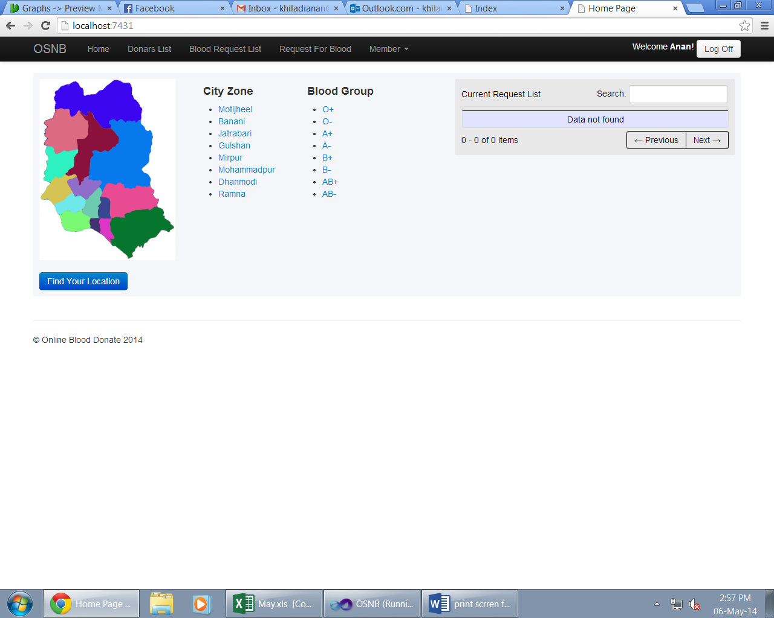
Admin Panel

Slide 18
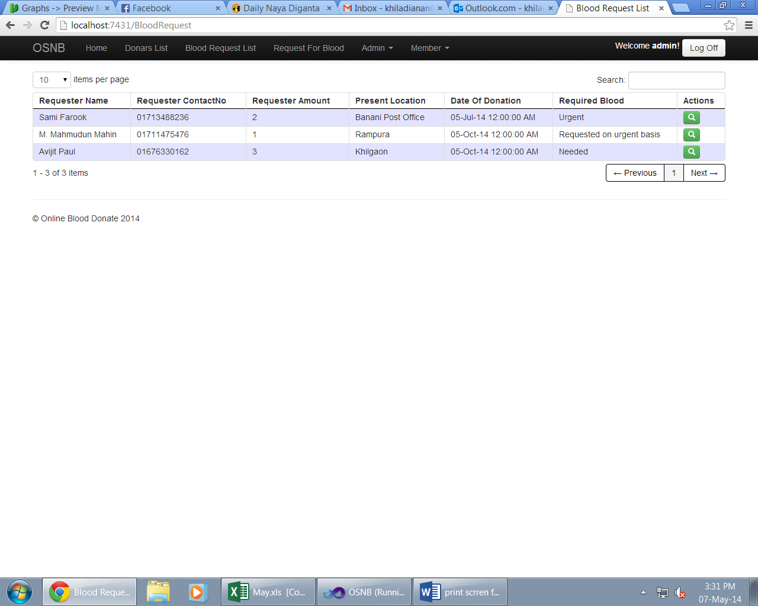
Blood Request Panel

Slide 19
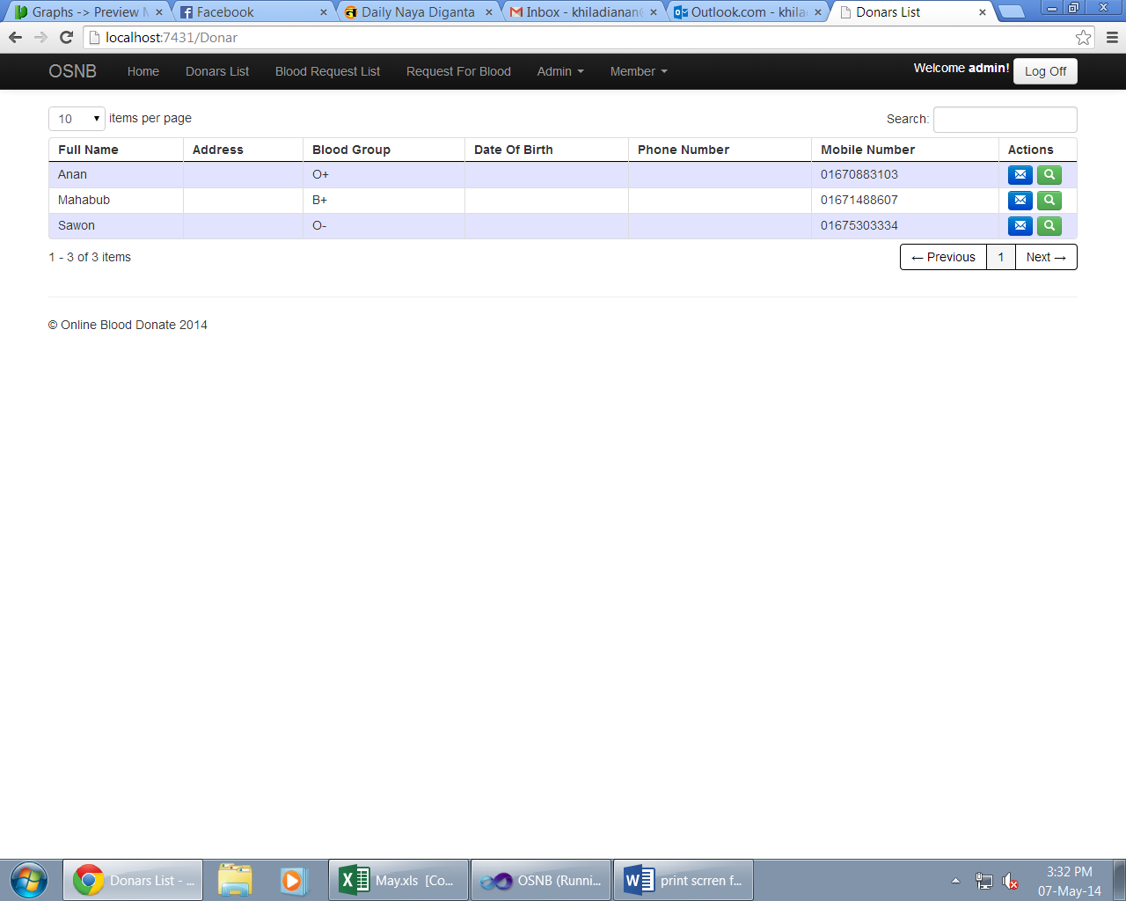
Donor List Panel

Slide 20
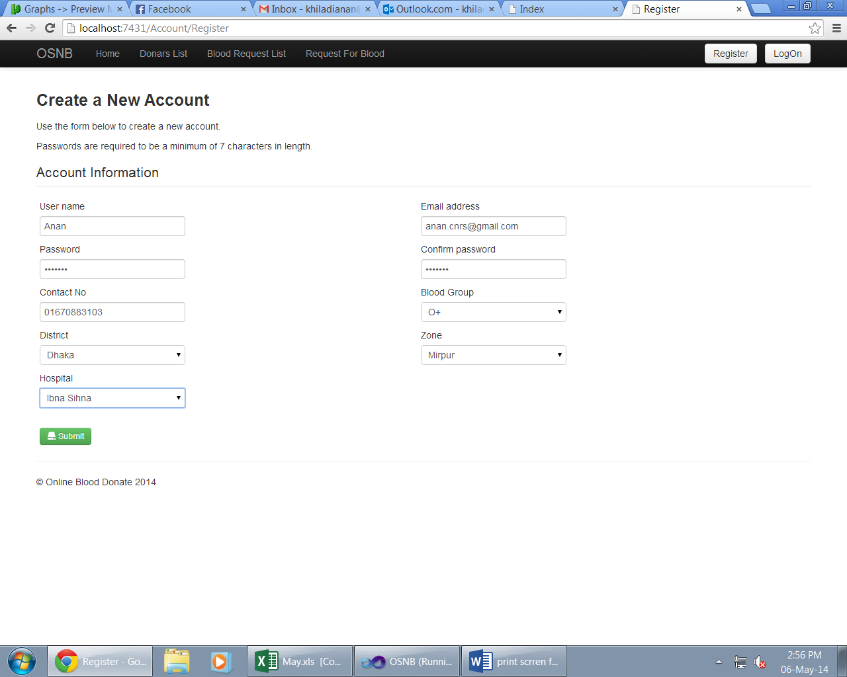
Add a Member

Slide 21
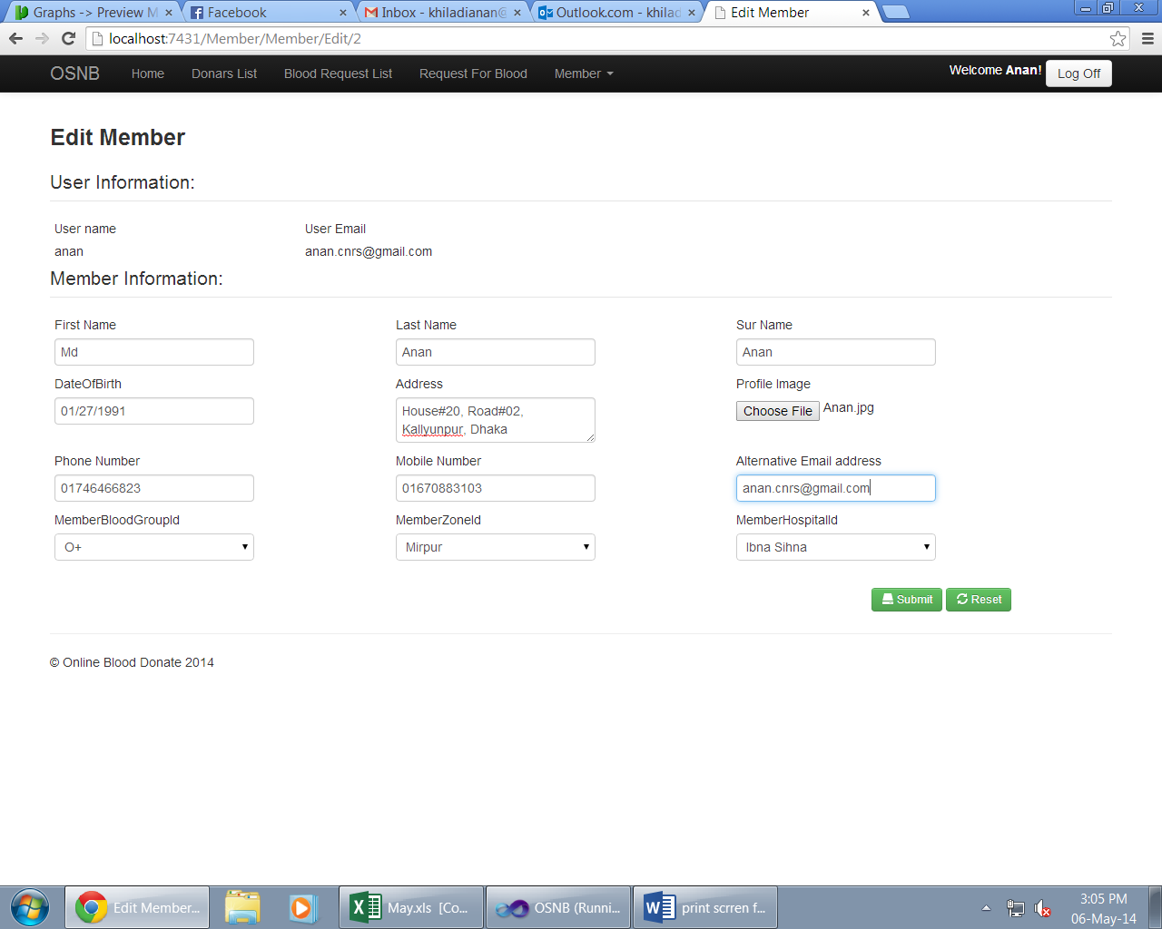
Update Member Info

Slide 22
Search by Blood Group
Have to add a Screen Shot ------------------------- --------------------------------------------------

Slide 23
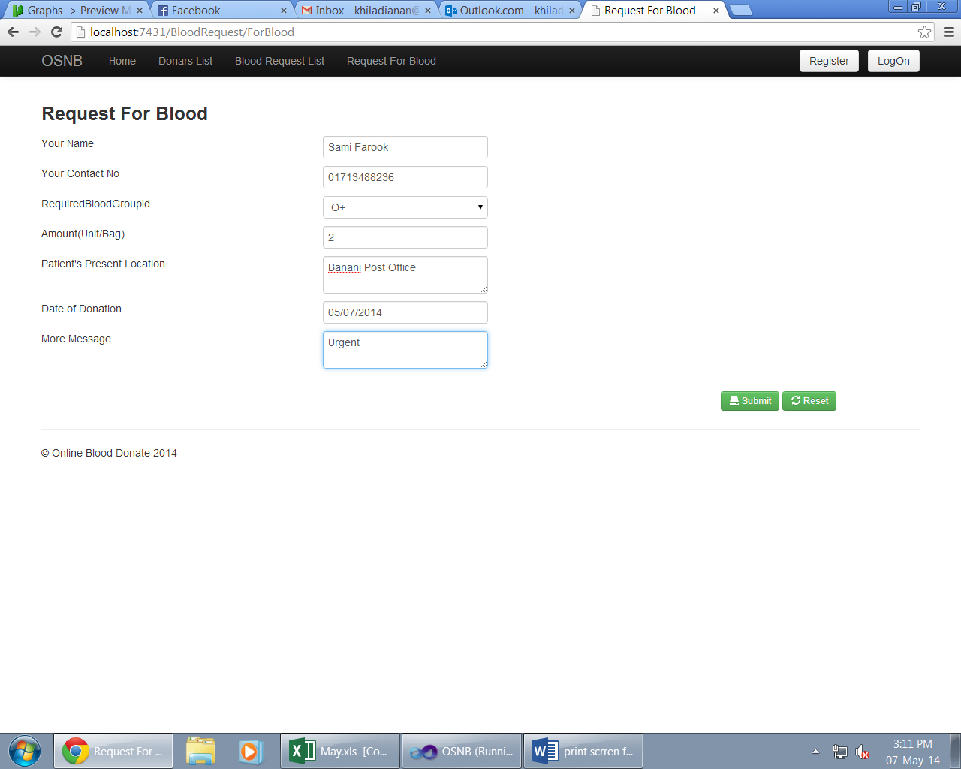
Add a Blood request

Slide 24
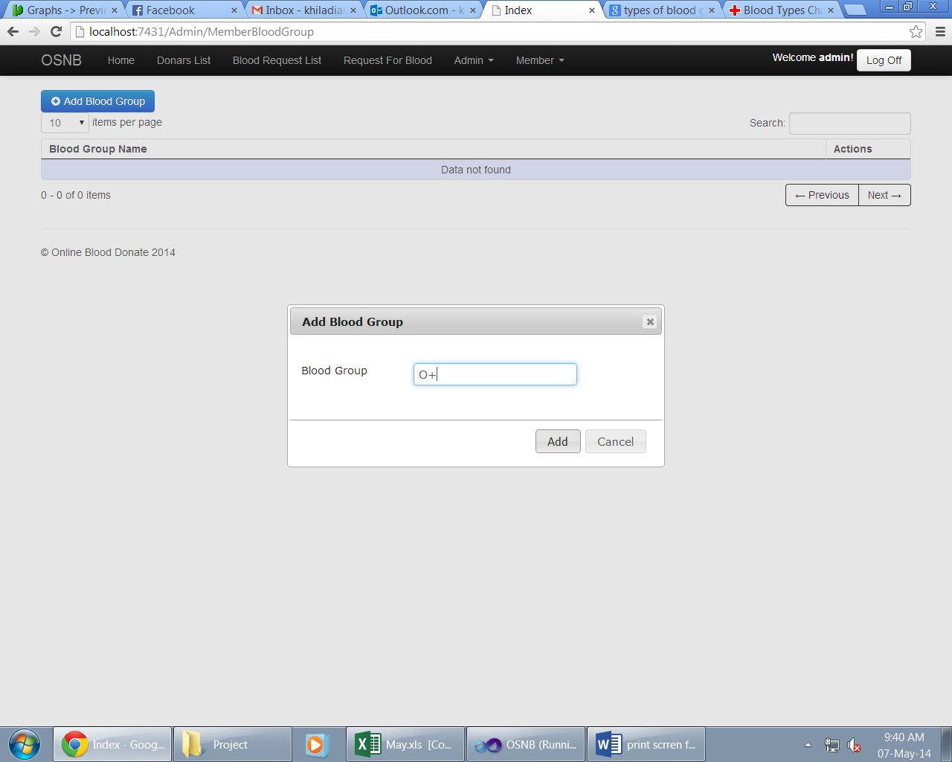
Add a Blood Group

Slide 25
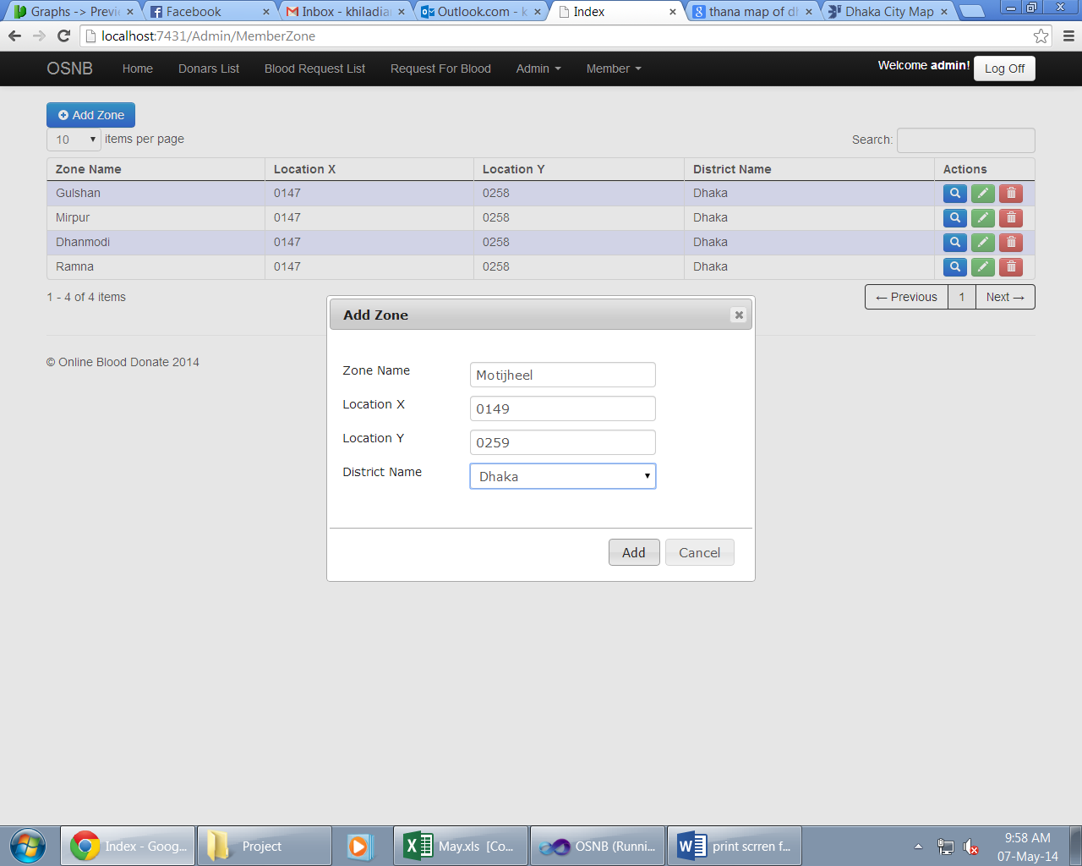
Add a Zone

Slide 26
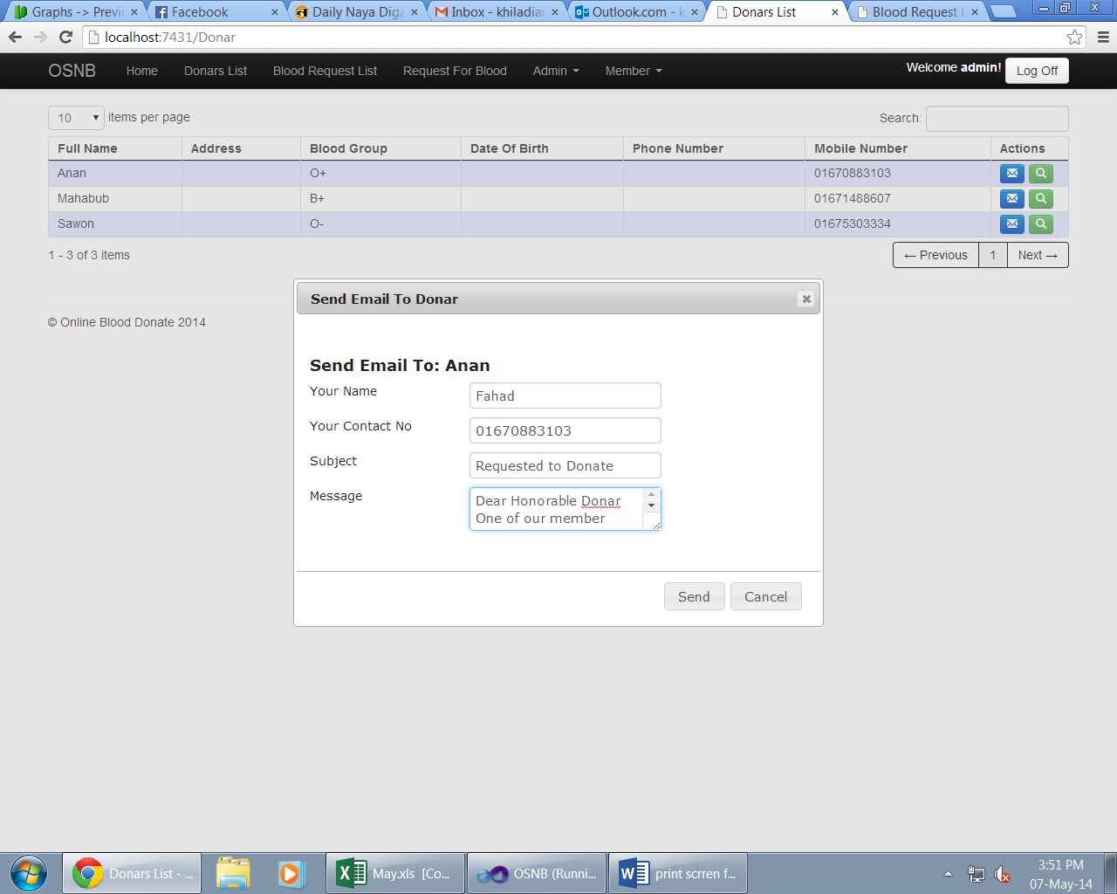
Send a message to Member

Slide 27
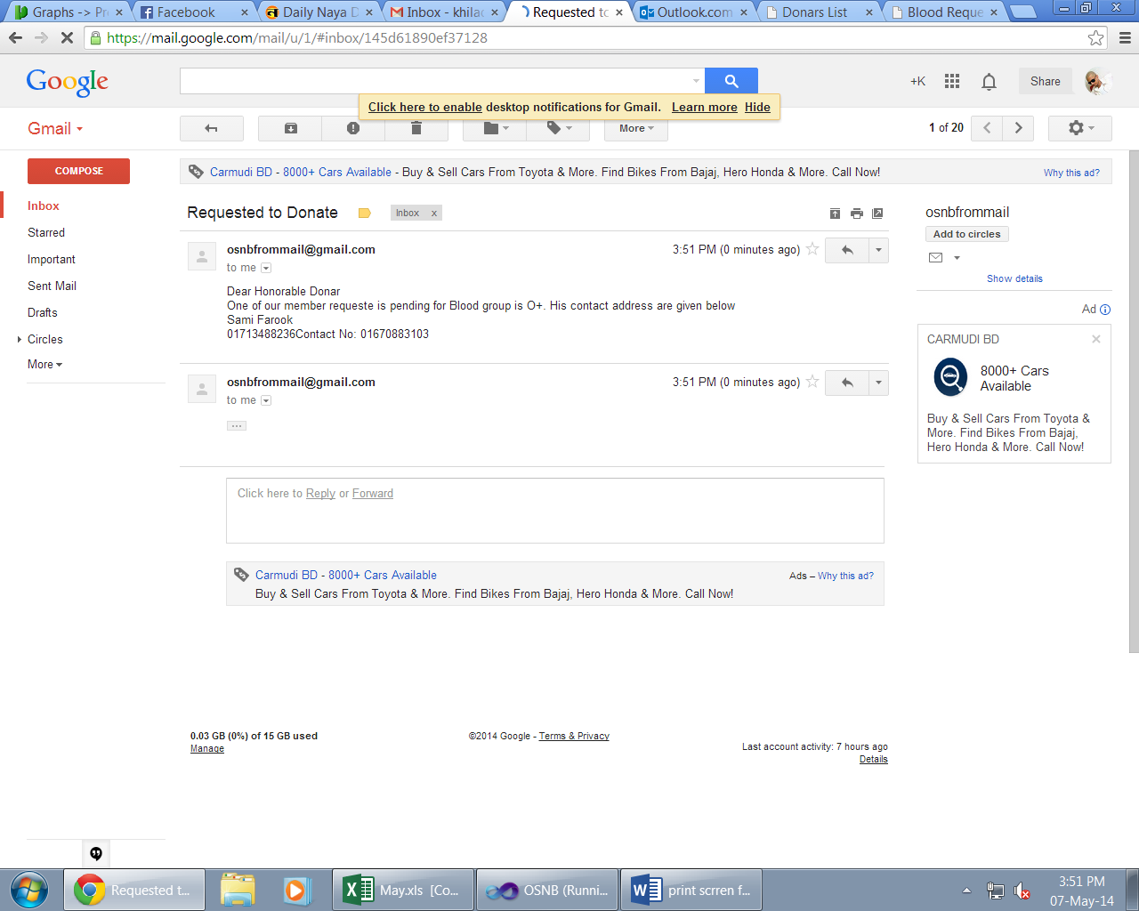
Check given message from Admin

Slide 28
Limitation
Performance: views create the appearance of a table, but the DBMS must still translate queries against the view into queries against the underlying source tables.
Update restrictions: when a user tries to update rows of a view, the DBMS must translate the request into an update on rows of the underlying source tables.
Database is dependence on sql server
Costly being SQL server, Host course.

Slide 29
Overcome the Limitation
Performance: If the view is defined by a complex, multi-table query then simple queries on the views may take considerable time.
Update Restriction: This is possible for simple views, but more complex views are often restricted to read-only.
It may cost being SQL server depenmdence, but it shows higher security like there is out of the box support for authentication, authorization, and various options for implementation with NTLM, Kerberos, and other standards
Being open source program, it can easily editable, accesseble. For this same reasons it reduces cost.

Slide 30
Conclusion
OSNB evaluation project was a very ambitious undertaking. Not only did it entail the implementation of two vastly different prototypes using related, but incompatible technologies, it also entailed the evaluation of these prototypes and – primarily – the interaction scheme of information items the prototypes are intended to visualize. Hence, this project was essentially two projects in one: The implementation portion and the evaluation.

Slide 31
End Of Presentation
Thank You

