Slide 1
Tensorflow
Designing and Building Neural Networks

Slide 2
Outline
About Tensorflow
Building your first ML model - Linear Regression Model
Image Classification in Tensorflow – Transitioning to Functional APIs
Computer Vision in Tensorflow – Training a Multi-Input Siamese Network

Slide 3
About Tensorflow A quick introduction
1: What is Tensorflow?
Created by Google AI
In simple terms, it’s an open source Python library to build and train models using data flow graphs
2: Provides two APIs
Sequential API – useful for simple models
Functional API – useful for complex models
3: Computations in Tensorflow are done using tensors which are multi-dimensional arrays
4: For this session, you should be familiar with the basics of Deep Learning
5: From job perspective, every Data Scientist should have implemented a few deep learning models since interviews are driven on your experience with data science and machine learning
Lots of standard problems like sentiment analysis, image classification etc

Slide 4
Build Your First ML model General Outline
1: Import or Load Data – lots of data available in tfds library or use Data Generators
2: Data Preparation/Cleaning - depends on the data
In NLP tasks, we can use nltk, beautifulSoup etc to clean data
For Computer Vision Tasks, we can use data augmentation techniques to reduce overfitting
3: Define model hyperparameters like learning rate etc – need to tune those during training
4: Define model architecture – consists of one or more layers
5: Specify training configuration like loss function, optimizer etc with model.compile()
6: Train the model using model.fit()
7: Evaluate the model

Slide 5
Build Your First ML model A Brief About the Various Layers
1: Flatten Layer – Converts a 2-dimensional input to 1-dimensions
2: Dense Layers – A layer of neurons
3: Convolutional Layers – applies a set of filters to learn complex features
4: MaxPool Layers – usually followed by Convolutional Layers. Highlights the dominant features
5: LSTM Layers – Useful for textual data. Takes into account context of the words while learning
6: Lambda Layer – Used to execute arbitrary expressions as a Layer
7: Embedding Layers – Contains vector representation of words in vocabulary
8: We can also design Custom Layers

Slide 6
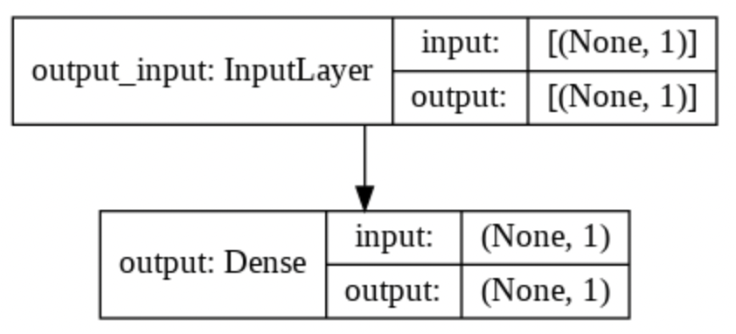
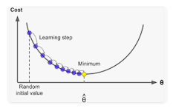
Build Your First ML model Linear Regression
1: With Linear Regression, we learn a linear model through data by minimizing loss function
2: Model Architecture: Contains one dense Layer
3: What does an optimizer do
Optimizers minimize the loss value based on gradient
4: Loss function: Mean-Squared Error
Loss function should be chosen such that it’s high when model
prediction is not accurate and should be low when model is accurate

Slide 7
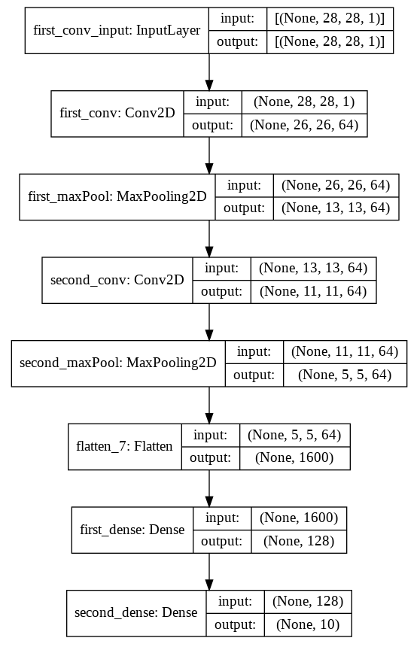
Transitioning to Functional APIs Image Classification
1: In Image Classification problems, we train a model to
predict the label of each test image
2: Model Architecture:
Usually a combination of CNN, Dense Layers
Depends on data size and complexity
Number of parameters: 2,43,786
3: Functional API:
Contains three parts: Input Layer, Deep Network, Model Definition

Slide 8
Sequential API vs Functional API
Sequential APIs are simpler and easier to implement
Sequential APIs allows us to create models layer-by-layer by stacking them
Sequential API doesn’t offer flexibility. It’s very difficult to implement complex models involving multiple inputs/outputs or shared layers
Functional APIs offers more flexibility. We can connect any layer to any other layer
For those familiar with OOPS concepts, Model Subclassing is another technique which offers even more flexibility than Functional APIs

Slide 9
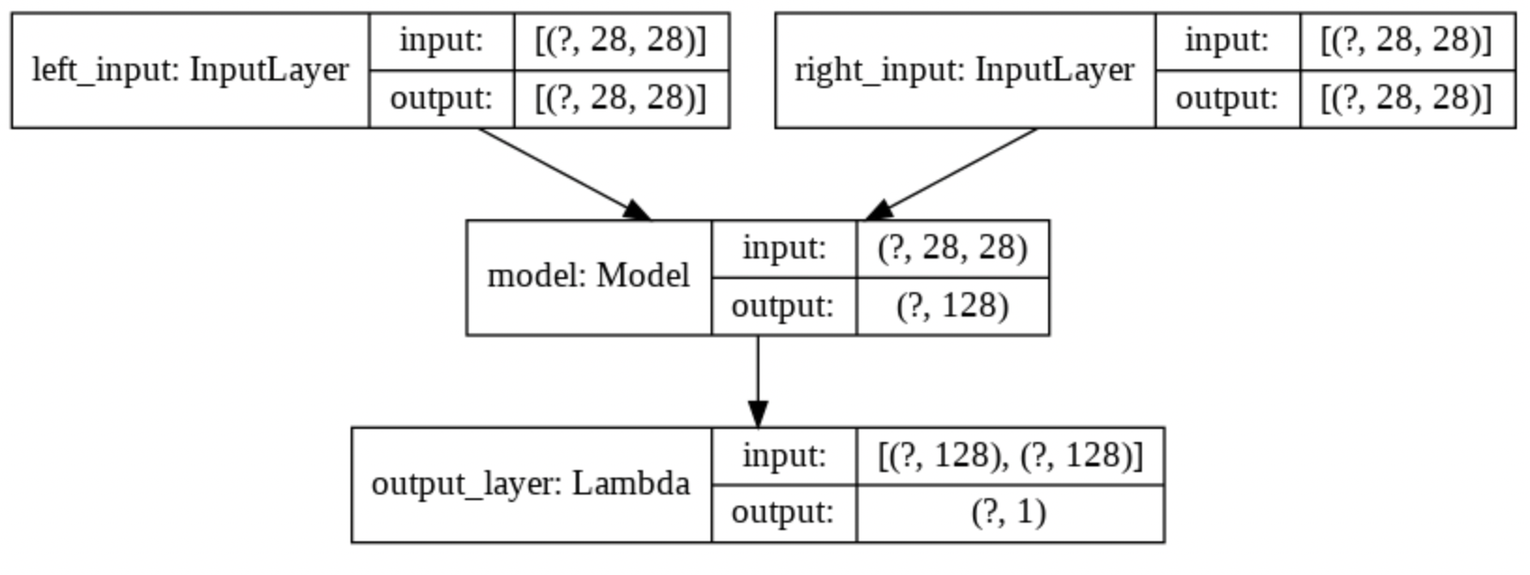
Multi-input Siamese Network Image Similarity
1: A brief on Siamese Network:
A neural network that consists of multiple inputs
Weights are shared between those inputs
Useful to predict the similarity of inputs
2: Loss function: contrastive loss
If pairs are from same class, will try to minimize the Euclidean distance
If pairs are from difference class, will try to maximize the Euclidean distance
3: Optimizer: RMSprop()
It’s an adaptive optimizer
Another popular options is Adam() optimizer
y_true | y_pred | Loss value
1 | 1 | 0
 | 0 | 1
0 | 1 | 1
 | 0 | 0

Slide 10
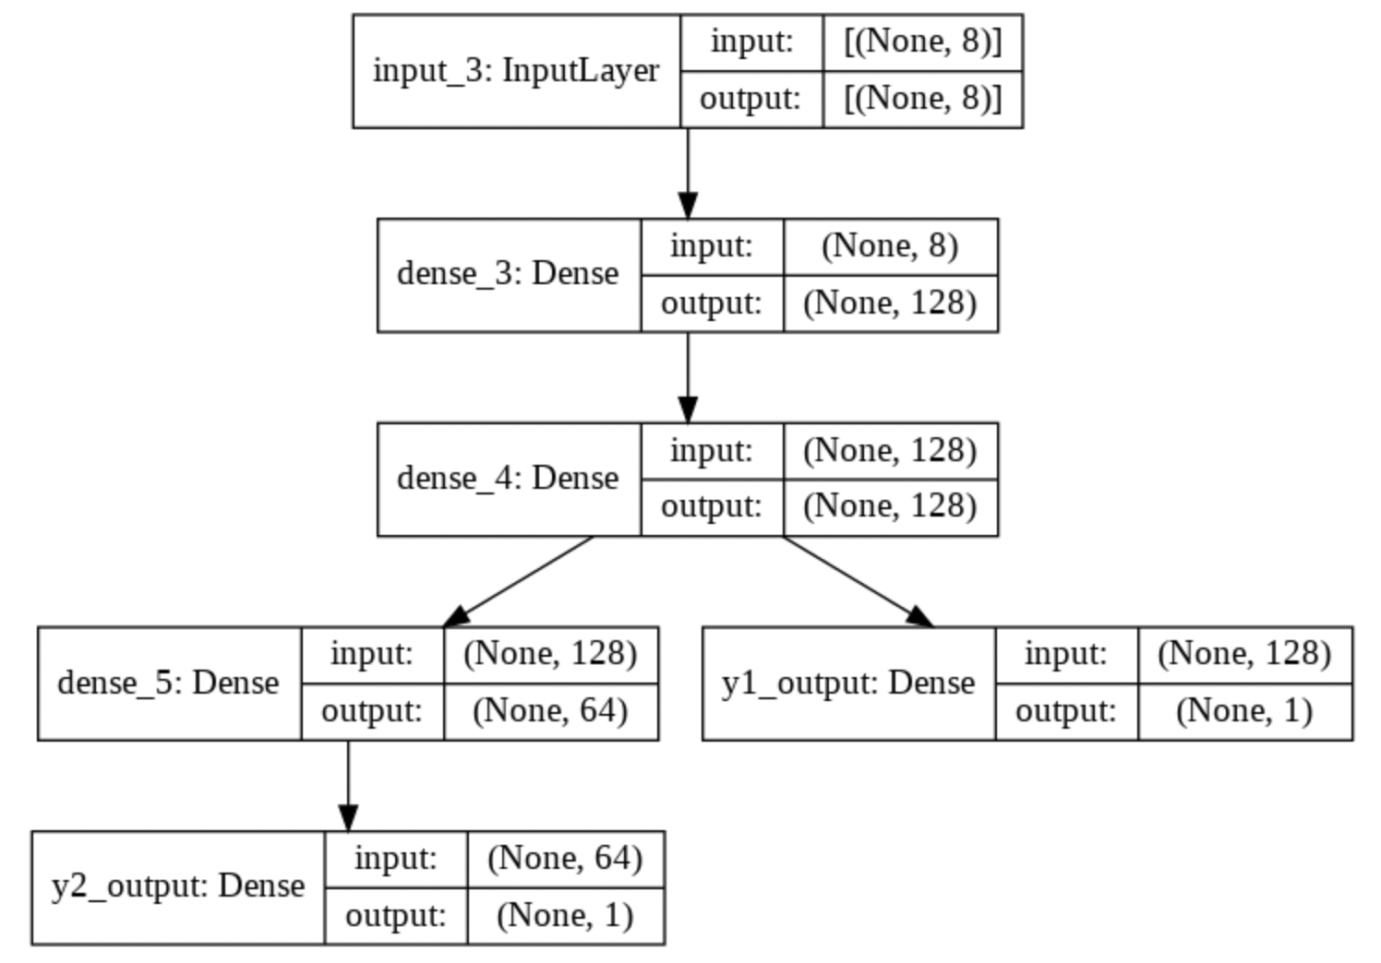
Multi-output Network
1: Applications in Object Segmentation/Localization problems
First output gives the object category – classification problem
The other output gives object location – LR model
2: Model architecture
We will use Functional APIs to build the model

Slide 11
Next Steps
Explore the world of Deep Learning
Train a few models yourself
Get familiar with Model Subclassing
Read about Data Generators
Train models using Transfer Learning
Participate in Data Science competitions

Slide 12
Thanks

