Slide 1


Slide 2


Slide 3


Slide 4


Slide 5


Slide 6
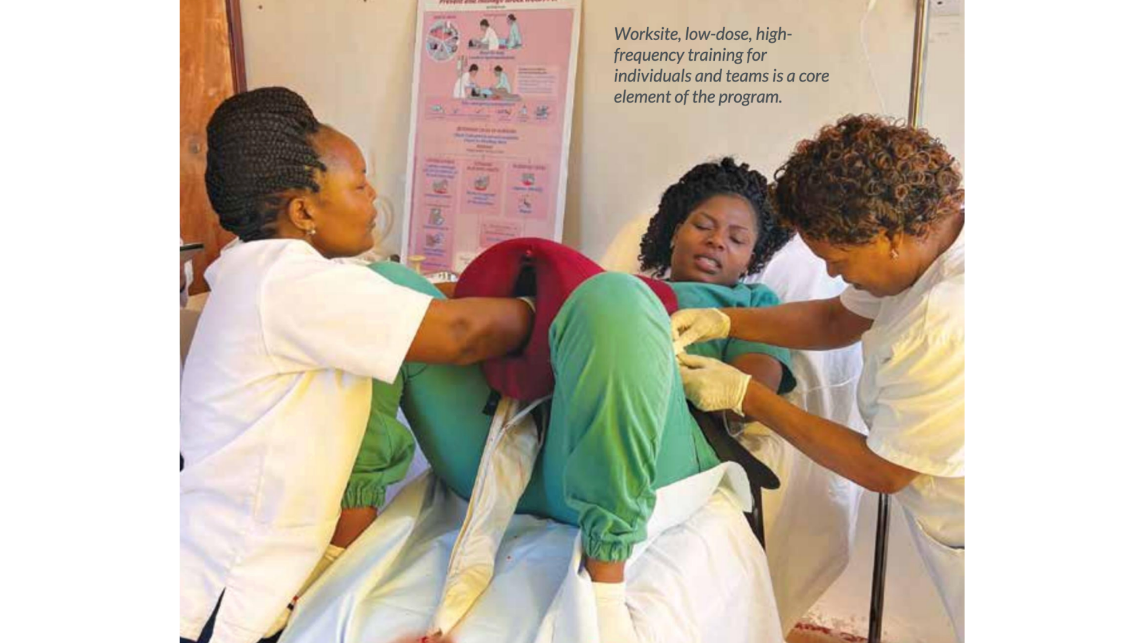

Slide 7


Slide 8
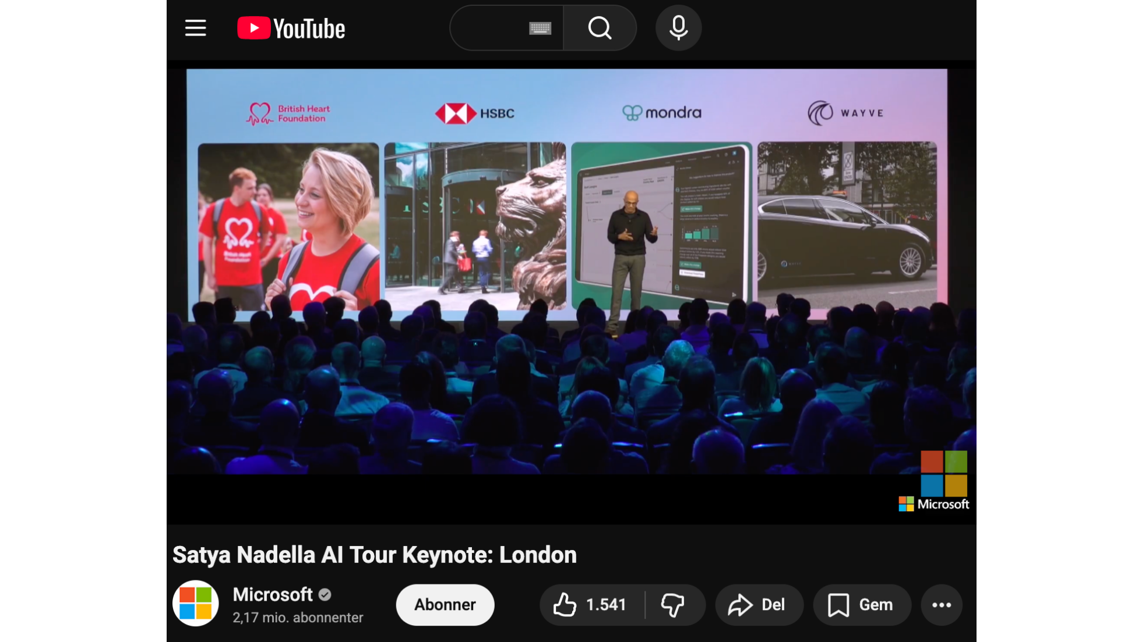

Slide 9


Slide 10
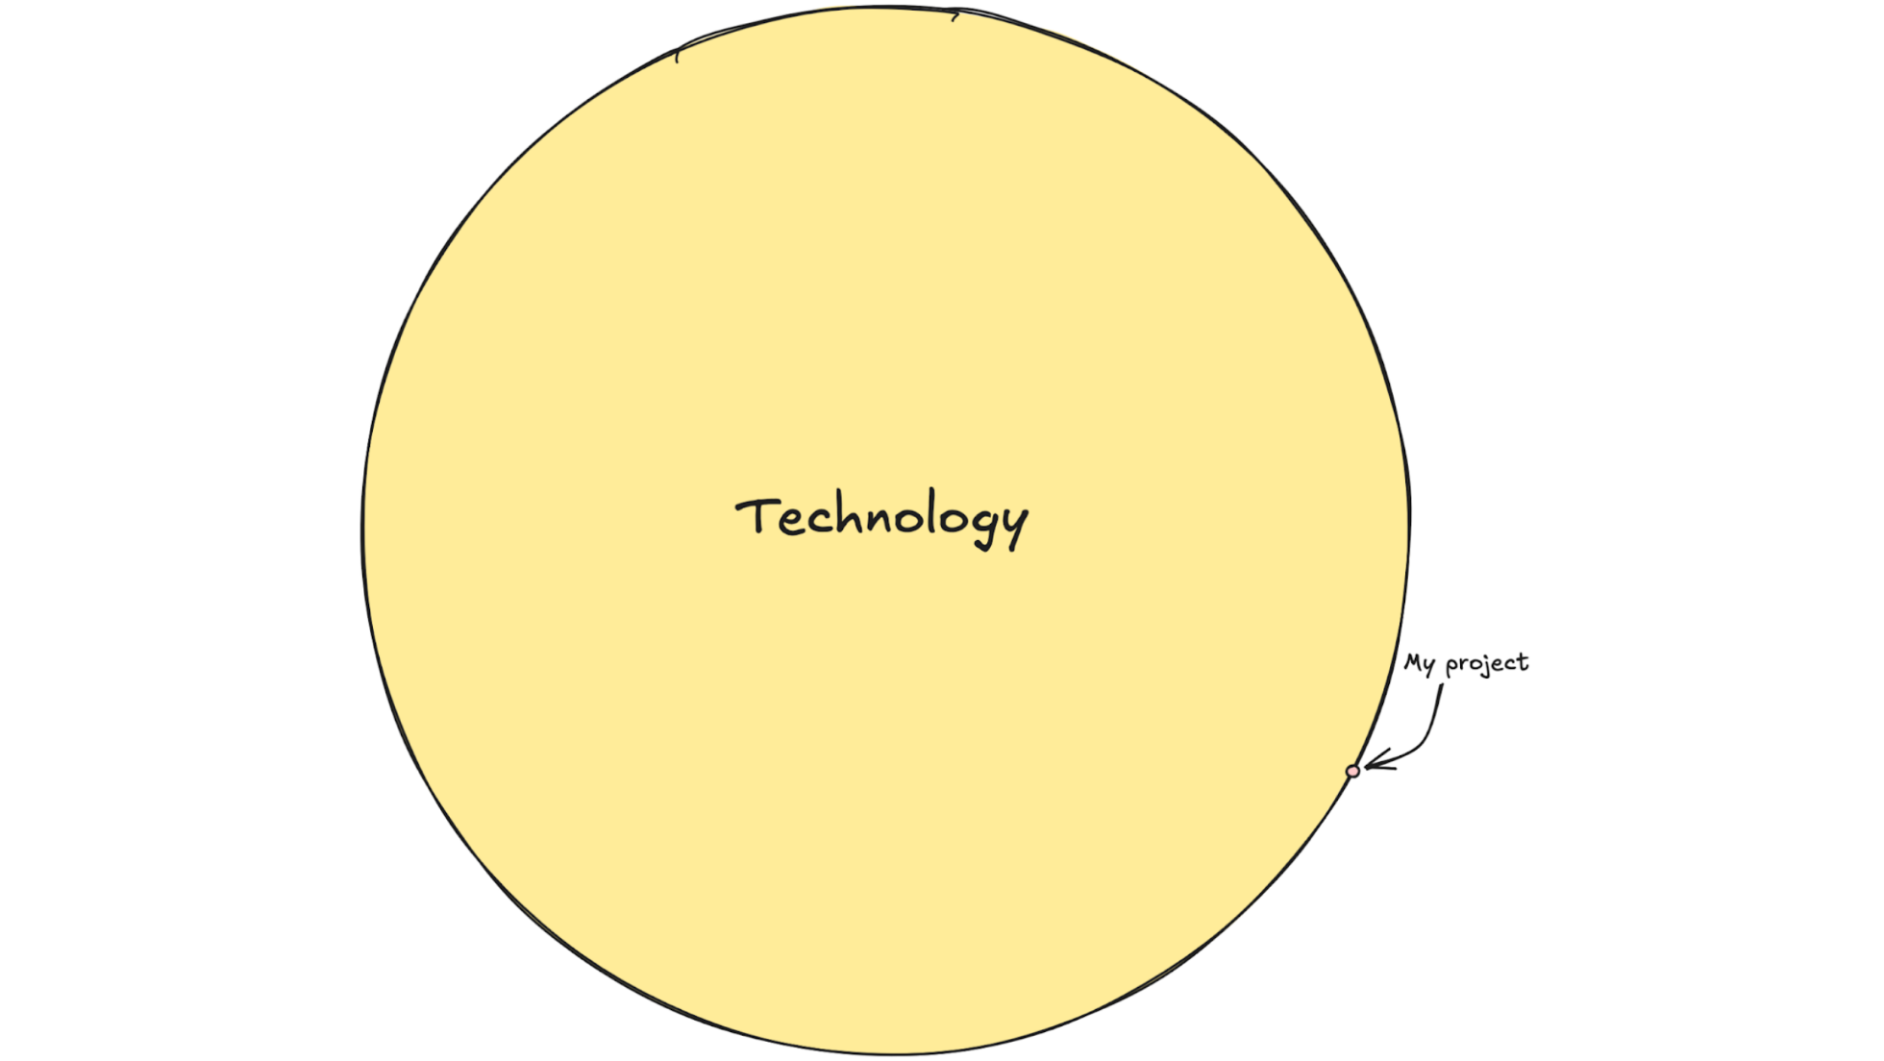

Slide 11


Slide 12


Slide 13
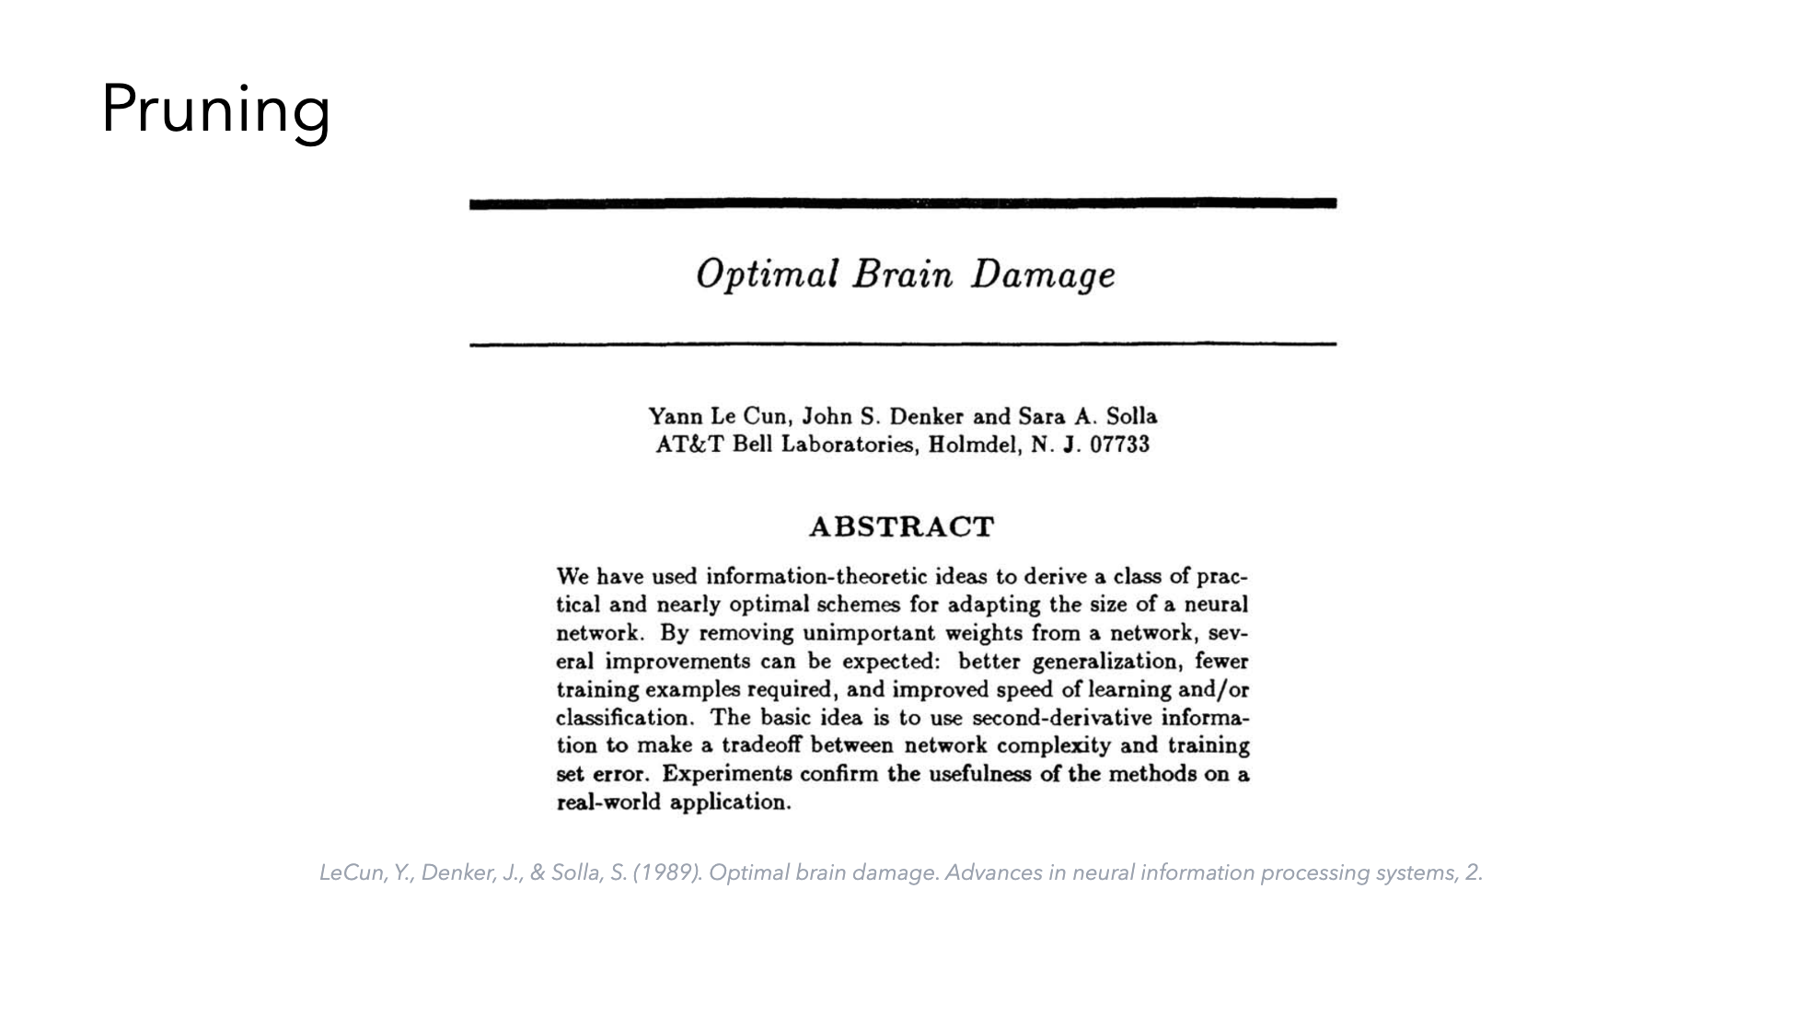

Slide 14
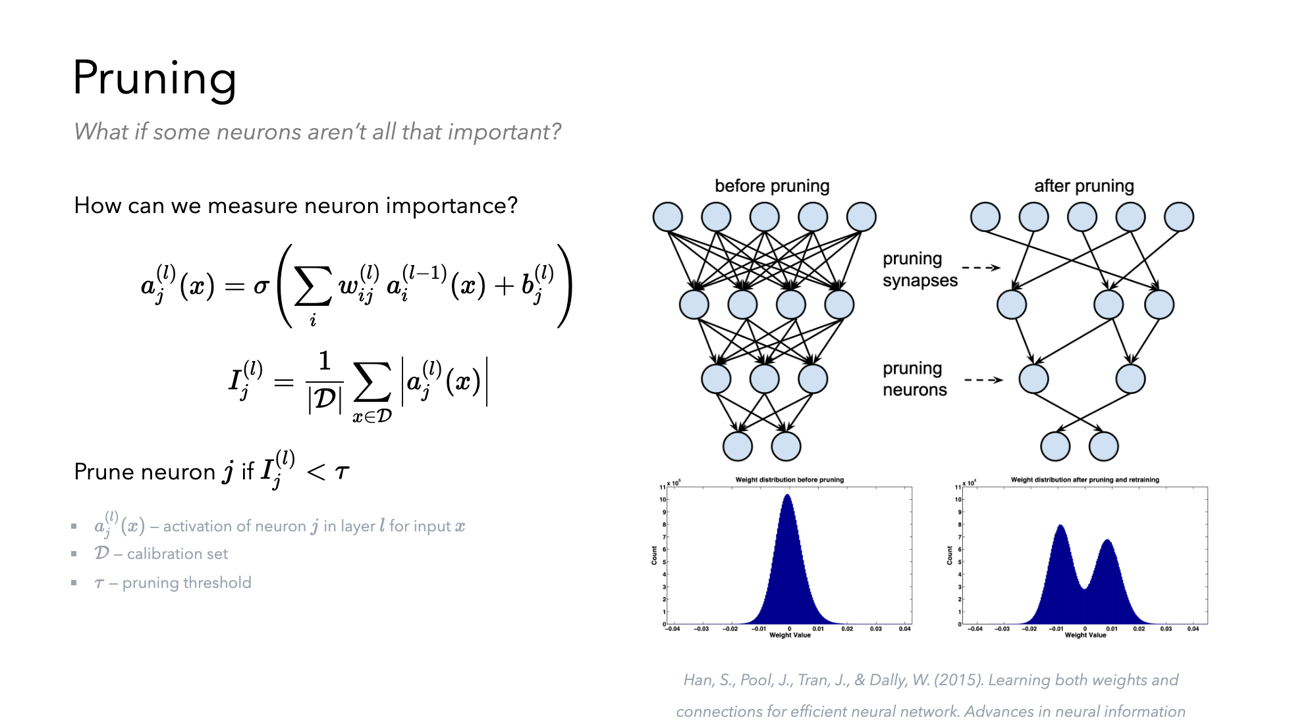

Slide 15
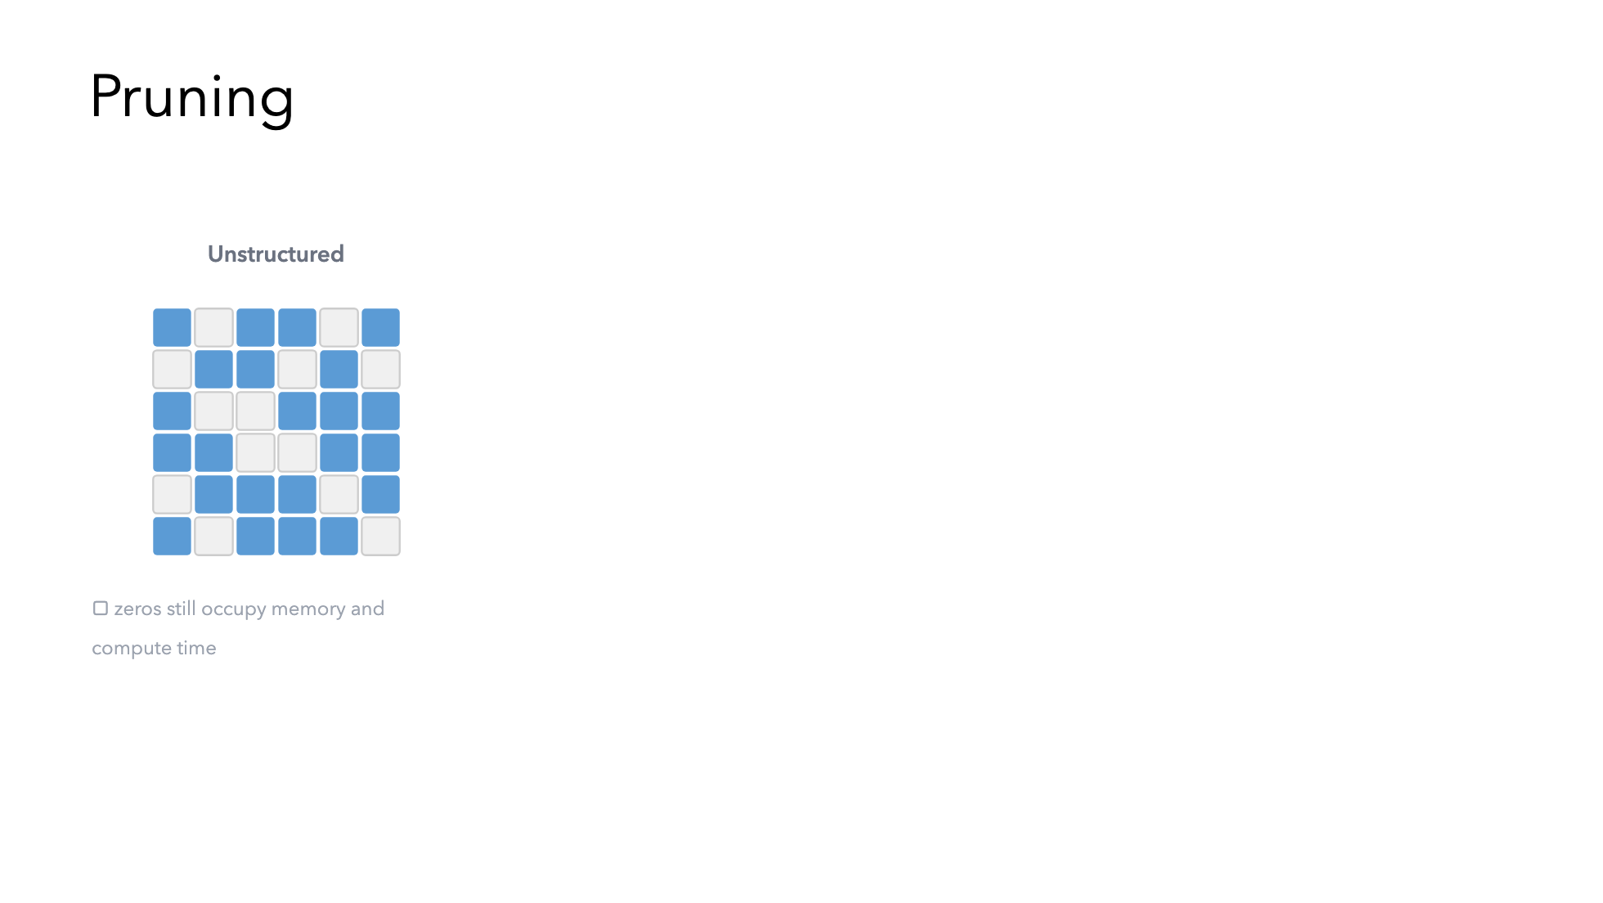

Slide 16
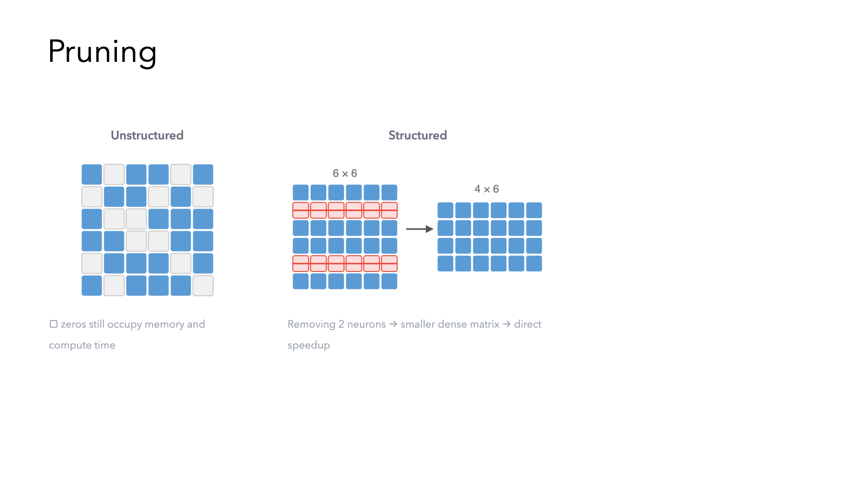

Slide 17
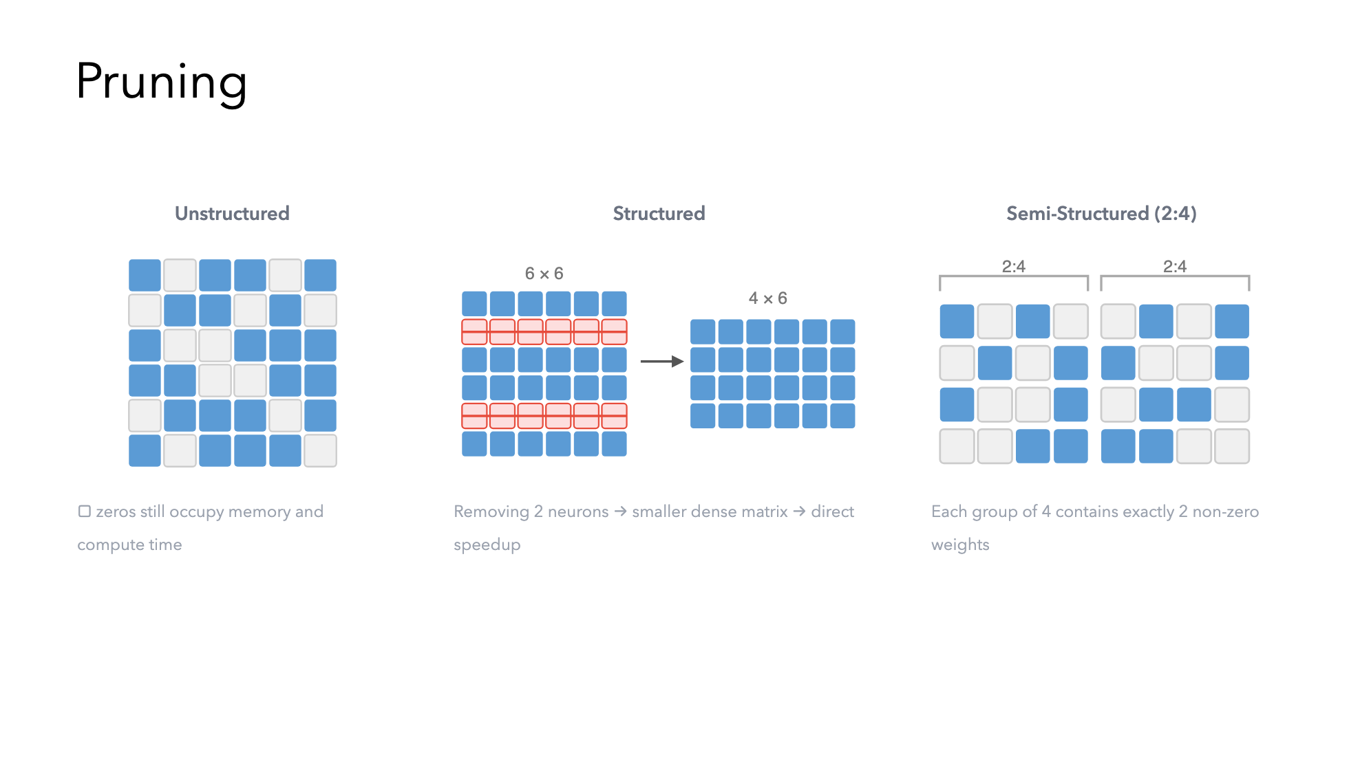

Slide 18
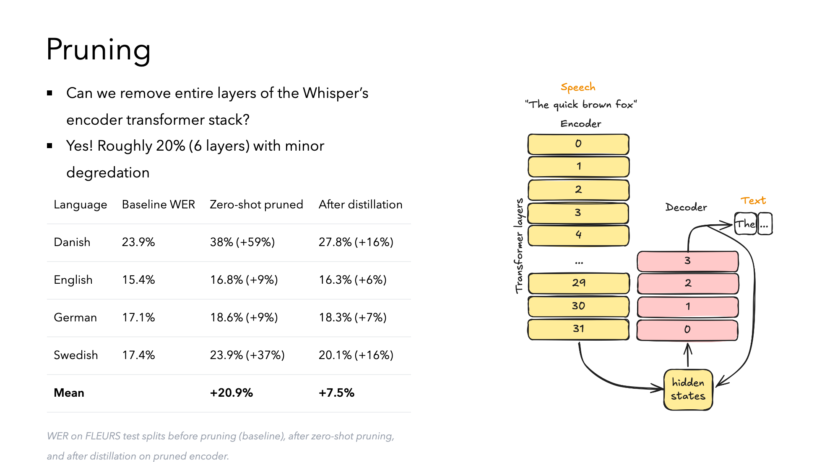

Slide 19


Slide 20


Slide 21
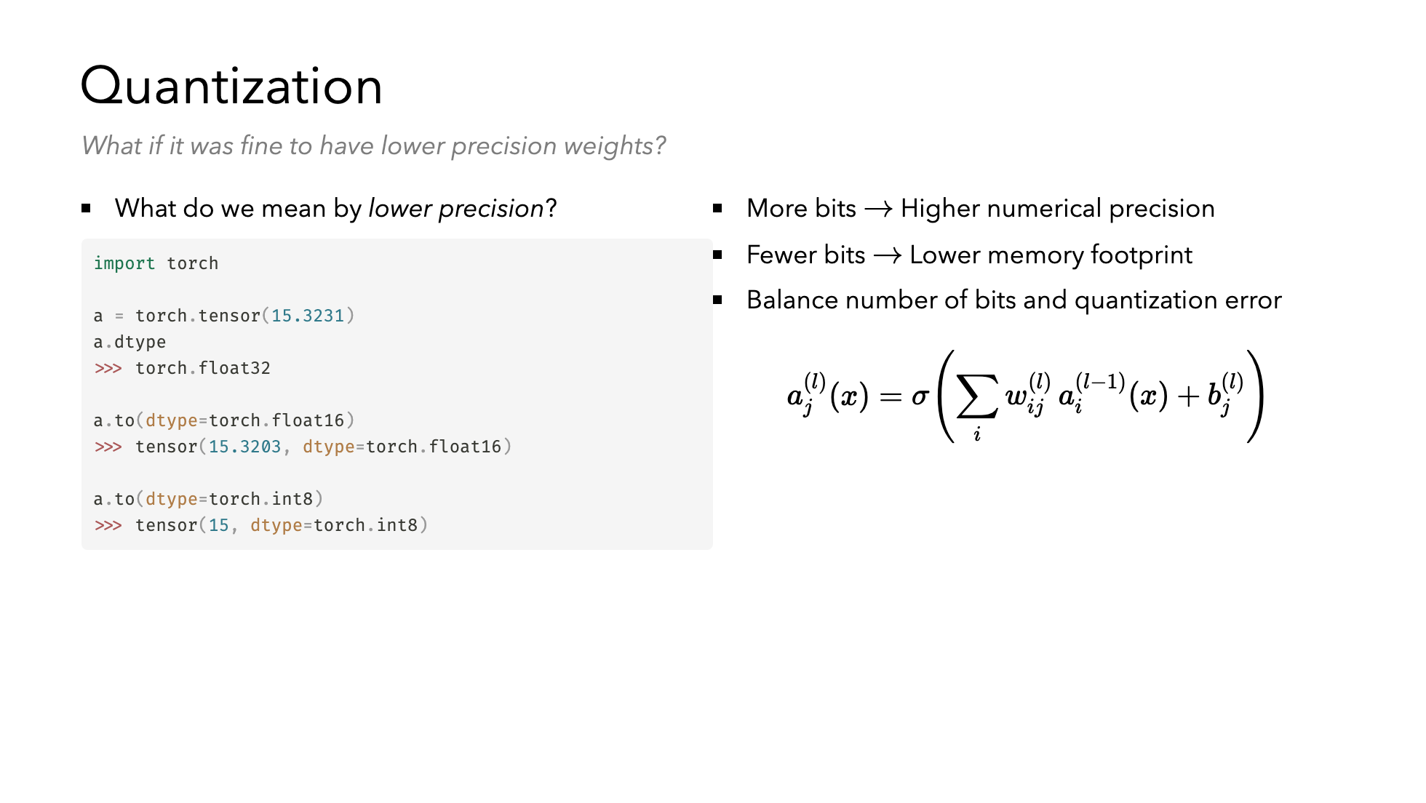

Slide 22
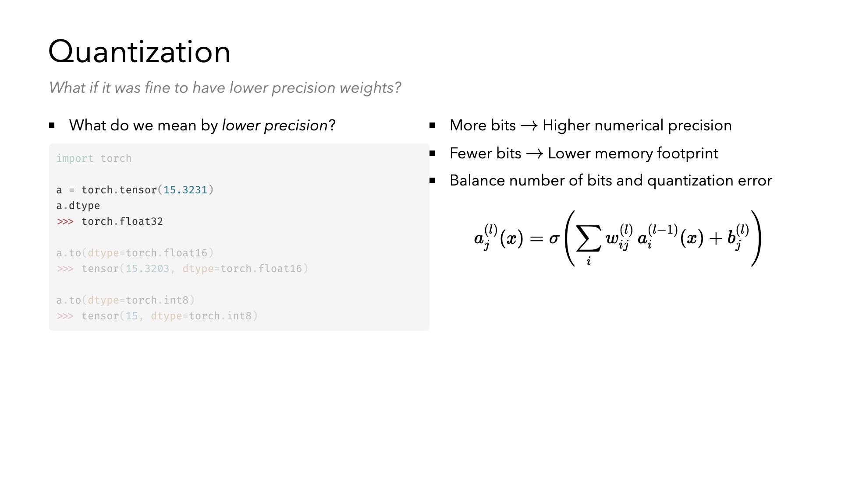

Slide 23
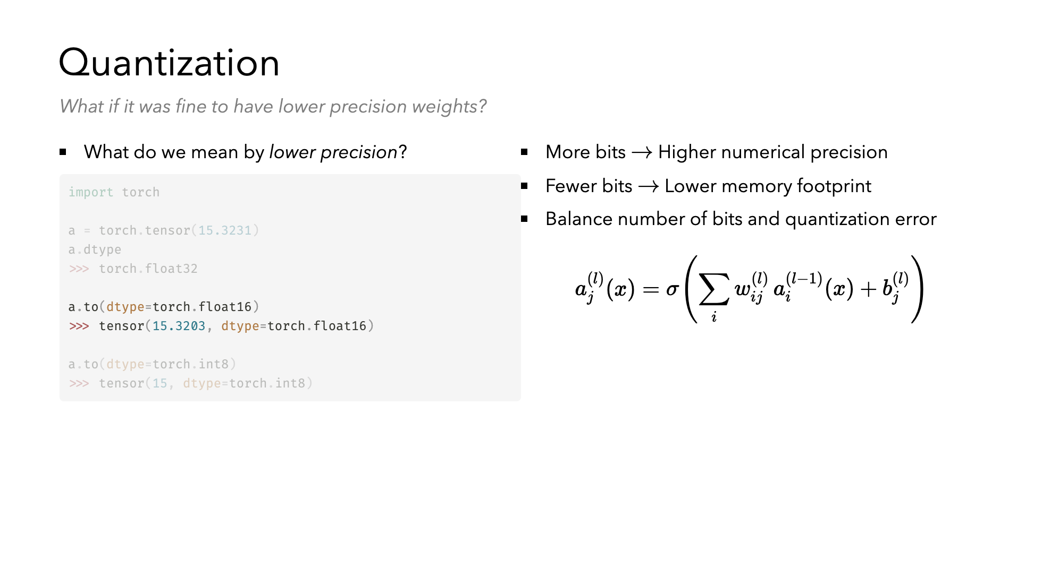

Slide 24
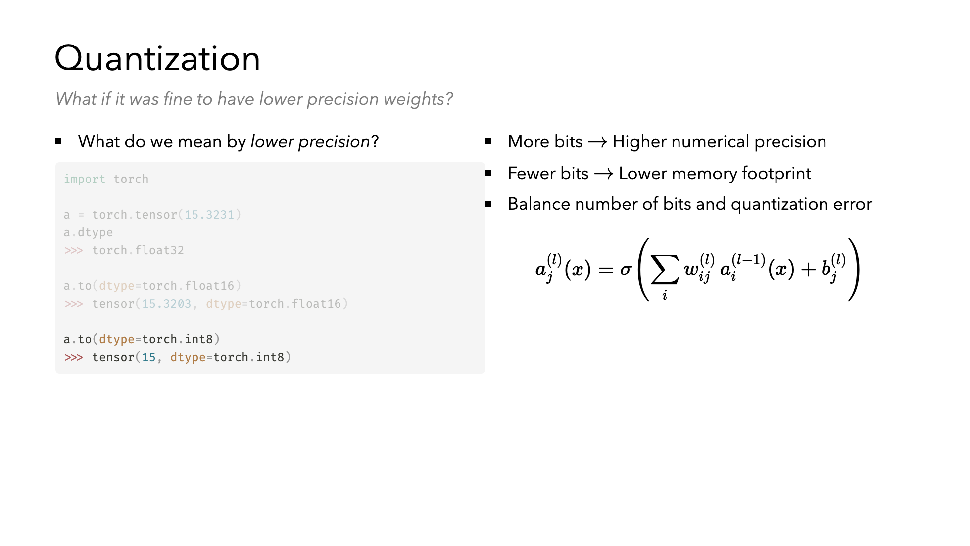

Slide 25
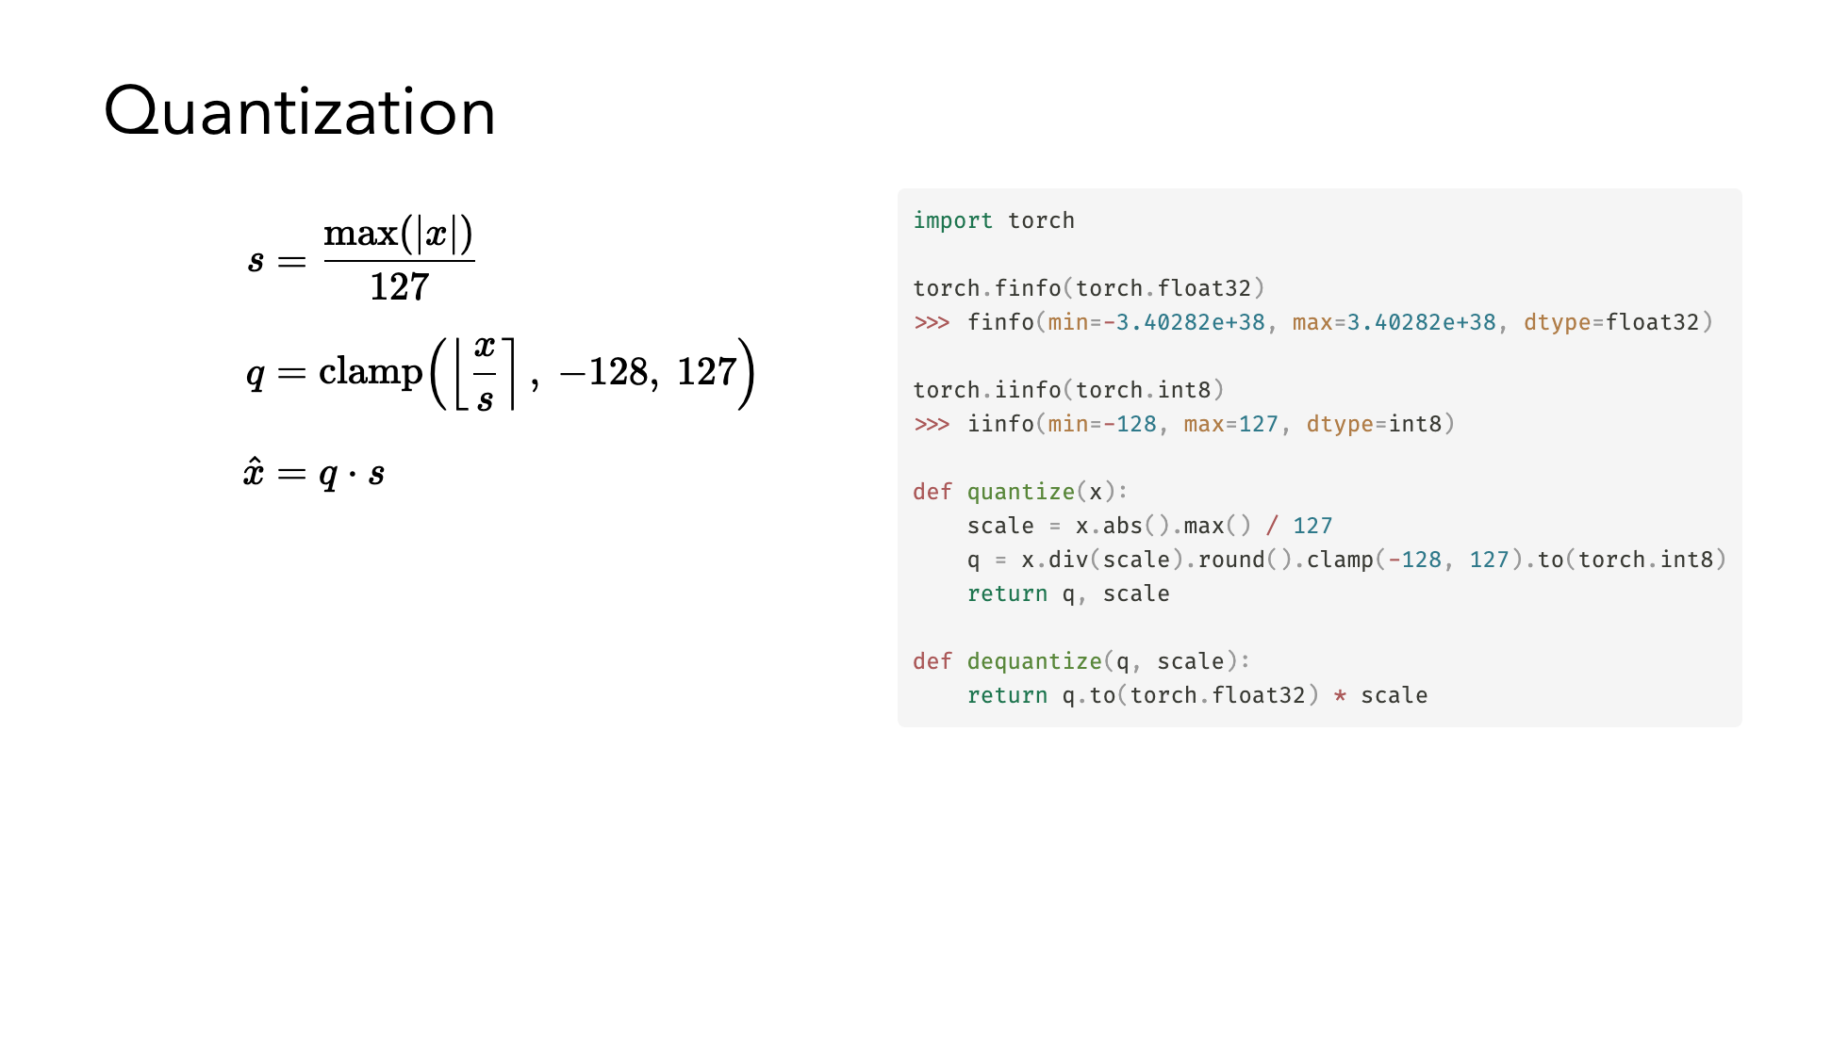

Slide 26
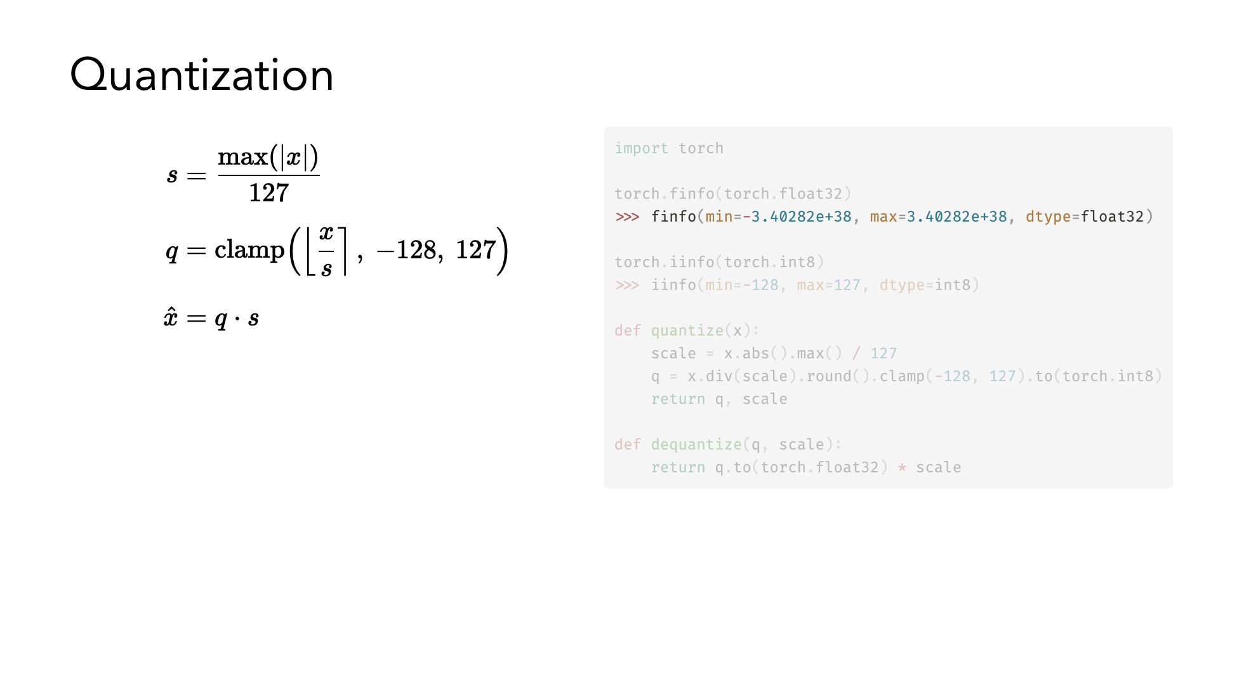

Slide 27
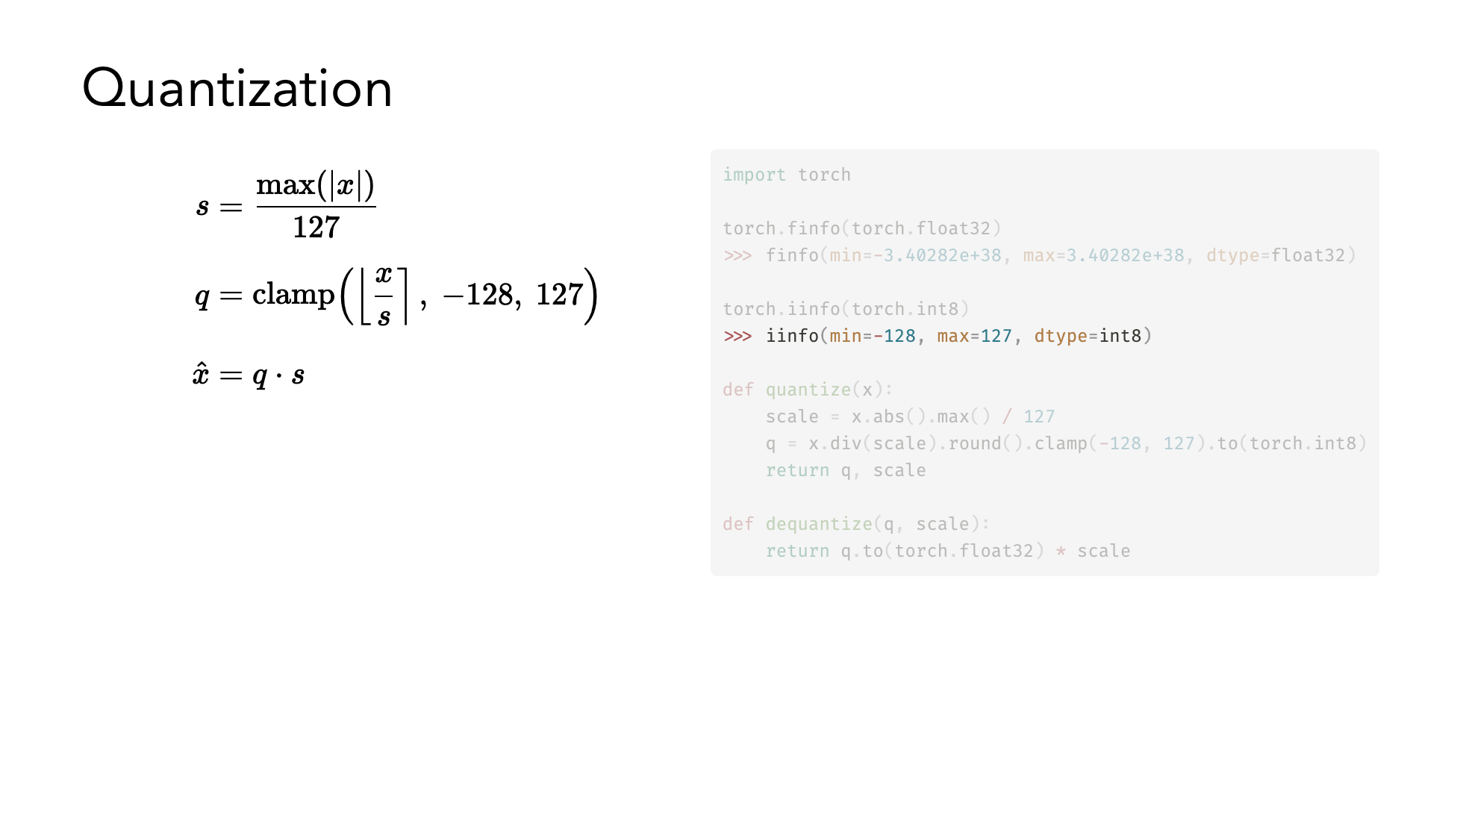

Slide 28
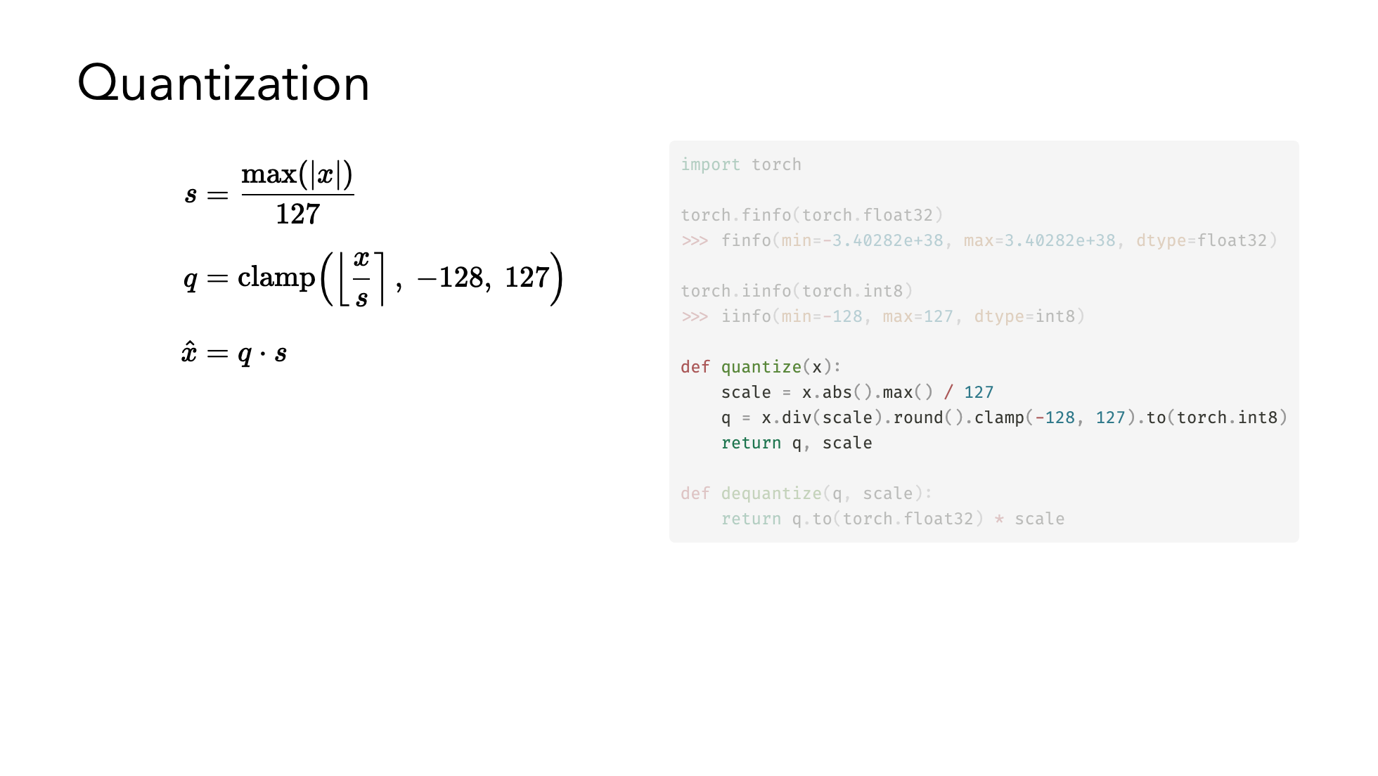

Slide 29
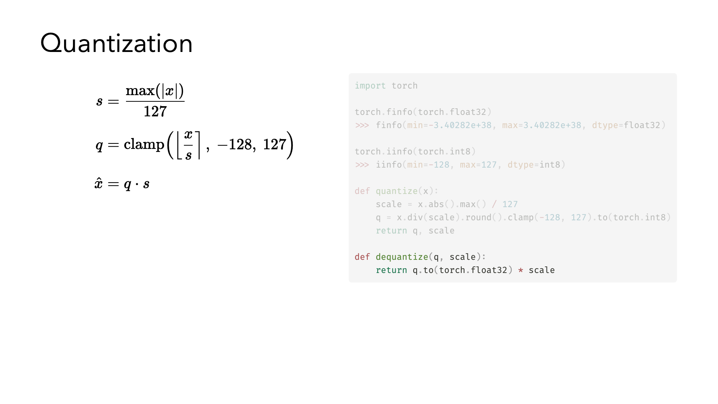

Slide 30
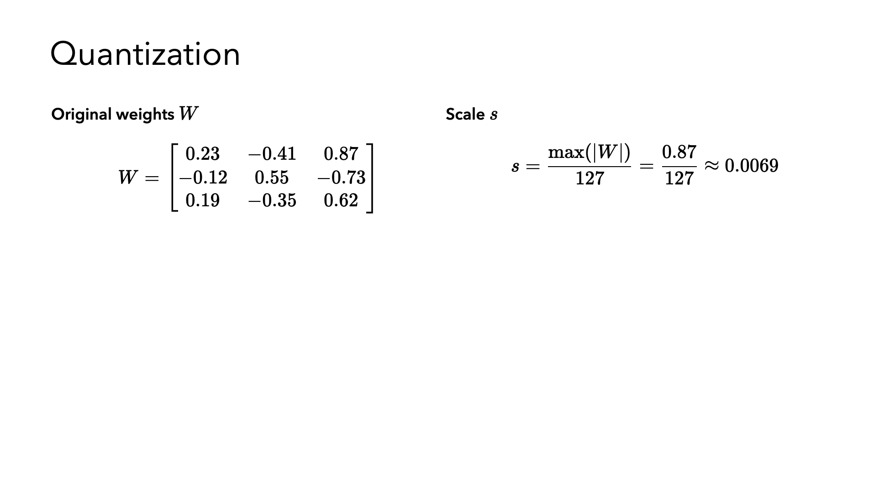

Slide 31
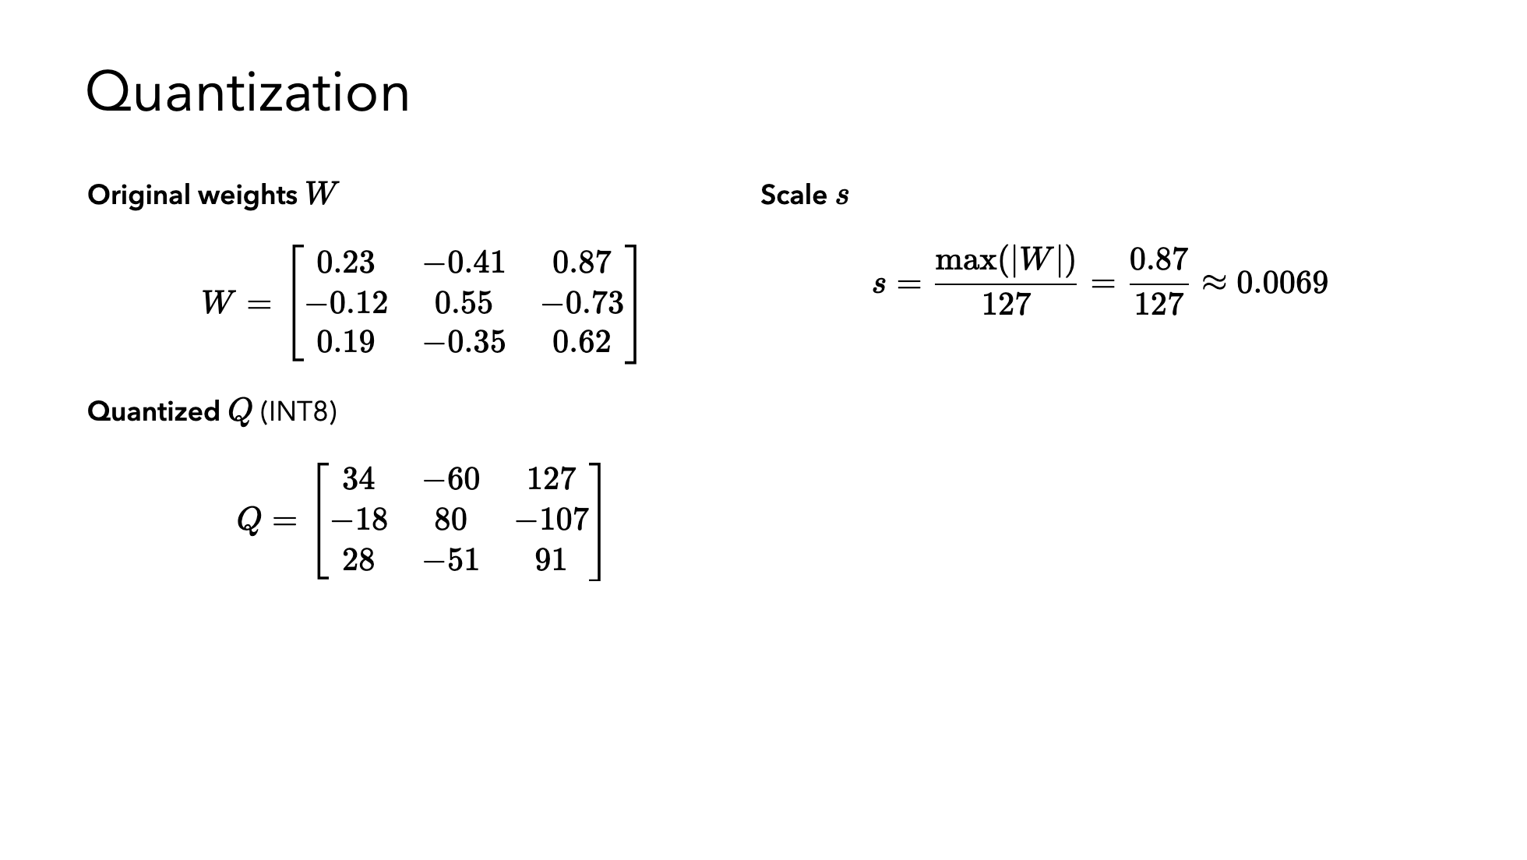

Slide 32
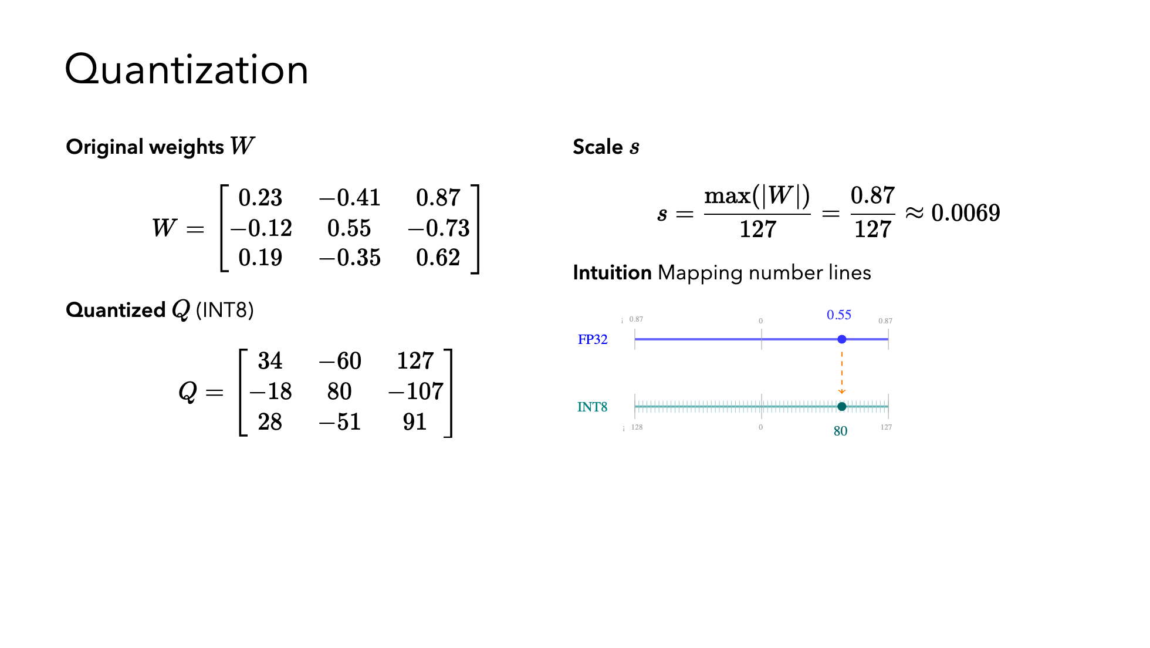

Slide 33
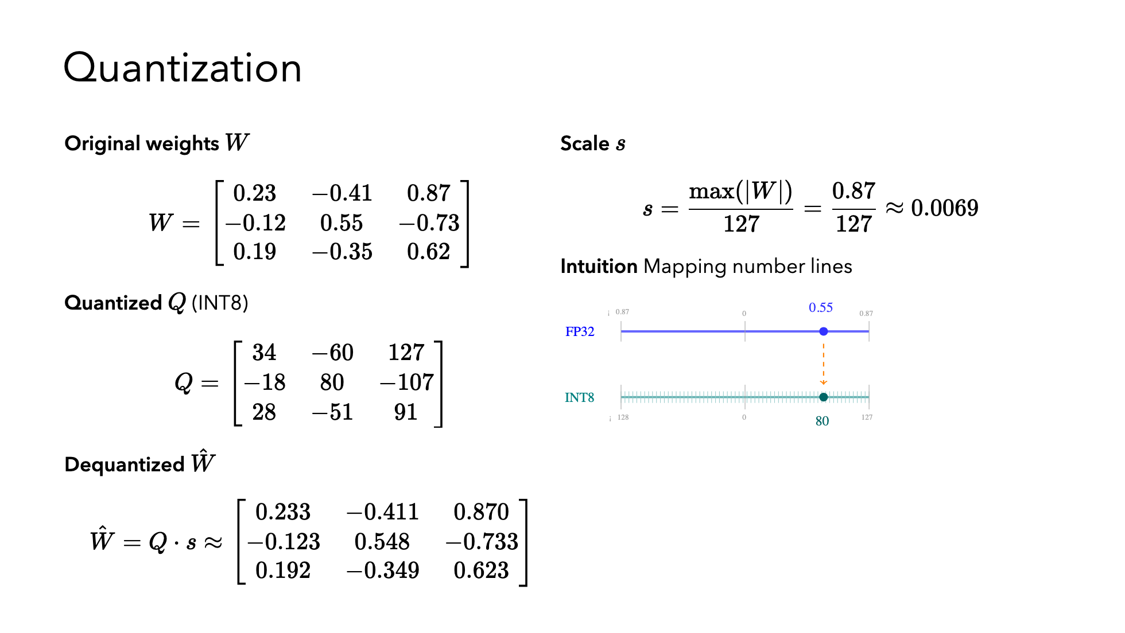

Slide 34
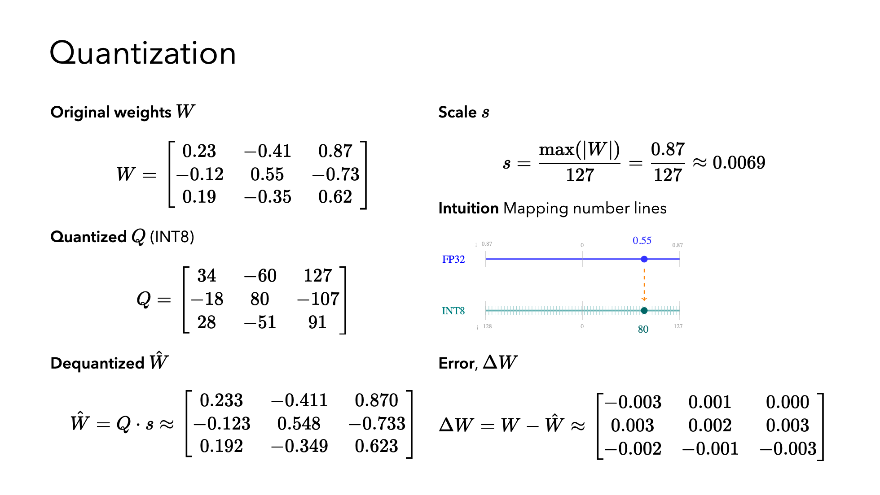

Slide 35
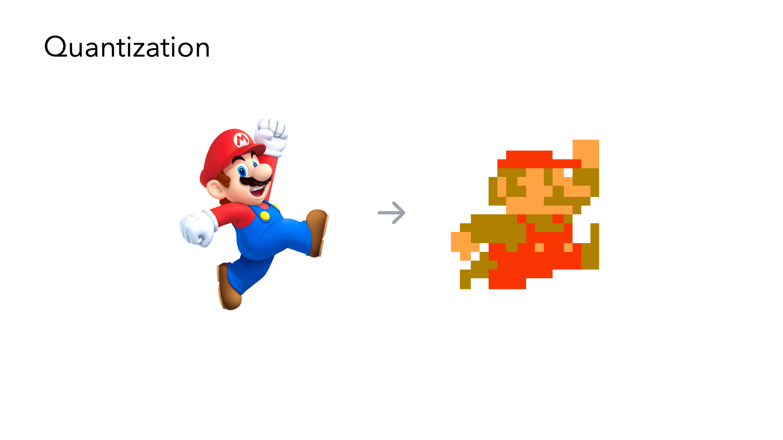

Slide 36
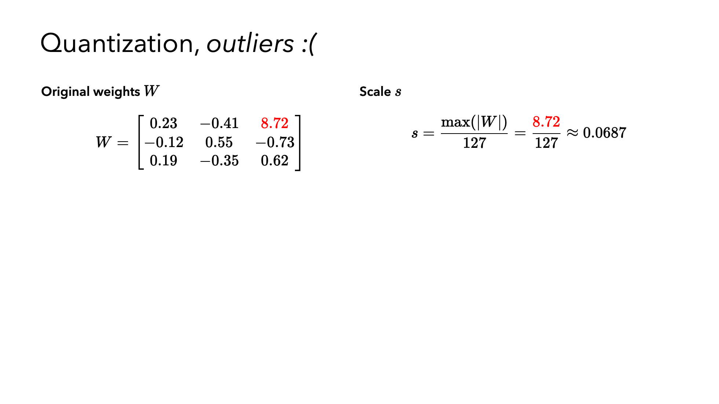

Slide 37
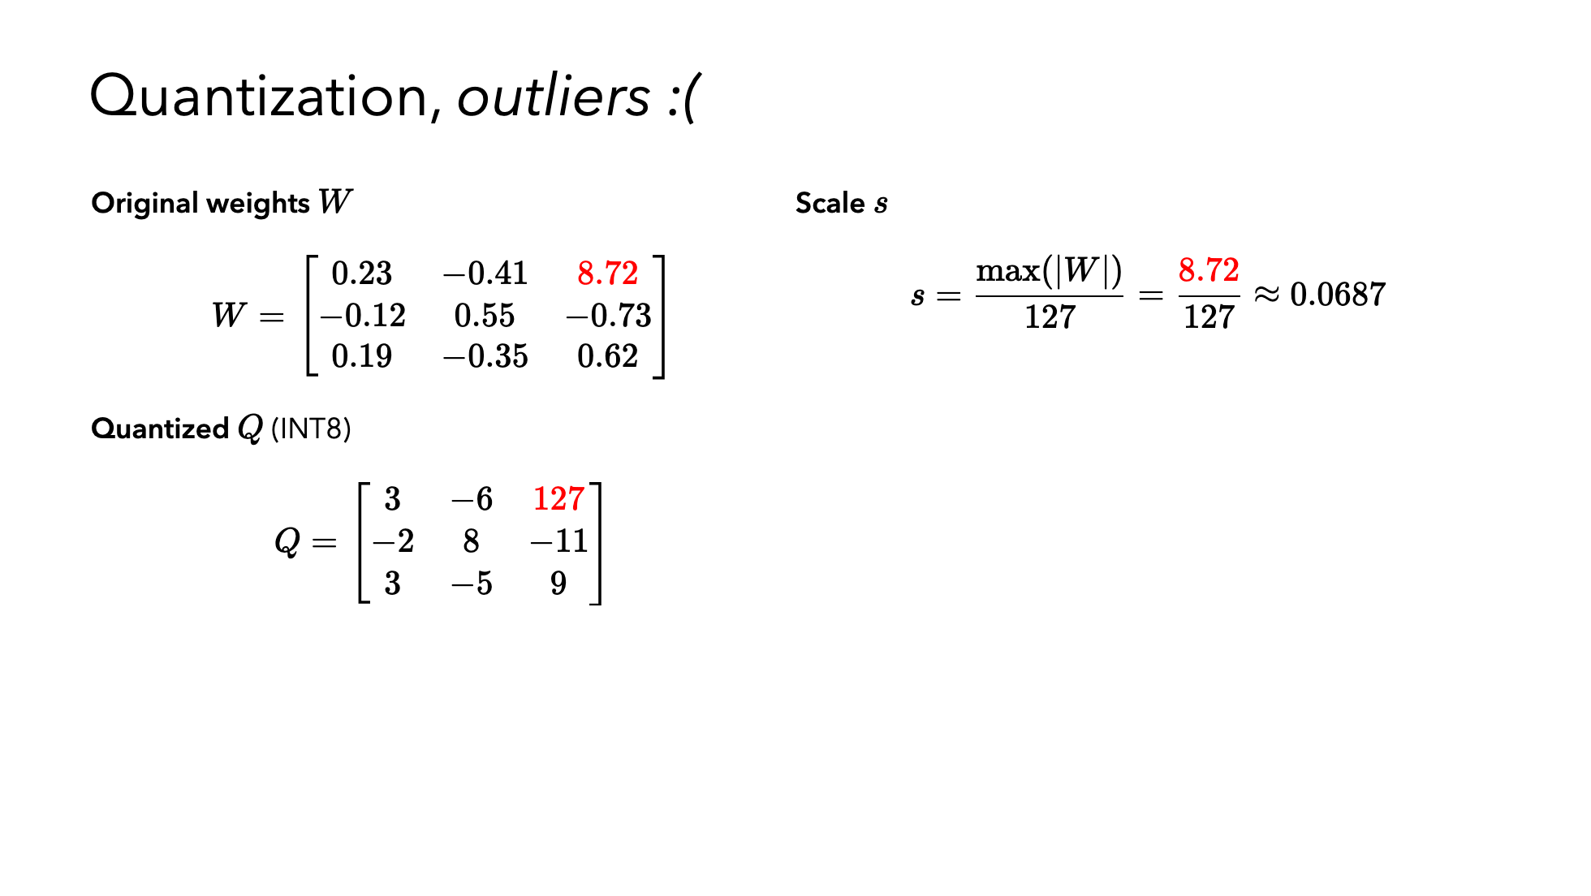

Slide 38
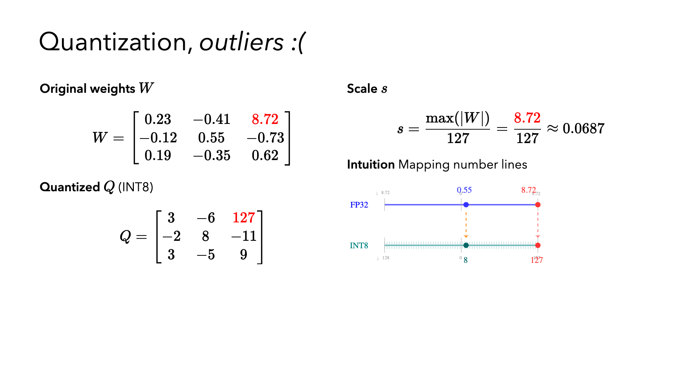

Slide 39
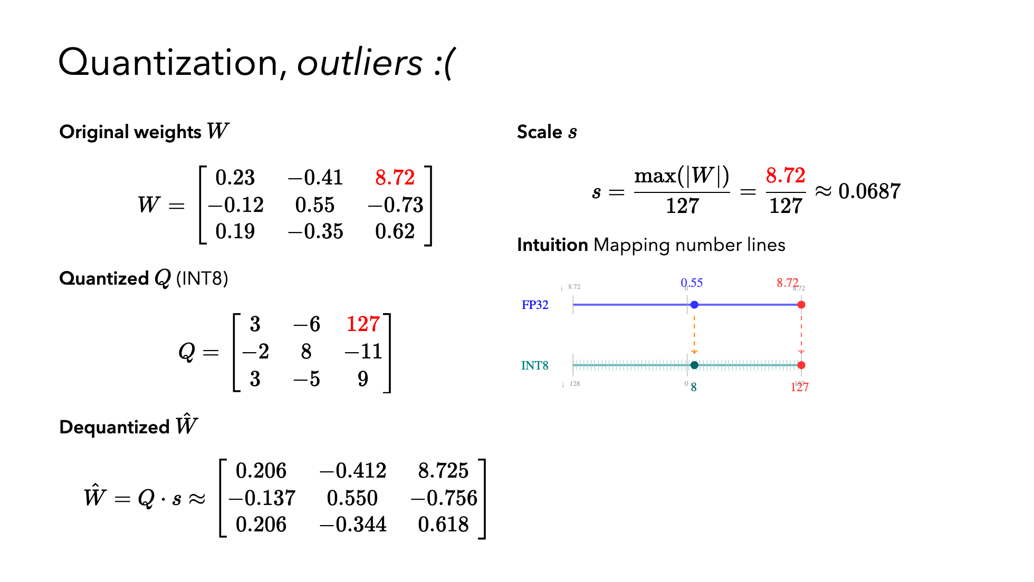

Slide 40
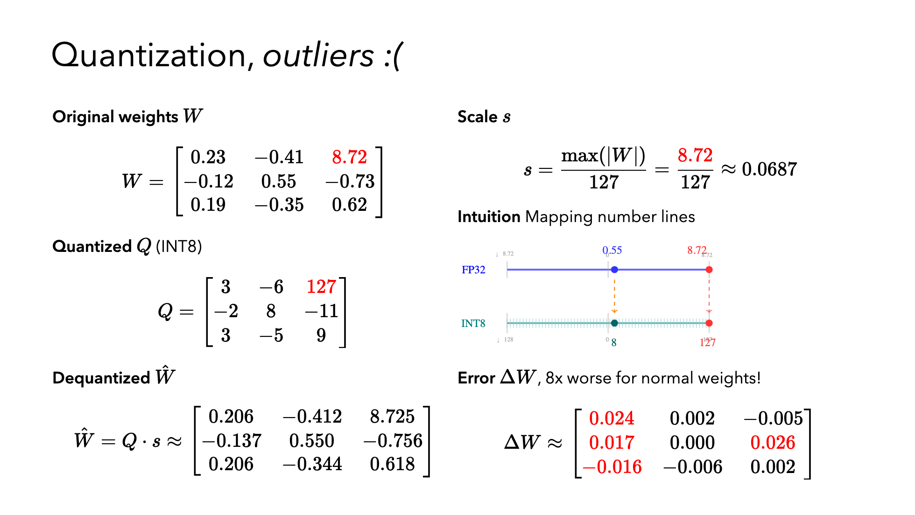

Slide 41
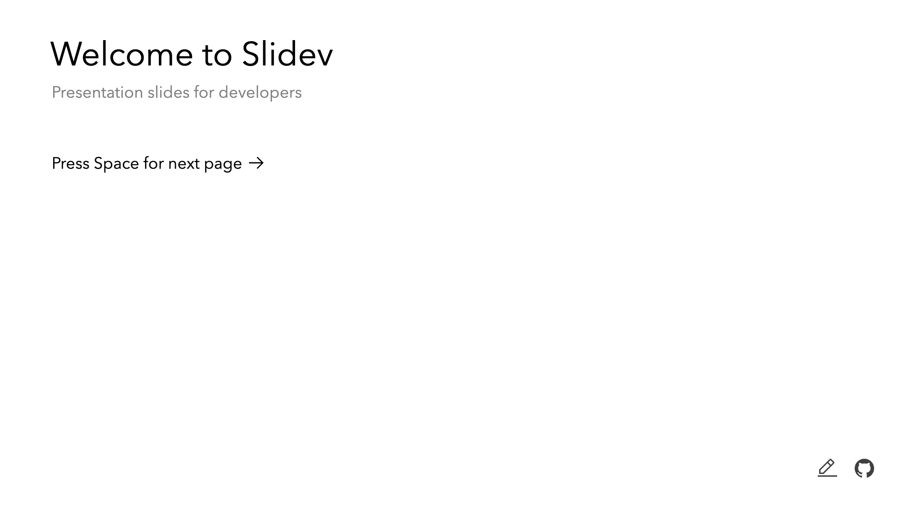
Notes:
The last comment block of each slide will be treated as slide notes. It will be visible and editable in Presenter Mode along with the slide. [Read more in the docs](https://sli.dev/guide/syntax.html#notes)

Slide 42
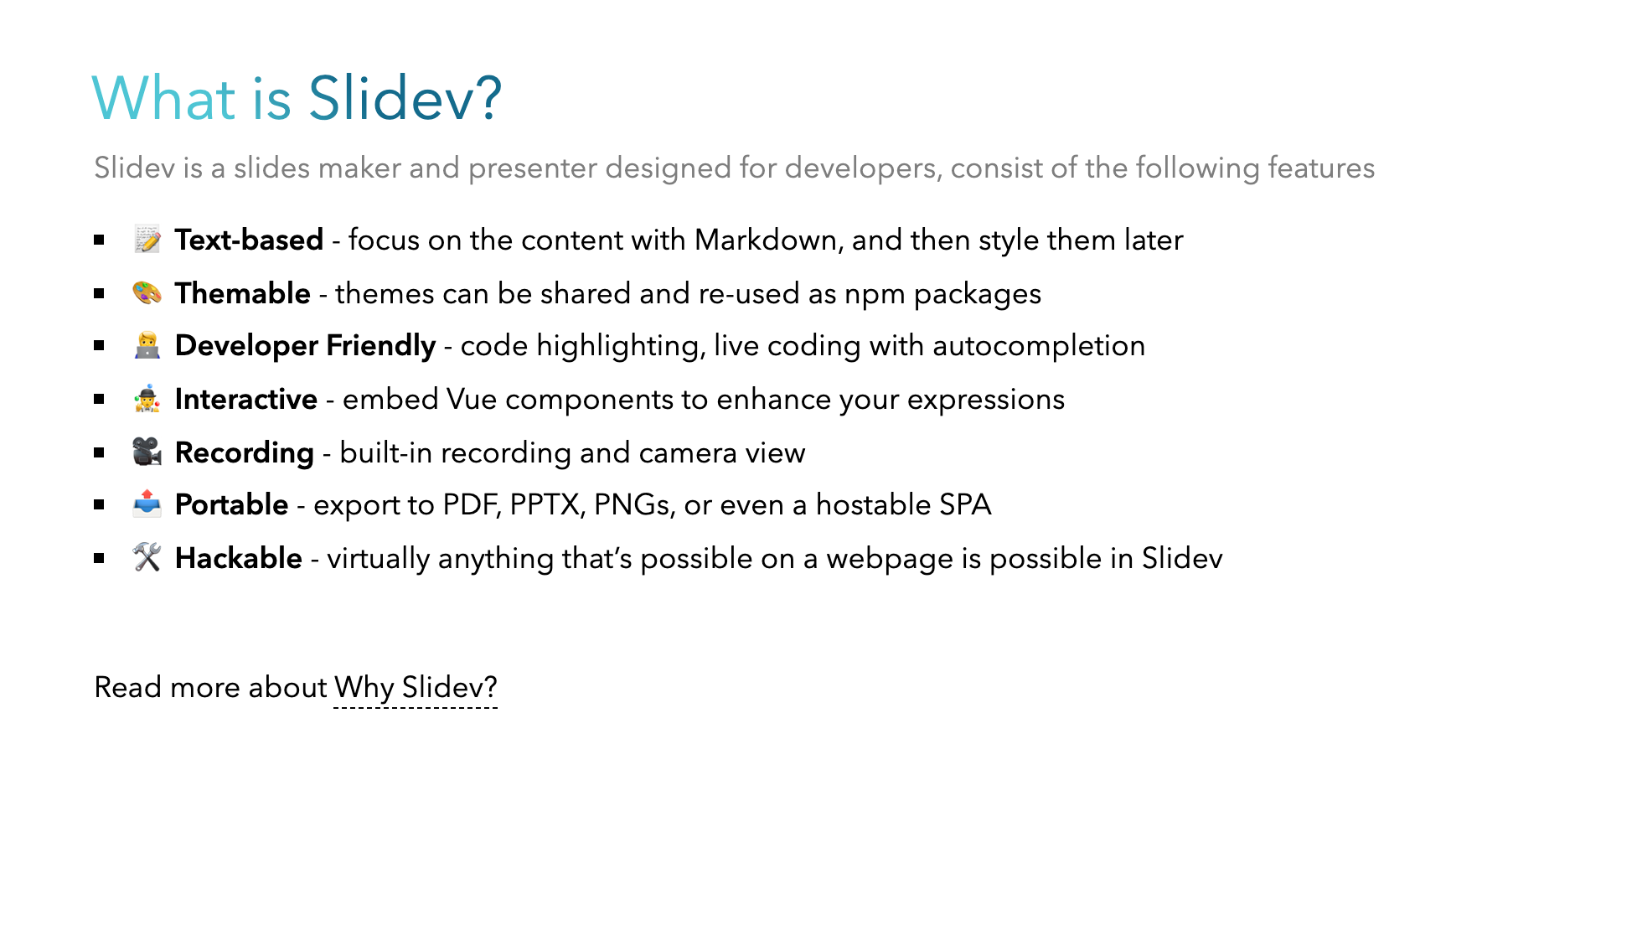
Notes:
Here is another comment.

Slide 43
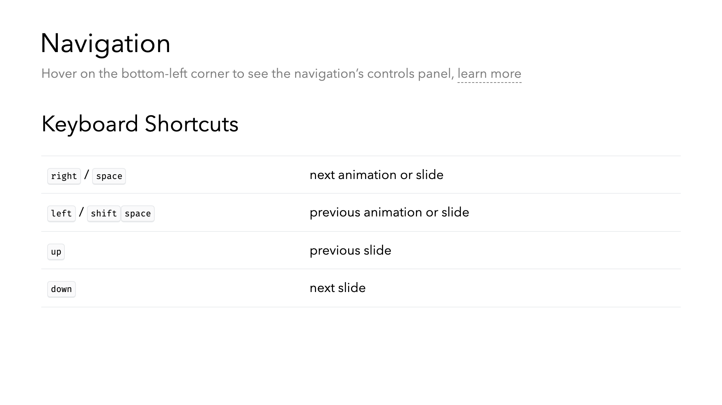

Slide 44
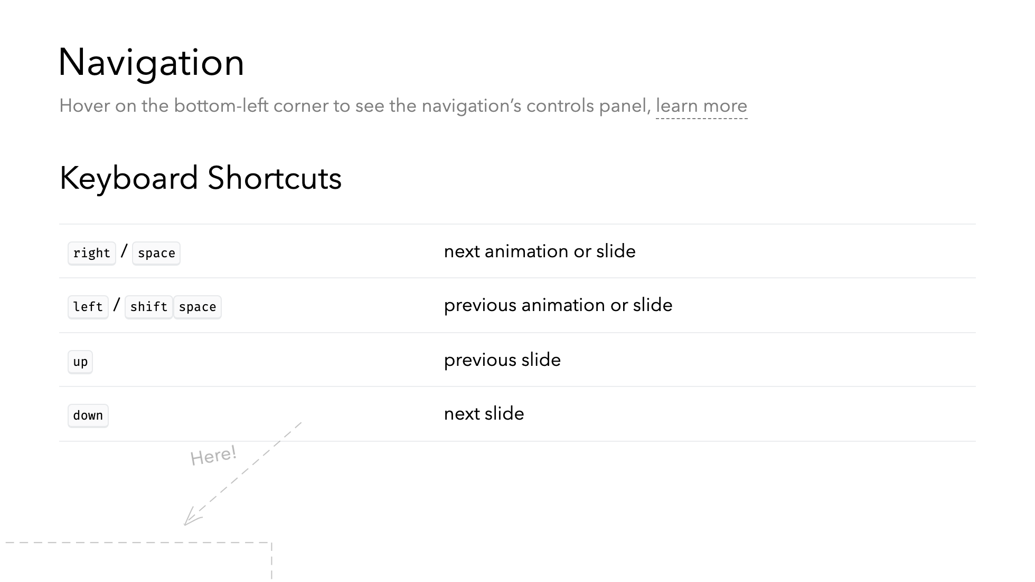

Slide 45
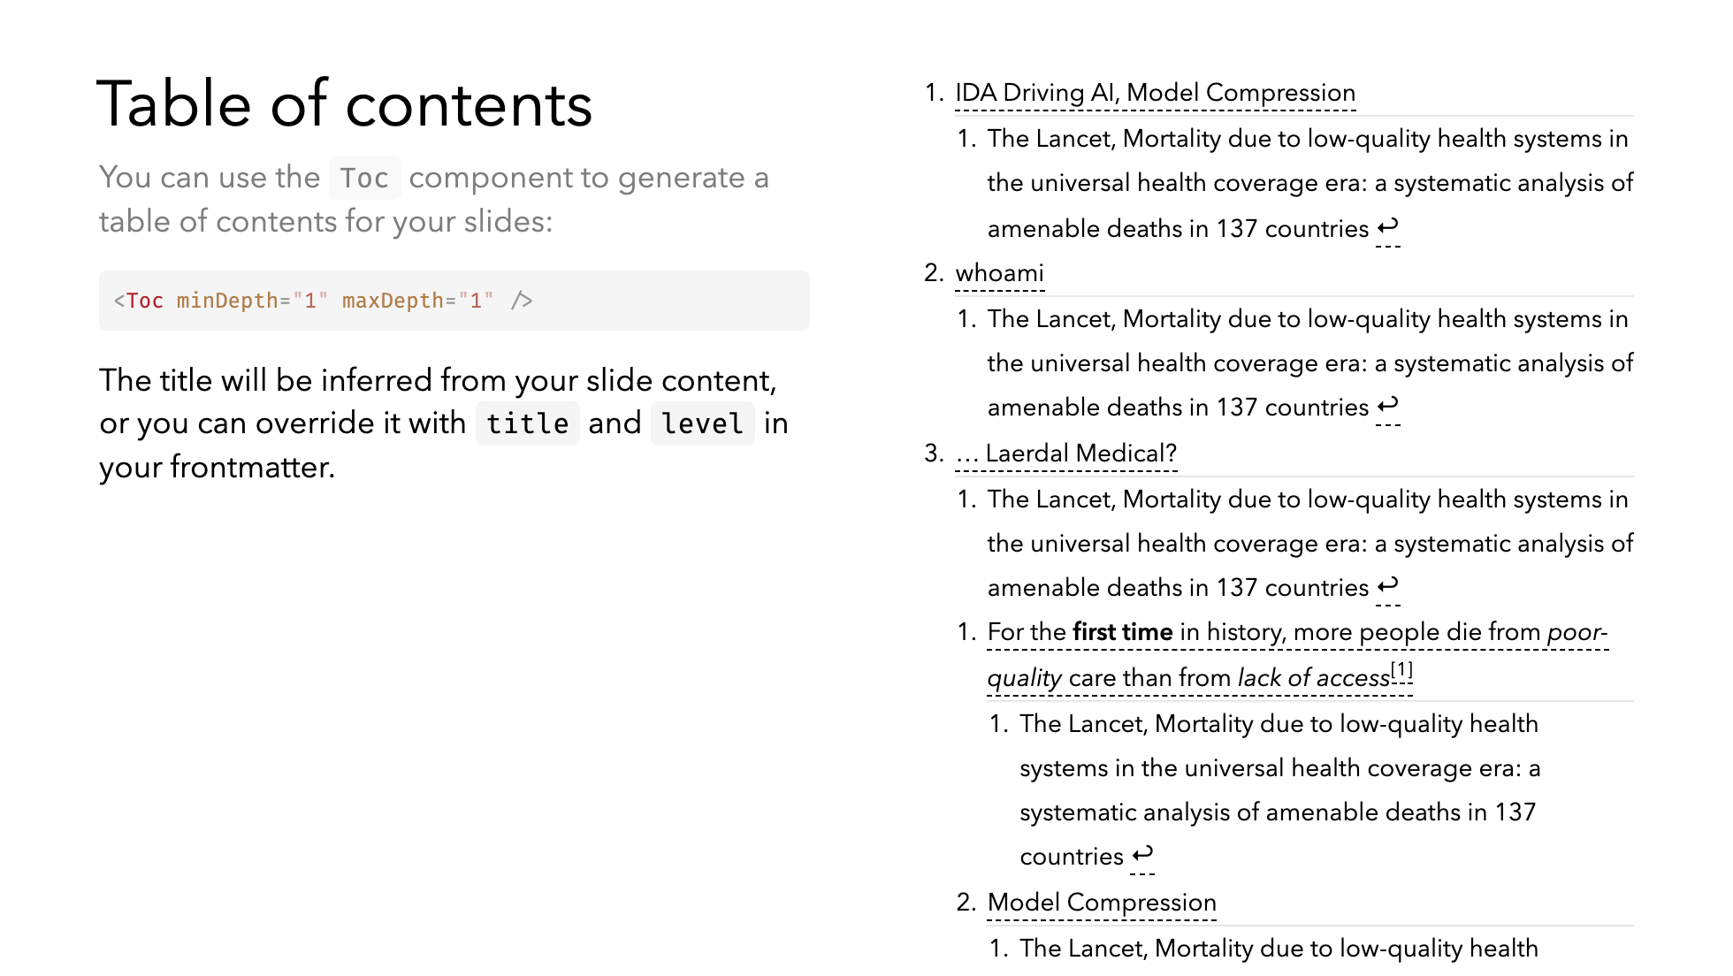

Slide 46
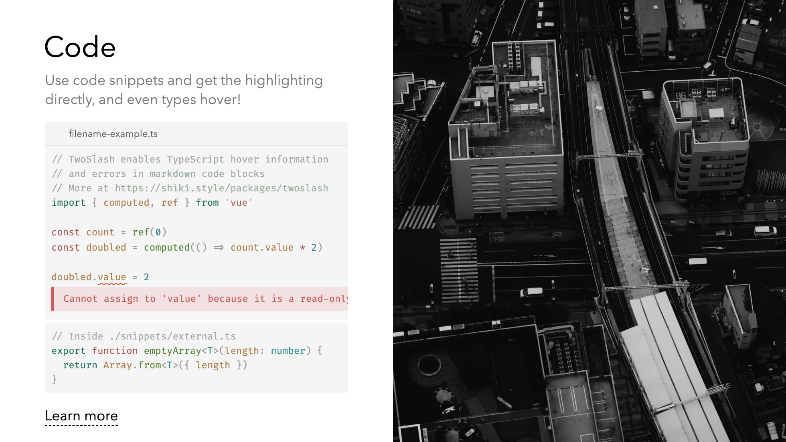
Notes:
Notes can also sync with clicks [click] This will be highlighted after the first click [click] Highlighted with `count = ref(0)` [click:3] Last click (skip two clicks)

Slide 47

Notes:
Notes can also sync with clicks [click] This will be highlighted after the first click [click] Highlighted with `count = ref(0)` [click:3] Last click (skip two clicks)

Slide 48
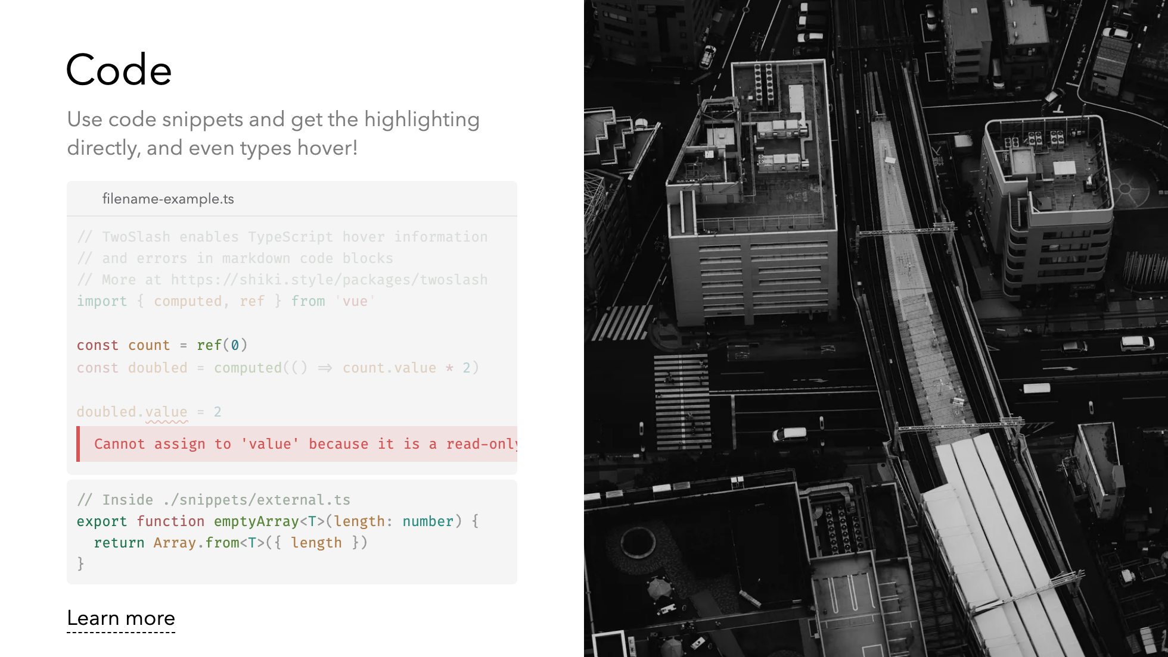
Notes:
Notes can also sync with clicks [click] This will be highlighted after the first click [click] Highlighted with `count = ref(0)` [click:3] Last click (skip two clicks)

Slide 49
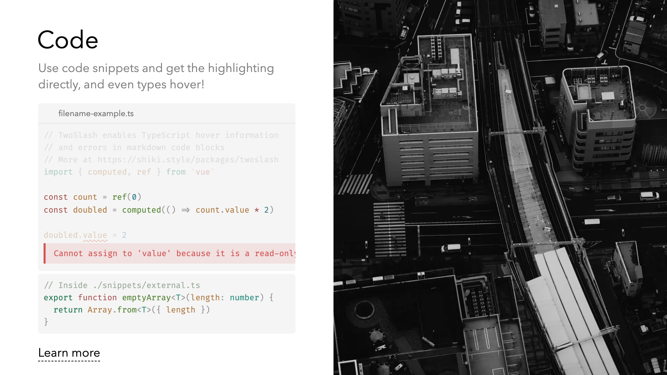
Notes:
Notes can also sync with clicks [click] This will be highlighted after the first click [click] Highlighted with `count = ref(0)` [click:3] Last click (skip two clicks)

Slide 50
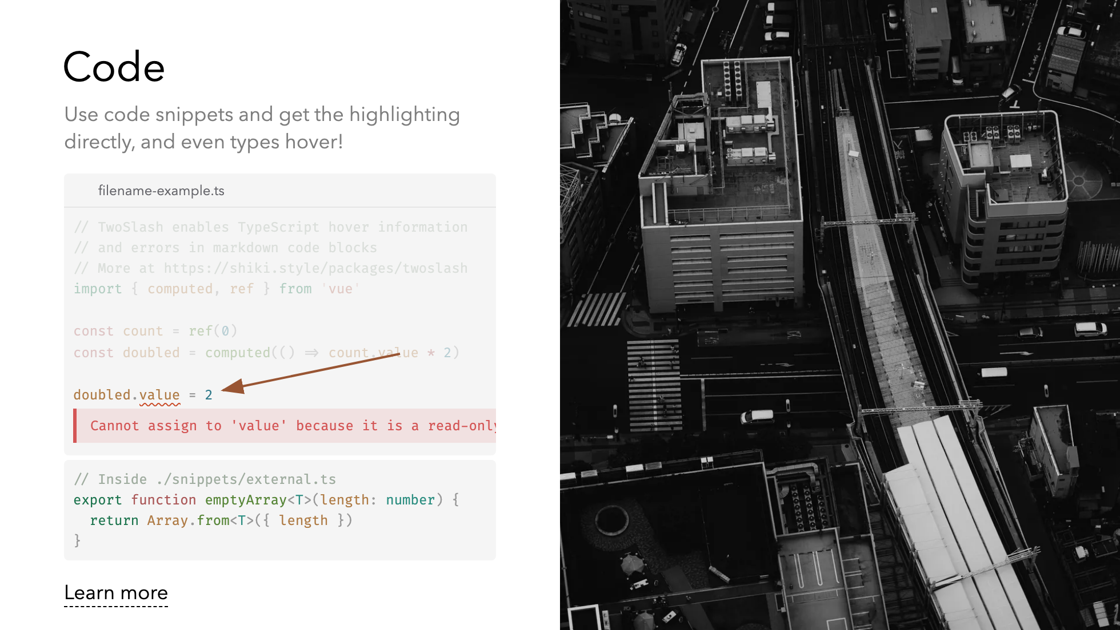
Notes:
Notes can also sync with clicks [click] This will be highlighted after the first click [click] Highlighted with `count = ref(0)` [click:3] Last click (skip two clicks)

Slide 51
Notes:
Notes can also sync with clicks [click] This will be highlighted after the first click [click] Highlighted with `count = ref(0)` [click:3] Last click (skip two clicks)

Slide 52
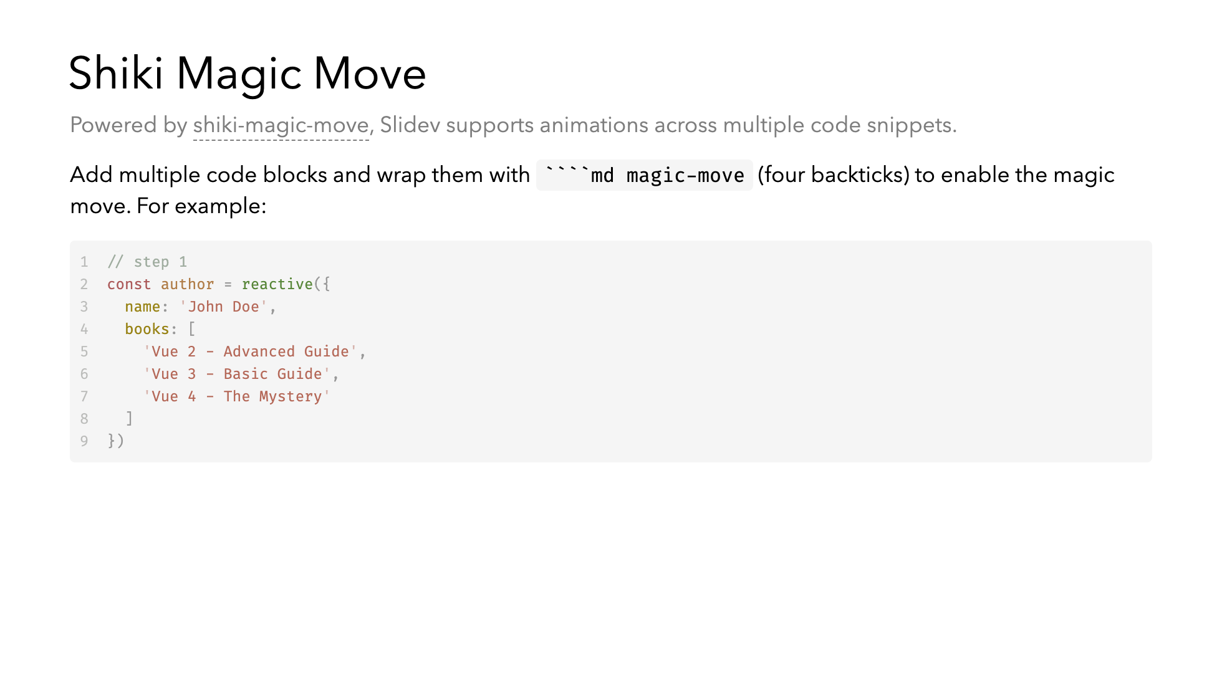

Slide 53
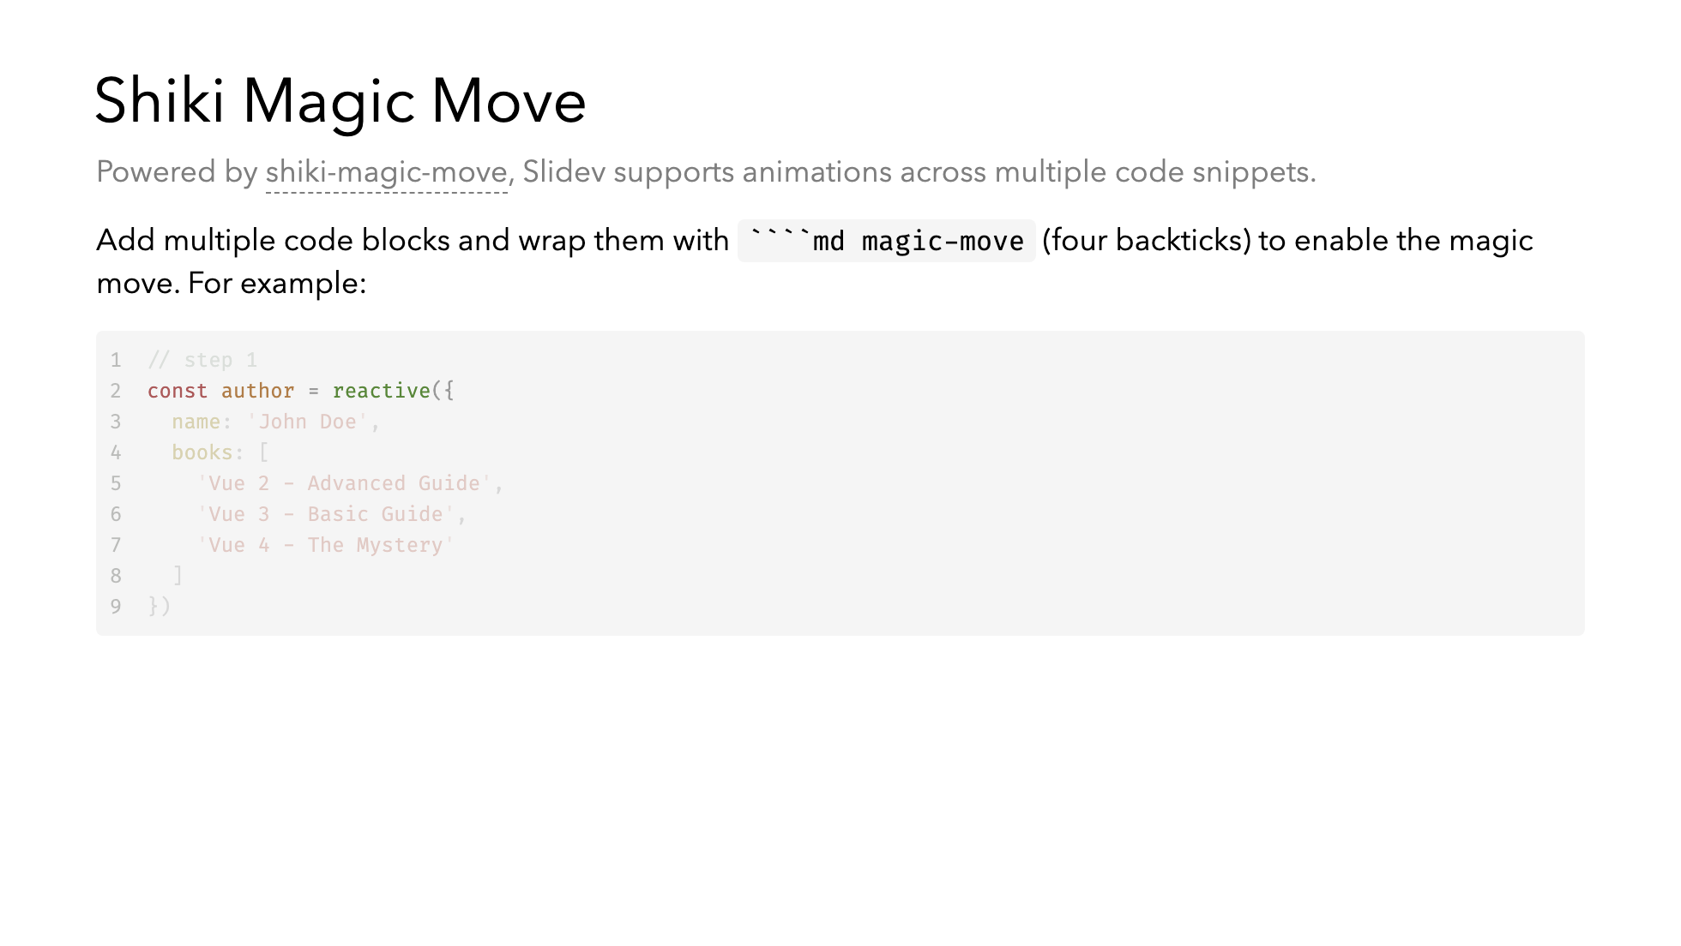

Slide 55
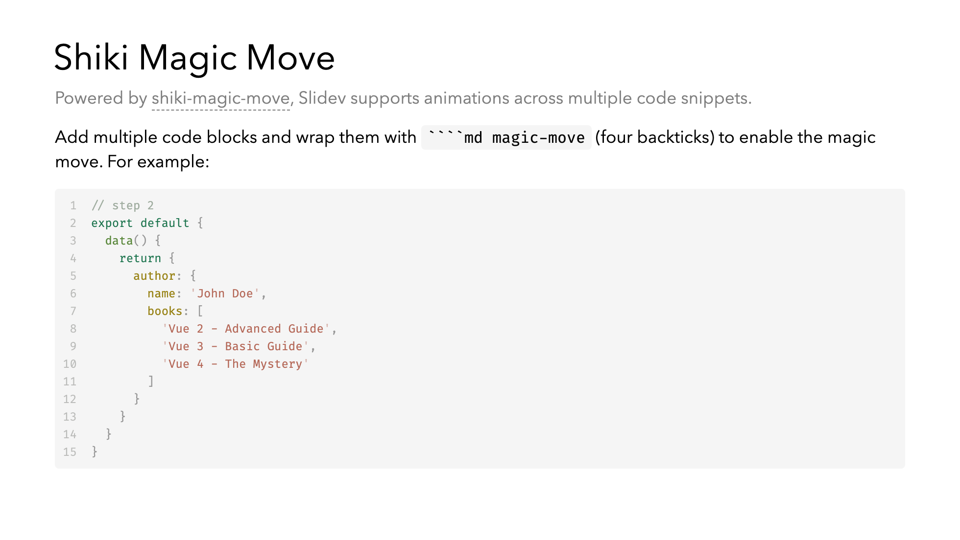

Slide 56
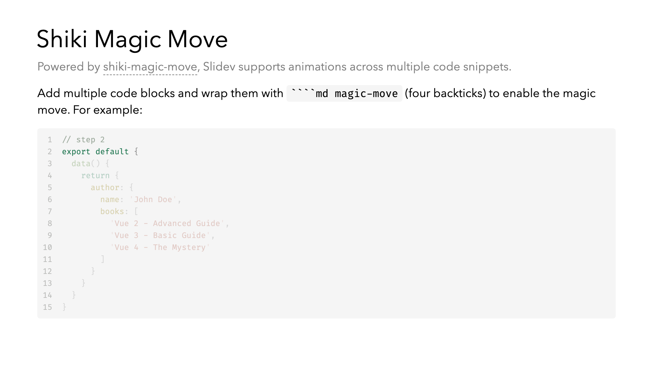

Slide 57
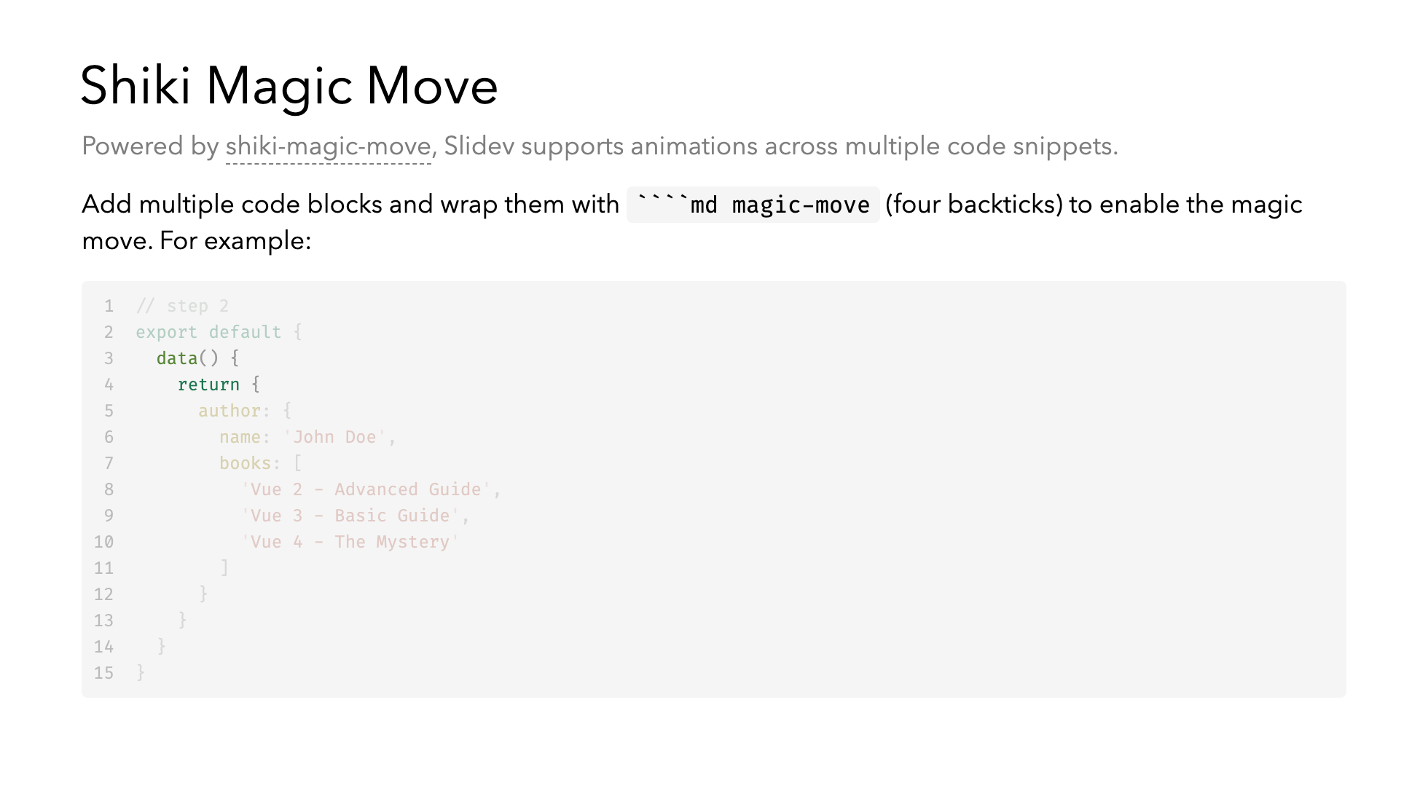

Slide 58
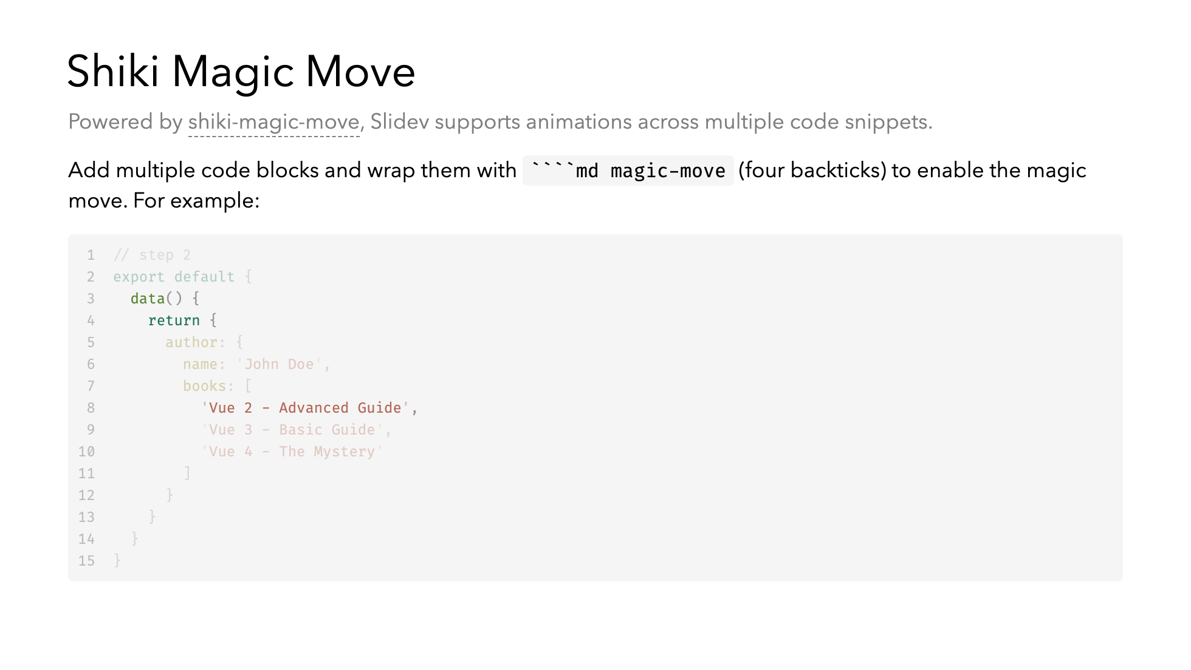

Slide 59
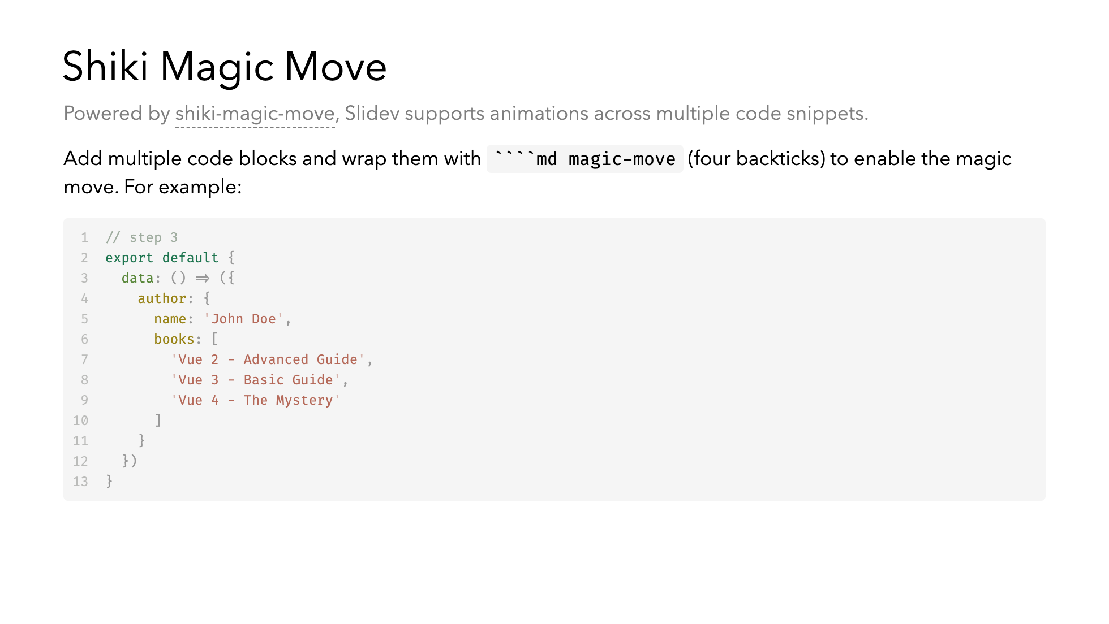

Slide 60
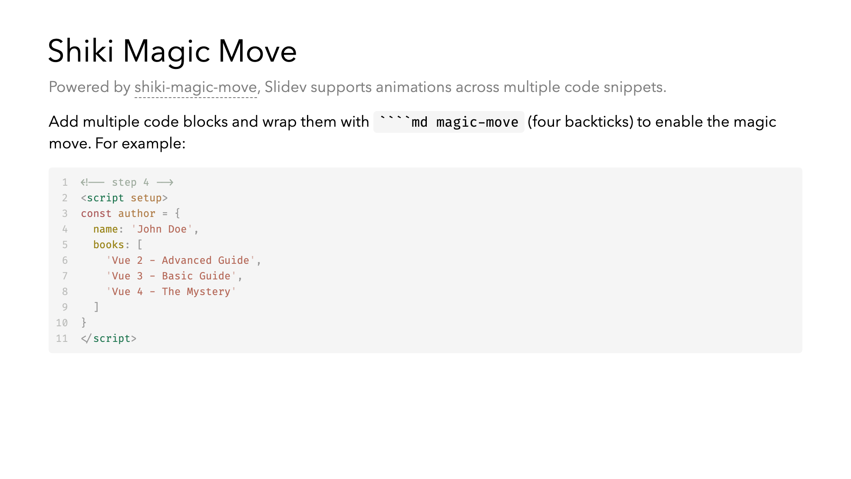

Slide 61
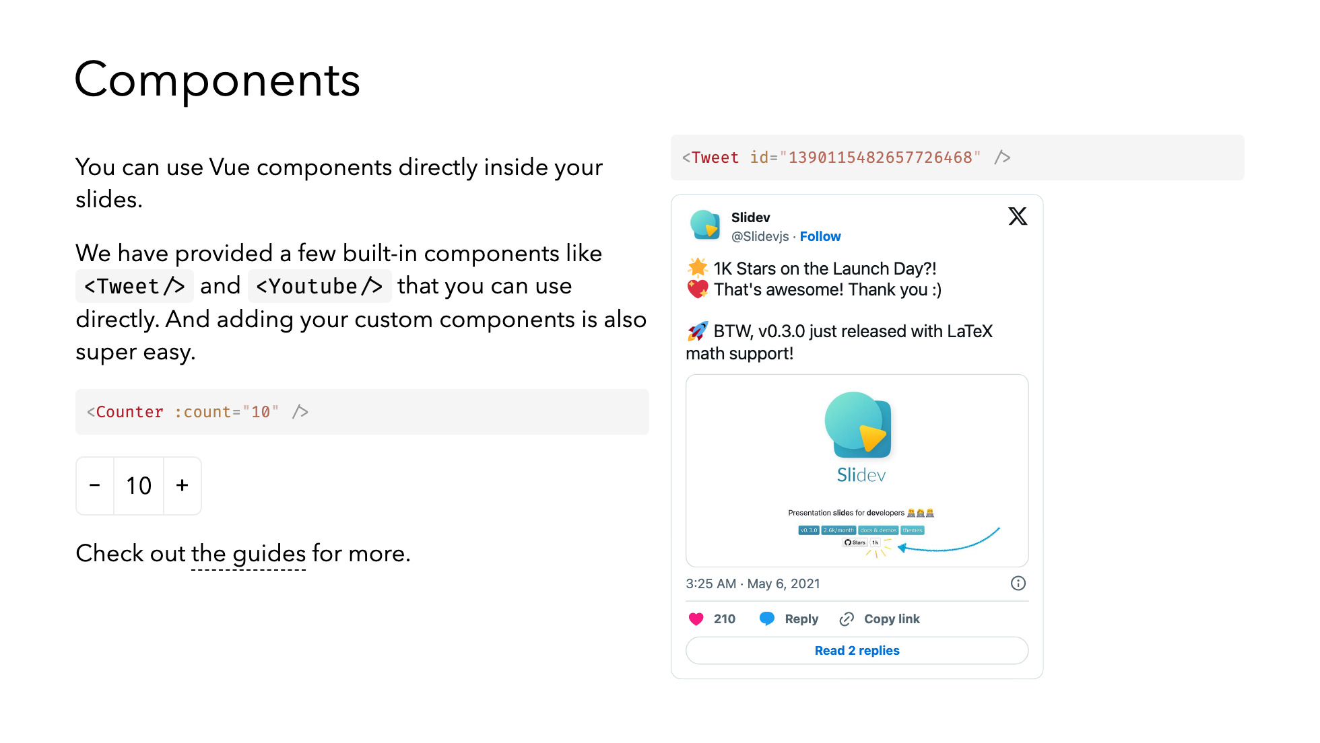
Notes:
Presenter note with **bold**, *italic*, and ~~striked~~ text. Also, HTML elements are valid: <div class="flex w-full"> <span style="flex-grow: 1;">Left content</span> <span>Right content</span> </div>

Slide 62
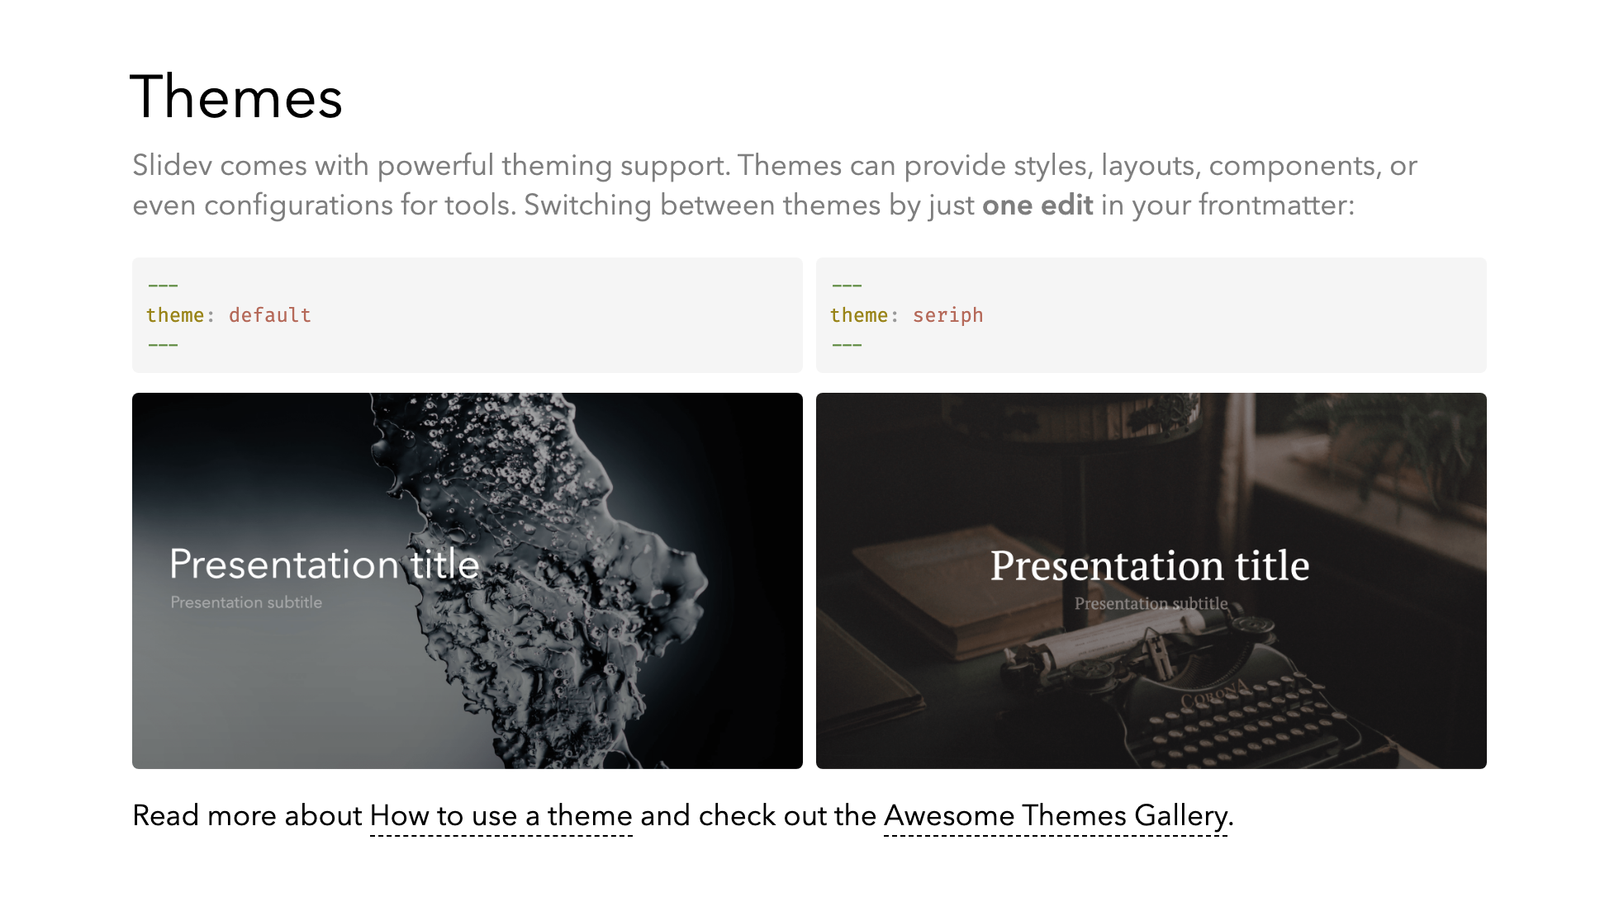

Slide 63
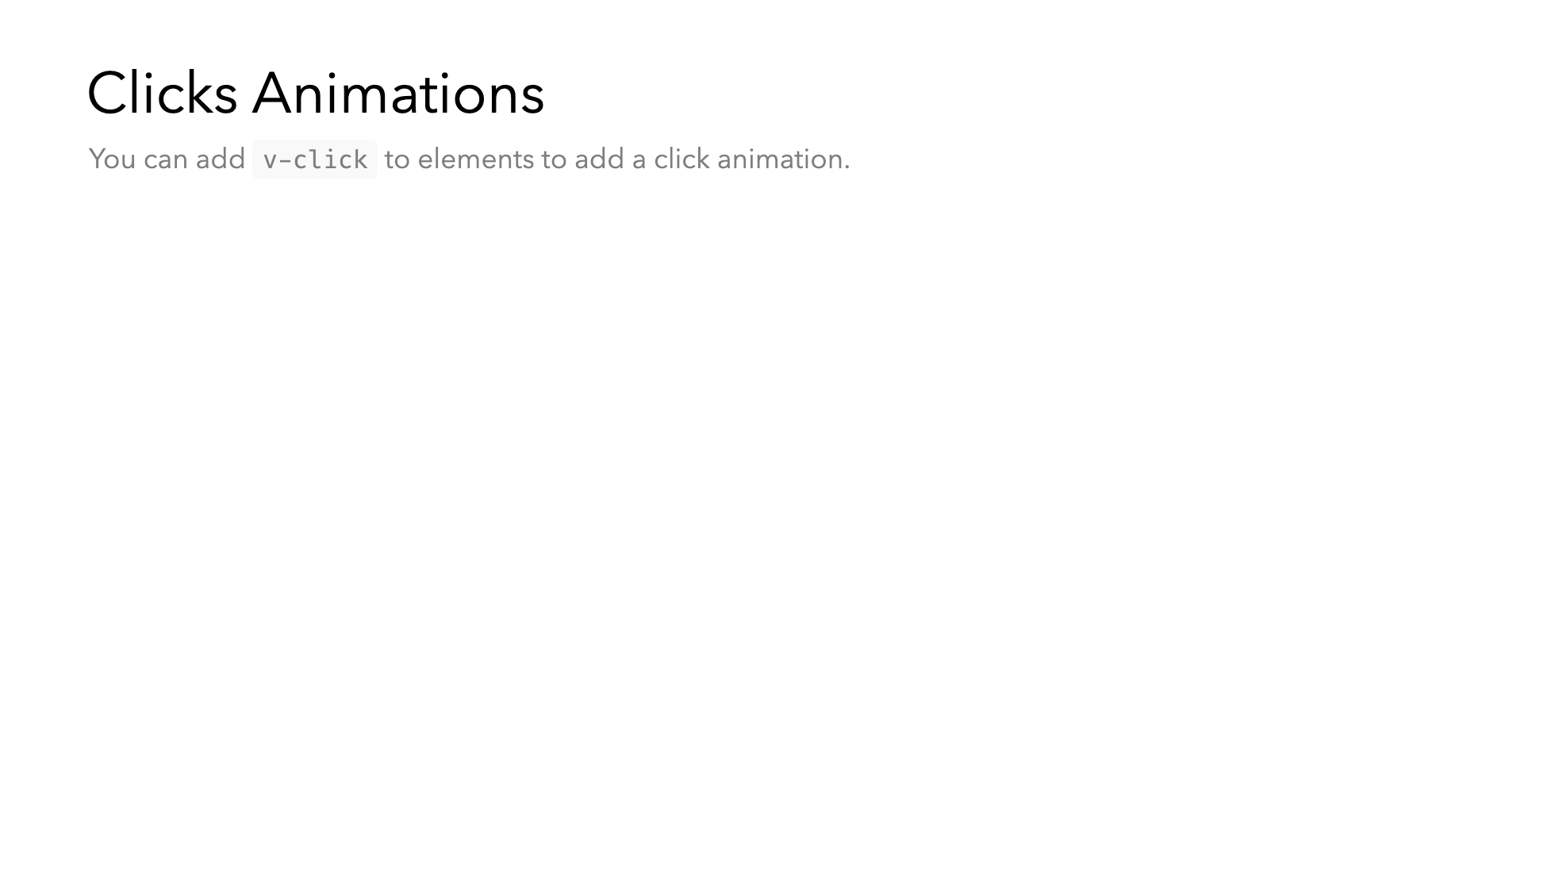

Slide 64
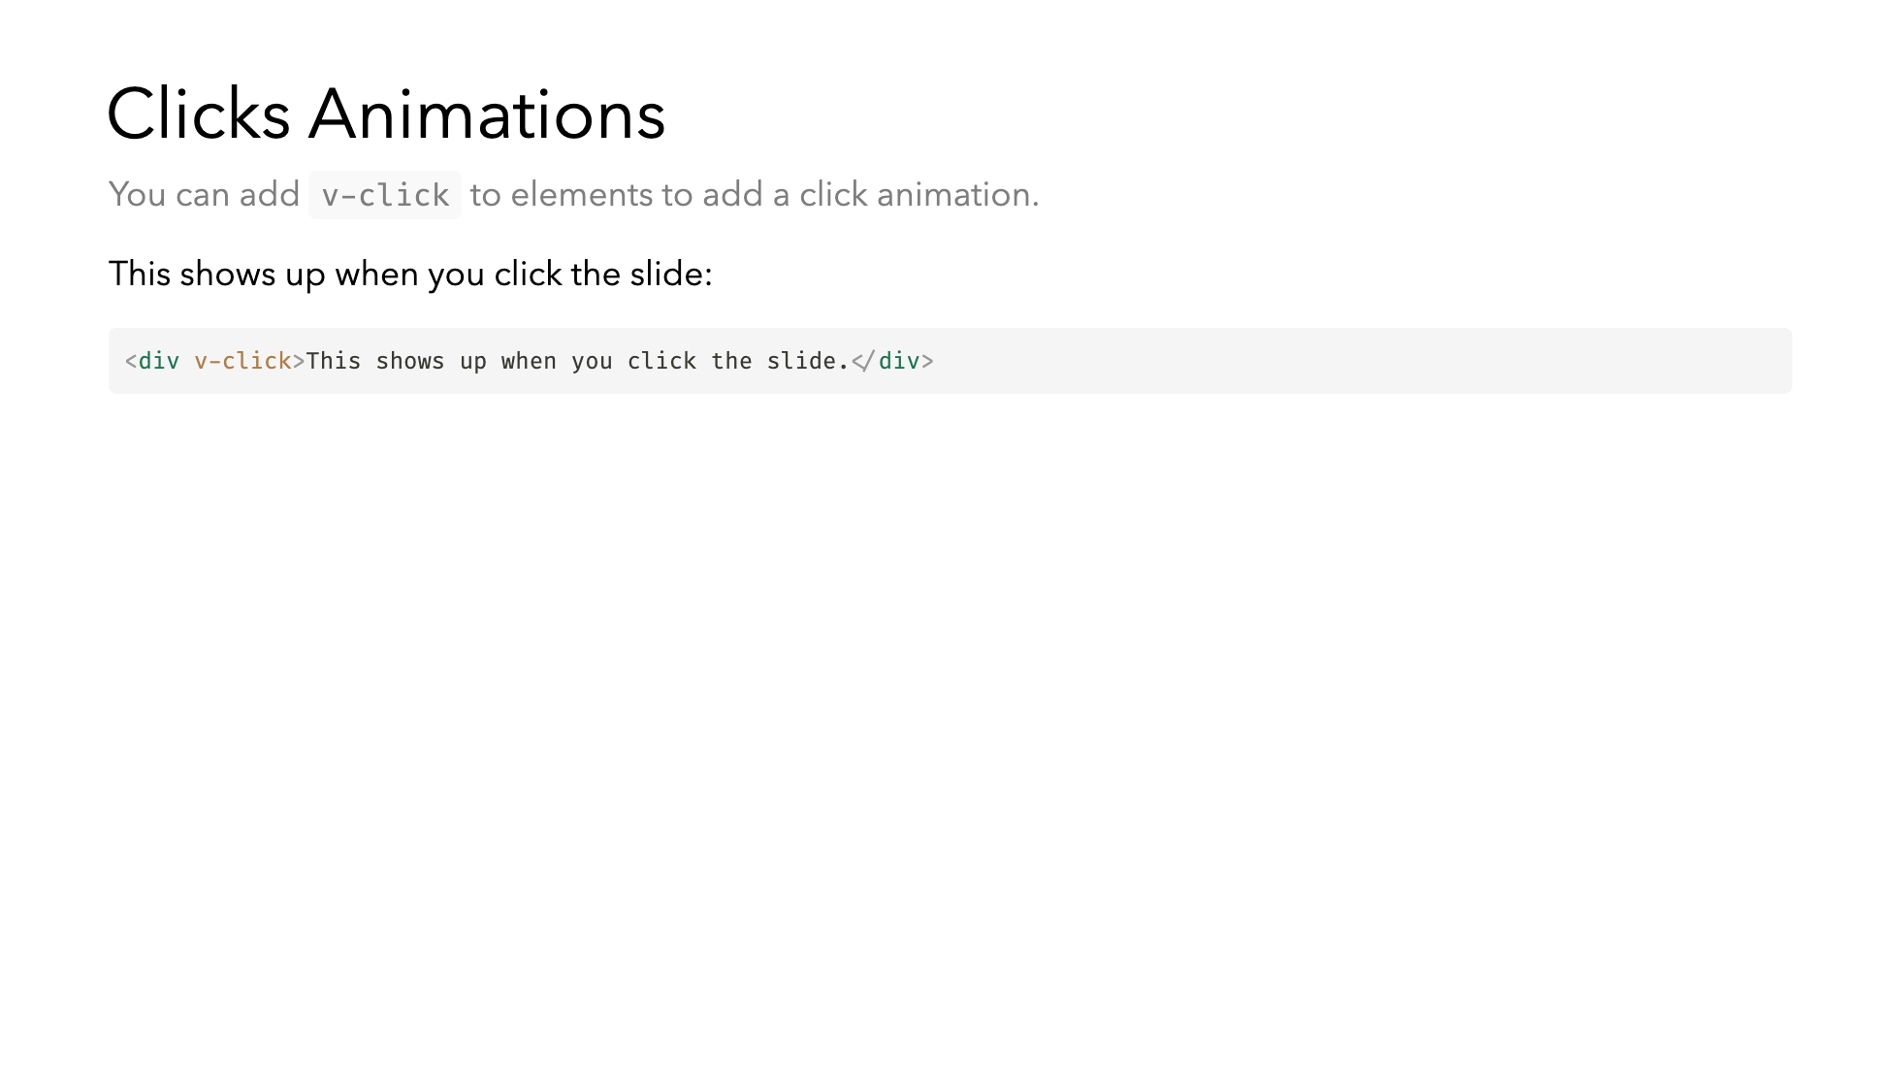

Slide 65


Slide 66


Slide 67


Slide 68


Slide 69


Slide 70


Slide 71


Slide 72


Slide 73


Slide 74


Slide 75


Slide 76


