Slide 1


TELL US A
CLIMATE
STORY
“GLOBAL ATMOSPHERIC CO2: OC0-2 GEOS CO2 “
CONCENTRATION
TEAM MEMBERS:
RAKSHA G
BINDUSHREE S
RAKSHITHA S
RAKESH N
SARVESH
GOWTHAM KUMAR

Slide 2

Today’s
Agenda
problem Statement
OCO-2 Satellite Overview
GEOS Model Overview
CO2 Data Analysis
Conclusion

Slide 3
Problem Statement
Climate Challenge
Climate Challenge – CO2 and Global Warming
CO2 as a Greenhouse Gas
Human Activities
industrialization and urbanization
Long-Term Effects
The Urgency of Action

Slide 4
OCO-2 Satellite Overview
Orbiting Carbon Observatory-2 (OCO-2)
Primary Mission
Data Collection
Orbit and Coverage
climate models, helping scientists predict future CO2 levels and climate change impacts.

Slide 5
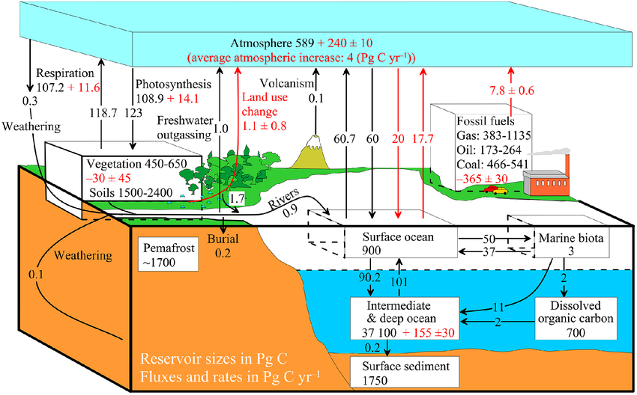

GLOBAL CARBON CYCLE

Slide 6
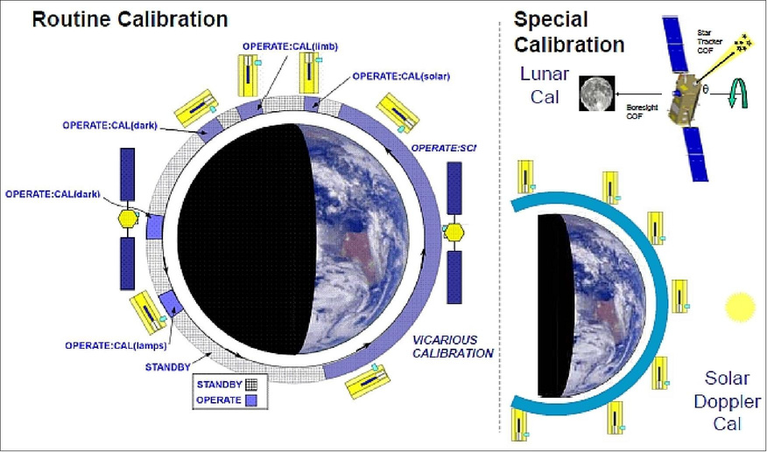
Visualization OF OCO-2

Slide 7
GEOS Model Overview
A global atmospheric model developed by NASA’s Goddard Space Flight Center.
Simulates Earth's atmosphere and weather patterns in great detail.
Integrates satellite observations (like OCO-2) with models to enhance data accuracy.
Helps visualize CO2 distribution and movement across different regions.

Slide 8
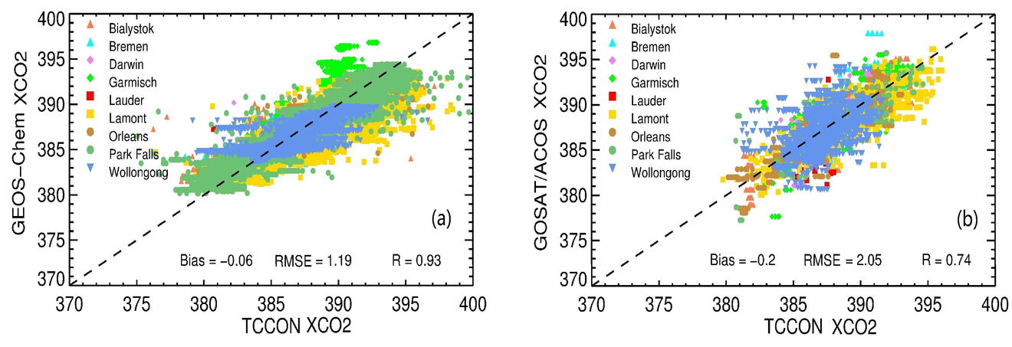
GEOS column CO2 graphic.

Slide 9
CO2 Data Analysis
OCO-2 and GEOS data show rising CO2 levels over time.
Notable seasonal variations due to natural cycles like plant growth and decay.
Hotspots of high CO2 concentration, especially in urban and industrial regions.

Slide 10
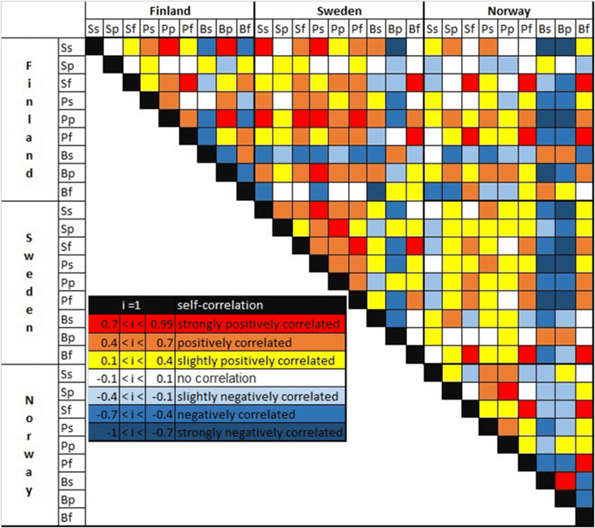
CO2 trend heatmaps

Slide 11
Conclusion
Understanding CO2 Dynamics
Importance for Climate Action
Real-World Impact
Future Prospects
Call to Action

Slide 12
ANY QUESTION?

Slide 13
THANK YOU

