Slide 1

Database Programming
2024/2025 First Semester (Dr. Ala Abuthawabeh)
Homework #2
Name: Rasha Khalid Alsaleh ID:202210632

Slide 2
Q1) Consider the employee database. Give an SQL DDL definition of this database. Identify referential-integrity constraints that should hold, and include them in the DDL definition
The Answer: -- in this question I want to use create
create table employee ( ID int primary key, person_name varchar2(100), street varchar2(255), city varchar2(100) );
create table company ( company_name varchar2(100) primary key, city varchar2(100) );
create table manager ( ID int primary key, manager_id int references employee(ID) on delete set null );
create table works ( ID INT primary key, company_name varchar2(100) references company(company_name) on delete cascade, salary decimal(10, 2) );

Slide 3
Q2) Consider the bank database, where the primary keys are underlined. Construct the following SQL queries for this relational database.
create table loan ( loan_number int primary key, branch_name varchar2(100) references branch(branch_name) on delete cascade, amount decimal(15, 2) );
create table account ( account_number int primary key, branch_name varchar2(100) references branch(branch_name) on delete cascade, balance decimal(15, 2) );
create table depositor ( ID varchar2(10) references customer(ID) on delete cascade, account_number int references account(account_number) on delete cascade, primary key (ID, account_number) );
A) Find the ID of each customer of the bank who has an account but not a loan.
-- First create the tables: create table branch ( branch_name varchar2(100) primary key, branch_city varchar2(100), assets decimal(15, 2));
create table customer ( ID varchar2(10) primary key, customer_name varchar2(100), customer_street varchar2(255), customer_city varchar2(100));
create table borrower ( ID varchar2(10) references customer(ID) on delete cascade, loan_number int references loan(loan_number) on delete cascade, primary key (ID, loan_number) );

Slide 4
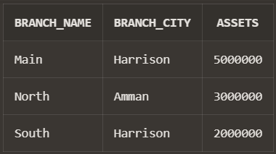
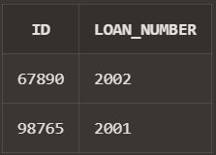
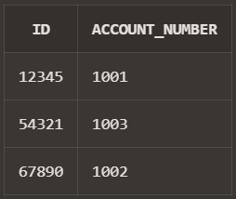
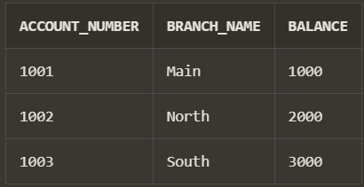
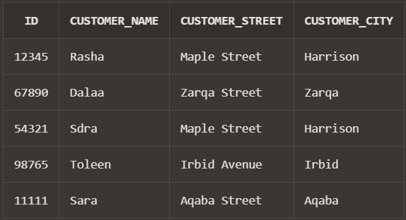
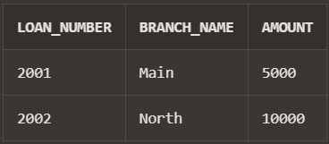
-- Then insert value into them, these are the tables:
Branch table:
Borrower table:
Depositer table:
Account table:
customer table:
Loan table:

Slide 5

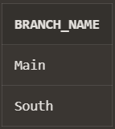

The Answer:
select depositor.ID from depositor left join borrower on depositor.ID = borrower.ID where borrower.ID is null;
Output:
Q2)
C) Find the name of each branch that has at least one customer who has an account in the bank and who lives in “Harrison”.
The Answer:
select b.branch_name from branch b join account a on b.branch_name = a.branch_name join depositor d on a.account_number = d.account_number join customer c on d.ID = c.ID where c.customer_city = 'Harrison';
Q2) B) Find the ID of each customer who lives on the same street and in the same city as customer '12345'.
The Answer:
SELECT c2.IDfrom customer c1 join customer c2 on c1.customer_street = c2.customer_street and c1.customer_city = c2.customer_city where c1.ID = '12345' and c2.ID !='12345'
Output:
Output:

Slide 6
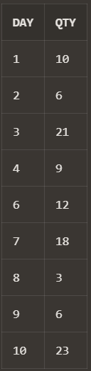
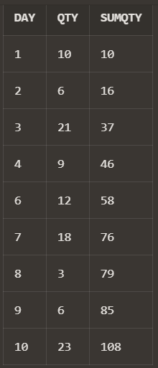
Q3) Using SQL Window Functions. A. From the demand table, find the cumulative total sum for qty.
-- The Answer:
select day, qty, sum(qty) over(order by day) as sumQty from sales
-- First of all I must create the table and insert the values to insure that my answer is correct create table sales ( day int, qty int );
Output:
-- Then insert the data as it in the pdf: select * from sales

Slide 7
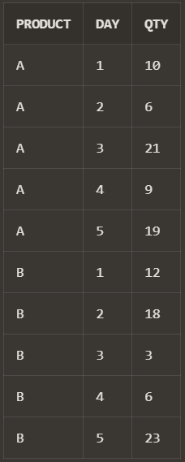
Q3) B. Extract the two worst performing days of each product in terms of number of qty sold. Paraphrasing it: Get the days corresponding to the two minimum most values of qty for each product.
-- Then insert the data as it in the pdf: Select * from sales
Output:
-- First of all I must create the table and insert the values to insure that my answer is correct create table sales ( product char(1), day int, qty int );

Slide 8
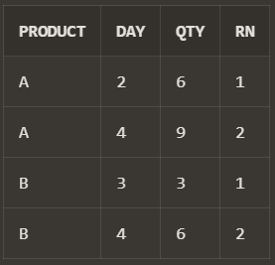
The Answer:
-- Firstly, I want to create a view that contains the products and there dense ranks, but every product separately: create view RankedSales as select product, day, qty, dense_rank() over(partition by product order by qty) as RN from sales
-- Then after that I want to specify only 2 minimum product values by specifying that RN=1 OR RN=2 so that the output will be only those whose rank 1 and 2 which is the 2 minimum qty values select * from RankedSales where RN = 1 or RN = 2 order BY products
Output:

