Slide 1

Database Programming
2024/2025 First Semester (Dr. Ala Abuthawabeh)
Homework #2
Name: Rasha Khalid Alsaleh ID:202210632

Slide 2
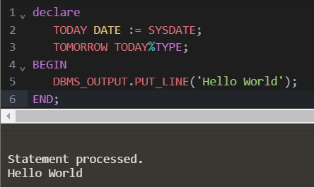
Q1) Create the following anonymous block and answer the following:
BEGIN
DBMS_OUTPUT.PUT_LINE('Hello World');
END;
1) Add a declarative section to this PL/SQL block. In the declarative section, declare the following variables:
A variable named TODAY of datatype DATE. Initialize TODAY with SYSDATE.
A variable named TOMORROW with the same datatype as TODAY. Use the %TYPE attribute to declare this variable.

Slide 3
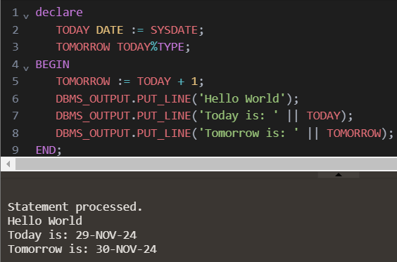
Q1) Create the following anonymous block and answer the following:
BEGIN
DBMS_OUTPUT.PUT_LINE('Hello World');
END;
2) In the executable section, initialize the TOMORROW variable with an expression that calculates tomorrow’s date (add 1 to the value in TODAY). Print the value of TODAY and TOMORROW after printing ‘Hello World’.

Slide 4
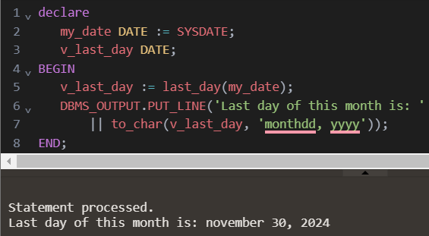
Q1) Create the following anonymous block and answer the following:
BEGIN
DBMS_OUTPUT.PUT_LINE('Hello World');
END;
3) Write an anonymous PL/SQL block that uses today's date and outputs it in the format of ‘Month dd, yyyy’. Store the date in a DATE variable called my_date. Create another variable of the DATE type called v_last_day. Assign the last day of this month to v_last_day. Display the value of v_last_day.

Slide 5
Q2) Create table called countries with two columns named country_name, median_age. using SQL code. Then insert several records to the table. Evaluate the variables in the following PL/SQL code. Change the declarations so they use the %TYPE attribute. Also rewrite code using Explicit cursor.
DECLARE
country_name VARCHAR2(50);
median_age NUMBER(6, 2);
BEGIN
SELECT country_name, median_age INTO country_name, median_age
FROM countries
WHERE country_name = 'Japan';
DBMS_OUTPUT.PUT_LINE('The median age in '|| country_name || ' is ' ||
median_age || '.');
END;

Slide 6
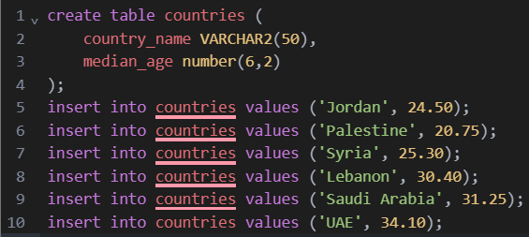
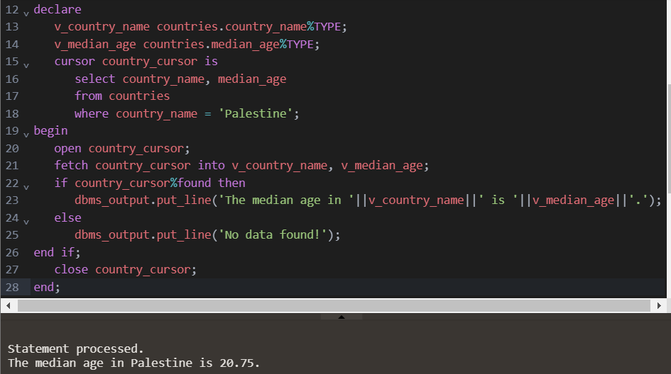
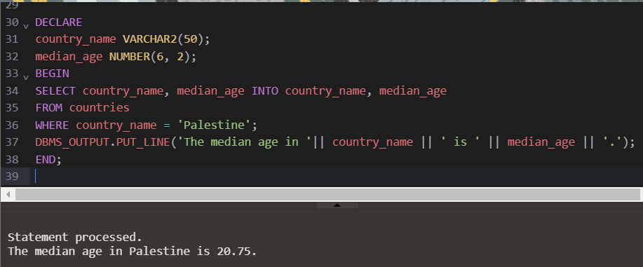
Q2) Create table called countries with two columns named country_name, median_age. using SQL code. Then insert several records to the table. Evaluate the variables in the following PL/SQL code. Change the declarations so they use the %TYPE attribute. Also rewrite code using Explicit cursor.

