Slide 1
AJAX
Asynchronous JavaScript And XML

Slide 2
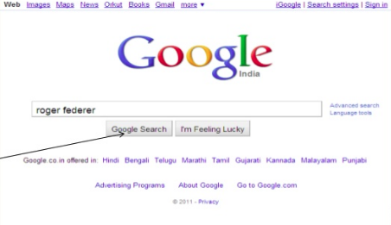


Slide 3
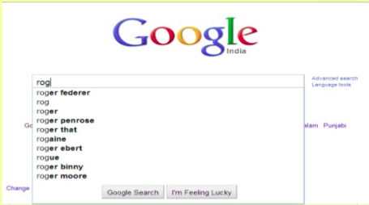
The magic behind this is
:AJAX
Google suggestion

Slide 4
What is Ajax?
A programming language ?? no…
A new technology ?!! not exactly…
Is Ajax a technology platform or is it an architectural style?
  It’s both. Ajax is a set of technologies being used together in a particular way.
Where can I download it?
  Ajax isn’t something you can download.
  It’s an approach, a way of thinking about the architecture of web applications using certain technologies.

Slide 5
Ajax core components:
HTML & CSS - data presenting and styling. .
Document Object Model (DOM) - to access and interact with data inside the page.
XMLHttpRequest object - to exchange data with the server asynchronously.
XML – for transferring data.
JavaScript – for local processing and binding everything together.

Slide 6
XMLHttpRequest: XHR
Create an XMLHttpRequest Object
  xmlhttp=new XMLHttpRequest();
Send a Request To a Server
  we use the open() and send() methods of the XMLHttpRequest object: xmlhttp.open(“GET”;”ajax_info.txt”,true);
  xmlhttp.send();
Method Description: open(method, url, async)
  Type of request: GET or POST
  url: the location of the file on the server
  async: true (asynchronous) or false (synchronous)‏
send(string) Sends the request off to the server.

Slide 7
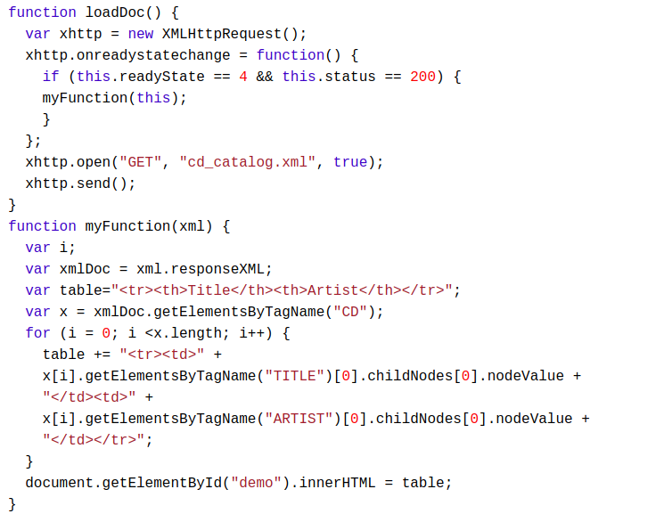
XMLHttpRequest: XHR
Server Response:
responseText
responseXML

Slide 8
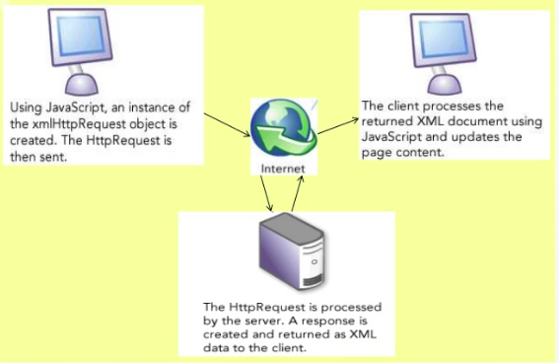
How Ajax works?

Slide 9
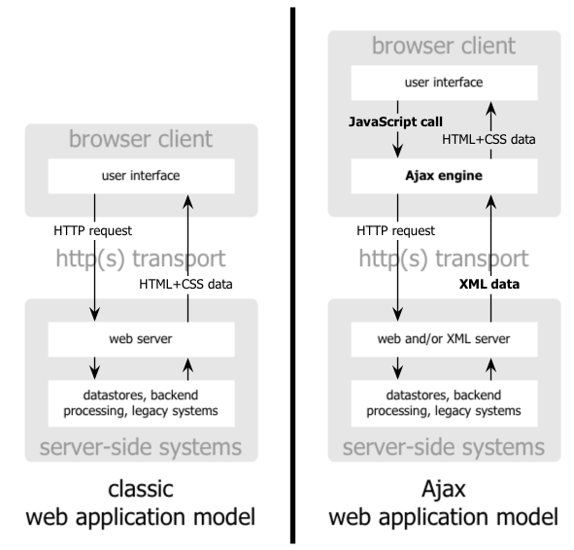
Classic Model vs AJAX

Slide 10
Why Ajax is important?
Helps to build fast, dynamic websites.
Ajax allows to perform processing on client computer (in JavaScript) with data taken from the server thereby reducing server load by moving a part of server functionality to client side.
Improves sharing of resources : it facilitates to use the power of all the client computers rather than just a unique server and network.
Ajax can modify a part of a page displayed by the browser, and update it without the need to reload the whole document with all images, menus etc.
It further reduces network traffic.

Slide 11
Resources
https://www.slideshare.net/Smithss25/ajax-ppt-32
https://www.slideshare.net/hemaprasanth/ajax-ppt-4410119

Slide 12
What is the Answer?
introducing an intermediary between the user and the server.
  The Ajax engine!
It seems like adding a layer to the application would make it less responsive
  but the opposite is true.
Instead of loading a webpage, at the start of the session, the browser loads an Ajax engine
  written in JavaScript and usually tucked away in a hidden frame.
This engine is responsible for
  rendering the interface the user sees
  communicating with the server on the user’s behalf.
The Ajax engine allows the user’s interaction with the application to happen asynchronously
  i.e., independent of communication with the server.
If the engine needs something from the server in order to respond it makes those requests asynchronously, usually using XML, without stalling a user’s interaction with the application
  submitting data for processing
  loading additional interface code
  retrieving new data
The server returns the requested data in the form of XML documents.
The XML documents may then be used by the JavaScript technology to update or modify the Document Object Model (DOM) of the HTML page

