Slide 1

SuperStore Analysis
By/rashad hazem ali
Data analyst

Slide 2
What is SuperStore Analysis?
SuperStore Analysis is a data-driven exploration of sales, customers, and product performance using the SuperStore dataset. This dataset contains detailed information about orders, customers, products, shipping, and profits, which allows us to analyze how the business is performing across different regions, categories, and time periods.
In short, SuperStore Analysis = turning raw sales data into actionable insights that help managers and decision makers improve strategy.

Slide 3
What is the Benefit from Our Analysis?
Performance Monitoring
Track sales growth, profitability, and order volumes over time.
Identify whether the business is improving or declining.
Customer Understanding
Segment customers by region, category, and purchasing behavior.
Discover who the most valuable customers are and how to retain them.
Product Insights
Identify best-selling and underperforming products.
Understand which categories or sub-categories drive the most revenue and profit.

Slide 4
SuperStore Dataset
The dataset we are analyzing is the SuperStore dataset, which is widely used for business analytics. It contains 9,994 rows and 21 columns, each representing an order-level transaction.
🔹 Dataset Size
Rows (records): 9,994
Columns (features): 21
Time period: Covers multiple years of sales and shipping data.
🔹 Key Columns
Order Information
Row ID, Order ID, Order Date, Ship Date, Ship Mode
Customer Information
Customer ID, Customer Name, Segment
Geographical Information
Country/Region, City, State, Postal Code, Region
Product Information
Product ID, Category, Sub-Category, Product Name
Financial & Sales Metrics
Sales, Quantity, Discount, Profit

Slide 5
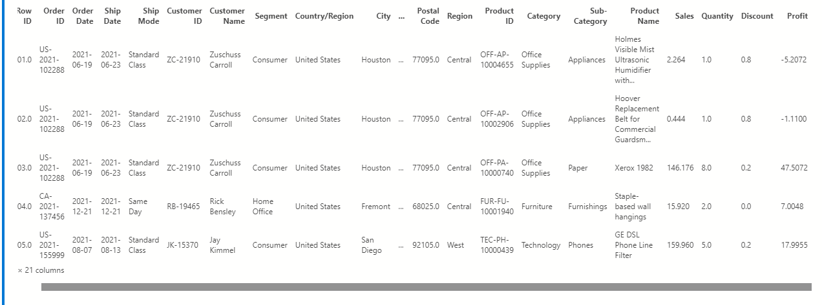
Dataset overview

Slide 6
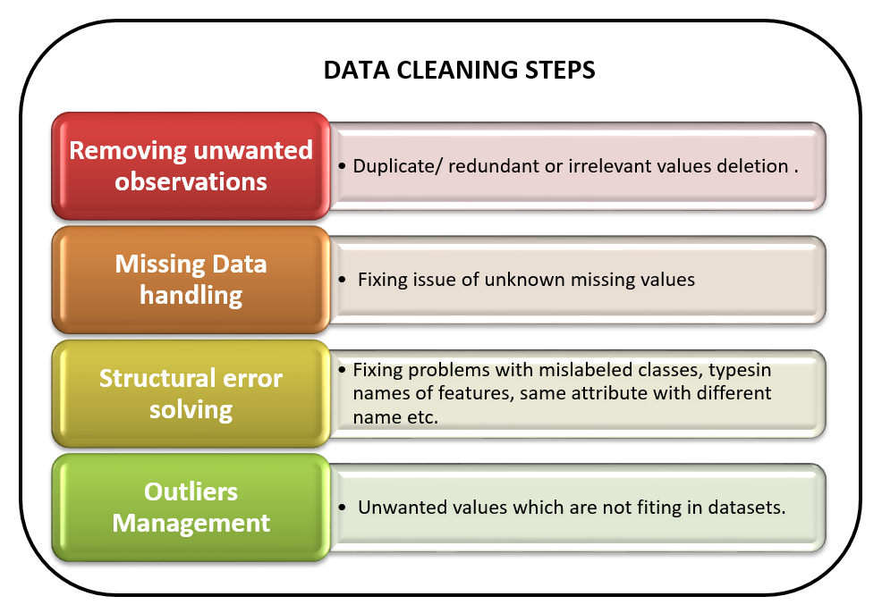
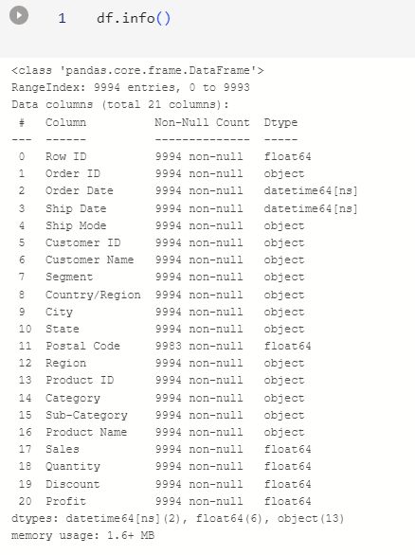
I have already checked the data cleanliness; the data is ready and prepared for direct analysis.

Slide 7
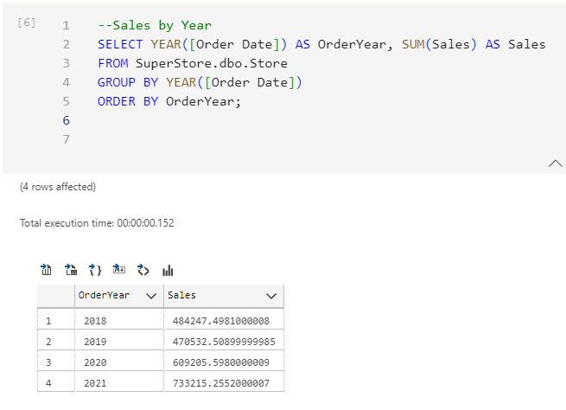
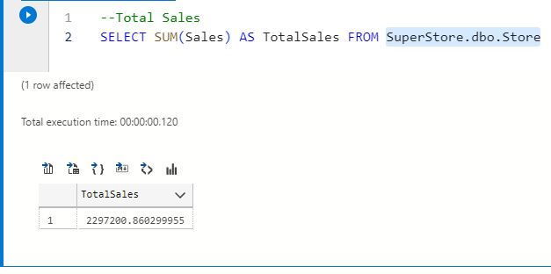
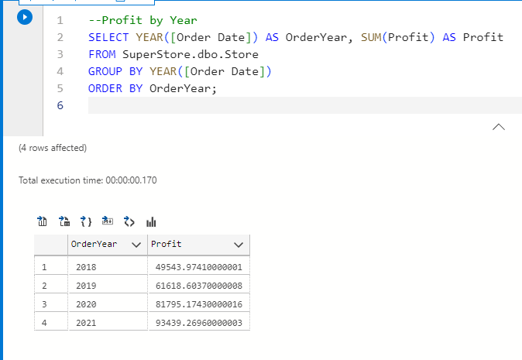
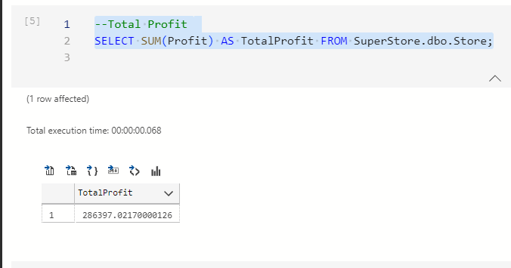
Sales And profit per years

Slide 8
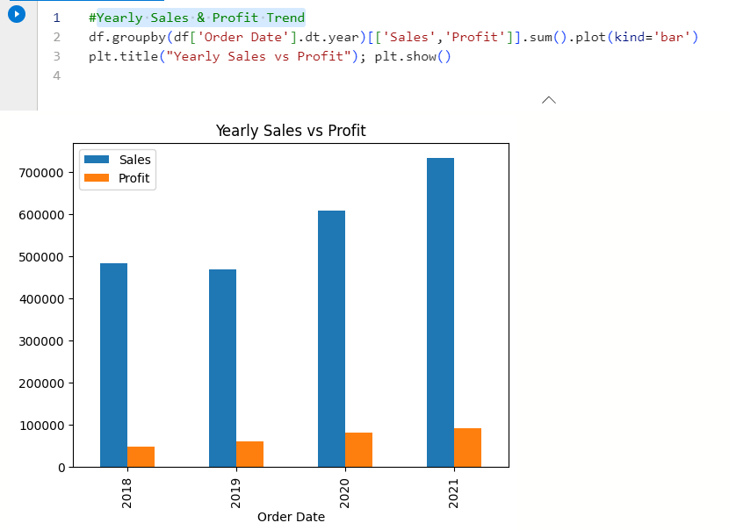
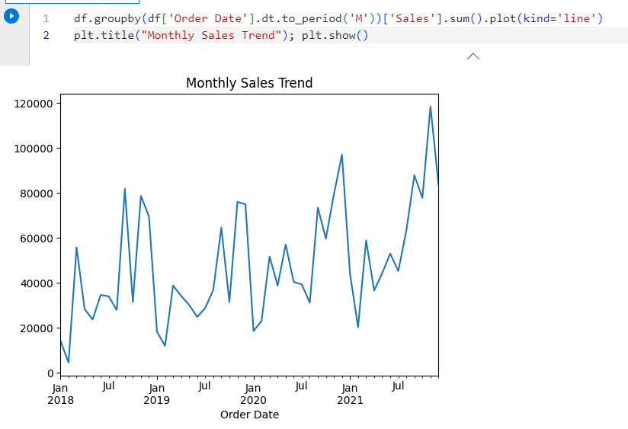
Yearly Sales & Profit Trend
We notice that every year sales increase compared to previous years, which indicates a noticeable growth in sales, and also the profit increases, even though the profit is small, but due to other factors that we will identify later.

Slide 9
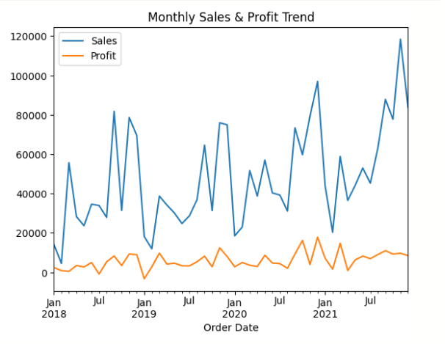
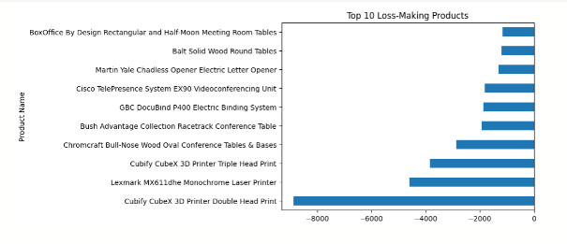
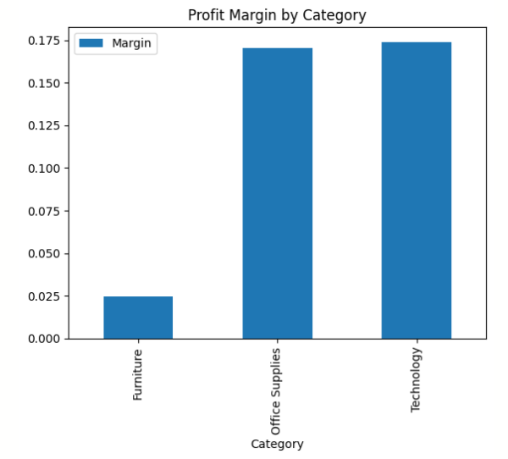
From my analysis I find :
-The year that we have more profit ad sales is 2021
-The most Profit Margin by category is technology
-The most product make loos Is Cubify cubex 3d Printer

Slide 10
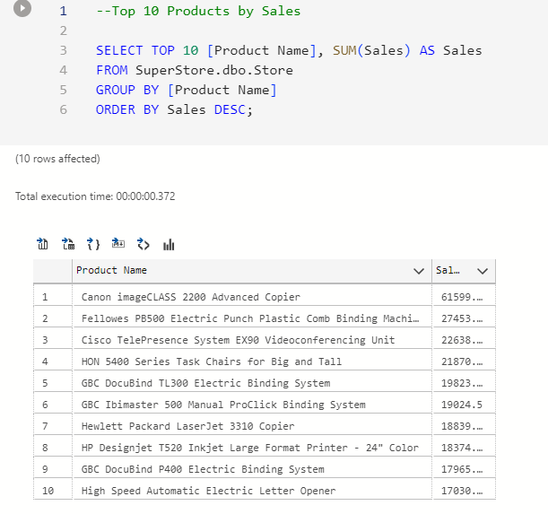
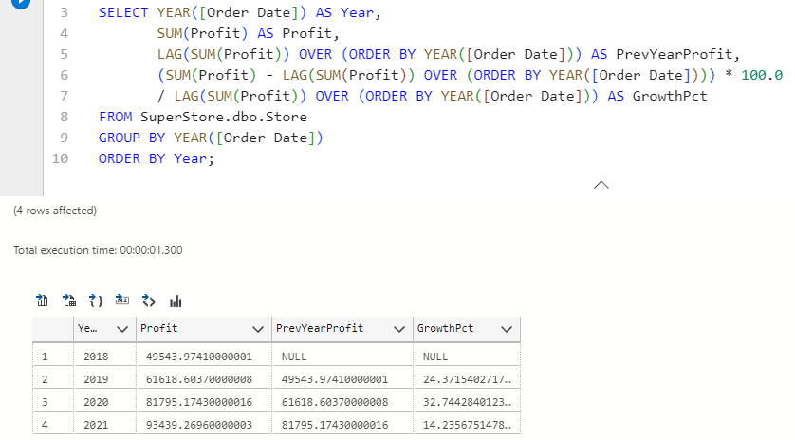
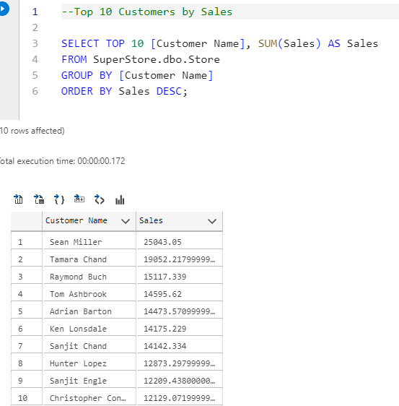

Slide 11

If you want to see more codes using python and sql for analysis visit my github repo https://github.com/rashadhazem?tab=repositories

