Slide 1
lab6
Class diagram & sequence diagram

Slide 2
UML diagrams
Class Diagram
Interaction diagram
Sequence diagram
Communication diagram
State diagram
Component & development diagram

Slide 3
Class diagram
Classes
Attributes
Operations
Relationships
Association
Generalization
Aggregation
Multiplicity

Slide 4
Example
An instructor can teach at least one course and at most 3 courses. Every course has one instructor, many students can register in a course, but a student is allowed to register in at least three courses and at most 7 courses.
Each course and instructor has a name and ID. Each student has name, ID and Address the student address is composed of country, city, road number and building number. The instructors can either be a full time or part time instructor.
Design the above class diagram.

Slide 5
UML Modeling Tools
MS Visual Paradigm
ArgoUML
StarUML
Etc..

Slide 6
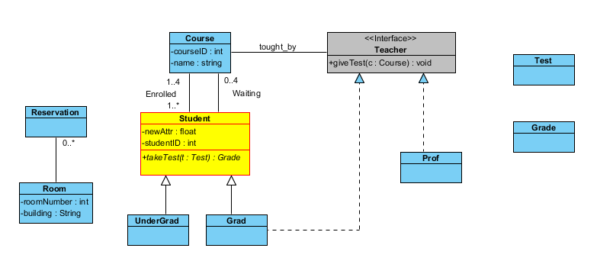
Lab activity #1

Slide 7
Lab activity #1
Step 1: Creating a new project
Create a project called Enroll.
Step 2: Naming the Model and the Diagram
Select class diagram
Name it enrollment

Slide 8
Lab activity #1
Step 3: Creating a Class and Name it
Add a new class
Name it Course
Step 4: Creating Attributes
Add to the course class two attributes courseID and name.

Slide 9
Lab activity #1
Step 5: Creating an Operation with parameters
add a new class called 'Student‘
Add 2 new attributes, calling them "newAttr" and "studentID".
Add a new Operation and call it "takeTest“, having one parameter called “t” of type “test” and returns Grade.
create a new class called "Test”.
create a new class called “Grade”.

Slide 10
Lab activity #1
Step 6: Using Styles
Change the color of the Student class to yellow and the border to red.
Step 7: Moving, Resizing, and drawing Associations
move the Student class below the Course class, and enlarge them.
Create two associations between the course and the student classes call them waiting and enrolled.

Slide 11
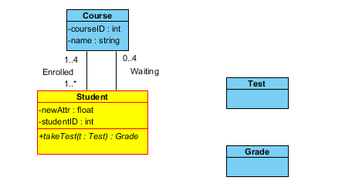
Lab activity #1
Step 8: Setting Multiplicity
Set the multiplicities for both associations as shown in the figure

Slide 12
Lab activity #1
Step 9: Creating an Interface, setting Navigability
Create an interface class and name it "Teacher", then create the operation "giveTest" on this interface, which takes as input c as class and returns grade.
Then add an association between the Course class and the new interface and name it "taught_by".

Slide 13
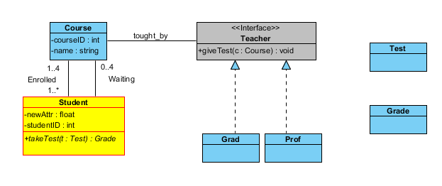
Lab activity #1
Step 10: Adding a Realization of an interface
Color the interface light gray.
To have classes implement this new interface, add a "Grad" and "Prof" class to the diagram. And then have these two classes Realize the "Teacher" interface.

Slide 14
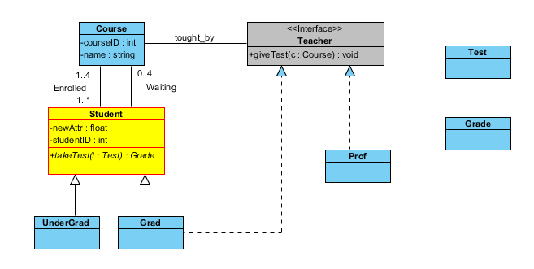
Lab activity #1
Step 11: Adding a Generalization
If you want to have underGrad and Grad classes to extend the Student class, use Generalization

Slide 15
Lab activity #1
Step 12: Finishing the diagram
To shift all items on the diagram aside to make room for the 2 new classes.
create the 2 classes needed: "Reservation" and "Room".

Slide 16
Lab activity #1

Slide 17
Lab activity #1
Step 14: Generating Code

Slide 18
Lab Activity #2
In a university there are different classrooms, offices and departments, a department has a name and contains many offices, A person working at the department has a unique ID and can be a professor or an employee. A professor can be full, associate or assistance professor and he is enrolled in one department. Offices and classrooms has an ID number, a class room has the number of seats. Every employee works in an office.
Design the class diagram of the above problem on the visual paradigm tool.

Slide 19
Students work
Student Activity #1
Student Activity #2
Due date: Next Tuesday 22/11/2016

Slide 20
Sequence diagram
Sequence diagram shows how objects interacts in a given situation.
Time starts from top to bottom.
Main components:
Actor-> the one who interacts with the system
Target -> objects and classes in which messages are send to
Message -> communication between targets

Slide 21

target
Target name
Life line : extends as long as the target exists

Slide 22
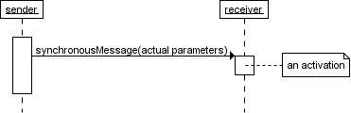
Message
Activation: object responding to message

Slide 23
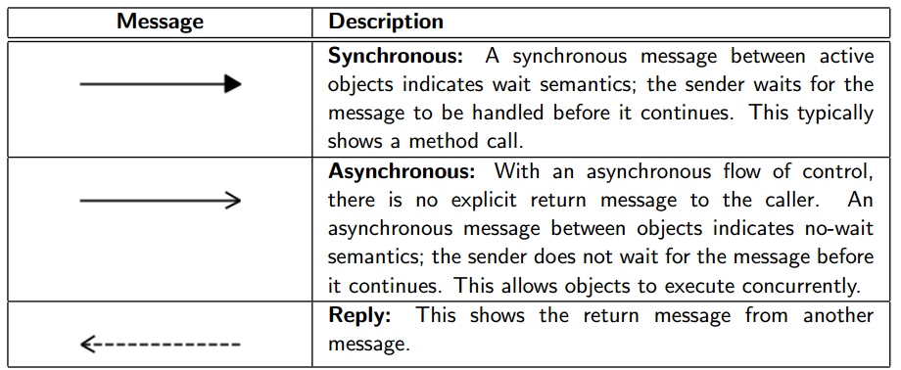
Message TYPE

Slide 24
Lab Activity #3
Step 1: Adding Sequence diagram to the project
Enter the diagram name (ATM system)
Step 2: Creating actor
CREATE AN ACTOR AND NAME IT atmUSER

Slide 25
Lab Activity #3
Step 3: Creating lifeline
CREATE A LIFELINE AND NAME IT atmcONTROLLER
Step 4: Adding Message
ADD A MESSAGE BETWEEN atmUSER AND ATM CONTROLLER AND SEND “insertCard()”

Slide 26
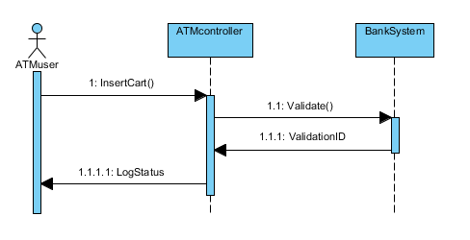
Lab Activity #3

