Slide 1
Virtualization Architecture
Virtualization Platforms

Slide 2
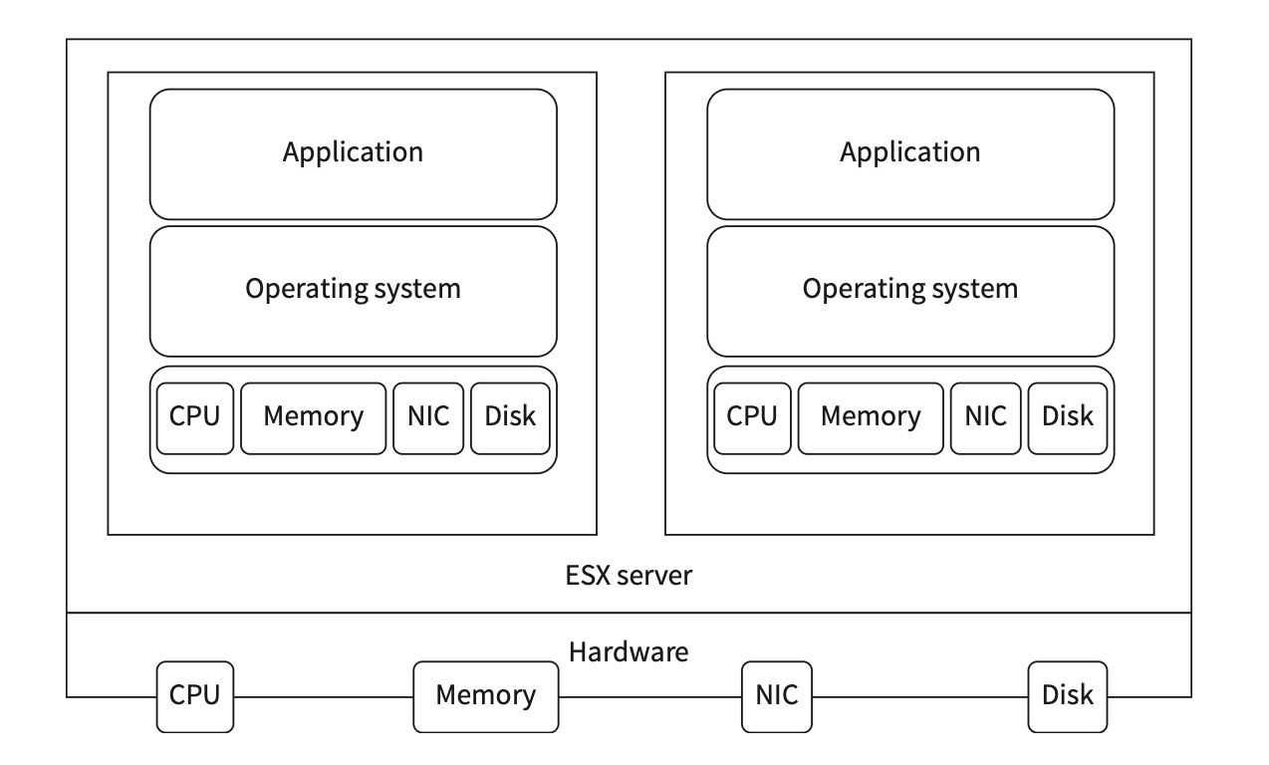
VMware ESX Server
VMware ESX Server’s virtualization layer abstracts the processor, memory, network, and storage resources into multiple VMs by delivering the highest levels of performance, scalability, and robustness for the enterprises

Slide 3
Features of VMware ESX Server
Bare-metal architecture
CPU virtualization
Network virtualization
Storage virtualization

Slide 4
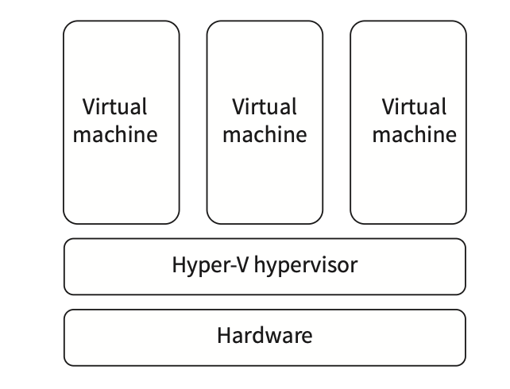
Microsoft Hyper-V
Microsoft Hyper-V is the hardware virtualization product that allows creating and running a VM in its own isolated space

Slide 5
Features of a Hyper-V Hypervisor
Bare-metal architecture
Enhanced security and isolation
Flexible infrastructure
Scalability
Availability

Slide 6
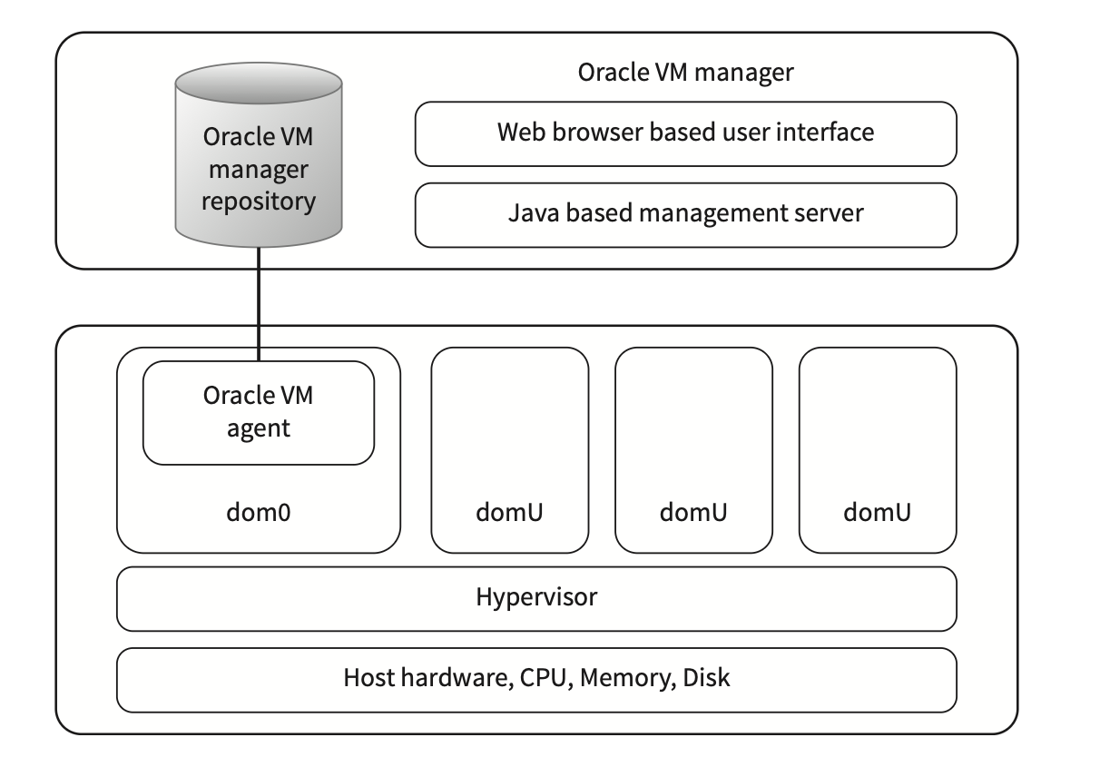
Oracle VM
The Oracle VM Manager controls the virtualization environment and serves as the only administrative interface of Oracle VM server as.
The hypervisor and privileged domain (dom0) in Oracle VM Server allow VMs to run on a single physical resource.

Slide 7
Features of Oracle VM Hypervisor
Bare-metal architecture
Network configuration and management
Storage configuration and management
Dynamic resource management

Slide 8
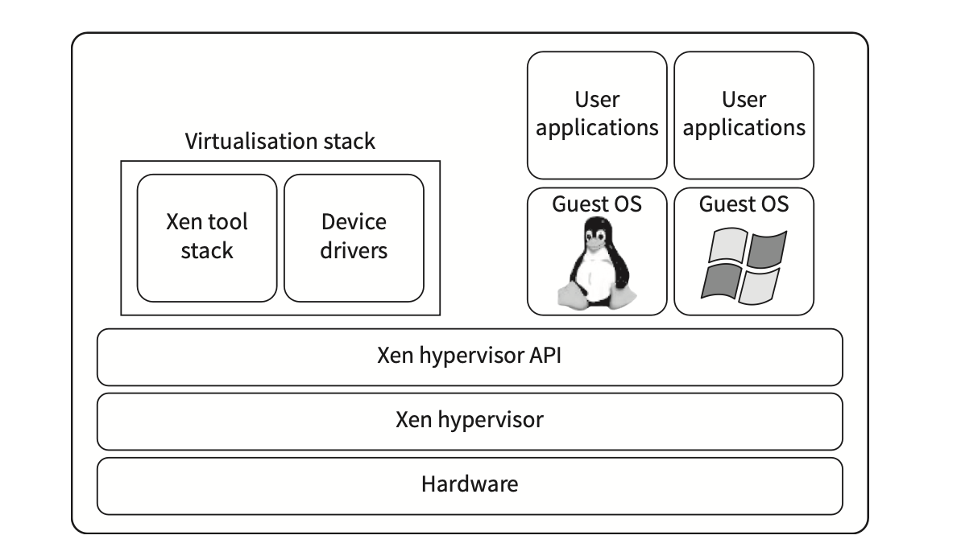
Citrix XenServer
A Citrix XenServer is the server virtualization platform from Citrix optimized for Windows and Linux

Slide 9
Features of Citrix XenServer
Bare-metal architecture
Low cost
Availability
Flexibility and portability

Slide 10
Additional Slides
Install Hyper-V
Oracle VM VirtualBox
Citrix XenServer

Slide 11
Install Hyper-VInstall Hyper-V
https://learn.microsoft.com/en-us/windows-server/virtualization/hyper-v/get-started/install-hyper-v?tabs=powershell&pivots=windows

Slide 12
Oracle VM VirtualBox
https://www.oracle.com/in/a/ocom/docs/dc/em/oracle-vm-virtualbox-overview-2981353.pdf

Slide 13
Citrix XenServer
https://docs.xenserver.com/en-us/xenserver/9/technical-overview

