Slide 1
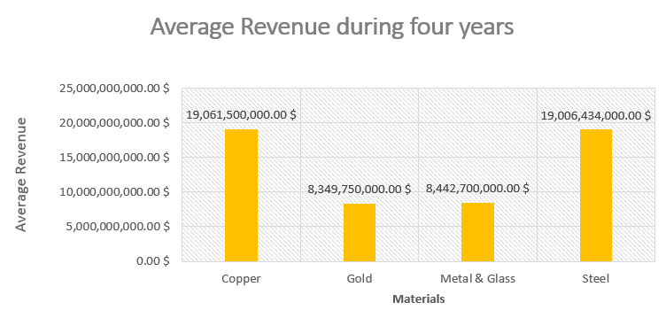
Among these materials which is have highest Revenue during four years ( Copper , Gold , Metal & Glass , Steel) ?
here are the chart that represents the average for Total Revenue each of the four materials ( Copper , Gold , Metal & Glass , and Steel) during the four years .
The highest value is copper when the mean is 19,061,500,000.00 $ and median is 19,465,500,000.00 $ and max reach to 21,438,000,000.00 $ in year 3 . The lowest value is gold when the mean is 8,349,750,000.00 $ and median is 8,071,500,000.00 $ and min value reach to 7,292,000,000.00 $ in year 3 .
The mean total revenue for company categorized under the materials Copper (19,061,500,000.00 $) was higher compared to mean total revenue for all the companies mentioned above While The mean total revenue for company categorized under the materials gold is
(8,349,750,000.00 $).
It looks like the companies of Copper and Steel have a higher revenue than Gold and Metal & Glass
Also, a median Copper and Steel have a close higher result than Gold and Metal & Glass that also have close median number .
the Range for the Copper Total Revenue it is 5,561,000,000.00 $
is higher than The Range of Total Revenue for the Gold at only 2,672,000,000.00 $
It looks like Copper have more significant variability in the total revenues they receive because their range is more spread out.
The standard deviation of total revenue for Copper materials industry (2,604,623,133.33 $) was higher than the standard deviation of total revenue for Gold (1,171,053,194.07 $). There's a higher variability of Total Revenues in the copper materials industry compared to gold materials industries

