Slide 1
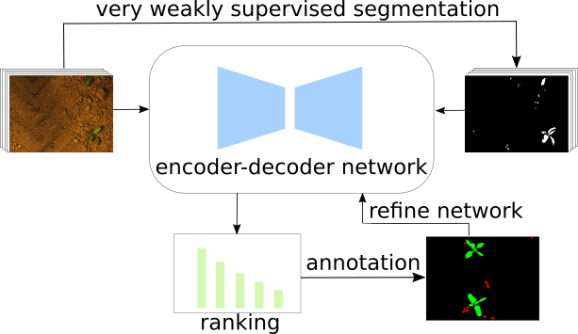
Gradient and Log-based Active Learning for Semantic Segmentation of Crop and Weed for Agricultural Robots
Rasha Sheikh, Andres Milioto, Philipp Lottes,
Cyrill Stachniss, Maren Bennewitz, Thomas Schultz
University of Bonn, Germany
Goal: facilitate automated weed control and reduce human labeling effort for semantic segmentation
Application: Transfer learning between fields with different crop statistics and growth stages
We design three gradient and log-based sampling strategies that make use of pseudo-labels
We obtain higher accuracies on two different fields with fewer images compared to random/entropy approaches

