Slide 1
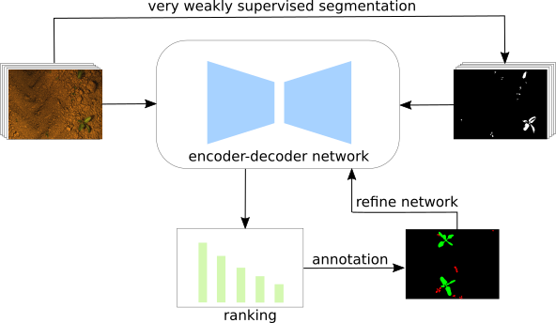
Gradient and Log-based Active Learning for Semantic Segmentation of Crop and Weed for Agricultural Robots
Rasha Sheikh, Andres Milioto, Philipp Lottes,
Cyrill Stachniss, Maren Bennewitz, Thomas Schultz
University of Bonn, Germany
Goal: facilitate automated weed control and reduce human labeling effort for semantic segmentation
Transfer learning between fields with different soil types and crop growth stages
We design three strategies to intelligently pick samples that make use of pseudo-labels
We obtain higher accuracies on two different fields with fewer images compared to random/entropy approaches

