Slide 1

Technology Mapping The Directed Acyclic Graph-Covering Problem and The Tree-Covering Problem
Presented by:
Rashed Hassan Siam
Class Roll: FH-2343
Registration No: 2022-518-433
Department of Computer Science and Engineering
University of Dhaka
Presented to:
Professor Dr. Hafiz Md. Hasan Babu
Department of Computer Science and Engineering
University of Dhaka
1

Slide 2
Contents
Technology Mapping and its Approaches
Dos and Don’ts of Technology Mapping
Directed Acyclic Graph
Prerequisites and Goals of the DAG-Covering Problem
Choice of Base Functions
Creating the Subject and Pattern Graphs
The DAG-Covering Problem Complexity
Alternative Approach: The Tree-Covering Problem
Splitting Subject Graph into Trees
The Tree Mapping Procedure
Pattern Matching
Tree Covering
Advantages and Limitations of The Tree-Covering Problem
1

Slide 3
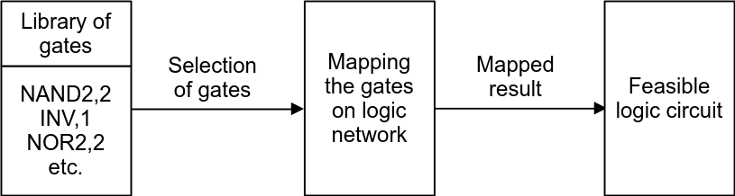
Technology Mapping
Helps to implement a logic circuit.
Performs the final gate selection from a particular library.
The library is also known as the Technology Library.
Consists of several gates (NAND2,2; NOR2,2; INV,1 etc.).
1

Slide 4
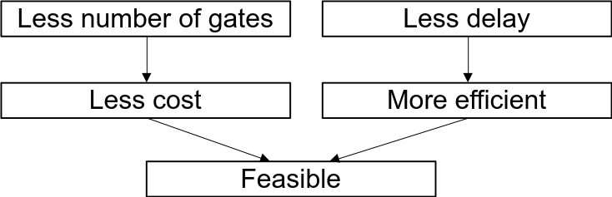
Feasible Circuits
Optimal with respect to area.
Least number of nodes/gates.
Satisfies a maximum critical-path delay.
The longest path of the circuit from input to output.
Should be within a specified threshold.
1

Slide 5
Dos and Don’ts of Technology Mapping
Doesn’t change the structure of the circuit radically.
Doesn’t reduce the number of levels of logic.
Technology Mapping
Chooses the fastest gates along the critical path.
Uses the most area-efficient combination of gates.
1

Slide 6
Technology Mapping Approaches
Two basic approaches
Rule-based techniques
Graph covering techniques
Applies a set of rules (e.g., De Morgan’s law) to convert expressions into implementable gate-level circuits.
Applies a set of base functions (e.g., NAND and inverter) which maps or covers all the graphs of the circuits and library gates.
<number>

Slide 7
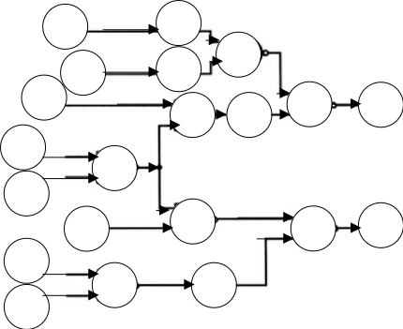
Directed Acyclic Graph
A graph made of nodes connected by directed edges.
There are no cycles.
We can't start at a node and return to it by following the edges.
In short, it is also called DAG.
A directed acyclic graph, where the circles are nodes and arrows are the directed edges.
<number>

Slide 8
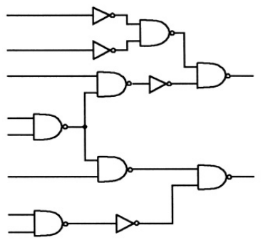
Logic Network in DAG Form
If we consider the previous DAG example, and replace its nodes with various gates, inputs and outputs, we get:
So, combinational logic networks are basically DAGs!
<number>

Slide 9
Prerequisites of the DAG-Covering Problem
Base Functions
Subject Graph
Pattern Graph
A set of chosen functions (e.g., a two-input NAND-gate and an inverter).
Used to design the graphs of the logic function and the library gates.
The simplified Boolean network is converted into the subject graph.
Each node is restricted to one of the base functions.
The logic function for each library gate is converted into a pattern graph.
Each node is restricted to one of the base functions.
<number>

Slide 10
Goals of the DAG-Covering Problem
To find a “minimum cost covering” of the subject graph by choosing appropriate collection of pattern graphs.
Covering means, every node of the subject graph is contained in one (or more) of the pattern graphs.
Minimum cost covering means:
Optimizing area of the cover.
Optimizing minimum delay of the cover.
<number>

Slide 11

Choice of Base Functions
The choice is arbitrary as long as the base function set is functionally complete.
A functionally complete function can express any other function.
Such as, two-input NANDs and inverters.
Different combinations of base functions produce different patterns of graphs.
Base function set with:
Two-input, three-input, and four-input NAND-gates: 1 pattern.
Two-input NAND-gates and inverters: 18 patterns.
<number>

Slide 12
Creating the Subject and Pattern Graphs
The logic function may have many combinations of graphs.
Happens due to the various possible combinations of the base function set.
Each representation is a potential subject graph for DAG-covering.
Every one of these subject graphs (starting points) should be considered for an optimum covering.
Similarly, many combinations of pattern graphs may also be generated.
Further increases the complexity of the DAG-covering problem.
<number>

Slide 13
The DAG-Covering Problem Complexity
DAG-covering-by-DAGs is NP-hard!
NP-hard means it’s not solvable in polynomial time.
Even with only three pattern graphs (inverter, two-input NAND, two-input NOR), and
Each subject graph node having no more than two incoming and outgoing edges.
Heuristics can be a more effective approach.
But this is still an open problem.
L. Lavagno at U.C. Berkeley has achieved some degree of success.
<number>

Slide 14
Alternative Approach: The Tree-Covering Problem
Reducing the DAG-covering problem to a set of tree-covering-by-trees problems.
Tree circuit is a single output circuit.
Each gate except the output, feeds exactly one other gate.
No fanout/branching at the outputs of any of the gates.
Partition the subject graph into trees by splitting it at the fanout points
Cover each tree optimally
Merge the tree-covers into a cover for the subject graph
<number>

Slide 15
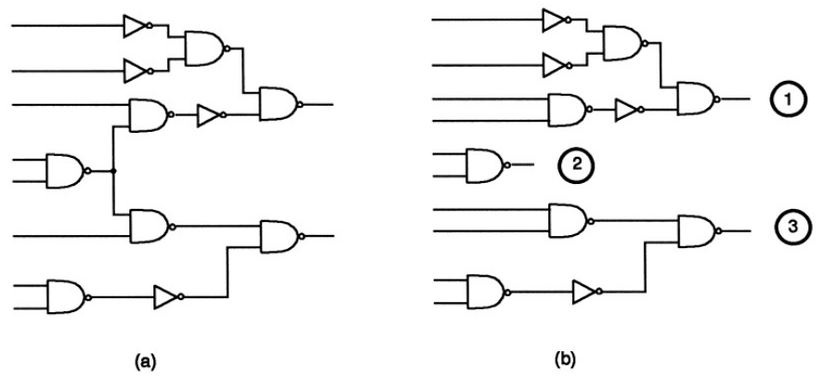
Splitting Subject Graph into Trees
Let’s consider the previous subject graph and split it:
The circuit on the left is not a tree, because there is one gate that feeds two other gates (marked as red crosses). So splitting it at these two locations, we obtained three trees (1, 2 and 3) on the right.
<number>

Slide 16
The Tree Mapping Procedure
Two phases
Pattern matching
Pattern matching
Pattern matching
Tree covering
Finds all possible ways in which a library pattern may cover some nodes of the subject tree.
Selects one optimum matching (minimum cost) for each node.
<number>

Slide 17
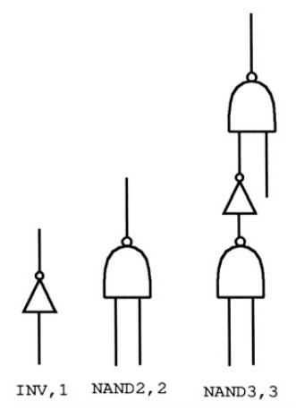
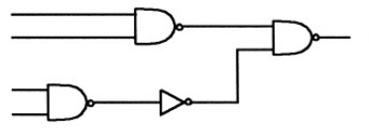


Some Assumptions
Let’s consider the Tree-3 for pattern matching and the library containing three gates (INV,1; NAND2,2; NAND3,3).
Base function set: two-input NANDs and inverters.
Figure: Tree-3 of the subject graph
Figure: Library gates
<number>

Slide 18
Pattern Matching (Cover 1)
If we select the three-input NAND gate to match the output node, then we cover gates f and g, besides h; hence, we do not need matches for f and g.
e
h
g
f
Figure: Tree-3 of the subject graph
Figure: Library gates
<number>

Slide 19
Pattern Matching (Cover 2)
If we choose the two-input NAND gate, then we need to select gates to cover f and g.
e
h
g
f
Figure: Tree-3 of the subject graph
Figure: Library gates
<number>

Slide 20
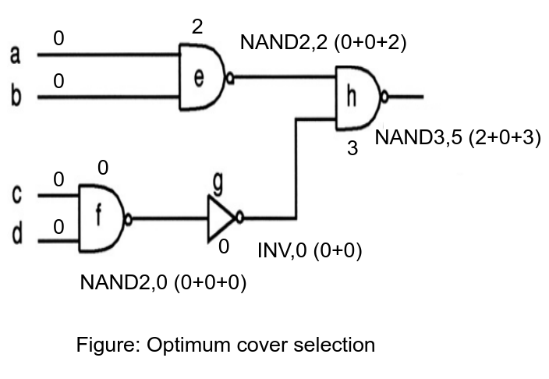
Tree Covering (Cover 1)
e
h
g
f
<number>

Slide 21
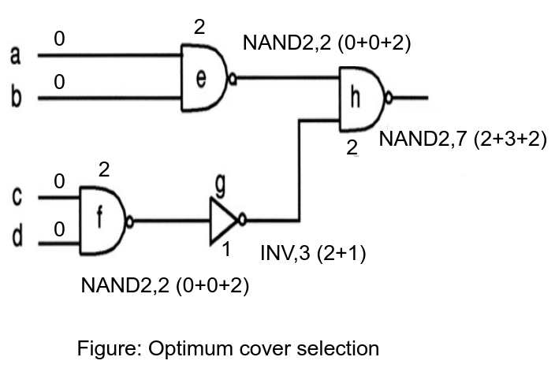
Tree Covering (Cover 2)
More costly than Cover 1,
so it is discarded
e
h
g
f
<number>

Slide 22
Advantages of Tree-Covering Problem
The NP-hardness of DAG-covering is removed.
Linear complexity can be achieved due to splitting of the subject graph.
Pattern matching is easier due to the reduction of search space.
This method has proven to be quite effective.
<number>

Slide 23
Limitations of Tree-Covering Problem
Loss of global view due to the step of partitioning into trees.
Covers across partition boundaries are not allowed.
Inefficient reduction of search space may affect the quality of the final solution.
Does not always provide the exact optimum solution.
<number>

Slide 24
References
Logic Synthesis and Verification Algorithms, Gary D. Hachtel and Fabio Somenzi.
DAGON: Technology Binding and Local Optimization by DAG Matching, K. Keutzer.
<number>

Slide 25
Thank You!
<number>

