Slide 1

Technology Mapping, The Directed Acyclic Graph-Covering Problem and The Tree-Covering Problem
Presented by:
Rashed Hassan Siam
Class Roll: FH-2343
Registration No: 2022-518-433
Department of Computer Science and Engineering
University of Dhaka
Presented to:
Professor Dr. Hafiz Md. Hasan Babu
Department of Computer Science and Engineering
University of Dhaka
1

Slide 2
Contents
Technology Mapping
Feasible Circuits
Dos and Don’ts of Technology Mapping
Technology Mapping Approaches
Directed Acyclic Graph
Logic Network in DAG Form
Prerequisites of the DAG-Covering Problem
Goals of the DAG-Covering Problem
Choice of Base Functions
Creating the Subject Graph
The DAG-Covering Problem
Alternative Approach: Tree-Covering Problem
Splitting Subject Graph into Trees
The Tree Mapping Procedure
Some Assumptions
Pattern Matching
Tree Covering
Advantages of Tree-Covering Problem
Limitations of Tree-Covering Problem
1

Slide 3
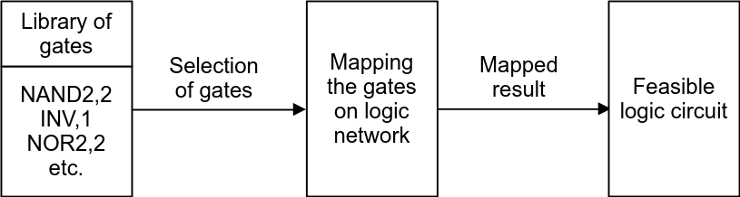
Technology Mapping
What does it mean?
The process of synthesizing or simply implementing the logic circuit by performing the final gate selection from a particular library.
1

Slide 4
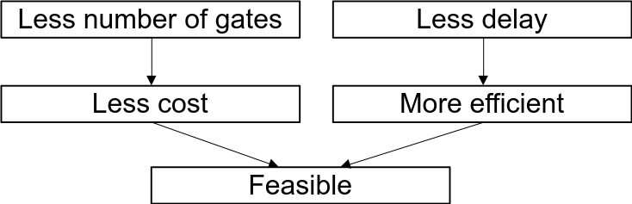
Feasible Circuits
Why is the final circuit called “feasible”?
Optimal with respect to area: Least number of nodes/gates.
Satisfies a maximum critical-path delay: The longest path of the circuit along which the input results the output, is within a specified threshold.
1

Slide 5
Dos and Don’ts of Technology Mapping
So, in general, Technology Mapping:
Doesn’t change the structure of the circuit radically.
Doesn’t reduce the number of levels of logic along the critical path.
Instead, Technology Mapping:
Chooses the fastest gates along the critical path.
Uses the most area-efficient combination of gates off the critical path.
1

Slide 6
Technology Mapping Approaches
Two basic approaches
Rule-based techniques
Graph covering techniques
Applies a set of rules (e.g., De Morgan’s law) to convert expressions into implementable gate-level circuits.
Applies a set of base functions (e.g., NAND and inverter) which maps or covers all the graphs of the circuits and library gates.
1

Slide 7
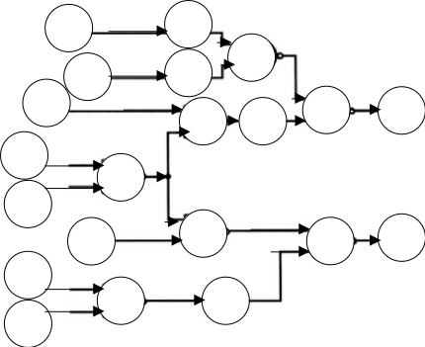
Directed Acyclic Graph
What does it mean?
It is simply a graph made of nodes connected by directed edges.
There are no cycles, meaning we can't start at a node and return to it by following the edges.
In short, it is also called DAG.
A directed acyclic graph, where the circles are nodes and arrows are the directed edges.
1

Slide 8
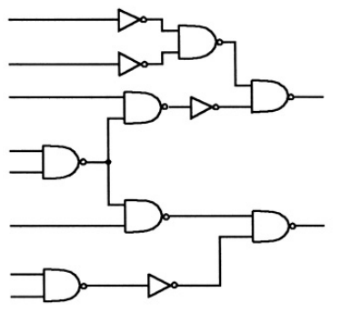
Logic Network in DAG Form
If we consider the previous DAG example, and replace its nodes with various gates, inputs and outputs, we get:
So, combinational logic networks are basically DAGs!
1

Slide 9
Prerequisites of the DAG-Covering Problem
Base Functions:
A set of base functions is chosen (e.g., a two-input NAND-gate and an inverter), using which the logic function and library gates will be designed as graphs.
Subject Graph:
The optimized/simplified Boolean equation is converted into the subject graph, where each node is restricted to one of the base functions.
Pattern Graph:
The logic function for each library gate is also represented by a pattern graph, where each node is restricted to one of the base functions.
1

Slide 10
Goals of the DAG-Covering Problem
The main goal is:
To find a “minimum cost covering” of the subject graph by choosing from the collection of pattern graphs for all gates in the library.
A cover is a collection of pattern graphs such that every node of the subject graph is contained in one (or more) of the pattern graphs.
Cost of the cover is defined in two ways:
For area optimization: The cost of the cover is defined as the sum of the areas of the individual gates.
For minimum delay optimization: The cost of a cover is defined as the critical path delay of the resulting circuit.
1

Slide 11

Choice of Base Functions
The choice of a set of base functions is arbitrary as long as the base function set is functionally complete.
A functionally complete set is a set of functions that can express any other function (e.g., two-input NANDs and inverters).
Different combinations of base functions can produce different patterns of the same logic function and library gates.
The goal is to find the base-function set which provides the highest level of optimization and produces a small set of patterns.
Base function set with:
Two-input, three-input, and four-input NAND-gates: 1 pattern.
Two-input NAND-gates and inverters: 18 patterns.
1

Slide 12
Creating the Subject Graph
A logic network has many representations as graphs of components from the base function set.
Each representation is a potential subject graph for DAG-covering, having different costs.
Every one of these starting points (subject graphs) should be considered for an optimum solution.
Heuristics (e.g., algebraic decomposition, Boolean simplification techniques, etc.) are used to find an optimal form for the subject graph.
<number>

Slide 13
The DAG-Covering Problem
This approach has a major issue: DAG-covering-by-DAGs is NP-hard!
It is NP-hard even with only three pattern graphs (inverter, two-input NAND, two-input NOR) and if each subject graph node has no more than two incoming and outgoing edges.
An exact covering algorithm was proposed based on a branch-and-bound procedure, but the complexity of the algorithm is very very large!
So, heuristics can be a more effective approach, but this is still an open problem.
L. Lavagno at U.C. Berkeley has experimented with a number of heuristics with some degree of success.
<number>

Slide 14
Alternative Approach: Tree-Covering Problem
Keutzer has proposed reducing the DAG-covering problem to a set of tree-covering-by-trees problems.
The steps are:
Partition the subject graph into trees by splitting it at the fanout points.
Cover each tree optimally.
Piece the tree-covers into a cover for the subject graph.
A tree circuit is a single output circuit in which each gate, except the output, feeds exactly one other gate, i.e., no fanout/branching at the outputs of any of the gates.
<number>

Slide 15
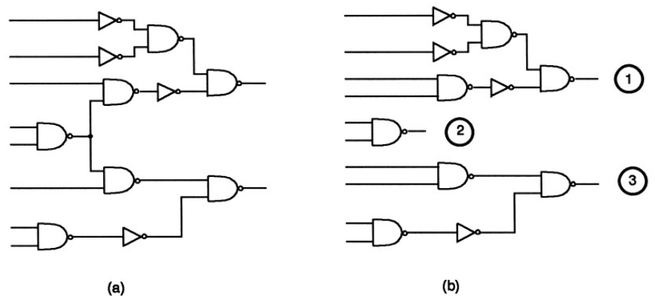
Splitting Subject Graph into Trees
Let’s consider the previous subject graph and split it:
The circuit on the left is not a tree, because there is one gate that feeds two other gates (marked as red crosses). So splitting it at these two locations, we obtained three trees (1, 2 and 3) on the right.
<number>

Slide 16
The Tree Mapping Procedure
Two phases
Pattern matching
Pattern matching
Pattern matching
Tree covering
Finds all possible ways in which a library pattern may cover some nodes of the subject tree.
Selects one optimum matching (minimum cost) for each node.
<number>

Slide 17
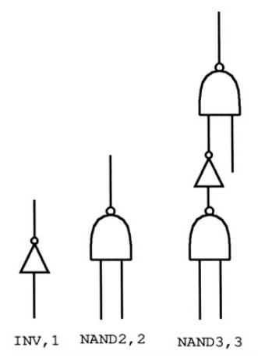
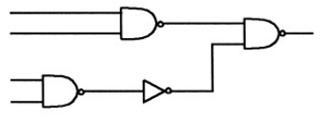
Some Assumptions
Let’s consider the tree-3 for pattern matching and the library containing three gates (INV,1; NAND2,2; NAND3,3) as shown below:
Figure: Tree-3 of the subject graph
Figure: Library gates
<number>

Slide 18
Pattern Matching
If we select the three-input NAND gate to match the output node, then we cover gates f and g, besides h; hence, we do not need matches for f and g.
If we choose the two-input NAND gate, then we need to select gates to cover f and g.
Figure: Library gates
e
h
g
f
Figure: Tree-3 of the subject graph
<number>

Slide 19
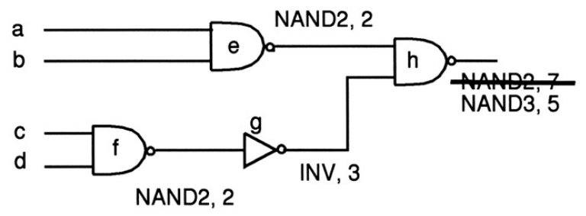
Tree Covering
0
2
(0+0+2)
0
(2+3+2)
2/3
0
2
(2+0+3)
0
1
(2+1)
(0+0+2)
Figure: Library gates
Figure: Optimum cover selection
e
h
g
f
Figure: Tree-3 of the subject graph
<number>

Slide 20
Advantages of Tree-Covering Problem
The NP-hardness of DAG-covering is removed.
Linear complexity can be achieved due to splitting of the subject graph.
Pattern matching is easier due to the reduction of search space.
This method has proven to be quite effective.
<number>

Slide 21
Limitations of Tree-Covering Problem
Loss of global view due to the step of partitioning into trees.
Covers across partition boundaries are not allowed.
Inefficient reduction of search space may affect the quality of the final solution.
Does not always provide the exact optimum solution.
<number>

Slide 22
References
Logic Synthesis and Verification Algorithms, Gary D. Hachtel and Fabio Somenzi.
DAGON: Technology Binding and Local Optimization by DAG Matching, K. Keutzer.
<number>

Slide 23
Thank You!
<number>

