Slide 1
Automatic System Adapter using
Bidirectional counting

Slide 2
Prepared By
Mohammad Rashedul Alam
ID-1511384642
Section-01

Slide 3
INTRODUCTION
A lot of the time we need counting solution
for simple uses that is easy to manage and low costly. For
such cases this project is suitable to implement as it requires
low power and management. A simple Microcontroller hooked
up with sensors is used.

Slide 4
Practical Example
Lights or fan used in a room or mall would adapt according to the people present inside. Similarly the power of A/C would adjust to people density and thus save power by reducing unnecessary consumption

Slide 5
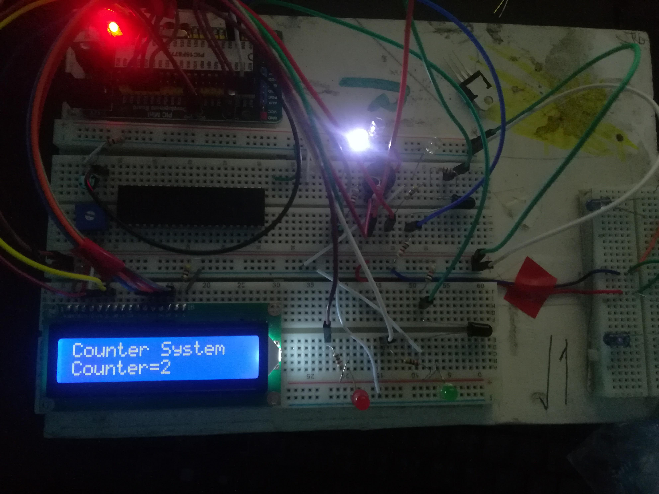

Slide 6
Equipments Used:
IR Pair
PIC 16F877A
16*2 LCD
LED
Crystal Oscillator
Capacitor
Resistors

Slide 7
PIC 16F877A
Program Memory Type
Flash
Program Memory (KB)
14
CPU Speed (MIPS)
5
RAM Bytes
368
Data EEPROM (bytes)
256
ADC
8 ch, 10-bit
Comparators
2
Temperature Range (C)
-40 to 125
Operating Voltage Range (V)
2 to 5.5
Pin Count
40

Slide 8
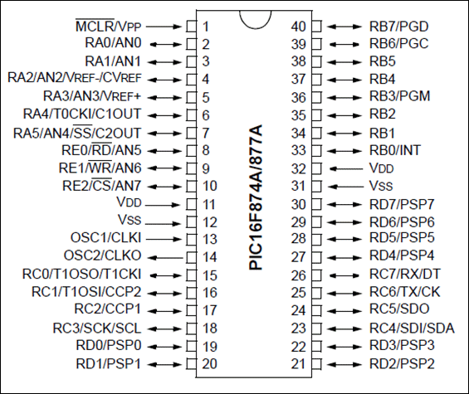
Pin Configuration
I/O Ports:
1)PORTA-6pin
2)PORTB-8 pin
3)PORTC-8 pin
4)PORTD-8 pin
5)PORTE-3 pin

Slide 9
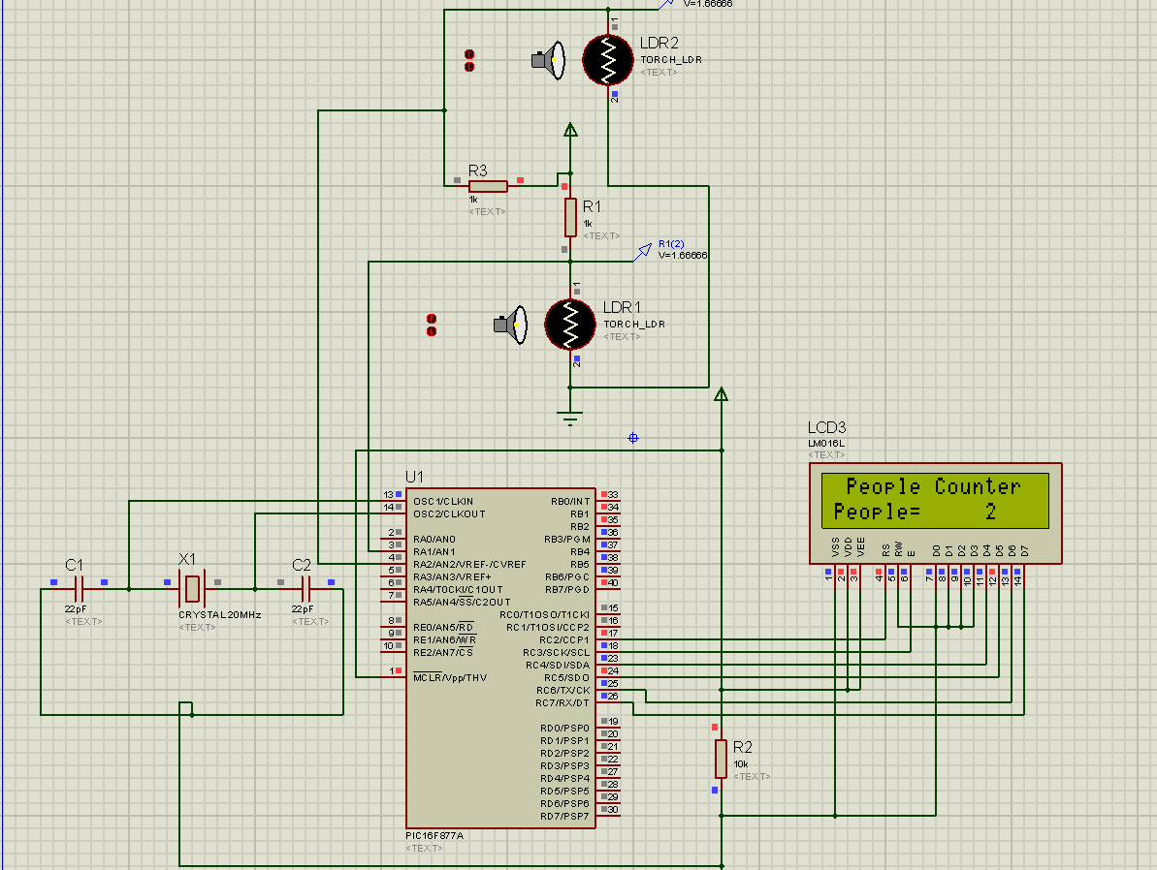
System Circuit

Slide 10
Applications:
Sitting Bus Services could keep track of passenger
Parcel Companies can keep track of parcels
Auditorium or Cinema Halls can keep track of people
Class Rooms can keep track of students
Aircondition System can auto adjust with people density
Light fan can auto adjust according to people

