Slide 1


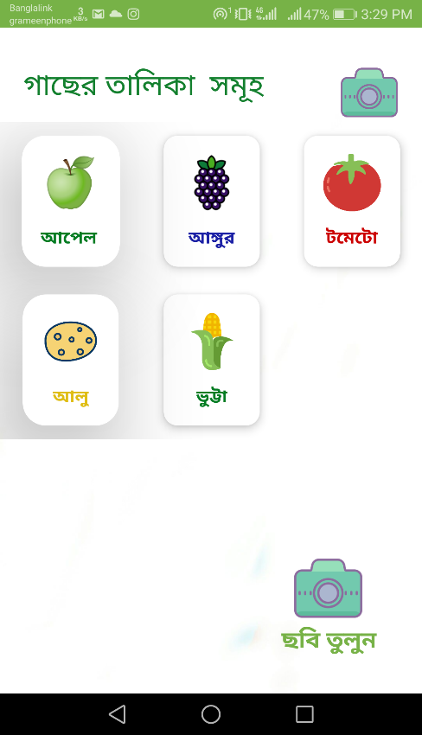
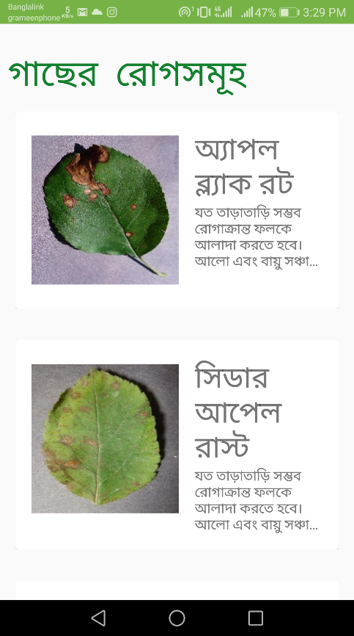
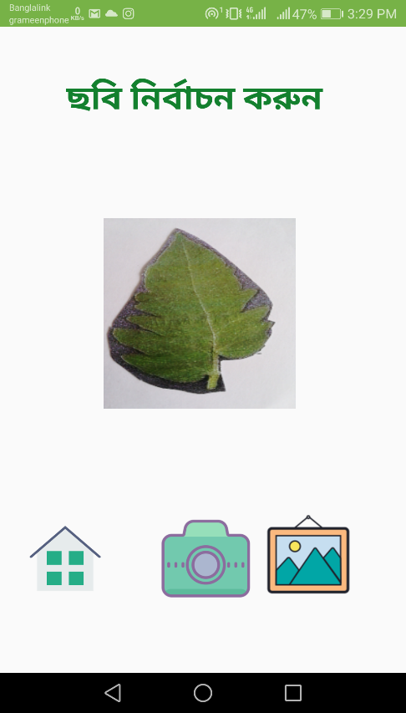
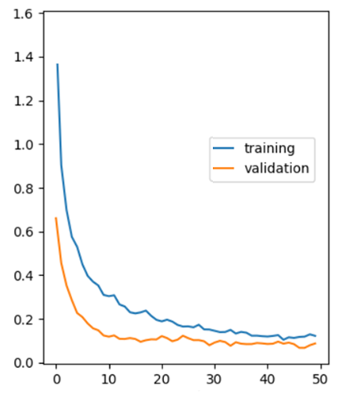
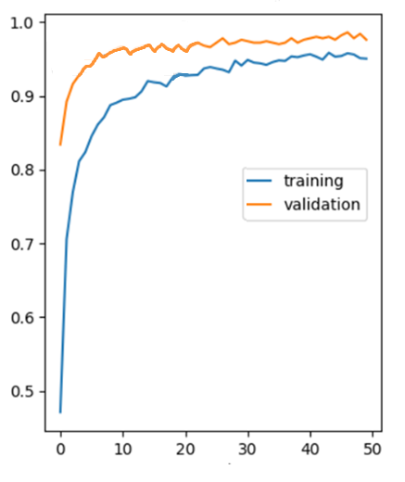
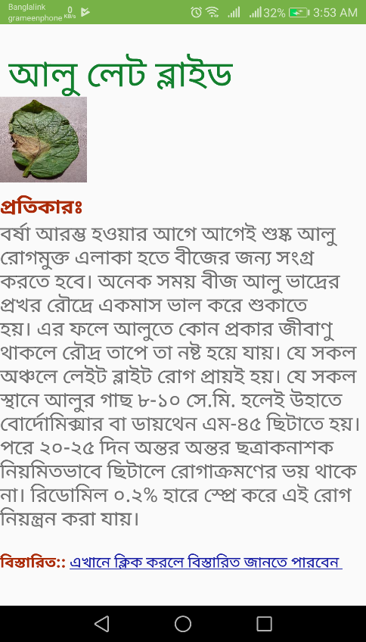
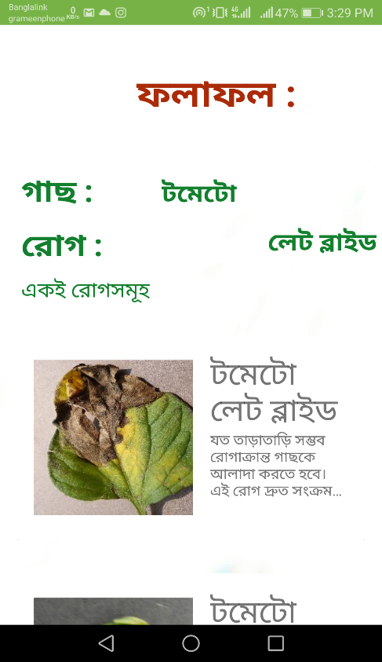

Plant Disease Detection and Solution for Rural Farmers Using Computer Vision, Cloud Computing and Android Platform Mohammad Rashedul Alam, Sakib Mukter, Aminul Islam Advisor: Md. Shahriar Karim
Overview
System Architecture
Model Description
Bangladesh is a densely populated country with considerably low per capita arable land. This makes a daunting task to grow sufficient food grains for about 160 million people.
Also, diseases prevalence and the lack of proper monitoring causes significant crop loss as high as 30% in some cases.
For instance, Potato, Tomato, and Rice production decrease by 37%, 43%, and 10% respectively, because of various leaf infection.
To assist farmers, we have developed a voice-assisted app, namely the কৃসহায়ক (Kri-Sho-hayok), for instant detection of plant diseases using low-resolution images of affected leaves.
Fig. 5: Model Architecture
We have chosen MobileNet as our base architecture.
A comparison among alternative candidate models reveals MobileNet as the best fit for this problem.
Significance
Early and accurate detection of plant diseases can prevent a large-scale yield loss.
Farmers can check their crops regularly through this voice-assisted app and take measures accordingly.
Also, the proposed framework is extendable to diseases detection for other crops.
Conclusion
Farmers will be able to detect diseases of potatoes, tomatoes, apples, etc. by using this app.
This allows the farmers to take necessary steps before it is too late.
The architecture of the project is also adaptable for other kinds of crops and poultry diseases.
Fig. 2: Overall system architecture
Method
Captured images are sent to the cloud and the server pre-processes those images and sends the predictions back to the device via database.
We have collected labeled-dataset of 5 different crops containing 25 classes of diseases.
The dataset is pre-processed and visualized for experimentation and feature extraction.
Supervised machine learning is used to train the classifier.
Android App
Results
Acknowledgements
Model Loss
Model Accuracy
We are thankful for all the comments and helpful instructions from our dear classmates of ECE499 section 8.
Also, we are most thankful to our honorable Advisor Md. Shahriar Karim
loss
accuracy
References
[1] Ferentinos, Konstantinos P. “Deep Learning Models for Plant Disease Detection and Diagnosis.” Computers and Electronics in Agriculture, vol. 145, 2018,pp.11–318.,doi:10.1016/j.compag.2018.01.009.
[2] Ferentinos, Konstantinos P. “Deep Learning Models for Plant Disease Detection and Diagnosis.” Computers and Electronics in Agriculture,vol.145,2018,pp.311–318., doi:10.1016/j.compag.2018.01.009.
[3] Tucker C. Red and photographic infrared linear combinations for monitoring vegetation. Remote Sens Environ. 2016.10.16
epoch
epoch
Fig. 4: Model accuracy and loss vs epoch
Model Comparison
Video Tutorial
Classifier | Accuracy
MobileNet | 96.08%
AlexNet | 86.08%
Custom CNN | 90.05%
Fig. 1: Model Learning Process
Fig. 3: Activity Screenshots

