Slide 1

Artificial Intelligence (AI)-Centric Management of Resources in Modern Distributed Computing Systems
By Shashikant Ilager, Rajeev Muralidhar, Rajkumar Buyya
Group Presentation
Course Name: Distributed Computing System
Course Code: CSE 707
Submitted To
Annajiat Alim Rasel
Lecturer, Department of Computer Science & Engineering
BRAC University
Submitted By
1. Towshik Anam Taj(21366026) 2. Tonusri Mahalanabish(21166012)
3. Jayed Mohammad Barek(21366008) 4. Raihana Tabassum(21366006)
5. Md. Rashedul Hasan Safa(21366027)
‹#›

Slide 2
Introduction
Cloud Data Centers and IoT
Resource Management System (RMS)
Possibility of Artificial Intelligence Driven RMS
What This Paper Explored
Possibilities
Necessities
Challenges
Conceptual Model
Test Cases
‹#›

Slide 3
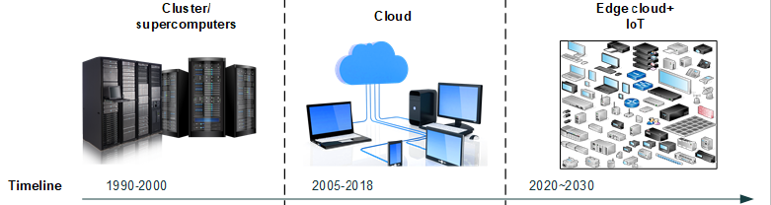
DCS Evolution
Scientific Domain Applications
Effective Usage of Resources
Autonomously Sense, Connect & Actuate Applications

Slide 4
Challenges
Availability of Data.
Managing the Deployment of Models.
Non-Deterministic Outputs.
Black Box Decision Making.
Lightweight and Meaningful Semantics.

Slide 5
Complex Network Architectures, Overlays, Upcoming Features.
Challenges
(Continue…….)
Commercial Clouds.
5G networks.
Performance, Efficiency, and Domain Expertise.
Need for learning .
Safety constraints .
Need of reward functions.
Inference .

Slide 6
Future Research Directions
Data-driven Resource Provisioning and Scheduling:
The problems related to provisioning such as estimating the number of resources required for an application, co-locating workloads
Spot Instances
Data-driven AI solutions can be used in scheduling tasks such as finding an efficient node, VM consolidation, migration, etc.
Managing Elasticity using Predictive Analytics:
Forecasting the future load and proactively scaling the resources vastly improves SLAs and saves costs.
Need time series analysis to predict future load using ARIMA or LSTM networks

Slide 7
Future Research Directions
Energy Efficiency and Carbon footprint Management:
AI techniques in device energy-optimised frequency management
Intelligent and energy-efficient workload management
Reducing cooling energy by fine tuning cooling parameters
Executing applications within power budgets
Security and Privacy Management:
AI-based Intruder Detection Systems (IDS)
Anomaly Detection
To identify the deviations in the application
AI techniques, including Artificial Neural Networks (ANNs), ensemble learning, Bayesian networks, association rules, and several classification techniques like SVM, can be effectively utilised

Slide 8
Future Research Directions
Managing Cloud Economics:
ML models can forecast resource demand, and excessive resources can be pooled in the open market
Pricing can be more dynamic
Generating the Large-scale Data Sets:
AI models itself can be used to create large-scale synthetic datasets that closely depict the real-world datasets.

Slide 9
Future Research Directions
Future Research Architectures
Other Avenues
‹#›

Slide 10
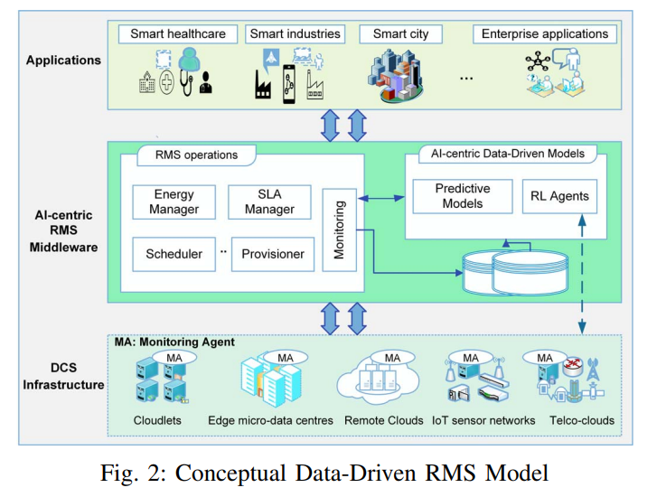
Conceptual Model for AI-Centric RMS
Users/ Applications
AI-centric RMS Middleware
DCS Infrastructure
‹#›

Slide 11
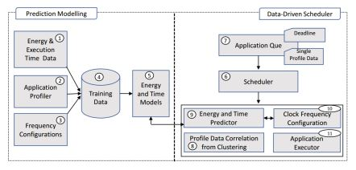
Demonstration Case Studies
Data-Driven GPU Clock Configuration and Deadline aware Scheduling
GPU s are widely used in compute-sensetive application
It is also used to run ML models.
Energy consumption problem.
DVFS is used
Configuring the optimal clock frequency is a non-trivial task
‹#›

Slide 12
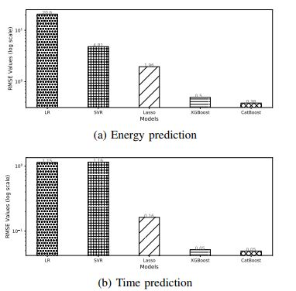
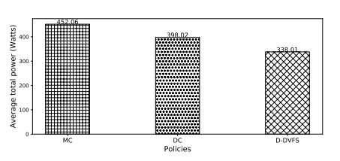
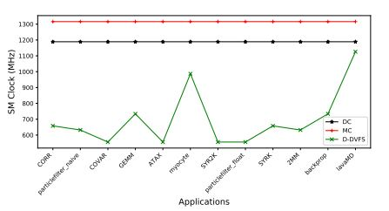
Demonstration Case Studies (Continue…….)

Slide 13
Demonstration Case Studies (Continue…….)
Industrial (Google Cloud and Microsoft Azure) Data Centre Management
Data centres are the backbone infrastructures of cloud computing.
Even a 1% improvement in data centre efficiency leads to savings in millions of dollars over a year.
The two systems they discussed are
Microsoft Azure
Google Cloud

Slide 14
Conclusion
Summery
Loopholes

Slide 15
Thank you!
‹#›

