Slide 1

Neural Machine Translation
(Document-level Neural Machine Translation Using BERT as Context Encoder)
By Zhiyu Guo , Minh Le Nguyen
Group Presentation
Course Name: Symbolic Machine Learning 2
Course Code: CSE 712
Submitted To
Annajiat Alim Rasel
Lecturer, Department of Computer Science & Engineering
BRAC University
Submitted By
1. Jayed Mohammad Barek(21366008) 2. Shanuma Afrin Meghla(21166010)
3. Ayesha Siddika(21166003) 4. Raihana Tabassum(21366006)
5. Md. Rashedul Hasan Safa(21366027)

Slide 2
Introduction
BERT significantly boosts the performance of many natural language understanding tasks
Purpose:
Achieve document-level representation
Integrated into encoder and decoder of Transformer NMT model.
Used:
Multihead attention mechanism and context gate to control

Slide 3
Introduction
BERT’s pre-training tasks is the binarized next sentence prediction (NSP)
Results showed:
Proposed model can outperform Transformer baselines
Previous state-of-theart document-level NMT models
BERT encoder can capture document level context representation

Slide 4
Related Works
Uni-encoder models (Tiedemann and Scher-
rer, 2017; Li et al., 2019; Ma et al., 2020)
Dual-encoder models (Voita et al., 2018; Zhang et al., 2018; Werlen et al., 2018; Maruf et al., 2019; Yang et al., 2019b

Slide 5

Approach
Here, X= x₁ ,x₂,...........,x_{N}
Y= y₁ ,y₂,...........,y_{N}
C_{B} = Bert(x)

Slide 6
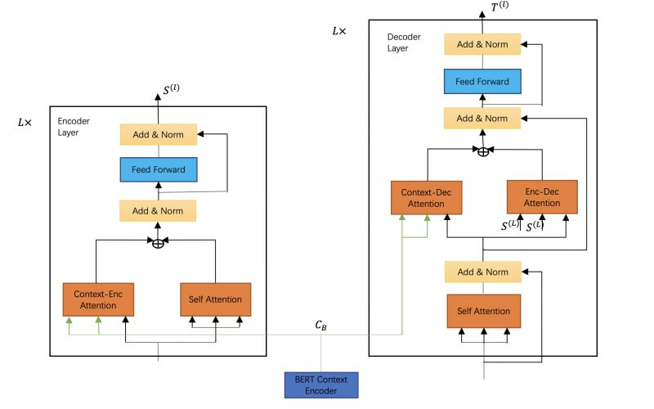
Approach (Contd.)

Slide 7
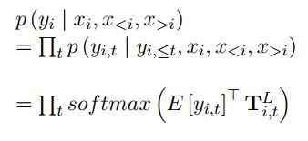
Approach (Contd.)
B^{(l)}= Multihead( S^{(l-1)}, S^{(l-1)}, S^{(l-1)} )
D^{(l)} = MultiHead( S^{(l-1)}, C_{B} , C_{B} )
g^{l} = σ( W^{l}_{g} [B^{(l)} , D^{(l)} ] + b^{l}_{g} )
A^{(l)} = g^{l} ⊙ B^{(l)} + (1- g^{l}) ⊙ D^{(l)}
S^{(l)} = FFN(A^{(l)})
E^{(l)}= Multihead( T^{(l-1)}, T^{(l-1)}, T^{(l-1)} )
F^{(l)} = MultiHead( T^{(l-1)}, C_{B} , C_{B} )
G^{(l)} = MultiHead( T^{(l-1)}, S^{(l)} , S^{(l)} )
d^{l} = σ( W^{l}_{d} [F^{(l)} , G^{(l)} ] + b^{l}_{d} )
H^{(l)} = d^{l} ⊙ F^{(l)} + (1- d^{l}) ⊙ G^{(l)}
T^{(l)} = FFN(H^{(l)})

Slide 8
Experiments

Slide 9
Dataset
Introduction
Two standard dataset containing translation from English to German are used.
TED: Machine Translation based arranged in sentence level from IWSLT 2017.
News Commentary: Data arranged in sentence level from document-delimited News Commentary v11.
Preprocessing
The same train-valid-test data has been used from “Selective attention for context-aware neural machine translation” for better comparison with former research.
Tokenization is conducted using Moses toolkit.
Byte pair encoding scheme for sentence segmentation with 30K merge operations.

Slide 10


Implementation Details
T
Transformer NMT
Training
Random Initialization of context encoder and decoder attention.
Bert model is bert_base_uncased
Trained
Transformer NMT
T
Initialization of
Document level
Implementation
Steps
T
Document Level Model

Slide 11
Implementation Details
Table: showing proposed NMT model configuration
Hidden layer size | 512
Dimension of FFN | 2048
No. of layers | 4
Attention head | 8
Sentence model dropout | 0.1
Document model dropout | 0.2
Optimization | Adam with 4000 epochs
Batch size | 4000 tokens
Loss function | Cross entropy
Transformer Implementation is rooted on FAIRSEQ
The paper mostly followed the model configuration of “Selective attention for context-aware neural machine translation”

Slide 12
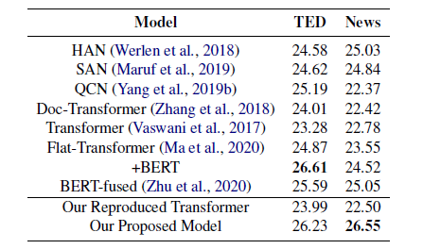
Experimental Results
Fig: BLEU scores on two document level machine translation benchmarks
The proposed model obtained a gain of 2.24 BLEU on TED dataset and 4.05 BLEU on News dataset over the re-implemented Transformer sentence level baselines.
Employing BERT document-level representation, the framework achieved supremacy over all other former structures on News dataset.

Slide 13
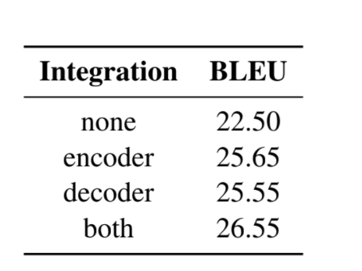
Ablation Study
Effect of Context Integration
Table: Effect of context integration

Slide 14
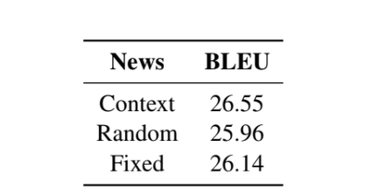
Ablation Study
Effect of Context Integration
3 types input for the BERT context encoder
Context
Random
Fixed
Table: BLEU scores using 3 context inputs

Slide 15
Conclusion
Summary
Future Work
Loopholes

Slide 16
Thank you!

