Slide 1
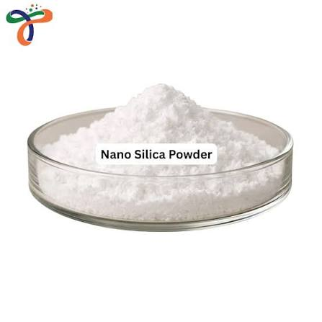
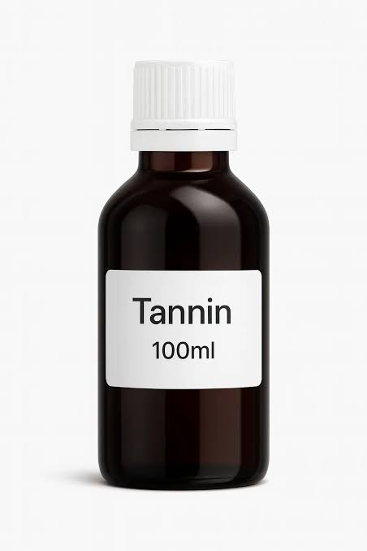
RESEARCH PROPOSAL PRESENTATION
Development of Nano-Reinforced
Bio-Based Adhesives for
Particleboard Manufacture
Presented by
Rashedul Sardar
Student ID: MS-260509
Forestry and Wood Technology Discipline
Khulna University

Slide 2
Introduction
02
Why develop improved adhesives for particleboard?
BIO-BASED
Nano-based adhesives offer a promising approach to improving the bonding performance of wood-based composites through nanoscale reinforcement.
Tannin from Acacia catechu bark
Conventional UF-based systems are effective, but formaldehyde emissions and moisture sensitivity remain concerns.
NANO-REINFORCED
Nano-silica as the main variable
Bio-based tannin can support renewable-resource use, while nano-silica may enhance adhesive performance.
TARGET
This study will incorporate nano-silica into a tannin–UF adhesive system to evaluate its effects on particleboard properties and identify the optimum concentration.
Strong, moisture-resistant particleboard
FORESTRY AND WOOD TECHNOLOGY | KHULNA UNIVERSITY

Slide 3
Research Objectives
03
Develop
Optimize
01
02
Develop a nano-reinforced bio-based adhesive for particleboard manufacture.
Optimize nano-silica concentration while maintaining the base adhesive components.
Evaluate
Identify
03
04
Evaluate physical, mechanical, moisture-related and thermal performance.
Identify the formulation that provides the best overall particleboard performance.
FORESTRY AND WOOD TECHNOLOGY | KHULNA UNIVERSITY

Slide 4
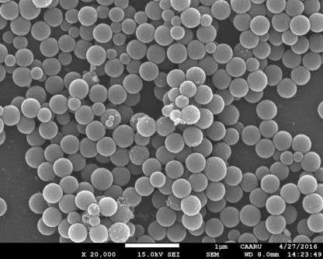
Methodology
04
Materials
Tannin, UF resin, nano-silica and hexamine; mango wood chips (1–3 mm).
1
Formulation
Keep tannin and UF fixed; vary nano-silica from 0 to 2.5%.
2
Dispersion
Stir at 600 rpm for 15 min, then ultrasonicate for 10 min.
3
SEM image of nano silica particles.
Board manufacture
Dry chips to 2–4% moisture; apply 10% adhesive; hot-press at 170°C, 10 MPa, 10 min.
4
Testing & analysis
Test density, moisture content, water uptake, thickness swelling, linear expansion, MOR, MOE and IB; analyze with SPSS.
5
FORESTRY AND WOOD TECHNOLOGY | KHULNA UNIVERSITY

Slide 5
Expected Outcomes, Timeline & Conclusion
05
Expected Outcomes
Research Activities & Timeline
Improved strength, moisture resistance, thermal stability and durability.
Jul–Aug 2026
Literature review
Aug–Oct 2026
Material collection & characterization
Greater use of renewable biomass and reduced dependence on conventional adhesive systems.
Oct–Dec 2026
Formulation & optimization
Potential contribution to SDGs 9, 12 and 13.
Particleboard manufacture
Dec 2026–Jan 2027
Jan–Mar 2027
Performance & durability tests
Mar–May 2027
Analysis, writing & submission
Conclusion
The study will identify an effective nano-silica-reinforced tannin–UF adhesive formulation and evaluate its suitability for stronger, more durable particleboard.
FORESTRY AND WOOD TECHNOLOGY | KHULNA UNIVERSITY

Slide 6
References
06
Bardak, T., Sozen, E., Kayahan, K., & Bardak, S. (2018). The impact of nanoparticles and moisture content on bonding strength of urea formaldehyde resin adhesive. Drvna industrija, 69(3), 247–252. https://doi.org/10.5552/drind.2018.1755
Cui, Z., Xu, Y., Sun, G., Peng, L., Li, J., Luo, J., & Gao, Q. (2023). Improving bond performance and reducing cross-linker dosage of soy protein adhesive via hyper-branched and organic–inorganic hybrid structures. Nanomaterials, 13(1), 203. https://doi.org/10.3390/nano13010203
Roumeli, E., Papadopoulou, E., Pavlidou, E., Vourlias, G., Bikiaris, D., Paraskevopoulos, K. M., & Chrissafis, K. (2012). Synthesis, characterization and thermal analysis of urea–formaldehyde/nanoSiO₂ resins. Thermochimica Acta, 527, 33–39. https://doi.org/10.1016/j.tca.2011.10.007
Zhu, Z., Zhang, E., Zeng, Q., Rao, J., & Chen, N. (2022). Graphene oxide functionalized cottonseed-lignin resin with enhanced wet adhesion for woody composites application. Polymers, 14(1), 1. https://doi.org/10.3390/polym14010001
FORESTRY AND WOOD TECHNOLOGY | KHULNA UNIVERSITY

Slide 7
THANK YOU
Questions & Discussion
Rashedul Sardar | MS-260509
Forestry and Wood Technology Discipline, Khulna University

