Slide 1
AWS Certified Associate
Setting up Basic AWS Account

Slide 2

Getting Started
Visit aws.amazon.com
Click on
A form will be displayed for capturing basic details
If you already had an AWS account in past, it may display sign into console, click on that and then select to create a new account

Slide 3
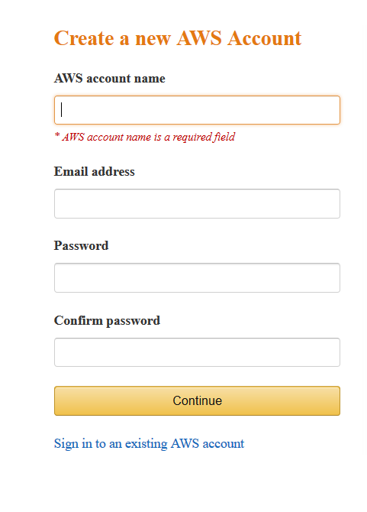
Basic Account details
Enter basic account details
Aws account name: Choose a name that you can remember
Email Address: Existing or new email account
Choose a Password that you can remember
Click Continue when done
If there are no errors you will be displayed with the next page

Slide 4
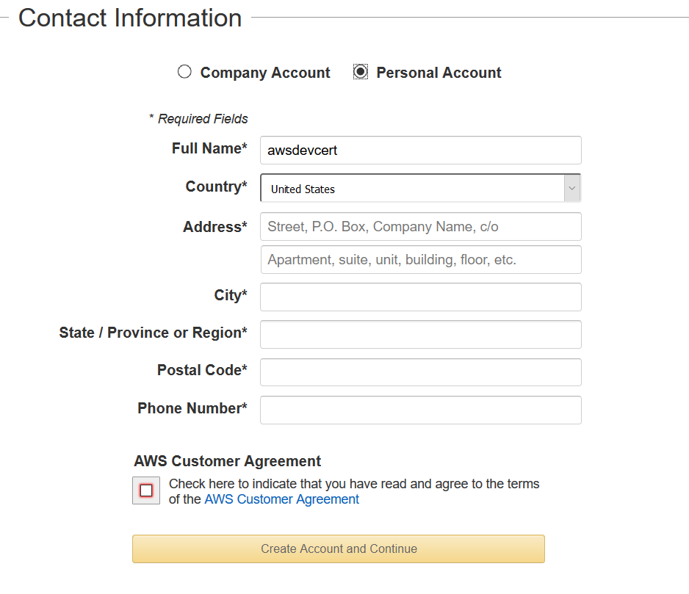
Contact Details
Select Personal Account
Enter Full name, Country, Address and phone details
Select checkbox to accept the agreement and then click on Create Account and Continue
If there are no errors you will be taken to Payment info form

Slide 5
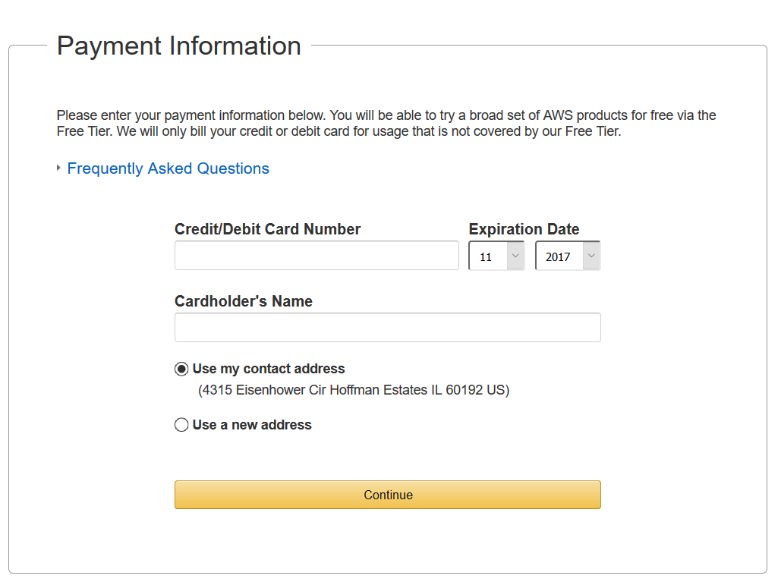
Payment information
Enter Payment information and click Continue
If there are no errors you will be directed to Identity verification screen

Slide 6
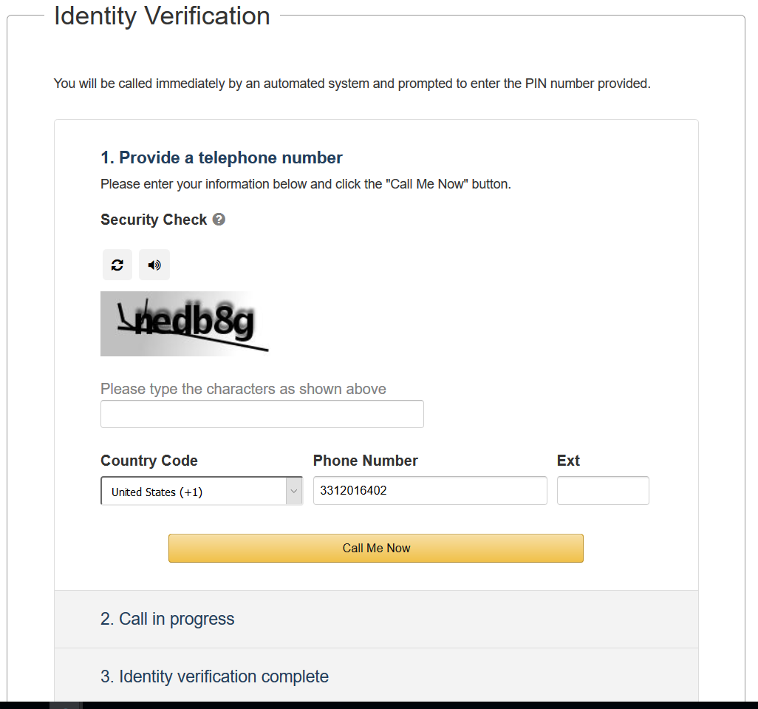
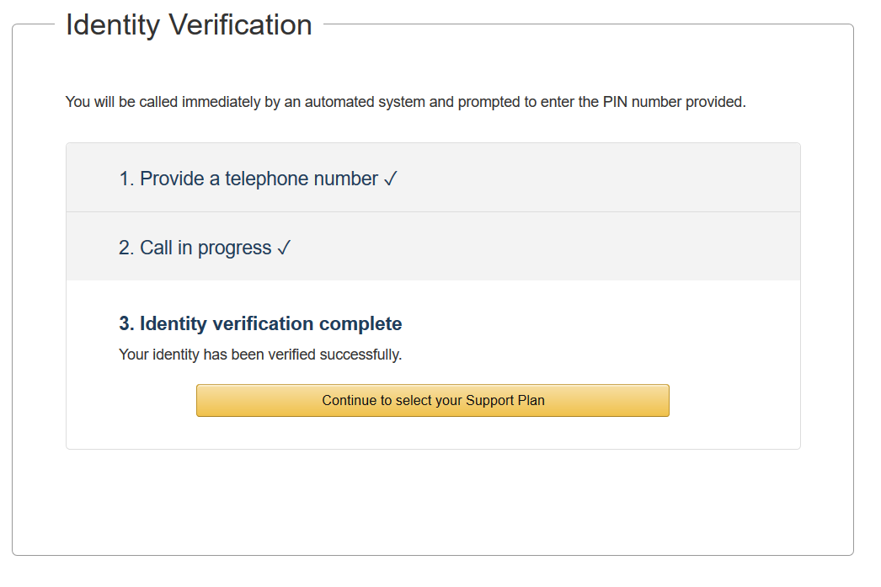
Identity Verification
This is a three step process
Step 1: Security code
Enter the Characters, Provide phone number and Click Call me now
Step 2: Call verification
At this point, you will get a call on the phone number you specified, at the same time a PIN will be displayed on your screen. Answer the phone, you will be asked to enter the PIN number displayed on your screen
Step 3:
As soon as PIN verification is complete you will see a success screen, click continue to select your support plan

Slide 7
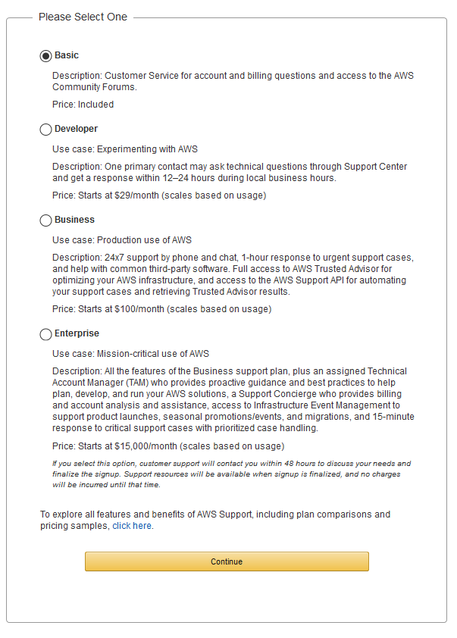
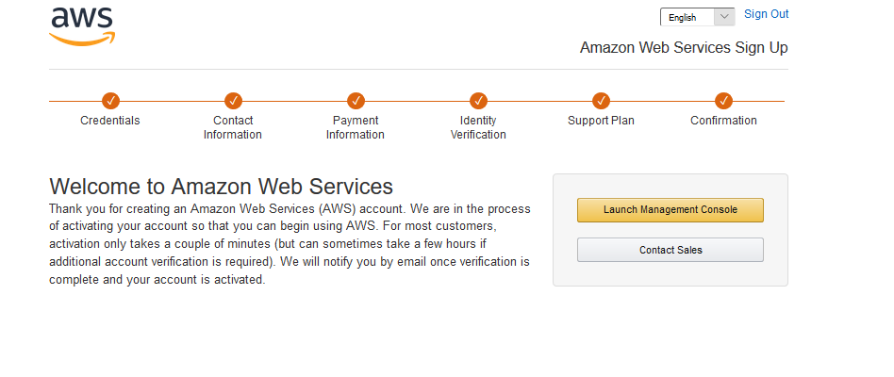
Select a Support Plan
When asked for support plan, make sure to select Basic and click Continue, at this point your account is setup and ready to go, you should see a success screen as below:

