Slide 1

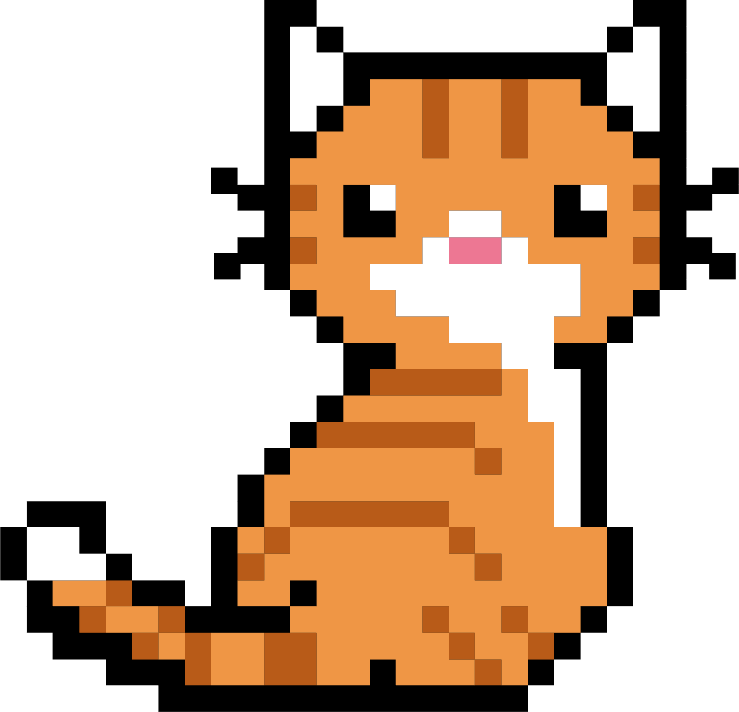

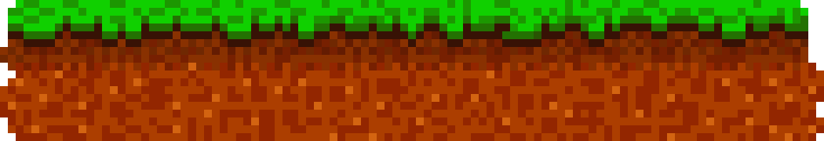
PLAYER PRESENTATION
Hack
-a-
Mini
Hack
-a-
Mini

Slide 2

CONTENTS
CONTENTS
Random act of kindness challenge generator
Generates random kindness challenges at the click of a button.
Code Storm
Hero section introduces the concept.
People often want to spread kindness but lack inspiration
HTML, CSS,
JavaScript,
Reactjs

Slide 3


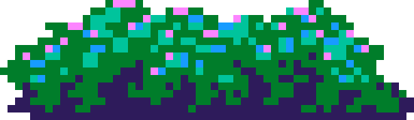
Random act of kindness challenge generator

Slide 4

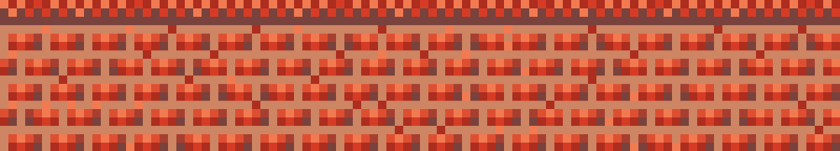
TEAM NAME
Code Storm
MOHD SULAIMAN
MOHD RASHEED

Slide 5
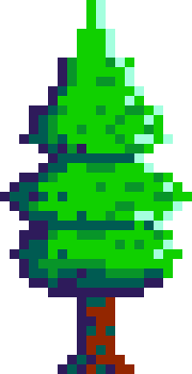

PROBLEM STAEMENT
People often want to spread
kindness but lack inspiration

Slide 6

SOLUTION
Generates random kindness
challenges at the click of a button.

Slide 7
WORKING
Completed challenges can be stored in localStorage
for persistence.

Slide 8
SUMMARY & TECH STACK
The project is a web-based kindness challenge generator.
Users land on the page.
Click “Generate Challenge” → get a random act of kindness.
Optionally, they can mark it completed or save challenges for later.
The site uses modern design principles.
Built for simplicity, accessibility, and engagement.
.

Slide 9

YEAY! GAME IS OVER!
THANK
YOU
THANK
YOU
SEE YOU AGAIN - DON’T FORGET TO FOLLOW US - @ms.9b

Slide 10
COMPLETE THE WORD
T
_
G
E
_

