Slide 1
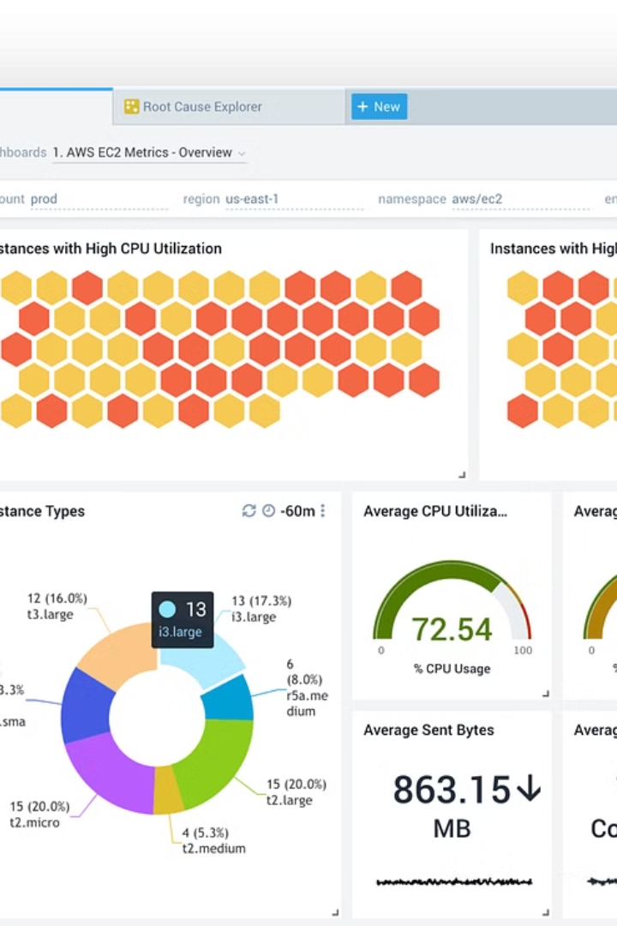
Monitoring Docker Data Usage with Prometheus and Grafana
Team: VerseHack

Slide 2
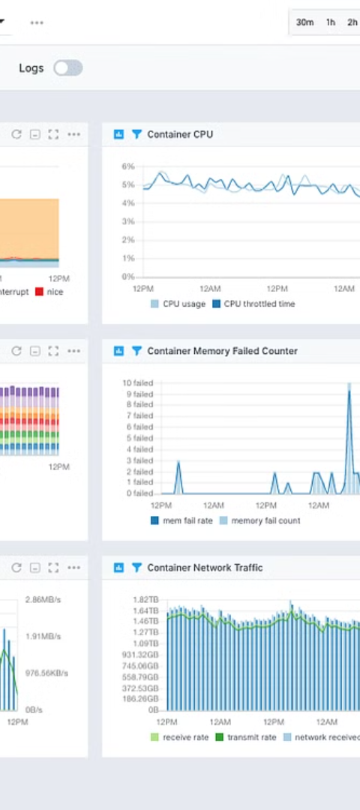
Introduction to Docker Data Usage Monitoring
1
Importance of Docker Resource Tracking
2
Challenges in Manual Monitoring
Understand container resource utilization and optimize deployments
Difficulty scaling and providing visibility across multiple containers
3
Benefits of Automated Monitoring
Proactive alerts, historical trends, and data-driven decisions

Slide 3
Overview of Prometheus and Grafana
Prometheus
Grafana
Integration Benefits
Open-source time series database for monitoring
Powerful data visualization and dashboarding tool
Real-time insights, historical trends, and alert triggers
Collects and stores metrics from various sources
Integrates with Prometheus to display container metrics
Customizable dashboards for different stakeholders

Slide 4
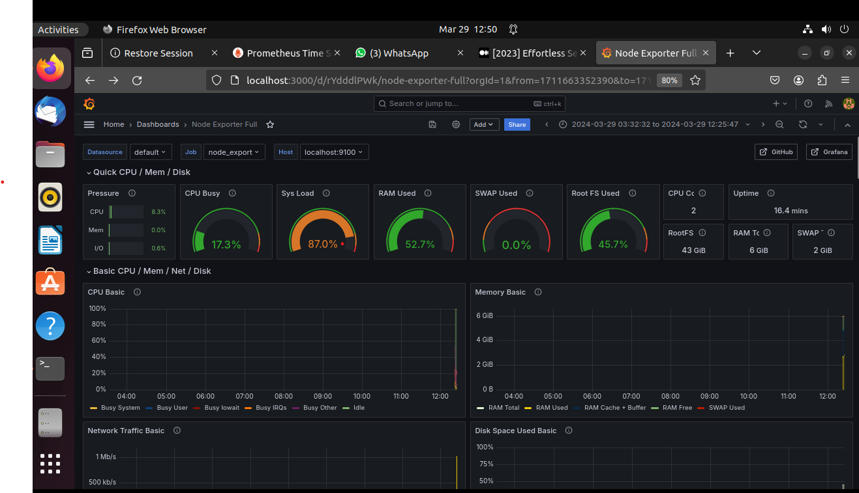
Overview of Prometheus and Grafana
Prometheus
Grafana
Integration Benefits
Open-source time series database for monitoring
Powerful data visualization and dashboarding tool
Real-time insights, historical trends, and alert triggers
Collects and stores metrics from various sources
Integrates with Prometheus to display container metrics
Customizable dashboards for different stakeholders

Slide 5
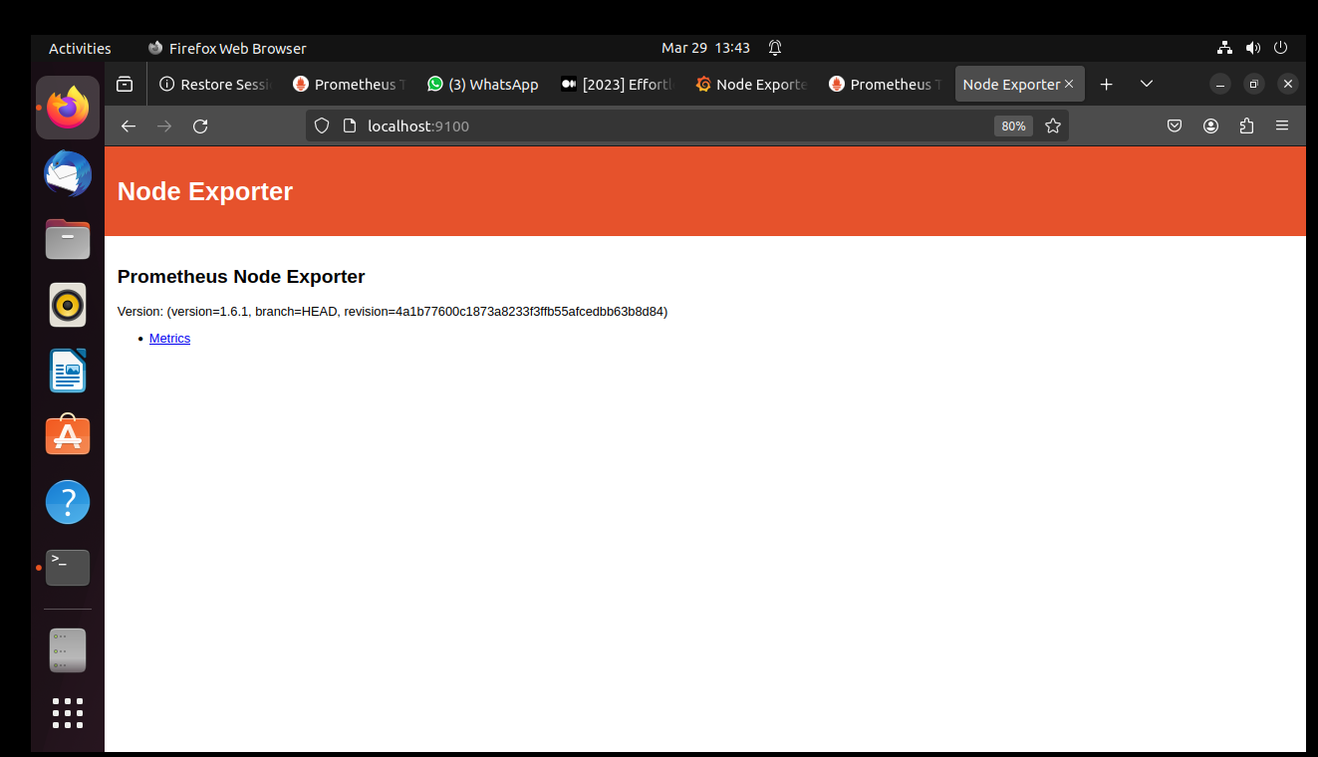
Overview of Prometheus and Grafana
Prometheus
Grafana
Integration Benefits
Open-source time series database for monitoring
Powerful data visualization and dashboarding tool
Real-time insights, historical trends, and alert triggers
Collects and stores metrics from various sources
Integrates with Prometheus to display container metrics
Customizable dashboards for different stakeholders

Slide 6
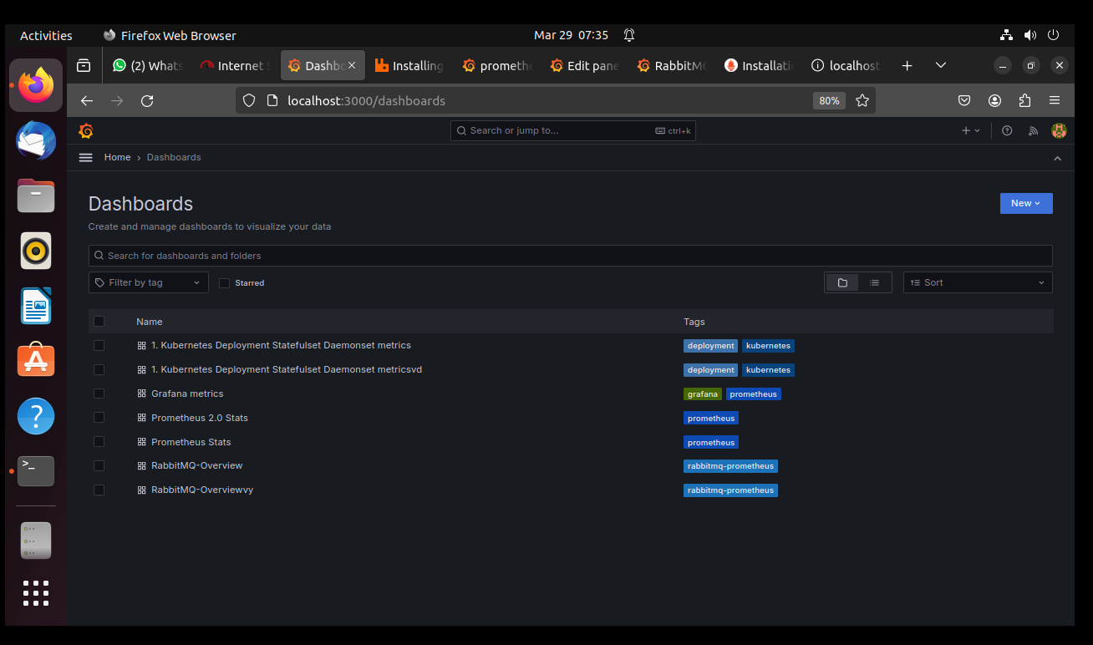
Overview of Prometheus and Grafana
Prometheus
Grafana
Integration Benefits
Open-source time series database for monitoring
Powerful data visualization and dashboarding tool
Real-time insights, historical trends, and alert triggers
Collects and stores metrics from various sources
Integrates with Prometheus to display container metrics
Customizable dashboards for different stakeholders

Slide 7
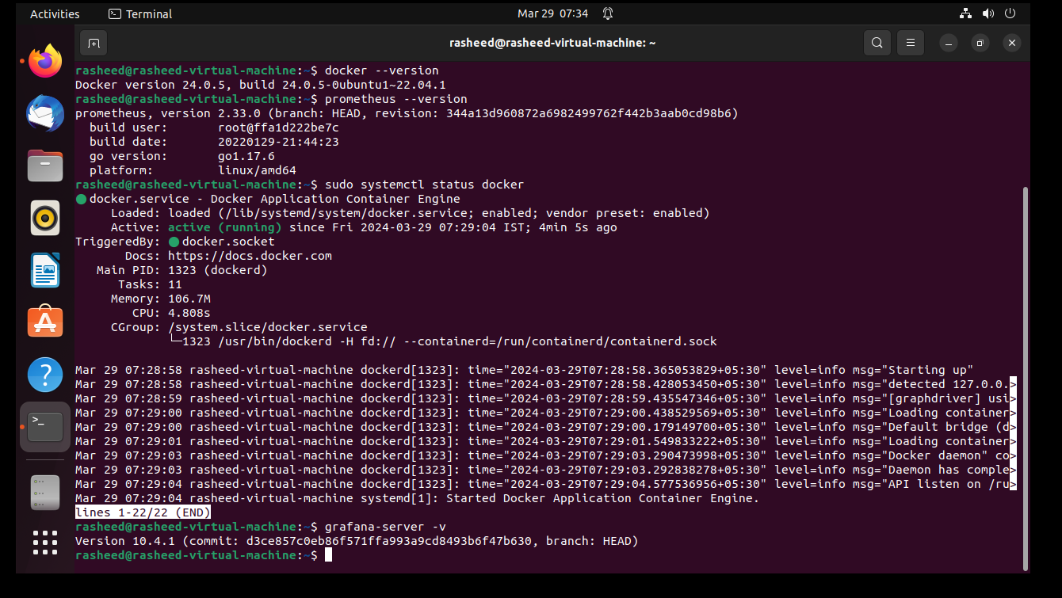
Overview of Prometheus and Grafana
Prometheus
Grafana
Integration Benefits
Open-source time series database for monitoring
Powerful data visualization and dashboarding tool
Real-time insights, historical trends, and alert triggers
Collects and stores metrics from various sources
Integrates with Prometheus to display container metrics
Customizable dashboards for different stakeholders

Slide 8
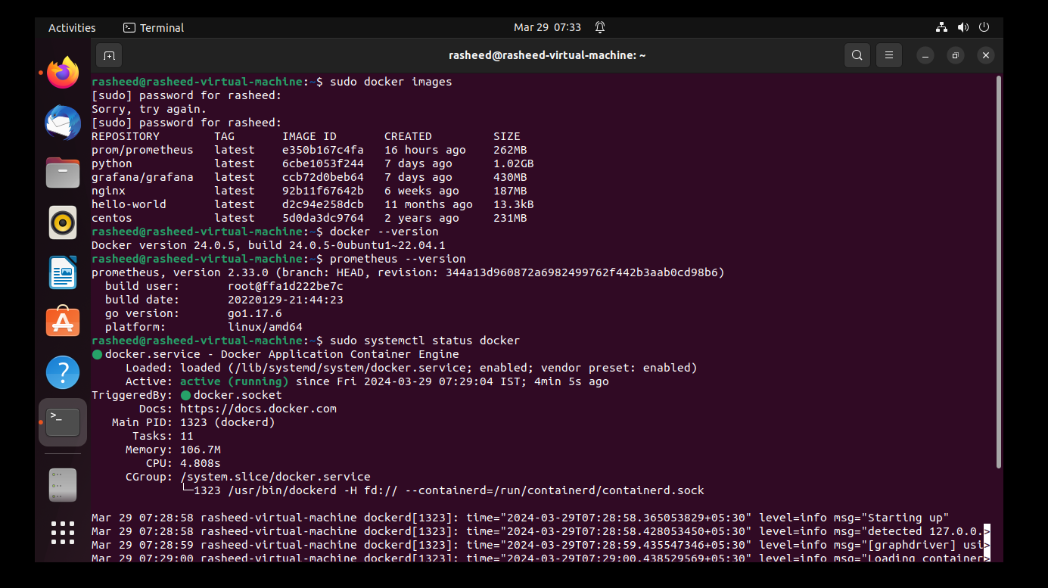
Overview of Prometheus and Grafana
Prometheus
Grafana
Integration Benefits
Open-source time series database for monitoring
Powerful data visualization and dashboarding tool
Real-time insights, historical trends, and alert triggers
Collects and stores metrics from various sources
Integrates with Prometheus to display container metrics
Customizable dashboards for different stakeholders

Slide 9
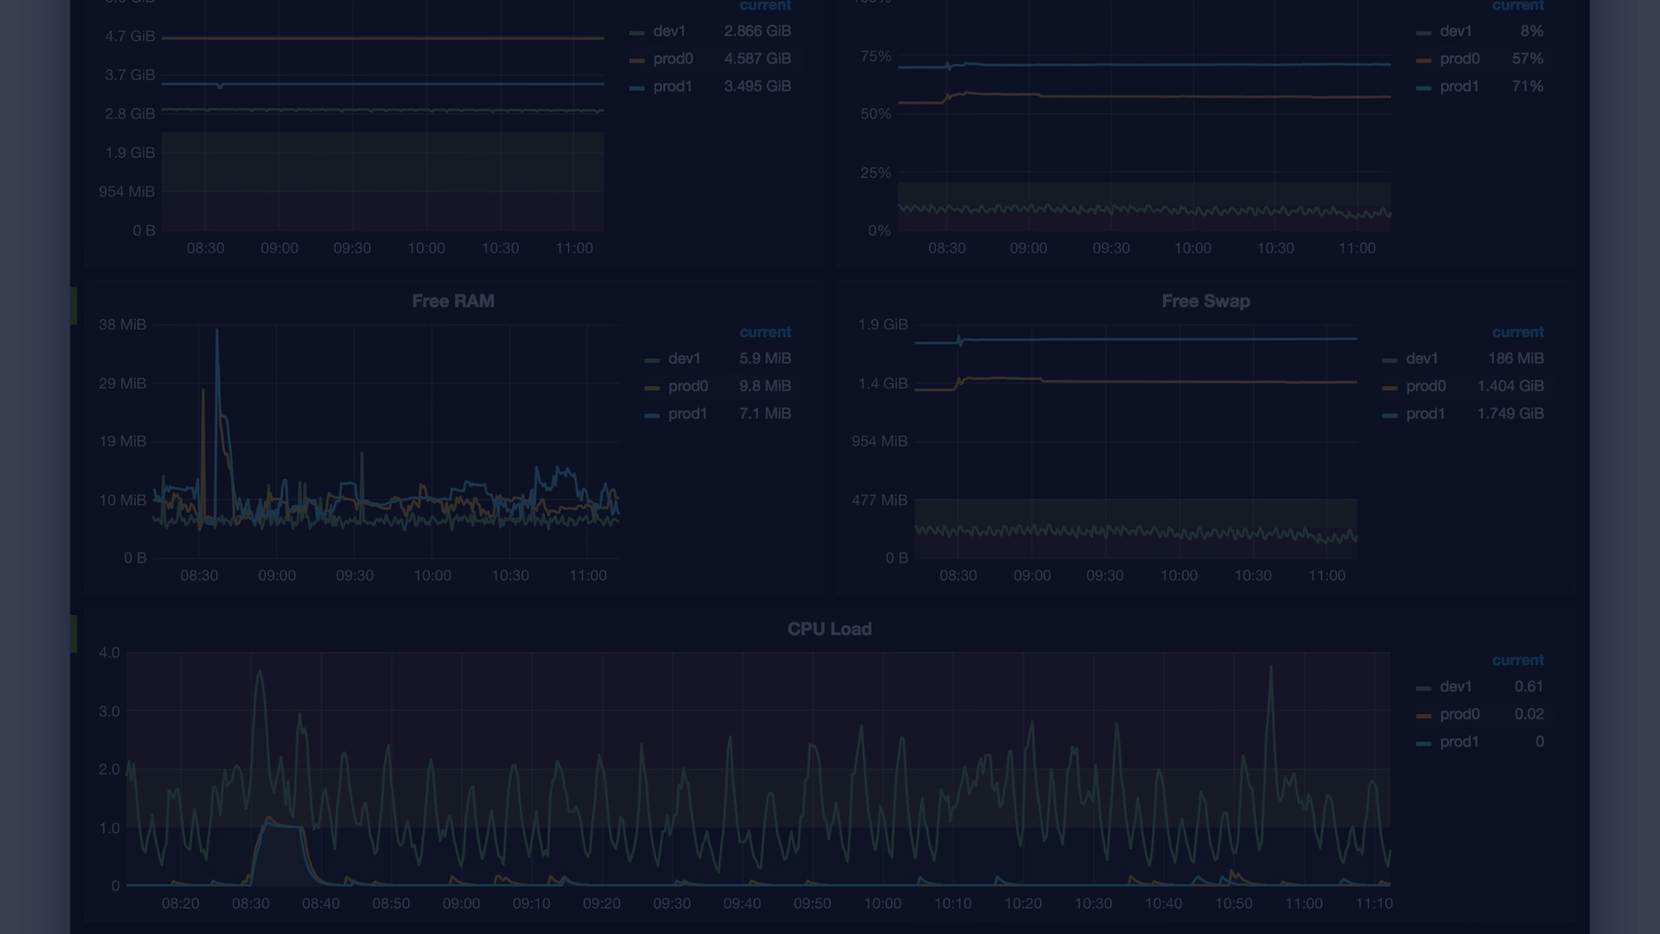
Setting up Prometheus to Monitor Docker Containers
Install Prometheus
1
Deploy Prometheus server and configure Docker scrape targets
2
Enable Docker Metrics
Configure Docker daemon to expose container metrics
Define Prometheus Rules
3
Create alerting and recording rules for Docker metrics

Slide 10
Configuring Grafana Dashboards for Docker Data Usage
Container Resource Usage
Container Lifecycle Events
Monitor CPU, memory, network, and storage usage per container
Track container start, stop, and restart events
Docker Host Metrics
Alerting and Notifications
Analyze utilization of the Docker host system resources
Set up alerts for critical resource thresholds and incidents

Slide 11



Conclusion and Key Takeaways
Improved Efficiency
Enhanced Visibility
Proactive Automation
Optimize Docker resource utilization and minimize waste
Gain real-time insights into container performance and trends
Automate alerts and remediation for resource-related incidents

