Slide 1

What Is Organizational Behavior?
© 2009 Prentice-Hall Inc. All rights reserved.
1-<number>

Slide 2
Chapter Learning Objectives
After studying this chapter you should be able to:
  Demonstrate the importance of interpersonal skills in the workplace.
  Describe the manager’s functions, roles, and skills.
  Define organizational behavior (OB).
  Show the value to OB of systematic study.
  Identify the major behavioral science disciplines that contribute to OB.
  Demonstrate why there are few absolutes in OB.
  Identify the challenges and opportunities managers have in applying OB concepts.
  Compare the three levels of analysis in this book’s OB model.
© 2009 Prentice-Hall Inc. All rights reserved.
1-<number>

Slide 3
The Importance of Interpersonal Skills
Understanding OB helps determine manager effectiveness
  Technical and quantitative skills are important
  But leadership and communication skills are CRITICAL
Organizational benefits of skilled managers
  Lower turnover of quality employees
  Higher quality applications for recruitment
  Better financial performance
© 2009 Prentice-Hall Inc. All rights reserved.
1-<number>

Slide 4
What Managers Do
They get things done through other people.
Management Activities:
  Make decisions
  Allocate resources
  Direct activities of others to attain goals
Work in an organization
  A consciously coordinated social unit composed of two or more people that functions on a relatively continuous basis to achieve a common goal or set of goals.
© 2009 Prentice-Hall Inc. All rights reserved.
1-<number>

Slide 5
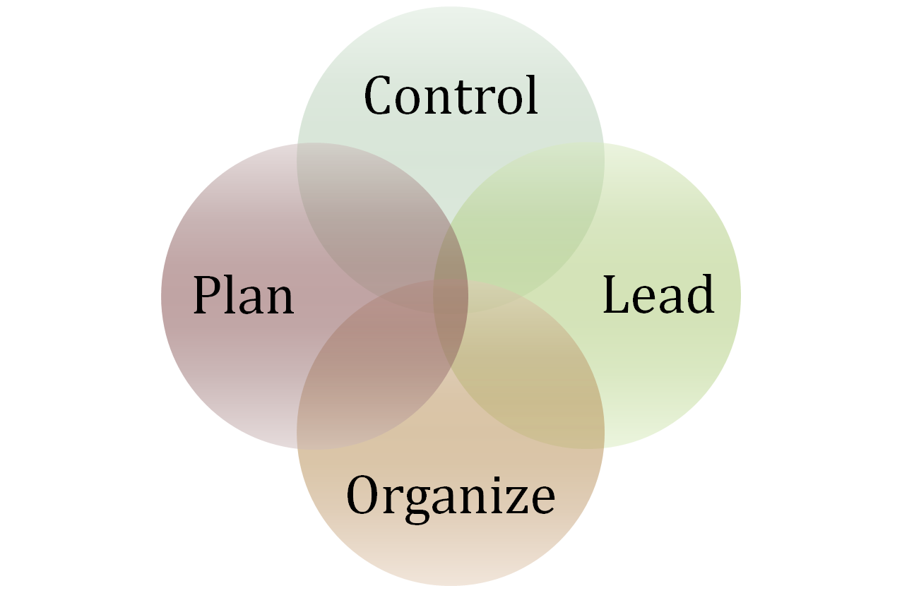
Management Functions
© 2009 Prentice-Hall Inc. All rights reserved.
1-<number>

Slide 6
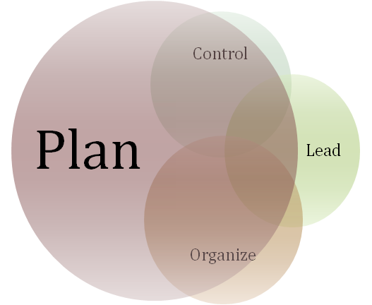
Management Functions: Plan
A process that includes defining goals, establishing strategy, and developing plans to coordinate activities.
As managers advance, they do this function more often.
© 2009 Prentice-Hall Inc. All rights reserved.
1-<number>

Slide 7
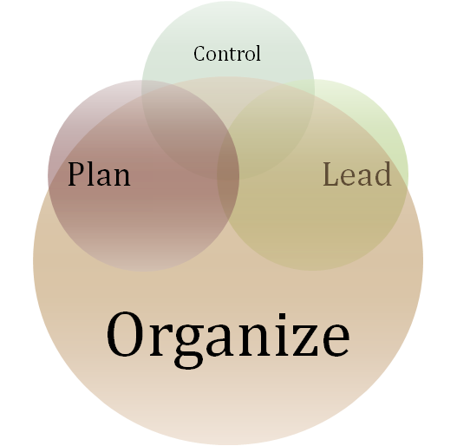
Management Functions: Organize
Determining what tasks are to be done, who is to do them, how the tasks are to be grouped, who reports to whom, and where decisions are to be made.
© 2009 Prentice-Hall Inc. All rights reserved.
1-<number>

Slide 8
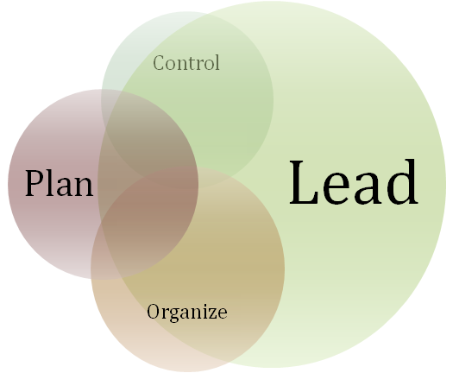
Management Functions: Lead
A function that includes motivating employees, directing others, selecting the most effective communication channels, and resolving conflicts.
It is about PEOPLE!
© 2009 Prentice-Hall Inc. All rights reserved.
1-<number>

Slide 9
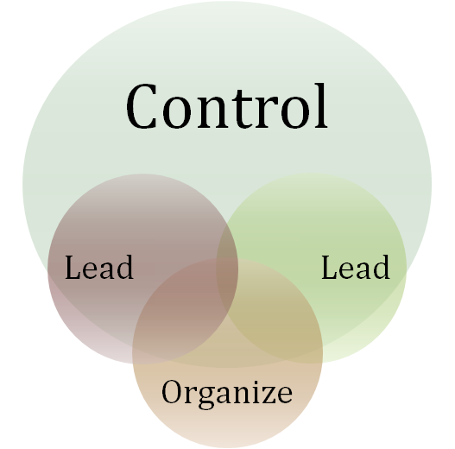
Management Functions: Control
Monitoring performance, comparing actual performance with previously set goals, and correcting any deviation.
© 2009 Prentice-Hall Inc. All rights reserved.
1-<number>

Slide 10

Mintzberg’s Managerial Roles
Discovered ten managerial roles
Separated into three groups:
  Interpersonal
  Informational
  Decisional
E X H I B I T 1–1
© 2009 Prentice-Hall Inc. All rights reserved.
1-<number>

Slide 11
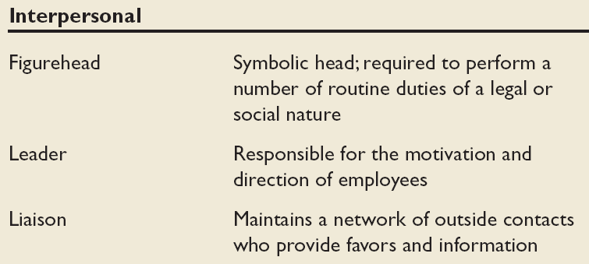
Mintzberg’s Managerial Roles: Interpersonal
Source: Adapted from The Nature of Managerial Work by H. Mintzberg. Copyright © 1973 by H. Mintzberg. Reprinted by permission of Pearson Education.
© 2009 Prentice-Hall Inc. All rights reserved.
1-<number>

Slide 12
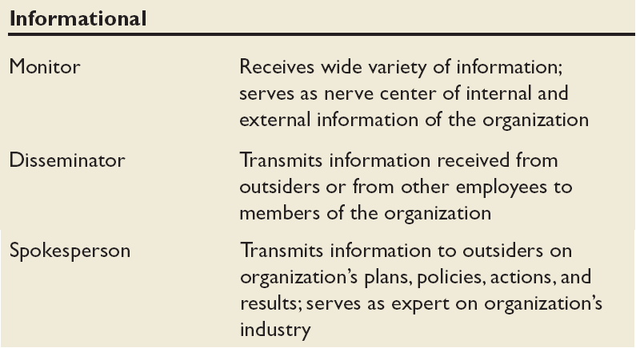
Mintzberg’s Managerial Roles: Informational
Source: Adapted from The Nature of Managerial Work by H. Mintzberg. Copyright © 1973 by H. Mintzberg. Reprinted by permission of Pearson Education.
© 2009 Prentice-Hall Inc. All rights reserved.
1-<number>

Slide 13
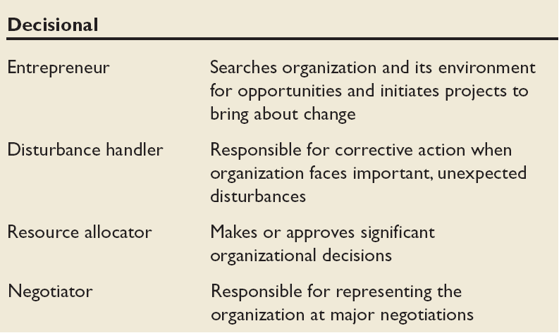
Mintzberg’s Managerial Roles: Decisional
Source: Adapted from The Nature of Managerial Work by H. Mintzberg. Copyright © 1973 by H. Mintzberg. Reprinted by permission of Pearson Education.
© 2009 Prentice-Hall Inc. All rights reserved.
1-<number>

Slide 14

Katz’s Essential Management Skills
Technical Skills
  The ability to apply specialized knowledge or expertise
Human Skills
  The ability to work with, understand, and motivate other people, both individually and in groups
Conceptual Skills
  The mental ability to analyze and diagnose complex situations
© 2009 Prentice-Hall Inc. All rights reserved.
1-<number>

Slide 15
Luthans’ Study of Managerial Activities
Is there a difference in frequency of managerial activity between effective and successful managers?
Four types of managerial activity:
  Traditional Management
    Decision-making, planning, and controlling.
  Communication
    Exchanging routine information and processing paperwork
  Human Resource Management
    Motivating, disciplining, managing conflict, staffing and training.
  Networking
    Socializing, politicking, and interacting with others.
© 2009 Prentice-Hall Inc. All rights reserved.
1-<number>

Slide 16
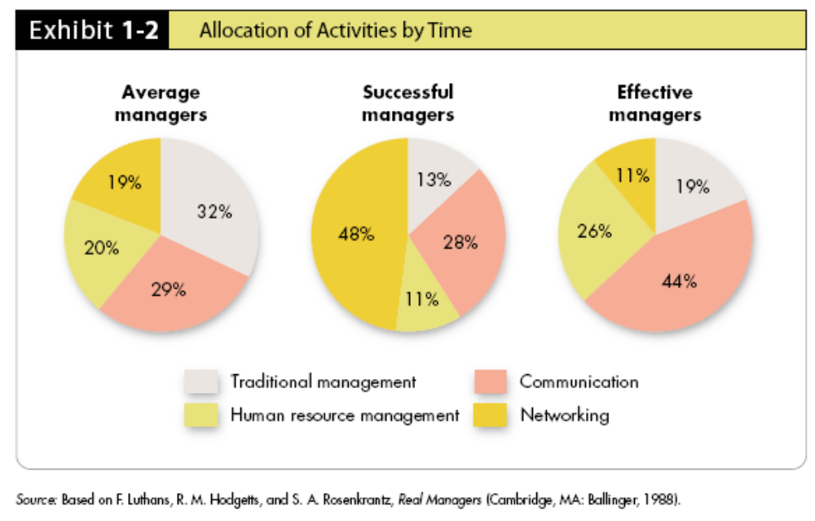
Successful vs. Effective Allocation by Time
Managers who promoted faster (were successful) did different things than did effective managers (those who did their jobs well)
E X H I B I T 1–2
© 2009 Prentice-Hall Inc. All rights reserved.
1-<number>

Slide 17

Organizational Behavior
A field of study that investigates the impact that individuals, groups, and structure have on behavior within organizations, for the purpose of applying such knowledge toward improving an organization’s effectiveness.
© 2009 Prentice-Hall Inc. All rights reserved.
1-<number>

Slide 18
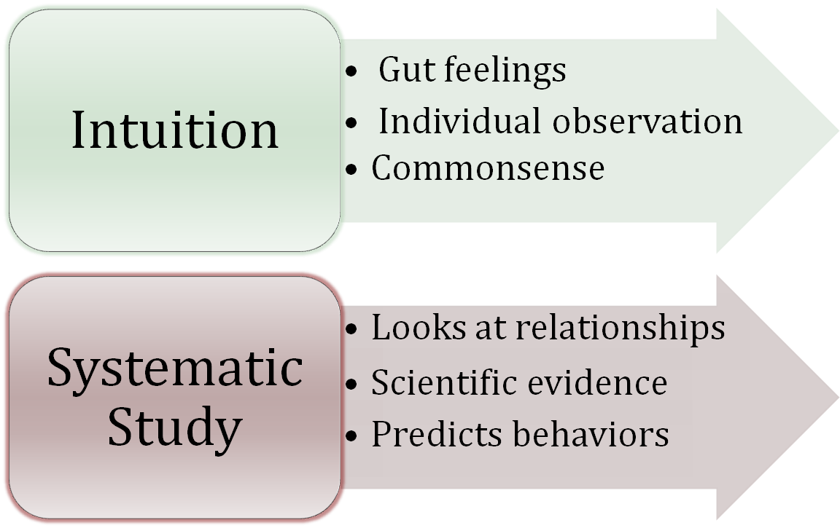
Intuition and Systematic Study
The two are complementary means of predicting behavior.
© 2009 Prentice-Hall Inc. All rights reserved.
1-<number>

Slide 19
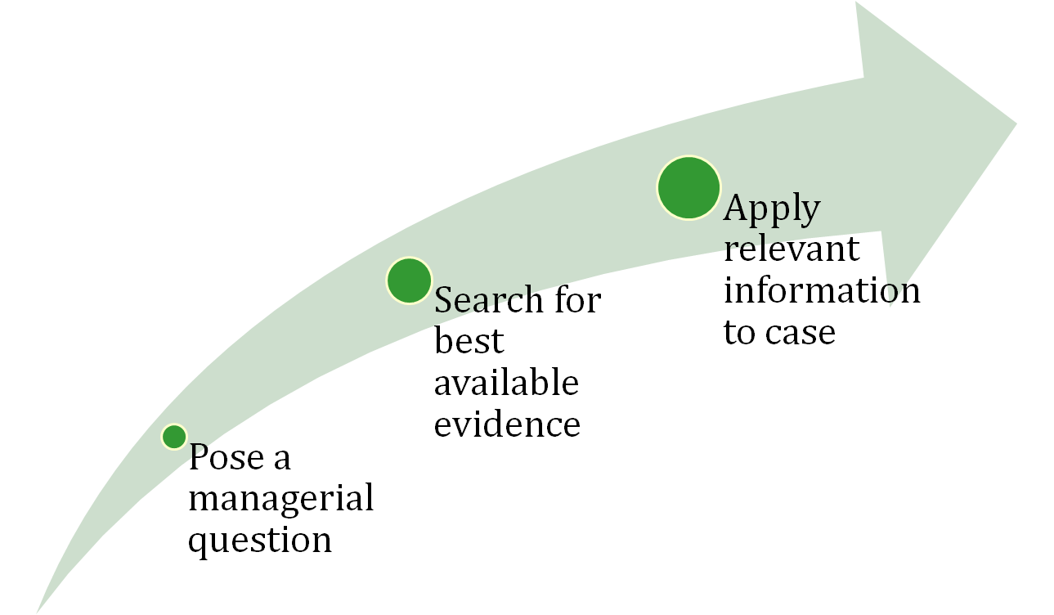
An Outgrowth of Systematic Study…
Evidence-Based Management (EBM)
Basing managerial decisions on the best available scientific evidence
Must think like scientists:
© 2009 Prentice-Hall Inc. All rights reserved.
1-<number>

Slide 20
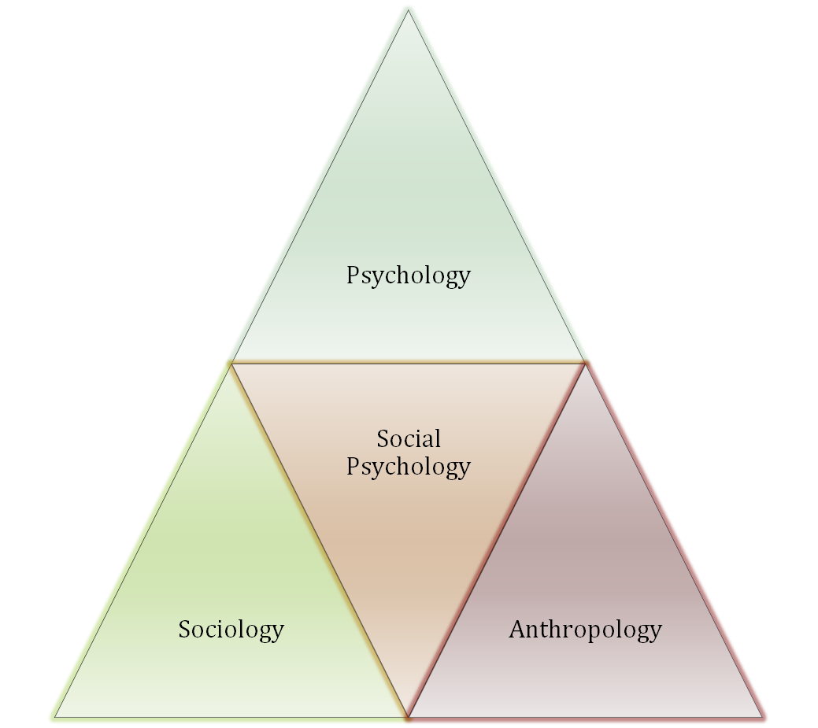
Contributing Disciplines
Many behavioral sciences
have contributed to the
development of
Organizational
Behavior
See E X H I B I T 1–3 for details
© 2009 Prentice-Hall Inc. All rights reserved.
1-<number>

Slide 21
Psychology
The science that seeks to measure, explain, and sometimes change the behavior of humans and other animals.
Unit of Analysis:
  Individual
Contributions to OB:
  Learning, motivation, personality, emotions, perception
  Training, leadership effectiveness, job satisfaction
  Individual decision making, performance appraisal attitude measurement
  Employee selection, work design, and work stress
© 2009 Prentice-Hall Inc. All rights reserved.
1-<number>

Slide 22

Social Psychology
An area within psychology that blends concepts from psychology and sociology and that focuses on the influence of people on one another.
Unit of Analysis:
  Group
Contributions to OB:
  Behavioral change
  Attitude change
  Communication
  Group processes
  Group decision making
© 2009 Prentice-Hall Inc. All rights reserved.
1-<number>

Slide 23
Sociology
The study of people in relation to their fellow human beings.
Unit of Analysis:
  -- Organizational System
  -- Group
Contributions to OB:
  Group dynamics
  Work teams
  Communication
  Power
  Conflict
  Intergroup behavior
  Formal organization theory
  Organizational technology
  Organizational change
  Organizational culture
© 2009 Prentice-Hall Inc. All rights reserved.
1-<number>

Slide 24

Anthropology
The study of societies to learn about human beings and their activities.
Unit of Analysis:
  -- Organizational System
  -- Group
Contributions to OB:
  Organizational culture
  Organizational environment
  Comparative values
  Comparative attitudes
  Cross-cultural analysis
© 2009 Prentice-Hall Inc. All rights reserved.
1-<number>

Slide 25

Challenges and Opportunities for OB
Responding to Globalization
Managing Workforce Diversity
Improving Quality and Productivity
Improving Customer Service
Improving People Skills
Stimulating Innovation and Change
Coping with “Temporariness”
Working in Networked Organizations
Helping Employees Balance Work-Life Conflicts
Creating a Positive Work Environment
Improving Ethical Behavior
© 2009 Prentice-Hall Inc. All rights reserved.
1-<number>

Slide 26

Responding to Globalization
Increased foreign assignments
Working with people from different cultures
Overseeing movement of jobs to countries with low-cost labor
Managing people during the war on terror
© 2009 Prentice-Hall Inc. All rights reserved.
1-<number>

Slide 27
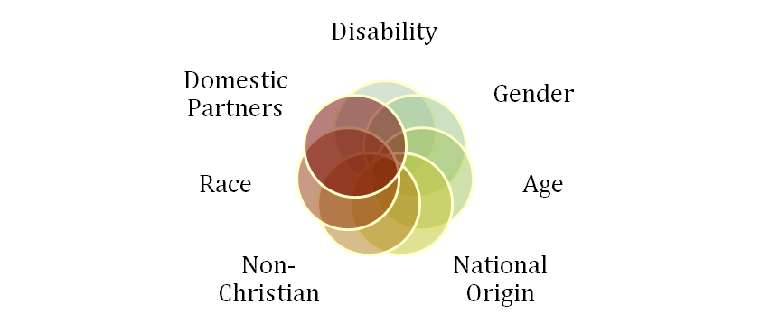
Managing Workforce Diversity
The people in organizations are becoming more heterogeneous demographically
  Embracing diversity
  Changing U.S. demographics
  Changing management philosophy
  Recognizing and responding to differences
See E X H I B I T 1–4
© 2009 Prentice-Hall Inc. All rights reserved.
1-<number>

Slide 28
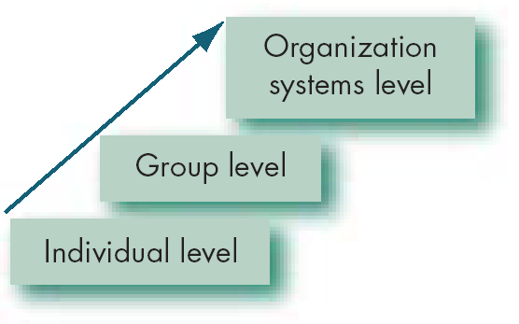
Developing an OB Model
A model is an abstraction of reality: a simplified representation of some real-world phenomenon.
Our OB model has three levels of analysis
  Each level is constructed on the prior level
E X H I B I T 1–5
© 2009 Prentice-Hall Inc. All rights reserved.
1-<number>

Slide 29
Interesting OB Dependent Variables
Productivity
  Transforming inputs to outputs at lowest cost. Includes the concepts of effectiveness (achievement of goals) and efficiency (meeting goals at a low cost).
Absenteeism
  Failure to report to work – a huge cost to employers.
Turnover
  Voluntary and involuntary permanent withdrawal from an organization.
Deviant Workplace Behavior
  Voluntary behavior that violates significant organizational norms and thereby threatens the well-being of the organization and/or any of its members.
© 2009 Prentice-Hall Inc. All rights reserved.
1-<number>

Slide 30

More Interesting OB Dependent Variables
Job Satisfaction
  A general attitude (not a behavior) toward one’s job; a positive feeling of one's job resulting from an evaluation of its characteristics.
© 2009 Prentice-Hall Inc. All rights reserved.
1-<number>

Slide 31
The Independent Variables
The independent variable (X) can be at any of these three levels in this model:
Individual
  Biographical characteristics, personality and emotions, values and attitudes, ability, perception, motivation, individual learning and individual decision making.
Group
  Communication, group decision making, leadership and trust, group structure, conflict, power and politics, and work teams.
Organization System
  Organizational culture, human resource policies and practices, and organizational structure and design.
© 2009 Prentice-Hall Inc. All rights reserved.
1-<number>

Slide 32
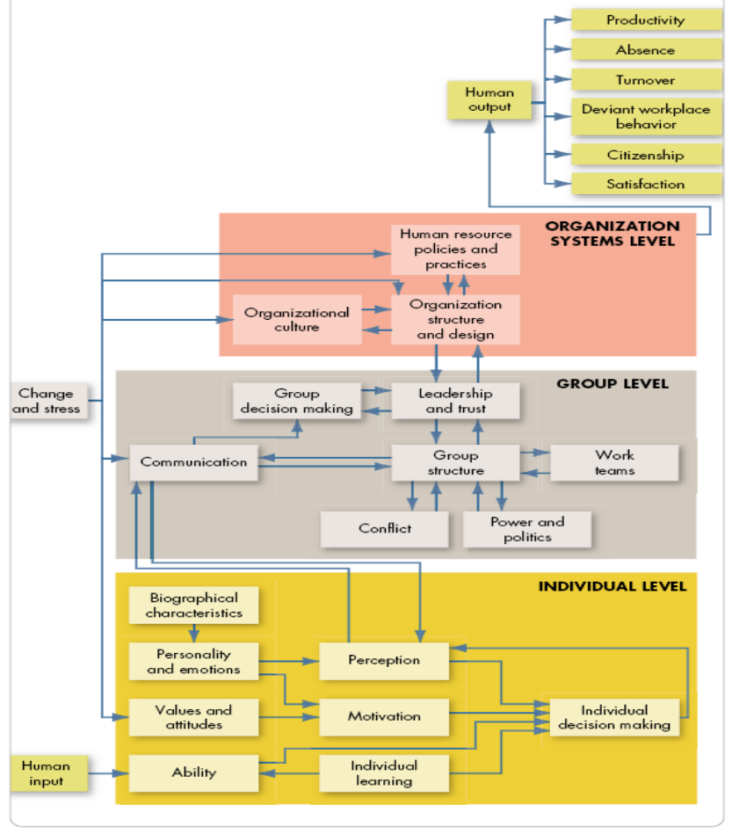

OB Model
Dependent Variables (Y)
Independent Variables (X)
E X H I B I T 1–6
© 2009 Prentice-Hall Inc. All rights reserved.
1-<number>

Slide 33
Summary and Managerial Implications
Managers need to develop their interpersonal skills to be effective.
OB focuses on how to improve factors that make organizations more effective.
The best predictions of behavior are made from a combination of systematic study and intuition.
Situational variables moderate cause-and-effect relationships – which is why OB theories are contingent.
There are many OB challenges and opportunities for managers today.
The textbook is based on the contingent OB model.
© 2009 Prentice-Hall Inc. All rights reserved.
1-<number>

Slide 34

All rights reserved. No part of this publication may be reproduced, stored in a retrieval system, or transmitted, in any form or by any means, electronic, mechanical, photocopying, recording, or otherwise, without the prior written permission of the publisher. Printed in the United States of America.
Copyright ©2009 Pearson Education, Inc. Publishing as Prentice Hall

