Slide 1

Foundations of Individual Behavior
© 2009 Prentice-Hall Inc. All rights reserved.
2-<number>

Slide 2
Chapter Learning Objectives
After studying this chapter, you should be able to:
  Contrast the two types of ability.
  Define intellectual ability and demonstrate its relevance to OB.
  Identify the key biographical characteristics and describe how they are relevant to OB.
  Define learning and outline the principles of the three major theories of learning.
  Define shaping, and show how it can be used in OB.
  Show how culture affects our understanding of intellectual abilities, biographical characteristics, and learning.
© 2009 Prentice-Hall Inc. All rights reserved.
2-<number>

Slide 3
Ability
An individual’s capacity to perform the various tasks in a job.
Made up of two sets of factors:
  Intellectual Abilities
    The abilities needed to perform mental activities.
    General Mental Ability (GMA) is a measure of overall intelligence.
    No correlation between intelligence and job satisfaction.
  Physical Abilities
    The capacity to do tasks demanding stamina, strength, and similar characteristics.
© 2009 Prentice-Hall Inc. All rights reserved.
2-<number>

Slide 4
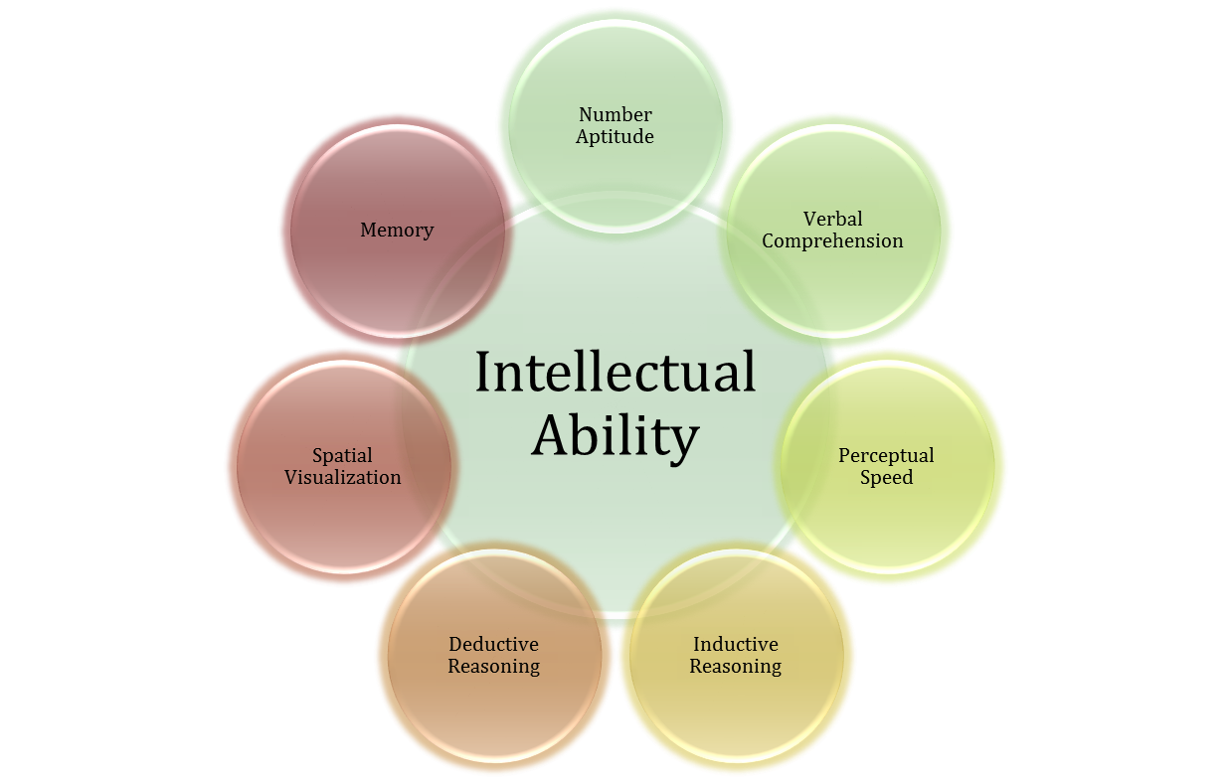
Dimensions of Intellectual Ability
E X H I B I T 2–1
© 2009 Prentice-Hall Inc. All rights reserved.
2-<number>

Slide 5

Nine Basic Physical Abilities
Strength Factors
  Dynamic strength
  Trunk strength
  Static strength
  Explosive strength
Flexibility Factors
  Extent flexibility
  Dynamic flexibility
Other Factors
  Body coordination
  Balance
  Stamina
E X H I B I T 2–2
© 2009 Prentice-Hall Inc. All rights reserved.
2-<number>

Slide 6
Biographical Characteristics
Objective and easily obtained personal characteristics.
Age
  Older workers bring experience, judgment, a strong work ethic, and commitment to quality.
Gender
  Few differences between men and women that affect job performance.
Race (the biological heritage used to identify oneself)
  Contentious issue: differences exist, but could be more culture-based than race-based.
© 2009 Prentice-Hall Inc. All rights reserved.
2-<number>

Slide 7
Other Biographical Characteristics
Tenure
  People with job tenure (seniority at a job) are more productive, absent less frequently, have lower turnover, and are more satisfied.
Religion
  Islam is especially problematic in the workplace in this post-9/11 world.
Sexual Orientation
  Federal law does not protect against discrimination (but state or local laws may).
  Domestic partner benefits are important considerations.
Gender Identity
  Relatively new issue – transgendered employees.
© 2009 Prentice-Hall Inc. All rights reserved.
2-<number>

Slide 8
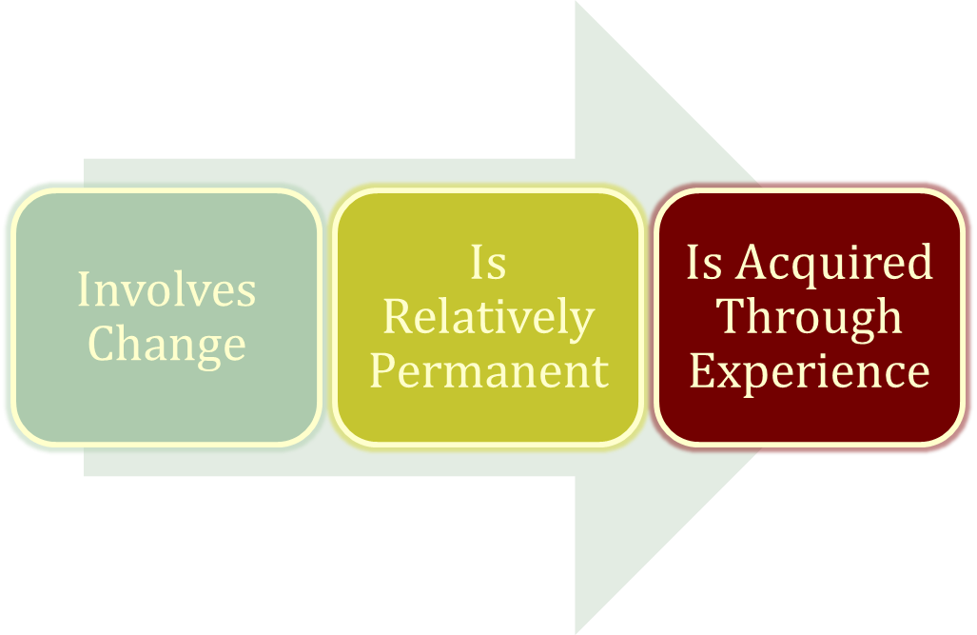
Learning
Any relatively permanent change in behavior that occurs as a result of experience
Learning components:
© 2009 Prentice-Hall Inc. All rights reserved.
2-<number>

Slide 9
Social-Learning Theory
Based on the idea that people can also learn indirectly: by observation, reading, or just hearing about someone else’s – a model’s – experiences.
Key Concepts:
  Attentional processes
    Must recognize and pay attention to critical features to learn.
  Retention processes
    Model’s actions must be remembered to be learned.
  Reinforcement processes
    Positive incentives motivate learners.
© 2009 Prentice-Hall Inc. All rights reserved.
2-<number>

Slide 10
Shaping: A Managerial Tool
Systematically reinforcing each successive step that moves an individual closer to the desired response.
Four Methods of Shaping Behavior:
  Positive reinforcement
    Providing a reward for a desired behavior (learning)
  Negative reinforcement
    Removing an unpleasant consequence when the desired behavior occurs (learning)
  Punishment
    Applying an undesirable condition to eliminate an undesirable behavior (“unlearning”)
© 2009 Prentice-Hall Inc. All rights reserved.
2-<number>

Slide 11

Schedules of Reinforcement: A Critical Issue
Two Major Types:
  Continuous Reinforcement
    A desired behavior is reinforced each time it is demonstrated
  Intermittent Reinforcement
    A desired behavior is reinforced often enough to make the behavior worth repeating but not every time it is demonstrated
    Multiple frequencies
© 2009 Prentice-Hall Inc. All rights reserved.
2-<number>

Slide 12
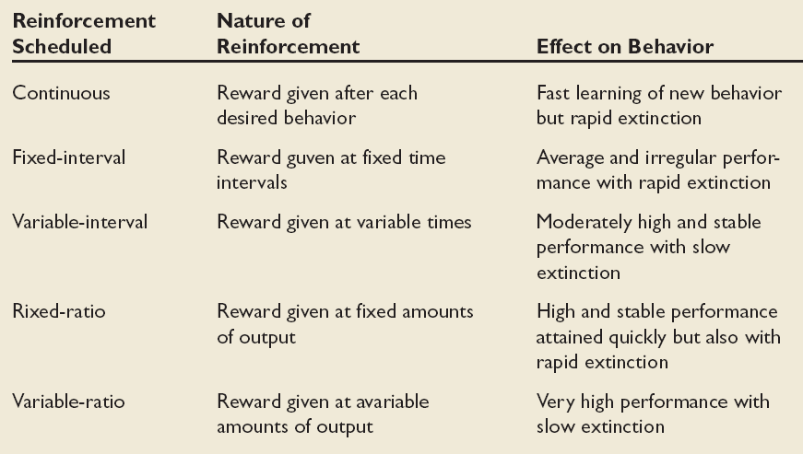
Schedules of Reinforcement
Fixed-ratio
E X H I B I T 2–3
© 2009 Prentice-Hall Inc. All rights reserved.
2-<number>

Slide 13
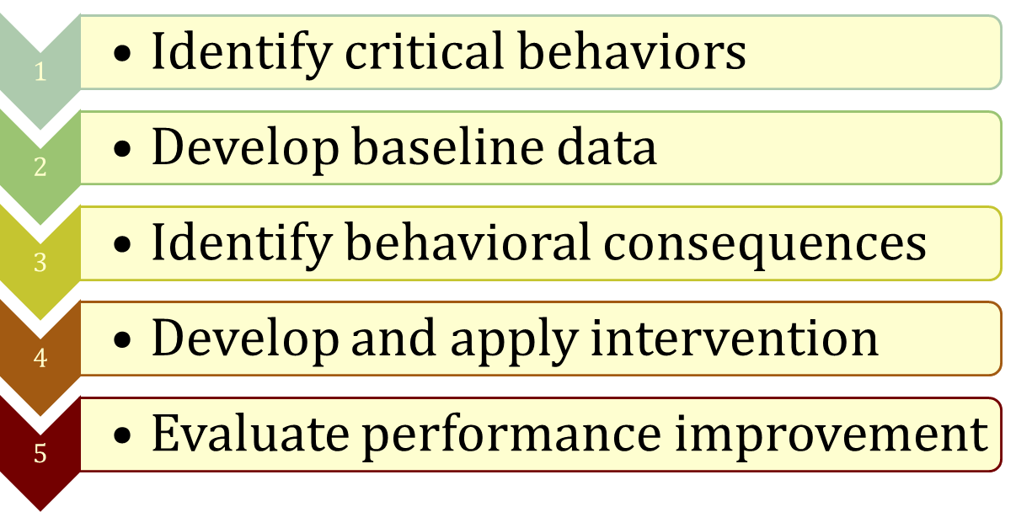
Behavior Modification (OB Mod)
The application of reinforcement concepts to individuals in the work setting
Follows the Five-Step Problem-Solving Model
© 2009 Prentice-Hall Inc. All rights reserved.
2-<number>

Slide 14

Problems with OB Mod and Reinforcement
OB Mod ignores thoughts and feelings.
OB Mod may not explain complex behaviors that involve thinking and feeling.
Stimuli may not be consciously given as a means of shaping behavior.
Modern managers and OB theorists are using cognitive approaches to shaping behavior.
© 2009 Prentice-Hall Inc. All rights reserved.
2-<number>

Slide 15

Global Implications
Intellectual Abilities
  Structures and measures of intelligence generalize across cultures.
Biographical Characteristics
  Not much evidence on the global relevance of the relationships described in this chapter.
  Countries do vary dramatically on their biographical composition.
Learning
  Again, not much evidence currently exists – we cannot generalize at this point.
© 2009 Prentice-Hall Inc. All rights reserved.
2-<number>

Slide 16
Summary and Managerial Implications
Three Individual Variables:
  Ability
    Directly influences employees level of performance.
    Managers need to focus on ability in selection, promotion, and transfer.
    Fine-tune job to fit incumbent’s abilities.
  Biographical Characteristics
    Should not be used in management decisions: possible source of bias.
  Learning
    Observable change in behavior = learning.
    Reinforcement works better than punishment.
© 2009 Prentice-Hall Inc. All rights reserved.
2-<number>

Slide 17

All rights reserved. No part of this publication may be reproduced, stored in a retrieval system, or transmitted, in any form or by any means, electronic, mechanical, photocopying, recording, or otherwise, without the prior written permission of the publisher. Printed in the United States of America.
Copyright ©2009 Pearson Education, Inc. Publishing as Prentice Hall

