Slide 1

Attitudes and Job Satisfaction
© 2009 Prentice-Hall Inc. All rights reserved.
3-<number>

Slide 2
Chapter Learning Objectives
After studying this chapter, you should be able to:
  Contrast the three components of an attitude.
  Summarize the relationship between attitudes and behavior.
  Compare and contrast the major job attitudes.
  Define job satisfaction and show how it can be measured.
  Summarize the main causes of job satisfaction.
  Identify four employee responses to dissatisfaction.
  Show whether job satisfaction is a relevant concept in countries other than the United States.
© 2009 Prentice-Hall Inc. All rights reserved.
3-<number>

Slide 3
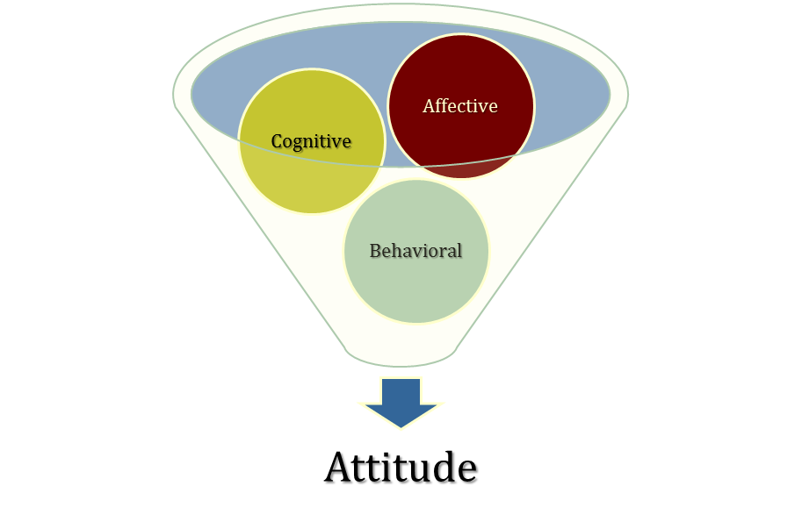
Attitudes
Evaluative statements or judgments concerning objects, people, or events.
Three components of an attitude:
The emotional or feeling segment of an attitude
The opinion or belief segment of an attitude
An intention to behave in a certain way toward someone or something
See E X H I B I T 3–1
© 2009 Prentice-Hall Inc. All rights reserved.
3-<number>

Slide 4

Does Behavior Always Follow from Attitudes?
Leon Festinger – No, the reverse is sometimes true!
Cognitive Dissonance: Any incompatibility between two or more attitudes or between behavior and attitudes
  Individuals seek to reduce this uncomfortable gap, or dissonance, to reach stability and consistency
  Consistency is achieved by changing the attitudes, modifying the behaviors, or through rationalization
  Desire to reduce dissonance depends on:
    Importance of elements
    Degree of individual influence
    Rewards involved in dissonance
© 2009 Prentice-Hall Inc. All rights reserved.
3-<number>

Slide 5
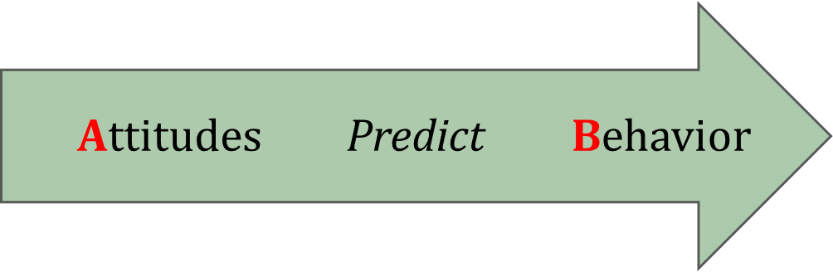
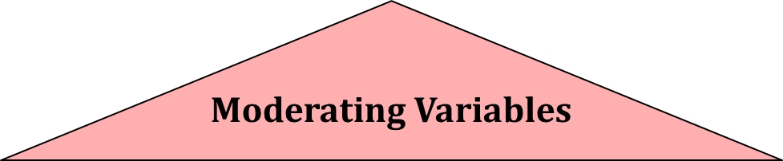
Moderating Variables
The most powerful moderators of the attitude-behavior relationship are:
  Importance of the attitude
  Correspondence to behavior
  Accessibility
  Existence of social pressures
  Personal and direct experience of the attitude.
© 2009 Prentice-Hall Inc. All rights reserved.
3-<number>

Slide 6


Predicting Behavior from Attitudes
  Important attitudes have a strong relationship to behavior.
  The closer the match between attitude and behavior, the stronger the relationship:
    Specific attitudes predict specific behavior
    General attitudes predict general behavior
  The more frequently expressed an attitude, the better predictor it is.
  High social pressures reduce the relationship and may cause dissonance.
  Attitudes based on personal experience are stronger predictors.
© 2009 Prentice-Hall Inc. All rights reserved.
3-<number>

Slide 7

What are the Major Job Attitudes?
Job Satisfaction
  A positive feeling about the job resulting from an evaluation of its characteristics
Job Involvement
  Degree of psychological identification with the job where perceived performance is important to self-worth
Psychological Empowerment
  Belief in the degree of influence over the job, competence, job meaningfulness, and autonomy
© 2009 Prentice-Hall Inc. All rights reserved.
3-<number>

Slide 8
Another Major Job Attitude
Organizational Commitment
  Identifying with a particular organization and its goals, while wishing to maintain membership in the organization.
  Three dimensions:
    Affective – emotional attachment to organization
    Continuance Commitment – economic value of staying
    Normative - moral or ethical obligations
  Has some relation to performance, especially for new employees.
  Less important now than in past – now perhaps more of occupational commitment, loyalty to profession rather than a given employer.
© 2009 Prentice-Hall Inc. All rights reserved.
3-<number>

Slide 9
And Yet More Major Job Attitudes…
Perceived Organizational Support (POS)
  Degree to which employees believe the organization values their contribution and cares about their well-being.
  Higher when rewards are fair, employees are involved in decision-making, and supervisors are seen as supportive.
  High POS is related to higher OCBs and performance.
Employee Engagement
  The degree of involvement with, satisfaction with, and enthusiasm for the job.
  Engaged employees are passionate about their work and company.
© 2009 Prentice-Hall Inc. All rights reserved.
3-<number>

Slide 10

Are These Job Attitudes Really Distinct?
No: these attitudes are highly related.
Variables may be redundant (measuring the same thing under a different name)
While there is some distinction, there is also a lot of overlap.
Be patient, OB researchers are working on it!
© 2009 Prentice-Hall Inc. All rights reserved.
3-<number>

Slide 11
Job Satisfaction
One of the primary job attitudes measured.
  Broad term involving a complex individual summation of a number of discrete job elements.
How to measure?
  Single global rating (one question/one answer) - Best
  Summation score (many questions/one average) - OK
Are people satisfied in their jobs?
  In the U. S., yes, but the level appears to be dropping.
  Results depend on how job satisfaction is measured.
  Pay and promotion are the most problematic elements.
See E X H I B I T 3–2
© 2009 Prentice-Hall Inc. All rights reserved.
3-<number>

Slide 12

Causes of Job Satisfaction
Pay influences job satisfaction only to a point.
  After about $40,000 a year (in the U. S.), there is no relationship between amount of pay and job satisfaction.
  Money may bring happiness, but not necessarily job satisfaction.
Personality can influence job satisfaction.
  Negative people are usually not satisfied with their jobs.
  Those with positive core self-evaluation are more satisfied with their jobs.
See E X H I B I T 3–3
© 2009 Prentice-Hall Inc. All rights reserved.
3-<number>

Slide 13
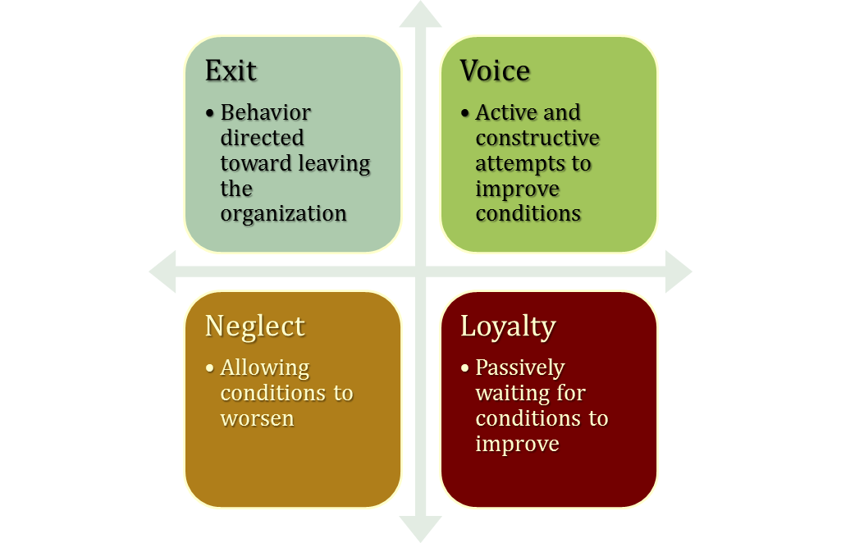
Employee Responses to Dissatisfaction
Active
Destructive
Constructive
Passive
See E X H I B I T 3–4
© 2009 Prentice-Hall Inc. All rights reserved.
3-<number>

Slide 14
Outcomes of Job Satisfaction
Job Performance
  Satisfied workers are more productive AND more productive workers are more satisfied!
  The causality may run both ways.
Organizational Citizenship Behaviors
  Satisfaction influences OCB through perceptions of fairness.
Customer Satisfaction
  Satisfied frontline employees increase customer satisfaction and loyalty.
Absenteeism
  Satisfied employees are moderately less likely to miss work.
© 2009 Prentice-Hall Inc. All rights reserved.
3-<number>

Slide 15

More Outcomes of Job Satisfaction
Turnover
  Satisfied employees are less likely to quit.
  Many moderating variables in this relationship.
    Economic environment and tenure
    Organizational actions taken to retain high performers and to weed out lower performers
Workplace Deviance
  Dissatisfied workers are more likely to unionize, abuse substances, steal, be tardy, and withdraw.
Despite the overwhelming evidence of the impact of job satisfaction on the bottom line, most managers are either unconcerned about or overestimate worker satisfaction.
© 2009 Prentice-Hall Inc. All rights reserved.
3-<number>

Slide 16

Global Implications
Is Job Satisfaction a U. S. Concept?
  No, but most of the research so far has been in the U. S.
Are Employees in Western Cultures More Satisfied With Their Jobs?
  Western workers appear to be more satisfied than those in Eastern cultures.
  Perhaps because Westerners emphasize positive emotions and individual happiness more than do those in Eastern cultures.
See E X H I B I T 3–5
© 2009 Prentice-Hall Inc. All rights reserved.
3-<number>

Slide 17

Summary and Managerial Implications
Managers should watch employee attitudes:
  They give warnings of potential problems
  They influence behavior
Managers should try to increase job satisfaction and generate positive job attitudes
  Reduces costs by lowering turnover, absenteeism, tardiness, theft, and increasing OCB
Focus on the intrinsic parts of the job: make work challenging and interesting
  Pay is not enough
© 2009 Prentice-Hall Inc. All rights reserved.
3-<number>

Slide 18

All rights reserved. No part of this publication may be reproduced, stored in a retrieval system, or transmitted, in any form or by any means, electronic, mechanical, photocopying, recording, or otherwise, without the prior written permission of the publisher. Printed in the United States of America.
Copyright ©2009 Pearson Education, Inc. Publishing as Prentice Hall

