Slide 1
Evaluation of a Haskell Web Framework
Junaid Rasheed

Slide 2
The Project
Evaluate a Haskell Web Framework
  Viable?
  Ready for Production?
  Worth it?
Notes:
The goal of the project was to determine whether a haskell web framework would be useful to use in the real world. Are they ready for production? What are the advantages and disadvantages of using these frameworks?

Slide 3
Our Hypothesis
The Haskell framework should be faster
  GHC compiles to code to native machine instructions
  Lazy evaluation speeds up code execution
But..
  Does the framework produce a reliable, fast website?
  Is developing in the framework viable? Refactoring? Testing?
Notes:
Haskell should be faster because the Glasgow Haskell Compiler translates code to native machine code.
Lazy evaluation is when Haskell won’t compile a variable, for example, if it’s not used later on in the code.
Is coding in the framework a pain? Does it take too long? Too much unneeded code?
Or does coding in the framework produce reliable code, safe code.
Does static types and type checking save time?
How’s refactoring? Testing?

Slide 4
The Frameworks
Yesod and Django
Both are modular, ‘batteries included’ frameworks
Django is very popular
Some sites do use Yesod
Notes:
The reason for choosing Yesod and Django is because they are both similar in the sense of modularity and including tools to reduce time spent doing common things like auhtorization
Django is very popular, Instagram and Disqus
Yesod, freckle education do use it. They get millions of visits from teachers and students in the US

Slide 5
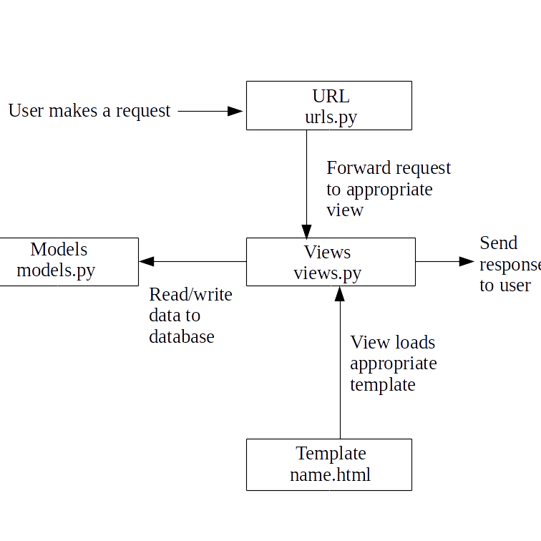
Overview: Django
Notes:
Django sites consists of a project split into apps that do specific things
Apps contain the files in the diagram
Show routes file
Show a handler
Show a model
Show a template

Slide 6
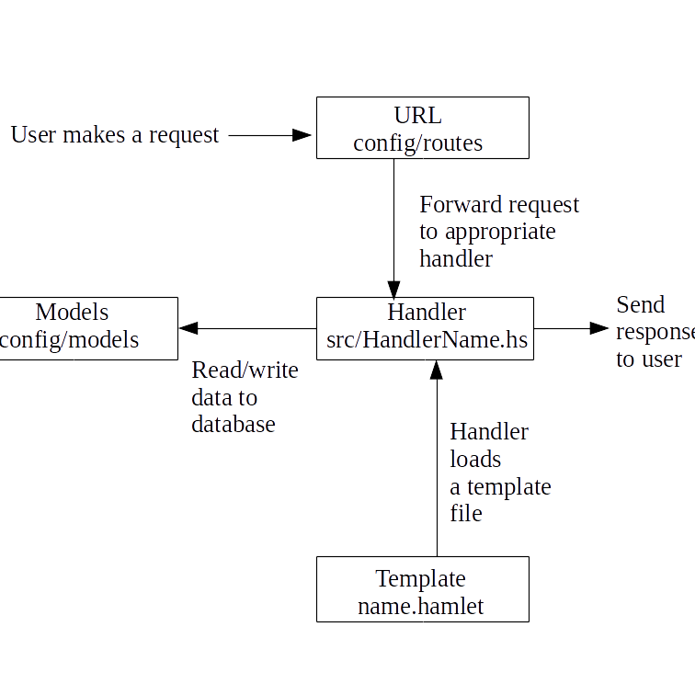
Overview: Yesod
Notes:
Yesod sites are scaffolded, nomrally
Creates files and code needed to connect to a database
You build on top of generated code
Helps promote best practices within Yesod
Show routes file
Show a handler
Show a model
Show a template

Slide 7
Learning the Frameworks
Haskell Programming From First Principles
Developing Web Applications with Haskell and Yesod
Django Documentation
Haskell Library Documentation
Forums, chat rooms
Notes:
Talk about learning Haskell from scratch
Went through the start of the book before starting to learn Yesod
Yesod writer wrote Yesod book as well, making it very accurate, good book, usage examples
Django documentation really good as well. Went through official tutorials
Haskell Library Docs are mixed. Some are great, but some are lackluster. Hard to read at the beginning, but then types and source code became easier to understand
Django, any issues you come across are most likely solved.
Yesod, smaller framework, you could be the first person to encounter an issue. Freckle CPU spike on launch, for example.
But the community is very helpful for Yesod. The writer of Yesod frequently answers questions on stackoverflow

Slide 8
Wire
A twitter clone was created, named Wire.
Users can
  Create accounts
  Post messages
    Including #hashtagged messages
  Follow each other
  Search for messages/users
Notes:
Give a live demo of the site on the amazon EC2 servers
Yesod: ec2-18-220-199-182.us-east-2.compute.amazonaws.com
Django: ec2-18-221-131-69.us-east-2.compute.amazonaws.com

Slide 9
Continuous Integration
GitHub Repositories integrated with Travis CI
Tests ran after every commit pushed to GitHub
E-mail received if a test fails
Notes:
Go to the github repos. Show the .travis.yml files
Show the Travis UI. Show tests running
Show time to run tests

Slide 10
Running the Experiments
Sites were hosted on identical Amazon EC2 instances
We ran page load speed tests, load tests, and analysed resource usage
Notes:
Show the web console. Show the specs (1 CPU, 1GB Ram). Mention the fact that these low spec servers could affect our resuls.

Slide 11
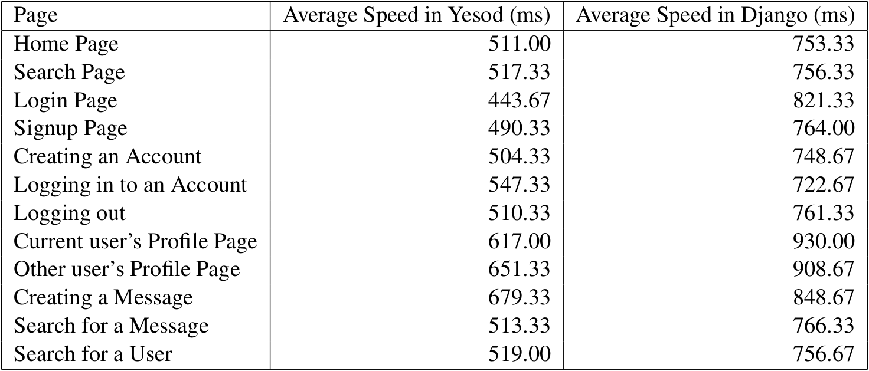
Page Load Speeds
Tests repeated 3 times
Yesod is ~200ms faster
Notes:
Mention that the tests were done with chromiums dev tools.
Reliability increased by repetition
Maybe do a live test? Load home page, show the number used

Slide 12
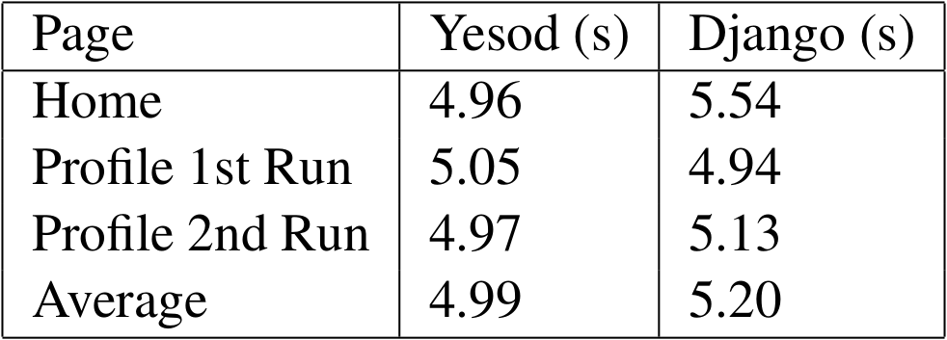
Load Tests
Used RedLine13 for these tests
80 users loaded a given URL
Test normally took 25 seconds to complete
Yesod transferred less data, ~6.46MB per test vs Django’s 18.19MB per test
Notes:
RedLine13 used Amazon EC2 servers, the free one.
To keep in line with usage limits, only three tests were done. Had to do quite a few discarded tests to figure out the service as well
80 was the max
Less data transferred because Yesod, by default, compresses all static files. These files are then decompressed when stored on the disk.
Show an example on home page

Slide 13
Resource Usage
Similar resource usage on both servers
Yesod server used 109MB of RAM, Django server used 125MB of RAM
Notes:
These values were read after the previous page load speed tests
Negligible difference considering resources we have available

Slide 14
Debugging
Yesod’s type safety does prevent some errors
No implicit type inference in Haskell
Haskell debug messages are also very useful
Tested how useful this is simulating errors
Notes:
Haskell’s type safety should prevent a lot of common bugs
Misspelt names, using wrong types when manipulating data, URL type safety

Slide 15
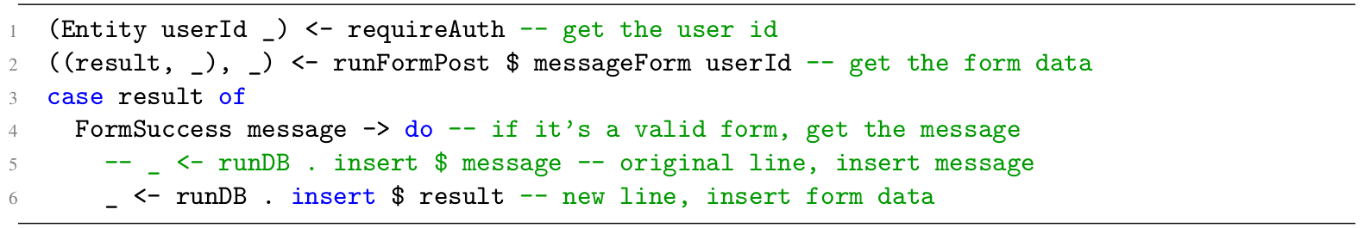
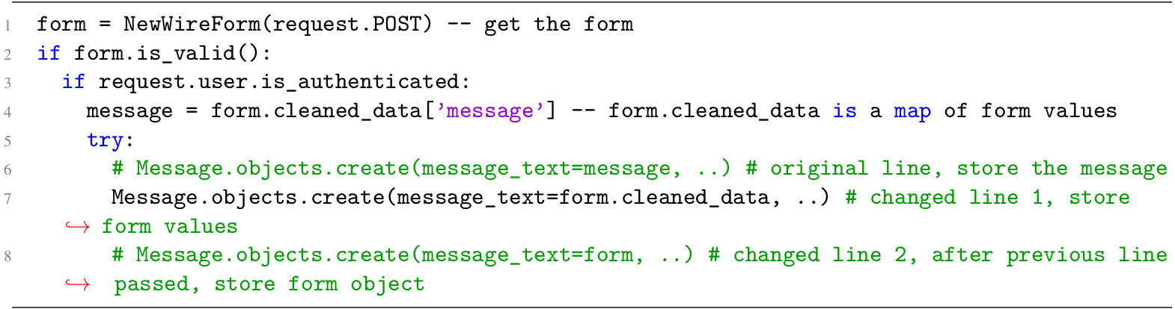
Saving Form Data
Notes:
Simulated an error, form data used to save message rather than message from form
Yesod caught this error
Django converted form data (map) to a string and saved it

Slide 16
Saving Form Data
Haskell compiler caught the error
Python converted the form data into a string, and saved it into the database
Tests should catch this
Notes:
Haskell compiler saves time by catching these types of errors during compile time
Would normally be caught by tests but it’s useful to catch these errors during compile time. Saves time

Slide 17
Test Limitations
Free Amazon AWS tier limited the tests we could do
Only a weak server was available
Powerful servers would have affected previous tests
Notes:
Only 1GB of RAM and 1 CPU core
Load tests were affected due to the weak servers
More powerful servers would have taken one more thing out of the equation for these tests
Couldn’t do too many repeats of load tests to keep within the free usage limits

Slide 18
Conclusion
Yesod is a production ready framework
Faster than Django in our tests
Yesod is recommended for:
  Experienced Haskell Developers
  Developers willing to learn Yesod
  Developers concerned with reliability

