Slide 1
Digital Portfolio
STUDENT NAME: Rasheeqa kulsum M
REGISTER NO AND NMID: 31224U09072
DEPARTMENT: BCA
COLLEGE: COLLEGE/ UNIVERSITY: Islamiah women's arts and science college

Slide 2
PROJECT TITLE
"Design and development of a personal portfolio website "

Slide 3


AGENDA
Problem Statement
Project Overview
End Users
Tools and Technologies
Portfolio design and Layout
Features and Functionality
Results and Screenshots
Conclusion
Github Link
3/21/2024 Annual Review

Slide 4

PROBLEM STATEMENT
In today’s digital age, professionals and students require a strong online presence to showcase their skills and projects. Traditional resumes often fail to demonstrate creativity and technical expertise effectively. A personal portfolio website solves this problem by providing a dynamic platform to present work, skills, and contact details.

Slide 5

PROJECT OVERVIEW
This project is a personal portfolio website for Rasheeqa, a BCA student, designed to highlight academic achievements, technical skills, creative projects, and contact information. The site follows a modern, responsive, and visually appealing layout, ensuring accessibility across devices.

Slide 6

WHO ARE THE END USERS?
Potential Employers / Recruiters – to evaluate technical and creative skills. Clients / Collaborators – to explore services such as video editing, graphic design, and development. Peers & Educators – to view academic and personal projects. General Audience – to learn about the developer and connect.

Slide 7

TOOLS AND TECHNIQUES
HTML5 – for structure and semantic markup. CSS3 (Tailwind CSS) – for responsive and modern styling. JavaScript – for interactivity. GitHub Pages / Hosting Platform – for deployment and accessibility.

Slide 8
POTFOLIO DESIGN AND LAYOUT
Navbar – fixed header with navigation links (About, Skills, Projects, Contact). Hero Section – introductory banner with name, role, and a call-to-action button. About Section – summary of academic background and passions. Skills Section – grid layout showcasing technical and creative skills. Projects Section – project cards with images, titles, and descriptions. Contact Section – email link for collaboration opportunities. Footer – copyright and branding.
8

Slide 9
FEATURES AND FUNCTIONALITY
Responsive design for desktop, tablet, and mobile devices. Smooth navigation with anchor links. Interactive hover effects for skill cards and project showcases. Organized project gallery for easy exploration. One-click email contact option.

Slide 10
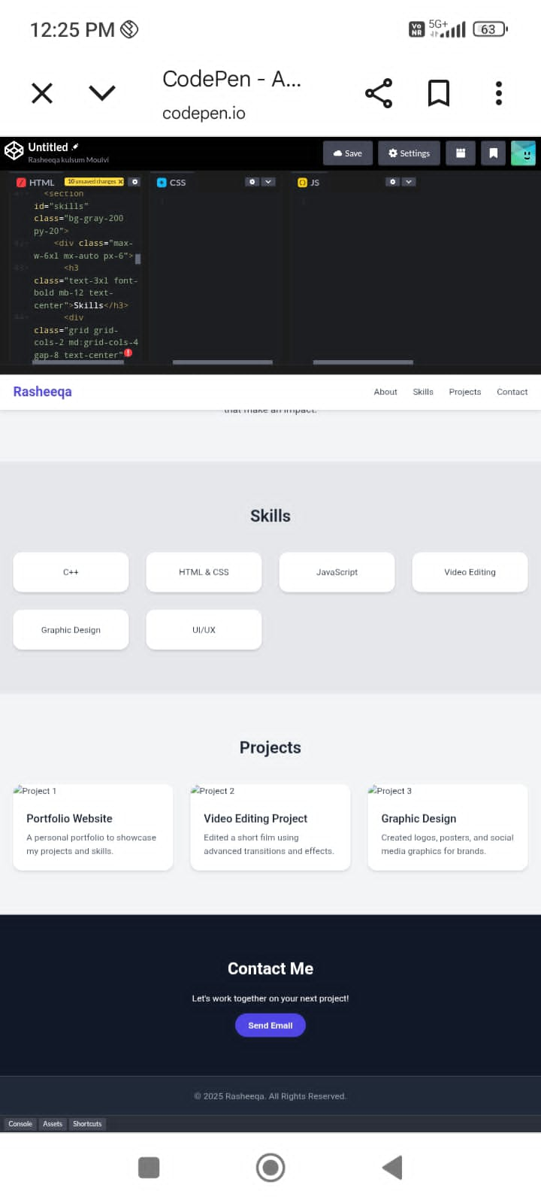

RESULTS AND SCREENSHOTS
3/21/2024 Annual Review
10

Slide 11
CONCLUSION
The portfolio website serves as a modern, responsive, and effective personal brand representation for Rasheeqa. It highlights skills in development, video editing, and design, while also serving as a central hub for potential employers, clients, and collaborators. Future improvements could include integrating a blog section, adding animations, or connecting with LinkedIn and GitHub APIs.
11

