Slide 1
Microcomputer Principles
&
Computer Interface
Lu Yin
luyin@nwpu.edu.cn

Slide 2
What it is?
A course about microprocessor principles
A course about computer science disciplines
A training about X86 assembly language programming
An introduction about the architecture of the X86 PC and X86 PC system design

Slide 3
The Textbook
The X86 PC Assembly language, Design, and Interfacing (the 5th edition)
By: Muhammad Ali Mazidi
Publisher: Publishing House of Electronics Industry

Slide 4
Information I want to know
Have u ever learned Numbering and Coding system? ( something like Binary code)
Have u ever learned Programming?
Have u ever learned the Analog and Digital Cycles?

Slide 5
Chapter 0
Introduction to Computing
Contains
  Numbering and Coding Systems
  Digital Circuits Primer
  Inside the Computer

Slide 6
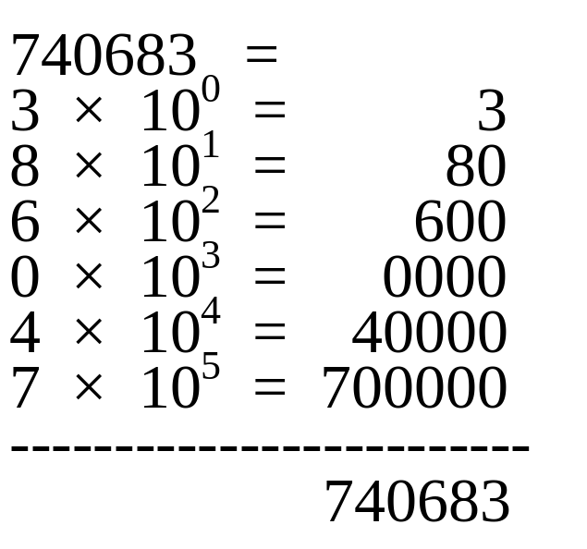
0.1 Numbering and Coding system
The concept of “weight”
  “Weight” is the actual value of a bit in a number.
  An example in Decimal

Slide 7
0.1 Numbering and Coding system
Three types of number system
  10 based system – Decimal
    Using decimal number, is a human nature
  2 based system – Binary
    A switch only have 2 static states
  16 based system – Hexadecimal
    A convenient representation of binary numbers
    For we are not computers

Slide 8
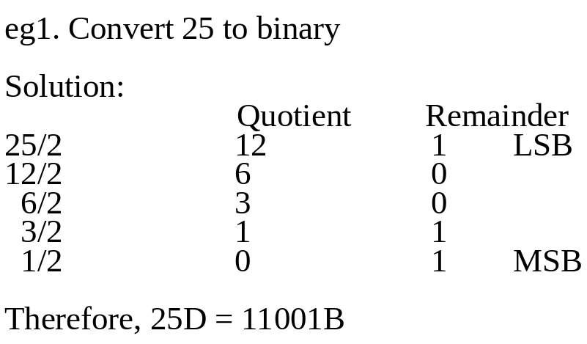
0.1 Numbering and Coding system
Convert between decimal and binary
  In order to convert from decimal to binary, we can divide the decimal number by 2 repeatedly, and keeping track of the remainders.
Notes:
讨论1： 怎么看出25是十进制？ A1 5只能出现在Decimal . 错误， Octonary numbering system.
A2： from the context we are discussing.
A3： indicate numbering system with some additional signs. D O B and Hex

Slide 9
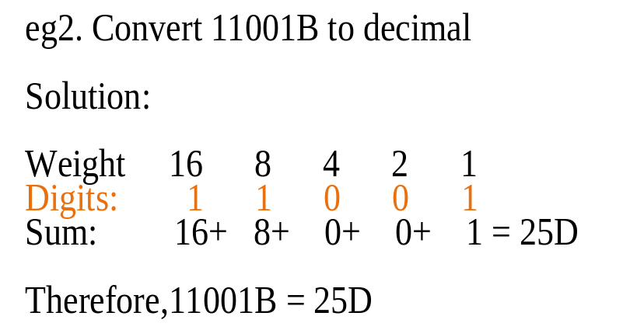
0.1 Numbering and Coding system
Convert between decimal and binary
  On the country, if we want to convert from binary to decimal, we have to do multiplication and addition.
  In the first step, multiply each digit with it’s weight
  Then adds up all the products.

Slide 10
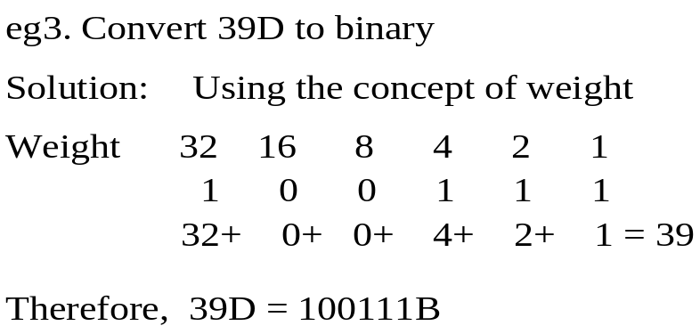
0.1 Numbering and Coding system
Convert between decimal and binary
  Convert from decimal to binary directly by counting the “weight” of each bit

Slide 11
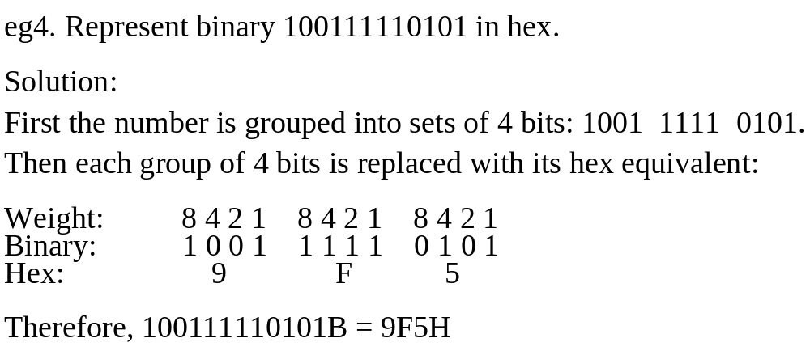
0.1 Numbering and Coding system
Convert between binary to hexadecimal
  Bin. to Hex.
  Hex. to Bin.
Start from the right and convert each 4-bit binary number to 1-bit hex number.
And vice versa.

Slide 12
0.1 Numbering and Coding system
Counting in each bases
  The highest digit plus 1 equals to zero with a carry to the next highest digit position

Slide 13
0.1 Numbering and Coding system
Computing
  Computing in Decimal
  Computing in Hexadecimal
  Computing in Binary

Slide 14
0.1 Numbering and Coding system
Addition and subtraction of decimal numbers
Addition and subtraction of hex numbers
  Start from the LSB digit, adds up the digits together
  When the result is greater then 16, subtract 16 from the result and take the remain as the digit, then carry 1 to the higher digit
  It is often used by programmers when programming

Slide 15
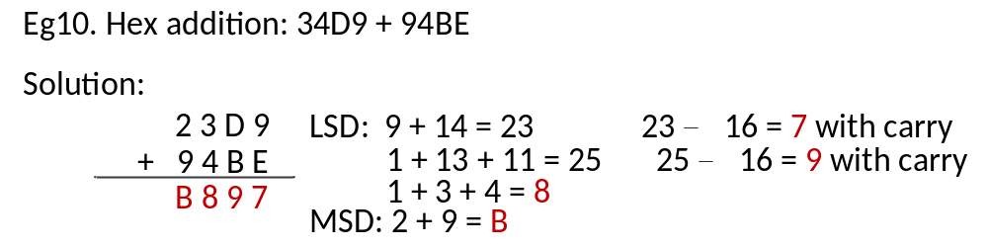
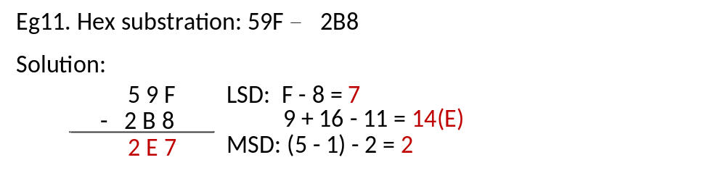
0.1 Numbering and Coding system

Slide 16
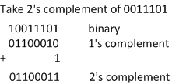
0.1 Numbering and Coding system
Addition and Subtraction of Binary numbers
  Addition is the same as decimals
  Subtraction is accomplished by adding up the 2’ complement of the subtrahend to the minuend
2’s complement
  Invert all bits, then plus 1;

Slide 17
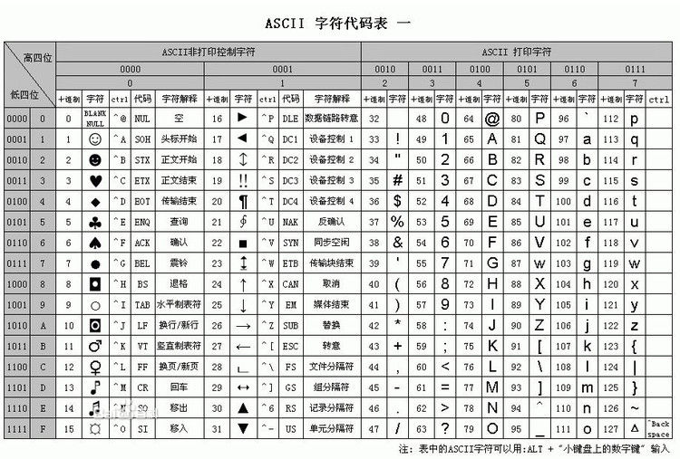
In Figure 0-1 at page 8, you can find the ASCII code table.

Slide 18
Notes of ASCII code
How does ASCII coding facilitate text processing and number inputting / outputting?
  The ASCII of ‘0’ to ‘9’ range form 30H to 39H. That is to say, ASCII code of numbers can be converted into BIN number by mask off the higher 4 digits.
  The ASCII of ‘a’ is 61H (0110 0001), while ASCII of ‘A’ is 41H(0100 0001). Therefore, conversion between uppercase and lowercase can be achieved by changing the bit5. So does other letters.

Slide 19
0.2 Digital Primer
Binary Logic
  Binary logic in computer (0 and 1) are defined by two distinct voltages (eg. 0V and 5V);
  Voltage level define have tolerances;
  A valid digital signal should be within the tolerance;

Slide 20
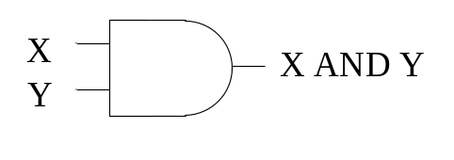
0.2 Digital Primer
Logic Gates
  And Gate
Logical | AND | Function
Inputs |  | Outputs
X | Y | X AND Y
0 | 0 | 0
0 | 1 | 0
1 | 0 | 0
1 | 1 | 1

Slide 21
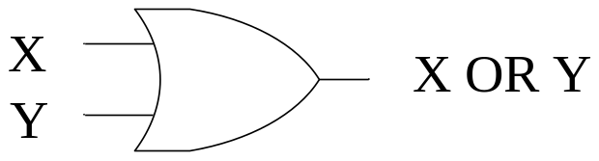
0.2 Digital Primer
Logic Gates
  OR Gate
Logical | OR | Function
Inputs |  | Outputs
X | Y | X OR Y
0 | 0 | 0
0 | 1 | 1
1 | 0 | 1
1 | 1 | 1

Slide 22
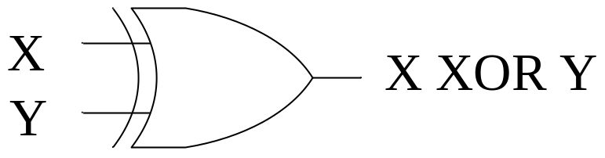
0.2 Digital Primer
Logic Gates
  XOR Gate
Logical | XOR | Function
Inputs |  | Outputs
X | Y | X OR Y
0 | 0 | 0
0 | 1 | 1
1 | 0 | 1
1 | 1 | 0

Slide 23
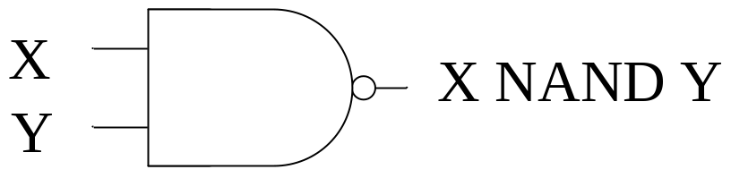
0.2 Digital Primer
Logic Gates
  NAND gate
Logical | NAND | Function
Inputs |  | Outputs
X | Y | X NAND Y
0 | 0 | 1
0 | 1 | 1
1 | 0 | 1
1 | 1 | 0

Slide 24
0.2 Digital Primer
Logic design using gates
  Half-adder
    Consider only two addend inputs
    Do not care about the carry bit from lower bit
Truth Table of Half Adder
X | Y | Sum | Carry
0 | 0 | 0 | 0
0 | 1 | 1 | 0
1 | 0 | 1 | 0
1 | 1 | 0 | 1

Slide 25
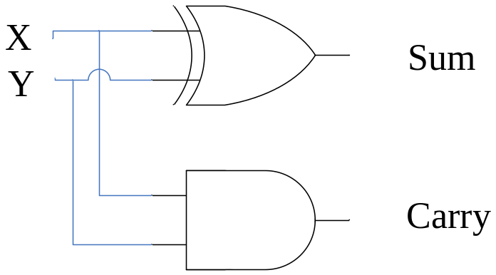
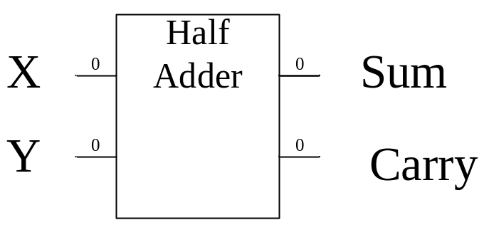
0.2 Digital Primer
Implementation of Half Adder
  Sum=X XOR Y
  Carry = X AND B

Slide 26
0.2 Digital Primer
Logic design using gates
  Full-adder
    Consider both addend inputs and carry bit from lower digit
    Can be implemented by two half-adders

Slide 27
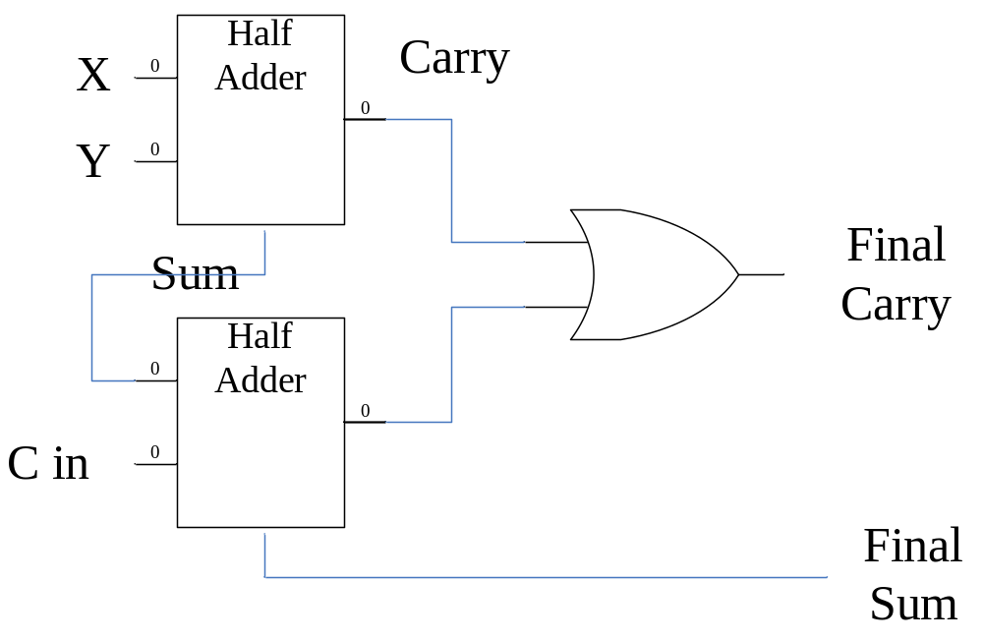
0.2 Digital Primer
Full-adder
  Construction:

Slide 28
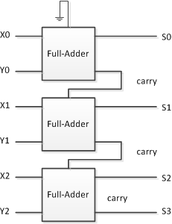
0.2 Digital Primer
Full-adder
  3-Bit adder using three
  full-adder:

Slide 29
0.2 Digital Primer
Flip-flops
  FF have stable stats
  FF shifts while CLK comes
  FF is often used to latch data

Slide 30
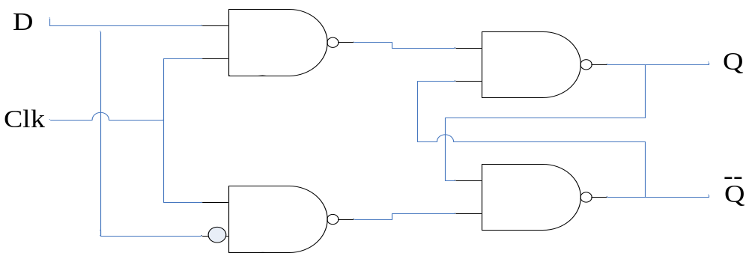
0.2 Digital Primer
Flip-flops
  The D-FF
    The D-FF is widely used to latch data.
    It grabs the data at the input as the clock is activated.
Clk | D | Q
No | X | No change
1 | 0 | 0
1 | 1 | 1

Slide 31
0.3 Inside the Computer
Some important terminology
  Bit, Byte, Word
  Kilobyte, megabyte and gigabyte
  RAM: random access memory, used for temporary storage of data.
  ROM: read-only memory, used for stable storages, such as BIOS.

Slide 32
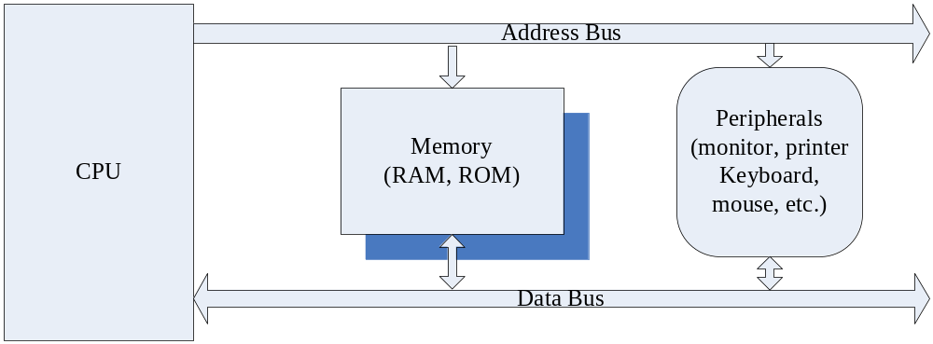
0.3 Inside the Computer
Common architecture: CPU+Mem+Peripherals(I/O)

Slide 33
0.3 Inside the Computer
Three types of bus:
  BUS: a strip of wires, which is used to carry information from place to place
  Three types: address, data, control
    Addresses are used by the CPU to locate device and memory spaces, the more wires within a addr bus, the more space can be accessed
    When data is putted on the data bus, each digit will take a wire. The more wires within a data bus, the more data can be transmitted within a clock.

Slide 34
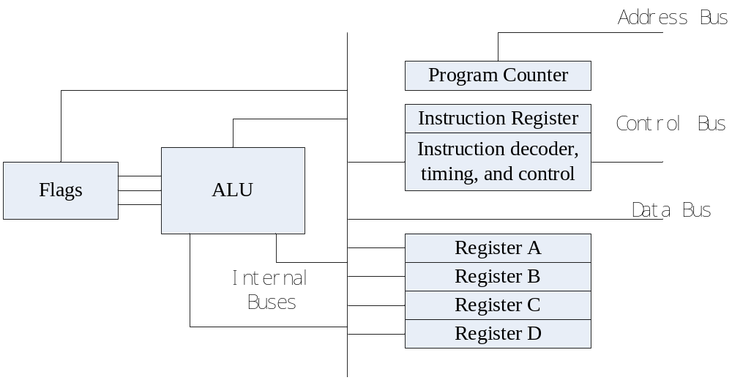
0.3 Inside the Computer

Slide 35
0.3 Inside the Computer
Inside the CPU
  Registers: to store information temporarily.
  Arithmetic/Logic unit: performing arithmetic functions, or logic functions.
  Program Counter: a special register, the data in which points to the address of the next instruction to be executed. It is also called as Instruction Pointer in the IBM PC.
  Instruction Decoder: interpret the instruction fetched into the CPU.

Slide 36
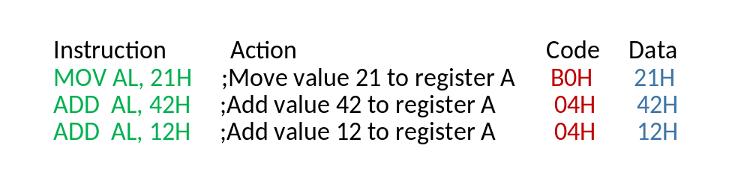
0.3 Inside the Computer
Example of how does a CPU work
  There are a piece of assembly language program that contains three instructions.

Slide 37
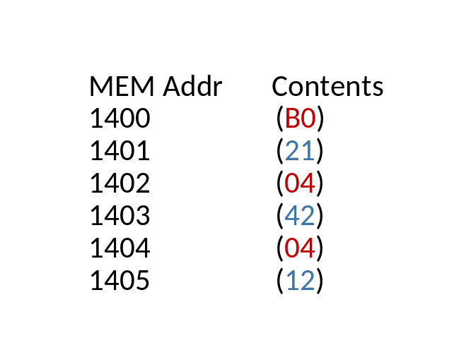
0.3 Inside the Computer
The operation codes and there operands are stored in the memory described below:
The CPU use program counter to locate the instruction that will be executed next;
AB and DB works together to load information from MEM o CPU
If the information loaded in is an op-code, it is decoded by the Instruction Decoder.
ALU will do addition with two operands
ALU can not hold operation result. It must be stored in an register.

