Slide 1
Microcomputer Principles & Computer Interface
Lu Yin
luyin@nwpu.edu.cn

Slide 2
Chapter 1 The X86 Microprocessor
Contains
The history of X86 family
The internal instructions of X86 quick view
Programming in assembly language quick view

Slide 3
The history of X86 CPU
Product | 8008 | 8080 | 8085 | 8086 | 8088
Year | 1972 | 1974 | 1976 | 1978 | 1979
Technology | PMOS | NMOS | NMOS | NMOS | NMOS
Transistors | 3000 | 4500 | 6500 | 29,000 | 29,000
Instructions | 66 | 111 | 113 | 133 | 133
Memory | 16K | 64K | 64K | 1M | 1M
DB width(in) | 8 | 8 | 8 | 16 | 16
DB width(ex) | 8 | 8 | 8 | 16 | 8
AB width | 8 | 16 | 16 | 20 | 20
Data width | 8 | 8 | 8 | 8/16 | 8/16

Slide 4
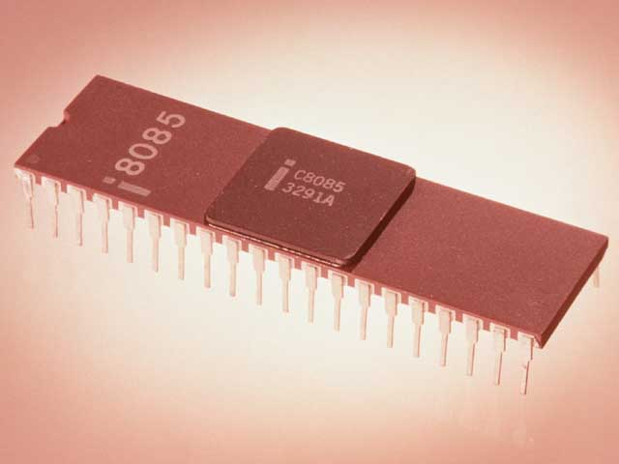
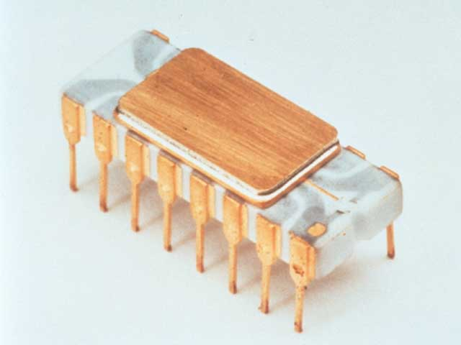
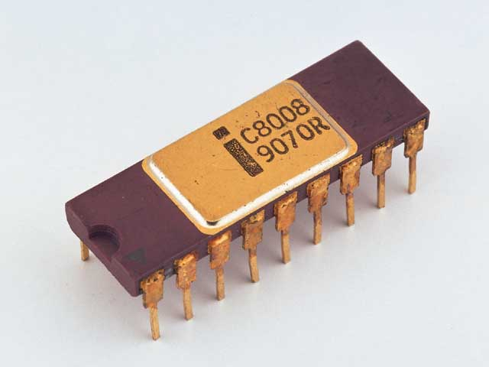
Intel 4004 to 8008/8085
4004 a prototype of CPU, 4-bit data;
8008 a successful type of 8-bit CPU;
8085 the last type of 8-bit microprocessor;

Slide 5
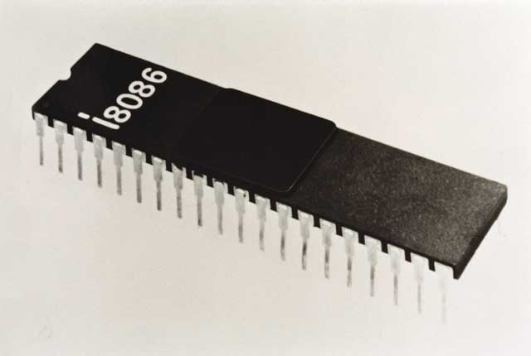
The history of X86 CPU
Intel 8086 in 1978
The beginning of 16-bit ages of PC
20-bit width address
IBM PC prototype
Why 8088
8-bit peripherals
The beginning of compatible computers

Slide 6

The history of X86 CPU
The chance for Microsoft
IBM PC
Operating system
DOS
Paul Allen and Bill Gates

Slide 7
The history of X86 CPU
Product | 8086 | 80286 | 80386 | 80486 | Pentium
Year | 1978 | 1982 | 1985 | 1989 | 1993
Technology | NMOS | NMOS | CMOS | CMOS | BICMOS
Transistors | 29,000 | 134,000 | 275,000 | 1.2M | 3.1M
Clock Rate | 10MHz | 16MHz | 33MHz | 33MHz | 66MHz,133M
Memory(Phy) | 1M | 16M | 4G | 4G | 4G
Memory (virtual) | None | 1G | 64T | 64T | 64T
DB width(in/ext) | 16/16 | 16/16 | 32/32 | 32/32 | 32/64
AB width | 20 | 24 | 32 | 32 | 32
Data width | 8/16 | 8/16 | 8/16/32 | 8/16/32 | 8/16/32

Slide 8
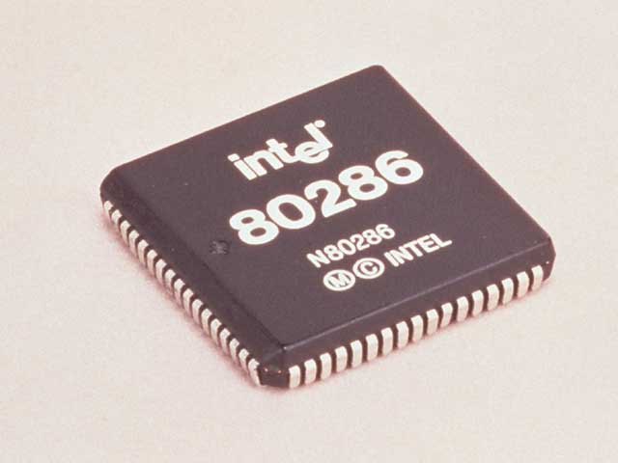
The history of X86 CPU
Intel 80286 – 1982
The ending of 16-bit ages
16-bit internal and external data
24-bit AB means 16 MB physical address
Virtual memory management unit (MMU) exits
Real and Protected mode
The CPU for IBM PC AT

Slide 9
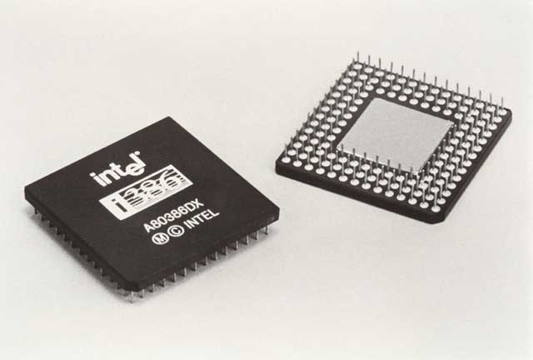
The history of X86 CPU
The powerful the good
80386 – 1985
The beginning of 32-bit ages
Last general-purpose processor
coprocessor: 80387 for float computing

Slide 10
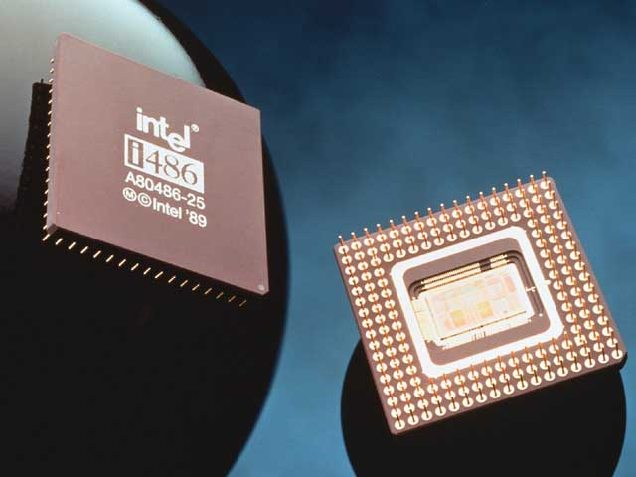
The history of X86 CPU
More powerful 80486– 1989
First Intel cpu that integrates coprocessors
Which enhanced its power of dealing with graphics greatly
It Cost Intel $3 Million
A glorious age of compatible computers

Slide 11
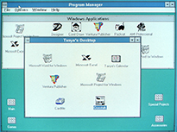

The history of X86 CPU
From command line to Graphic User Interface
Windows 3.1

Slide 12
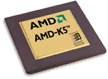
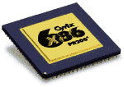
The history of X86 CPU
The Enemy of Intel
AMD
Cyrix
Others: TI, IBM, UMC

Slide 13
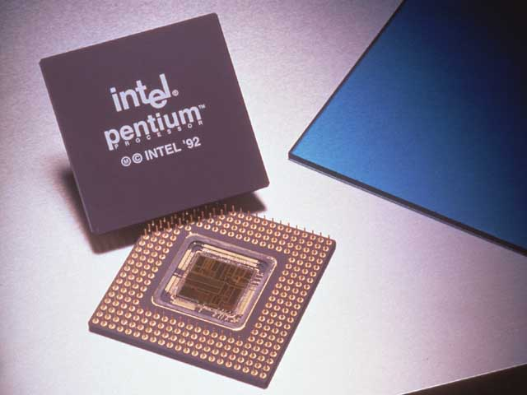
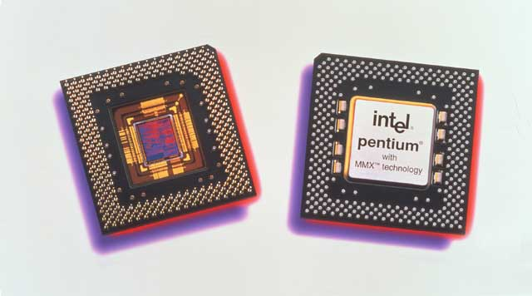
The history of X86 CPU
Pentium – 80X586 in legends – 1992
Intel hates “Cottage products”
Leads to the age of “clock rate competition”
Introduces MMX instruction groups (P55C Pentium MMX)

Slide 14

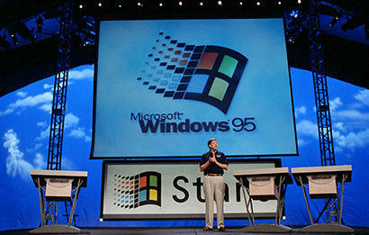
The history of X86 CPU
Revolution：To real GUI OP.
Even it is after Apple

Slide 15
The history of X86 CPU
Product | Pentium II | Pentium III | Pentium 4 | Itanium II | Core Dual
Year | 1997 | 1999 | 2000 | 2002
Transistors | 7.5M | 9.5M | 42M | 220M
Cache Size | 512K | 512K | 512K | 3M
Number of | Single | Single | Single | Single | twin
Memory(Phy) | 64G | 64G | 64G | 64G
DB width(in/ext) | 32/64 | 32/64 | 32/64 | 64/64 | 64/64
AB width | 36 | 36 | 36 | 64
Data width | 8/16 | 8/16 | 8/16/32 | 8/16/32/64 | 8/16/32/64

Slide 16
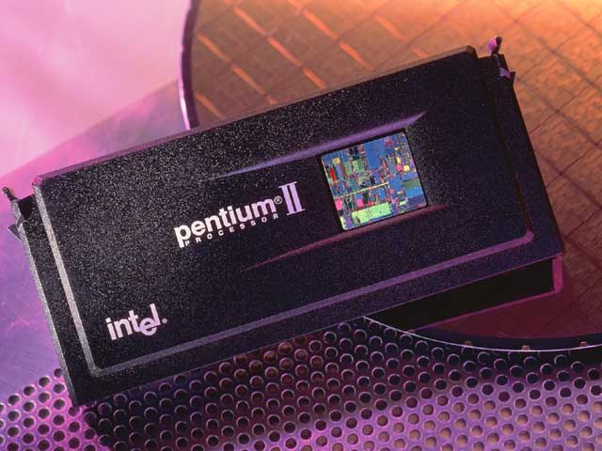
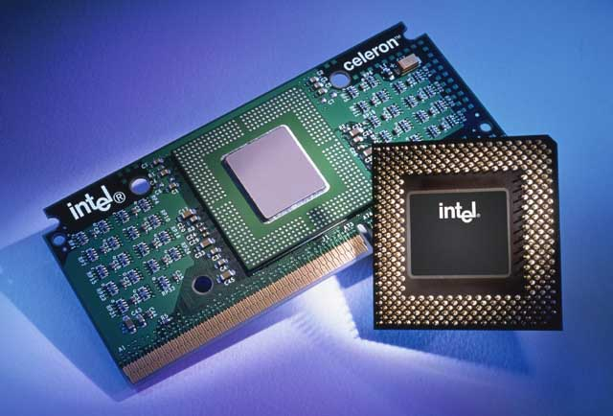
The history of X86 CPU
Pentium II the success of Cache – 1997
Celeron and “overclocking” rush

Slide 17
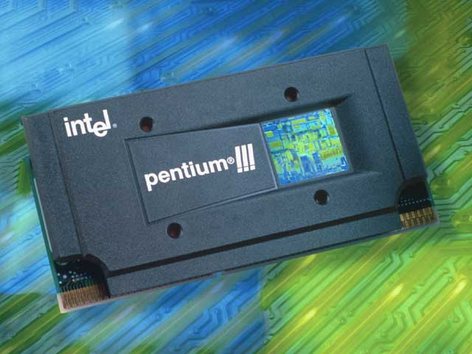
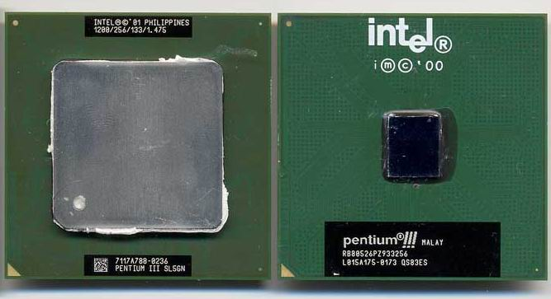
The history of X86 CPU
Pentium III – 1999
MMX and SSE instruction group
SIMD (single instruction stream with multi data stream)

Slide 18
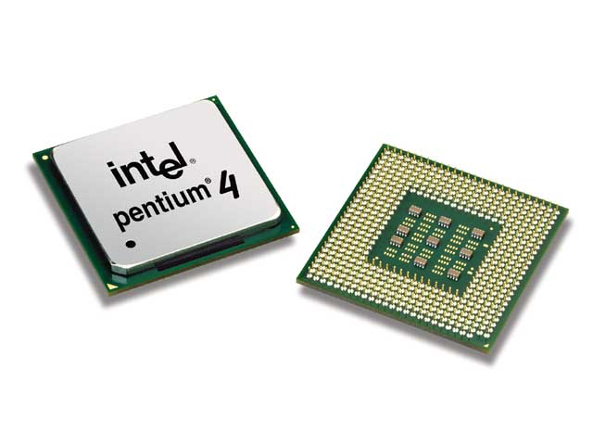
The history of X86 CPU
To the future

Slide 19
The history of X86 CPU

Slide 20
The history of X86 CPU

Slide 21
Section1.2 Inside the 8086
There are two ways to make the CPU process information faster:
Increasing the working frequency. However, increasing frequency is technology dependent, and costly. The technology and materials used in making ICs determine the integration density, power consumption and heat sinking, and hence working frequency. In an other word, there ought to be a limitation in increasing the working frequency.
Changing the internal architecture of CPU. In a typical CPU, there always takes two (or up to four) steps in executing an instruction: fetch instruction, then execute (or fetch instruction, decoding, fetch operand, execute). If these steps is proceeded in different parts inside the CPU, a pipeline may be build to increase the CPU processing power.

Slide 22
Section1.2 Inside the 8086
8086 implements 2 stages pipeline
It splits the internal structure of the microprocessor into 2 sections:
The execution unit (EU)
The bus interface unit (BIU)
EU and BIU can work simultaneously

Slide 23
Section1.2 Inside the 8086

Slide 24
What is “Pipelining” ?
In computing, a pipeline is a set of data processing elements connected in a series, in which the output of one element is the input of the next one. The elements of a pipeline are often executed in parallel (or in time-sliced fashion, in such a case, registers have to be used as buffers between elements).

Slide 25
Branch penalty in pipeline
In order to keep the pipeline flow fluently, the CPU always fetch some instructions in an instruction queue to build a buffer, especially when the CPU runs much faster than the system bus.
However, in some cases the CPU has to flush out the queue. For example, when a jump instruction goes to an instruction out of the queue.
In such a situation, the EU has to wait until the BIU fetches the new instruction. In computer science, it is called Branch Penalty.
Superscalar may reduce the lose of branch penalty. In a superscalar architecture processor, there may be two or more pipelines. The BIU may predict the branches, and load different branches into different pipelines. When jump happens, processing may be re-distributed to the other pipeline to avoid branch penalty.

Slide 26
Section1.2 Inside the 8086

Slide 27
Section1.2 Inside the 8086

Slide 28
Section1.2 Inside the 8086

Slide 29
Section1.2 Inside the 8086
Registers
The registers inside the CPU are used to store information temporarily.
The information could be either an operand, or the address of an operand or an instruction, or even flags that show the running status of the CPU.
There are several types registers inside x86 processer, for example, general-purpose register, stack pointer register, and segment register. (They can be found in table1-4).

Slide 30
Section1.2 Inside the 8086
Table 1-4
Category | Bits | Register Names
General | 16 | AX,BX,CX,DX
 | 8 | AH,AL,BH,BL,CH,CL,DH,DL
Pointer | 16 | SP(stack pointer), BP(base pointer)
Index | 16 | SI(source index), DI(destination index)
Segment | 16 | CS(code), DS(data), SS(stack), ES(extra)
Instruction | 16 | IP(instruction pointer)
Flag | 16 | FR(flag register)

Slide 31
Registers
The General-purpose registers are used to store operands or address of operands. They can be accessed in either 16-bit or 8-bit formats, and different names are used in different accessing formats.
The first letter of general-purpose register indicates its use:
A for accumulator;
B for base addressing register;
C for counter in a loop;
D for data pointer in an I/O operation.

Slide 32
Registers
Pointer Registers are used to locate operands inside stack segment.
The structure STACK will be discussed in detail in section 1.5
BP: base pointer, points to the beginning of the stack;
SP: stack pointer, points to the currently top slot of the stack, which is an empty slot and will be used by the next PUSH instruction;

Slide 33
Registers
Index registers.
As segment register points to the beginning address of a segment, there must be some other ways to locate a slot within the segment, especially when the program wants to access an array of string inside the memory.
Pointer registers are used in the program together with segment registers to locate operands inside segments, DS of ES.
SI: source index; - DI: destination index

Slide 34
Registers
Segment Registers is used in memory management
Segment registers points to the beginning address of a program segment inside the memory:
CS : code segment; - DS : data segment
SS : stack segment; - ES : extra segment
The meaning of “segment” will be discussed in detail in section 1.4;

Slide 35
Registers
IP: Program counter.
It is also called as “Instruction pointer” in Inter x86 family processors.
IP always points to the next instruction that is going to be loaded into processor;
After the load operation, IP is increased automatically by the address generator;
In program jumps, the address of the target is calculated by the ALU together with the address generator, and is send to the IP. After the load of the target instruction, IP is increased automatically.

Slide 36
Registers
FR: Flag register
It holds flag bits that indicate the current status of CPU. Thus it is also referred to as “status register”
There are three groups of bits inside FR:
Conditional flags: CF, PF, AF, ZF, SF, and OF;
Control flags: DF, IF and TF;
Reserved bits and unused bits: bit1, 3, 5, 8, 12~15;
The meaning and function of each bits will be discussed in detail in section 1.6.

