Slide 1
Microcomputer Principles & Computer Interface
Lu Yin
luyin@nwpu.edu.cn

Slide 2
Chapter 12 Interfacing DAC and ADC
Contains
Interfacing a Digital-to-Analog converter;
Interfacing a Analog-to-Digital converter;
Code the corresponding programs in Assembly programming language;

Slide 3
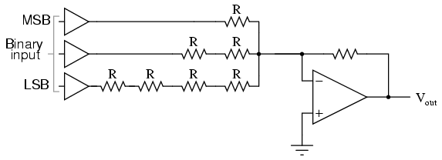
Chapter 12 Interfacing DAC and ADC
12.3 Digital-to-Analog converter
Binary-Weighted-Input DAC
Binary-weighted input DAC requires several different precise input resistors for different input pins. It is a little complicated in implementation of IC design.

Slide 4
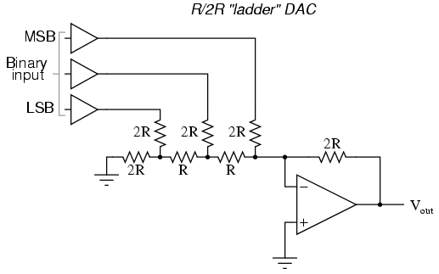
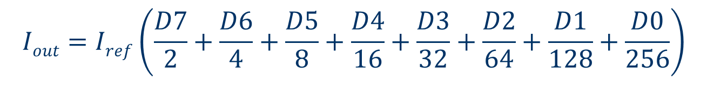
Chapter 12 Interfacing DAC and ADC
12.3 Digital-to-Analog converter
R/2R network DAC
The implementation of R/2R network DAC requires more resistors but less resistor values.
The principle of R/2R DAC is current accumulation.

Slide 5
Figure 12-10
12.3 Digital-to-Analog converter
Interfacing DAC

Slide 6
Chapter 12 Interfacing DAC and ADC
12.3 Digital-to-Analog converter
Two methods of wave generating (1)
Function Waveform Generation
The Function waveform generating methods calculating the output value in real-time.
//This piece of C codes generates SIN wave
Do {
for(a=0; a<360; a++){
Vout=5+(5*sin((3.14*a)/180));
magnitude = Vout*25.6;
outp(PORT_8255PA, (char)magnitude);
}
}

Slide 7
Chapter 12 Interfacing DAC and ADC
12.3 Digital-to-Analog converter
Two methods of wave generating (1)
Pre-Stored Wave Table
Use XLAT or Indexed relative addressing modes
Wave Table for SIN wave of 256 degrees
Angle | Sin(Angle) | Vout | DAC input
0 | 0 | 5 | 128
30 | 0.5 | 7.5 | 192
60 | 0.866 | 9.33 | 238
90 | 1.0 | 10 | 255
… | … | … | …

Slide 8
Chapter 12 Interfacing DAC and ADC
12.4 Analog-to-Digital converter
ADC converter ADC 0809
It is a 8 Input 8 digit ADC
ADDa~c select input source
IN0~IN7 are analog input pins
START starts ADC
EOC end of convert
OE(output-enable) transmit convention result to data output buffer
D0~D7 digital output pins

Slide 9
Chapter 12 Interfacing DAC and ADC
12.4 Analog-to-Digital converter
Sequence of using (Query Mode)
Output ADDA~ADDC, select a analog input;
Provide ALE to latch the channel section;
Provide START to start convention;
Input EOC status to check whether convention finished;
When EOC restore to HIGH, provide OE to latch result and then, read out data via data bus
We need up to 6 ports to interface a ADC0809

Slide 10
Chapter 12 Interfacing DAC and ADC
12.4 Analog-to-Digital converter
Interfacing ADC0809 in query mode:
ADC0809 Signals | Ports Required | Function Description
[IN] ADDA~ADDC | [OUT][buffered] port 1 | Send channel selection number
[IN] ALE | [OUT] port 2 | Command ADC to latch channel selection number
[IN] START | [OUT] port 3 | Command ADC to start convert
[OUT] EOC | [IN] port 4 | Query working states
[IN] OUT EN | [OUT] port 5 | Command ADC to prepare data output
[OUT] Data Bus | [IN] port 6 | Read convert result

Slide 11
Chapter 12 Interfacing DAC and ADC
12.4 Analog-to-Digital converter
Interfacing ADC0809 in virtual channel mode:

Slide 12
Chapter 12 Interfacing DAC and ADC
12.4 Analog-to-Digital converter
Interfacing ADC0809 in virtual channel mode:
1) The channel selection pin ADDA,B,C of ADC0809 is connected to A0 A1 and A2 and the address latch pin(ALE) is activated by an output of system address decoder(Y7, named as AD_S), together with IOWR signal. As a result, the execution of a OUT instruction that visit an address within the range of Y7, will force ADC0809 to lock up an channel.
2) The start convert pin of ADC0809 is also connected to AD_S. So, once the channel is locked up, the convert will begin.
3) The output signal End Of Convert(EOC) is connected to 8259.PortA.BIT0;
4) The input signal Output Enable(OUT EN) is connected to the system address decoder output Y7, together with IORD signal. As a result, the execution of an IN instruction that visit an address within the range of Y7, will enable the convert result output of a ADC0809 channel.
Interfacing like this, we can write to an IO address to command ADC0809 to start a sampling process; and read the same IO address to retrieve result, just like visiting an IO port.

Slide 13
Chapter 12 Interfacing DAC and ADC
12.4 Analog-to-Digital converter
The channel selecting signal ADDA~C have been connected with system address bus A0~A2; And ALE has been connected with START -- AD_S pin.
If we connect the AD_S pin with an output pin of Address Decoder unit, we can regard the 8channels of ADC0809 as 8 separated AD Ports. And by providing port address via system bus, a ADC channel can be selected and started.
The EOC pin has been connected with AD_E(OC) connection pin. Thus we can import EOC status via direct IO port or any port of 8255.
The digital out pin D0~D7 have been connected with data bus directly. Thus we have to read out convention result through the AD ports.

Slide 14
Chapter 12 Interfacing DAC and ADC
12.4 Analog-to-Digital converter
Sequence to do sampling in virtual ports mode
1) Write to a sampling channel. The WR and address decoding output will select a channel and start convert;
2) Read the status of EOC pin from an additional input interfacing port;
3) When EOC is valid, do READ of that port. The RD and address decoding output will enable result output, and sent data to data bus.

