Slide 1
Microcomputer Principles
&
Computer Interface
Lu Yin
luyin@nwpu.edu.cn

Slide 2
Chapter 2
Assembly Language Programming
Contains
  Basic structure for a assembly language of x86
  Show a sample shell of the program
  New instructions: Control transfer instructions
  Design your program with flowcharts and pseudo code

Slide 3
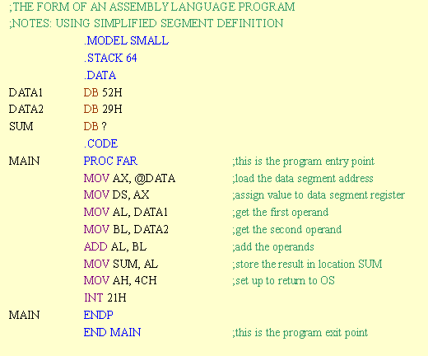
Section2.1
Directives and a Sample Program
En example of an assembly language program

Slide 4
Section2.1
Directives and a Sample Program
Directives
  Directives are not instructions. They will not generate any runnable machine codes when your program is assembled.
  Directives are used to tell the assembler how to translate the Assembly language instructions into machine code.
  Examples for directives are: model definitions; Segment definitions; Declarations;
Four parts of an assembly language instruction
[label:] mnemonic [operands] [;comment]
  1. Label field: give the line in your program a handle to be referred to;
  2. Mnemonics
  3. and operands: these are the major body of the instruction. They will handle the actual work of the instruction
  4. comment: words written for programmers, It is used to explanation the function of the instruction

Slide 5
Section2.1
Directives and a Sample Program
1) Model definition – selects the size of the memory model
.MODEL SMALL | ;the data must fit into 64K bytes ;the code must fit into 64k bytes
.MODEL MEDIUM | ;the data must fit into 64K bytes ;the code can exceed 64K bytes
.MODEL COMPACT | ;the data can exceed 64K bytes ;but the code cannot exceed 64K bytes
.MODEL LARGE | ;both data and code can exceed 64K ;but no single set of data should exceed 64K
.MODEL HUGE | ;both code and data can exceed 64K ;data items (such as arrays) can exceed 64K
.MODEL TINY | ;used with COM files, in which data and code must fit ;into 64K

Slide 6
Section2.1
Directives and a Sample Program
2) Segment definition
  Declare the segments of the program
3) Stack segment
  Declare the stack size for the program
    STACK 64 ;reserves 64 bytes of memory for the stack
4) Data segment
  Declare variables of the program
    .DATA
    DATA1 DB 52H ;declare var DATA1, size 1 byte,
    ; value 52H(more types in sec2.5)

Slide 7
Section2.1
Directives and a Sample Program
4) Code segment
  Procedure: A procedure is a group of instructions designed to accomplish a specific function.
  A code segment may consists of only one procedure (the main procedure), or to be organized into several small procedures for more structured.
  To define a procedure:
    Proc_name PROC FAR/NEAR
    ; code
    Proc_name ENDP
    ; Plz note that the OS requires that the entry point to the
    ; user program be a FAR procedure

Slide 8
Section2.1
Directives and a Sample Program
4) Code segment
  Initialize the Segment Registers
  CS, SS, (& ES) are initialized by the OS automatically (as declared in by the directives);
  DS should be initialized by the user program:
    MOV AX. @DATA ; DATA refers to the start of the data segment
    MOV DS, AX ; initialize the Data Segment Register
5) To finish the program
  Use directive to declare the end of the program
    END MAIN
    Plz note that the END pseudo-instruction ends the program by indicating to OS that the entry point MAIN has endded.

Slide 9
Section2.1
Directives and a Sample Program
;THE FORM OF AN ASSEMBLY LANGUAGE PROGRAM
;USING SIMPLIFIED SEGMENT DEFINITION
 |  | .MODEL SMALL
 |  | .STACK 64
 |  | .DATA
 |  | ;
 |  | ;place data definition here
 |  | ;
 |  | .CODE
MAIN |  | PROC FAR | ;this is the program entry point
 |  | MOV AX, @DATA | ;load the data segment address
 |  | MOV DS, AX | ;assign value to data segment register
 |  | ;
 |  | ;place code here
 |  | ;
 |  | MOV AH, 4CH | ;set up to
 |  | INT 21H | ;return to DOS
MAIN |  | ENDP
 |  | END MAIN | ;this is the program exit point

Slide 10
When your program is been assembled and executed, what value is actually assigned to the CS, DS and SS register?
As there are only offset addresses inside the program, segment registers must be initialized before the running of the program;
Only the operating system knows the size of memory space, and the exact spare block that can be allocated; Various OSs have different memory maps.
Therefor, specific memory locations can not been required by the program, for example, from 25FFF to 289E2;
The allocation of memory for your program is the work of operating system
  CS, SS, (& ES) are initialized by the OS automatically (as declared in by the directives);
  Data segment is allocated while DS is not initialized
  Thus DS should be initialized by the user program:
    MOV AX. @DATA ; DATA refers to the start of the data segment
    MOV DS, AX ; initialize the Data Segment Register

Slide 11
Section2.2
Assemble, Link, and Run a program
Create and Assemble, and Run an assembly language program
Step | Input | Program | Output
1. Edit the program | Keyboard | Notepad; UltraEdit | Myfile.asm
2. Assemble | Myfile.asm | MASM | Myfile.obj
3. Link | Myfile.obj | Link16 | Myfile.exe

Slide 12
Section2.3
More Sample Programs
Program 2-1 :Sum up 5 DB data in date segment.
- do it in a JNZ loop.

Slide 13
Section2.3
More Sample Programs
Program 2-2 : Sum up 4 DW data in date segment.

Slide 14
Section2.4
Control Transfer Instructions
Director: FAR and NEAR
  NEAR: If the target address lies inside the current code segment, it is a NEAR address;
  FAR: If the target address lies outside the current code segment , it is a FAR address;
  In a NEAR jump, only the IP is updated; while in a FAR jump, both CS and IP will be updated;
  A NEAR jump is also called a intersegment transfer; while FAR jump is called intrasegment transfer.

Slide 15
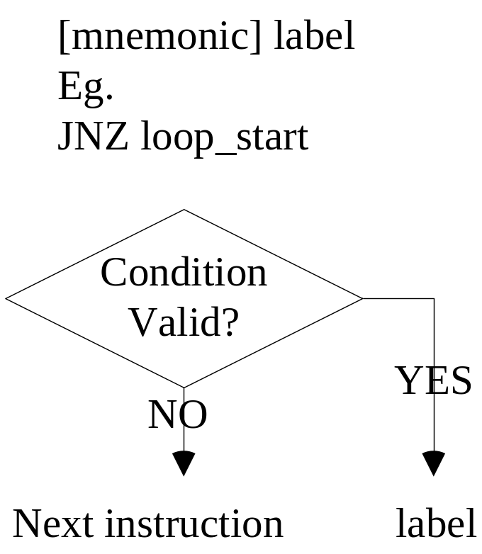
Section2.4
Control Transfer Instructions
What is conditional jump?
  Goto label if condition is valid;
  Goto next instrument if condition is not valid.
All conditional jump are short jumps. In such a case, the address of the target must be within -128 ~ +127 bytes of the IP.

Slide 16
Section2.4
Control Transfer Instructions
Conditional Jump instructions: Table 2-1 @ pp69
Mnemonic | Condition Tested | “Jump if…”
JAE/JNB | CF = 0 | above or equal/ not below
JC | CF=1 | Carry
JE/JZ | ZF=1 | Equal /zero
JNC | CF = 0 | Not carry
JNE/JNZ | ZF=0 | Not equal/not zero
JNO | OF=0 | Not overflow
JS | SF=1 | Result is negtive

Slide 17
Section2.4
Control Transfer Instructions
Question: How does the processor knows the address to go ?
In the source code, the label of the target instruction is used as an operand;
After being assembled and linked, an offset value is calculated between the jump instruction and the target instruction, and it will replace the label sign;
If jump forward, the offset is an active one, and its value equals to the distance between the two instructions; if jump backward, the offset is the 2’s complement of the distance.

Slide 18
Section2.4
Control Transfer Instructions
Unconditional jumps
  “JMP label
    NEAR JUMP: within code segment
    Register indirect JUMP: JMP BX
    Memory indirect JUMP: JMP [DI]
    FAR JUMP: JMP FAR PTR label, both IP and CS should be changed.

Slide 19
Section2.4
Control Transfer Instructions
CALL statements
  It is used to invoke procedures;
  CALLs to sub procedures are used to perform tasks that need to be performed frequently. It would make a program more structured;
  If the target procedure resides in the current code segment, it is a NEAR CALL. In such a case, only the IP will be preserved into the stack automatically;
  If the target address resides in an other code segment, it is a FAR CALL. In such a case, both the CS and IP will be preserved automatically.

Slide 20
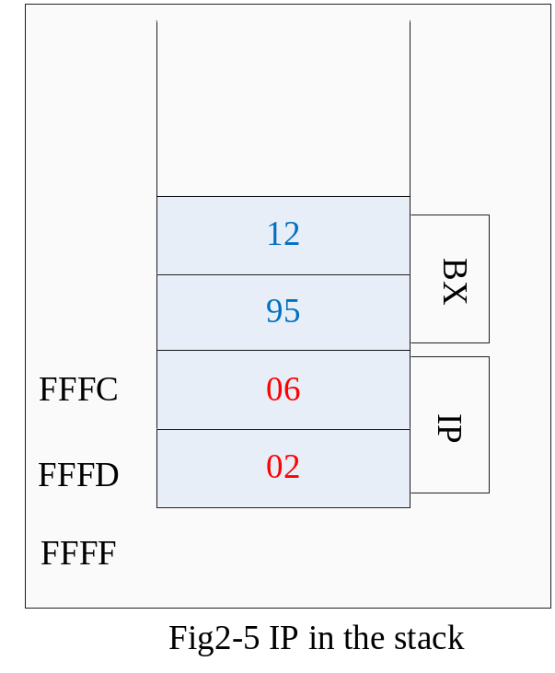
Section2.4
Control Transfer Instructions
Example:
Logical Address | Machine Code | Assembly Instructions
12B0:0200 | BB1295 | MOV BX, 9512
12B0:0203 | E8FA00 | CALL 0300
12B0:0206 | B82F14 | MOV AX, 142F
…
12B0:0300 | 53 | PUSH BX
12B0:0301 | … | …
…………… | … | …
12B0:0309 | 5B | POP BX
12B0:030A | C3 | RET

Slide 21
Section2.4
Control Transfer Instructions
RET statement
  It is used to return back the invoker procedure;
  In a FAR CALL, both the CS and IP are popped out; In a NEAR CALL, only the IP is popped out.
  The control transfers to the instrument below the CALL instrument.
  Notice: only the top 2(/4) bytes on the top of the stack are popped out as IP(/CS&IP). Thus the number of PUSH and POP instructions inside the sub procedure must match.

Slide 22
WAIT to be completed.
Differences between a CALL and a JUMP
  The control must be transferred back to the next instruction below CALL, which is the one pointed by the IP
  So the CS:IP will be preserved by the processor
  There must be a RET at the end of the sub-procedure.

Slide 23
Section2.4
Control Transfer Instructions
Define a sub routine
 | .CODE
MAIN | PROC FAR
 | MOV AX, @DATA
 | MOV DS, AX
 | CALL SUBR1
 | …
 | MOV AH, 4CH
 | INT 21H
MAIN | ENDP
;--------------------------
SUBR1 | PROC
 | PUSH [ANY REGISTERS USED IN THE PROC]
 | … []
 | RET
SUBR1 | ENDP
 | END MAIN ;this is the exit point

Slide 24
How to pass parameters and return values?
There are several way in passing parameters into sub procedures.
  Passing parameters via registers;
  Passing via memory;
  Passing via the stack;
Generally, stack is always used in passing inlet parameters; while register is always used in passing export parameter;

Slide 25
Passing parameters via registers
  Inlet and export parameters are stored in registers;
  Registers involved must be documented in detail before programming; So that to avoid miss using, or damaging other program segments;
  The father procedure put inlet parameters in a register before calling sub procedures;
  The subroutine put export parameter in a register before return to father procedure;
  The number of spare registers limits the number of parameters that can be passed in.

Slide 26
Passing parameters via registers
  Example ParamReg.asm shows the use of registers to pass parameters;
  The main procedure defined a score table, and invoke the sub procedure to calculate the average score.
  The address of the score table is passed in via BX register; And the average score is passed out via AX register;
  Both registers(BX and AX) should be prepared before invoke the subroutine.

Slide 27
Passing parameters via memory
  A pre-defined memory is used to pass parameters;
  The location of the memory block, together with the storage order of parameters should be documented before programming;
  Example ParamMem.asm shows the use of shared memory to pass parameters;

Slide 28
Passing parameters via stackExample ParamStc.asm shows the use of stack to pass parameters;
  Play with stack in passing parameters is highly risky. For IP is preserved in stack when calling a subroutine;
  The main pushes parameters one by one into stack, then invoke the subroutine;
  Parameters is stored in stack below IP(&CS). Thus POP can not be used to access them;
  Based relative addressing mode is used in such a case to load parameters, and BP should be used as the base address register.

Slide 29
Section2.5
Data Types and Data Definition
Directives | functions
DB (define type) | 1 byte
DW (define word) | 2 bytes
DD (define double word) | 4 bytes
DUP (duplicate) | DUP is used to duplicate a given number of characters. Eg. DATA8 DB 6 DUP(0FFH) ; fill 6 bytes with FFH
EQU (equate) | Define a constant that do not occupying a memeory location. The constant var can be used in your programming, and can be understood by the assembler. Eg. COUNT EQU 25 .CODE MOV CX, COUNT ;this is a immediate addressing

Slide 30
Chapter 2
Exercises:
  Section4: Problem 10
  Section5: Problem 16

