Slide 1
To Build A Polling System and Deploy it in EC2 Instance
~A fullstack application creation and deployment project
Team Members
Biprajit Debnath
Rashi Gupta
10/04/2023
R
Reshi Gupta

Slide 2
Introduction :-
The Eligibility Questionnaire Form website is a web-based platform designed to simplify the eligibility determination process for various programs and services offered by the organization. The website is built using HTML, CSS, JavaScript, Node.js, and MongoDB, and is deployed on AWS EC2 for scalability and security.
This website is designed to simplify the eligibility determination process and improve the overall application experience for our users.
During this presentation, I will be showcasing the key features of this Eligibility Questionnaire Form website, including how it works, the technology stack used, and the benefits it provides for both the applicants and the organization.
Overall, this Eligibility Questionnaire Form website provides a much-needed solution to simplify the application process, save time and effort for both the applicants and the organization, and ensure that only eligible candidates are considered. Thank you for your time, and I hope you find this presentation informative and valuable.
Aim of the Project
With this Eligibility Questionnaire Form website, we aim to provide a fast, reliable, and user-friendly system that streamlines the application process and ensures that only eligible candidates are considered for a particular program or service.
By using advanced technologies like HTML, CSS, JavaScript, Node.js, and MongoDB, we can create a website that is responsive, easy to navigate, and securely stores user data on the cloud.

Slide 3
Needs
A user-friendly interface that is easy to navigate for users of all technical backgrounds.
Secure storage of user data in the backend using MongoDB to ensure the confidentiality and privacy of user information.
Efficient and accurate validation of user input to avoid errors and mistakes in data collection.
Easy deployment on AWS EC2 for scalability and accessibility to a larger user base.
Clear and concise instructions for users on how to fill out the questionnaire and what kind of data is required.
Goals
To collect relevant and accurate data from users to help sortlist students for placements.
To ensure that user data is secure and confidential at all times.
To minimize the time taken by users to fill out the questionnaire by providing clear instructions and easy-to-use interface.
To create a scalable and efficient system that can handle a large volume of user data.
To make the questionnaire accessible to users from different technical backgrounds and with varying levels of expertise.

Slide 4
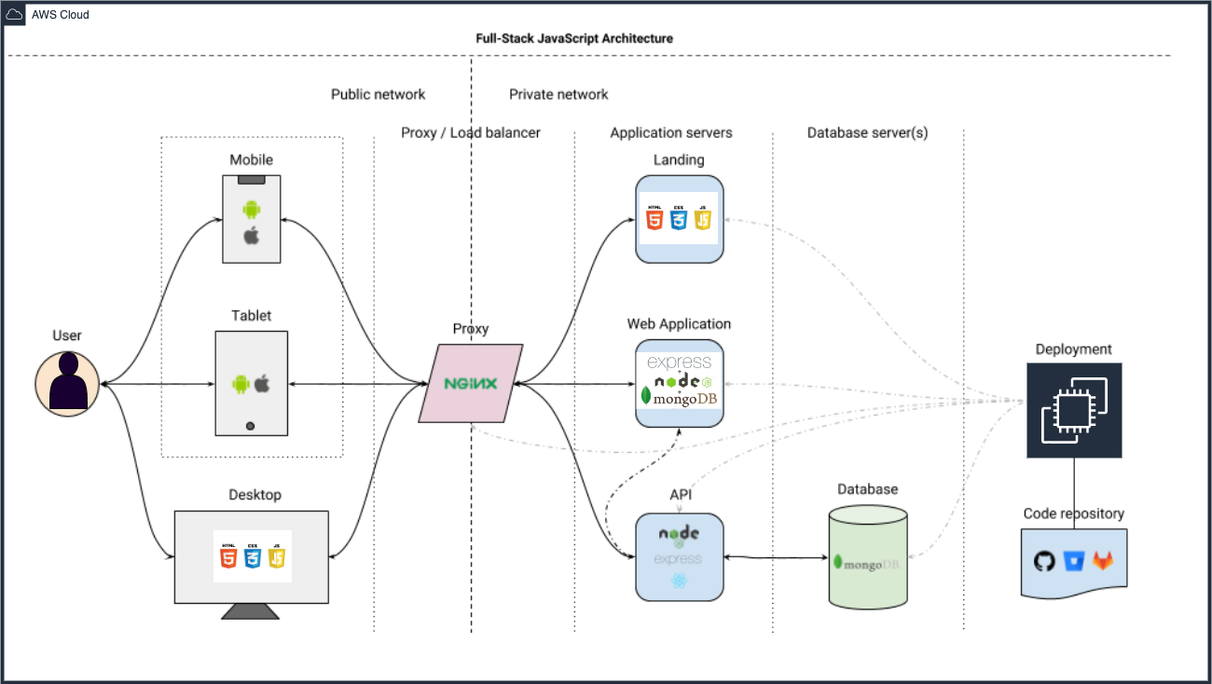
Architecture Diagram

Slide 5
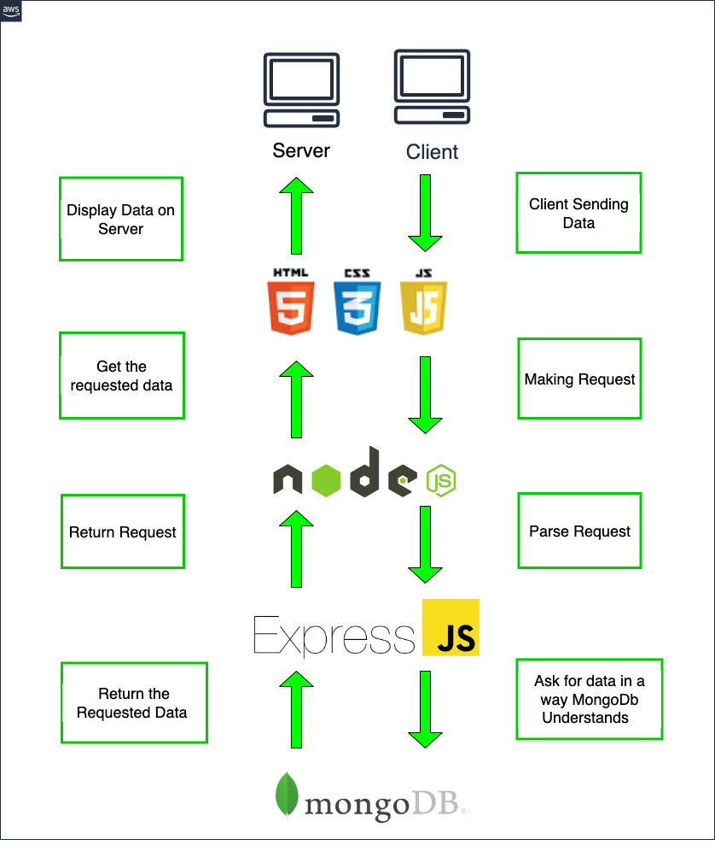
Core Structure
Stack Flow Diagram
Pooling System
├── backend
│ ├── api
│ │ > NodeJS, ExpressJs
│ │ > PORT 3000
│ │ >http://13.233.2.67:3000/
│ │
│ ├── database
│ │ > MongoDB Atlas
│ │ > PORT 27017
│ │
│
├── deployment
│ > EC2
│
├── frontend
│ ├── app
│ │ ├── mobile
│ │ │ > iOS (Apple App Store)
│ │ │ > Android (Google Play Store)
│ │
│ └── landing
│ > html,css,js
│ > PORT 3000
│ > http://13.233.2.67:3000/
│
└── README.md (specified instructions)

Slide 6
Stack Used
Frontend
Landing
HTML
CSS
Javascript
Bootstrap
Deployment
Technologies
AWS EC2 instance
Github
Backend
API
NodeJS
Express
Database
MongoDB Atlas
Prerequisites
Node (v16.15.0)
MongoDB shell(v5.0.6)
Visual Studio (latest)
Express (4.16.1)
MongoDB Atlas For database
MongoDB Compass (optional)

Slide 7
Setup and Running
Steps | Commands | Usage
1 | Create a new public repository with name “Polling System” | To deploy the project on GitHub
2 | mkdir survey | To create/make a directory named survey
4 | cd survey | To change the pwd (present working directory) to survey
3 | git clone https://github.com/biprajit1999/polling-system.git | To Clone the Repository to the destination directory
4 | cd Pooling System | To change the pwd (present working directory) to Pooling System
5 | npm install express --save | To install all the express dependencies to the pwd. Express allows us to set up middlewares to respond to HTTP Requests.
6 | npm install body-parser --save | To read HTTP POST data , you have to use the “body-parser” node module

Slide 8
Steps | Commands | Usage
7 | npm install mongoose --save | Mongoose is an object document modeling (ODM) layer which sits on the top of Node’s MongoDB driver
8 | mkdir public | To make a public directory to store the front-end pages i.e., index.html, style.css, survey_success.html
9 | Index.html | To create a front-end landing page where the survey form is displayed using html5
10 | style.css | To define the style and layout of the index.html and survey_success.html page.
11 | survey_success.html | This page is redirected upon successful submission of the form and it has an option to redirect again to index.html form to submit another response.
12 | app.js | This is the express js connection page to the mongoDB Atlas, it fetches the data from the client and send it to mongoDB Atlas Database
13 | mongod | mongod is the primary daemon process for the MongoDB system. It handles data requests, manages data access, and performs background management operations.

Slide 9
Steps | Commands | Usage
14 | Create a cluster in Mongo Atlas and get the connection string for nodejs | To connect the application to the mongoDB Atlas form mongoDB
15 | node app.js | To run the main executable application file. Then the app will be running in http://127.0.0.1:3000/ where the landing page appears.
16 | browse collection in mongoDB Atlas | To check for the data entry to the mongoDB Atlas refresh the page for new entries.
17 | brew install mongosh | Mongosh, is a fully functional JavaScript and Node.js 16.x REPL environment for interacting with MongoDB deployments. To interact with mongoDB Atlas from terminal we need to install mongoose
18 | mongosh "mongodb+srv://cluster0.has27be.mongodb.net/placement" --apiVersion 1 --username biprajit | To connect to the mongoDB Atlas from the terminal

Slide 10
Some basic MongoDB commands to Analyse the received data
Steps | Commands | Usage
1 | show dbs | To display a list of all the databases that are currently stored on the MongoDB server
2 | use test | To select a database to work with, it uses the test database if exits in the server else creates a new database with name “test”
3 | show collections | To list all collections created within a MongoDB database
4 | db.details.find().pretty() | Selects documents in a collection or a view.
5 | db.details.find({$and:[{"cpi":{$gte:"75"}},{"attendence":{$gte:"80"}},{"backlogs":{$lte:"0"}}]}).pretty() | To find the documents for shortlisting where the student have cpi>=75 along with attendence>=80 and no backlogs. Similarly, we can provide others shortlisting criteria as per our requirements .
12 | exit | To exit from the atlas database

Slide 11
Commands used to deploy the Project
Steps | Commands | Usage
1 | ec2-user | To login as an ec2 user
2 | ls | To list down files and directories
3 | sudo su | To switch to root user
4 | Yum update | To allow user to easily install, update software programs on system
5 | curl -o- https://raw.githubusercontent.com/nvm-sh/nvm/v0.39.3/install.sh | bash | To set up Node.js on your Linux instance Connect to your Linux instance as ec2-user using SSH. We will use nvm to install Node.js because nvm can install multiple versions of Node.js and allow you to switch between them.
6 | ~/.nvm/nvm.sh | To Activate nvm

Slide 12
Steps | Commands | Usage
7 | nvm install --lts | To Use nvm to install the latest version of Node.js
2 | Git clone ”https://github.com/biprajit1999/polling-system.git” | To Clone the Repository to the destination directory
3 | npm start | executing a start script without typing its execution command.
4 | npm install pm2@latest-g | To Install pm2 globally so we access our website anytime even after closing linux terminal
5 | pm2 start app.js | To Start app.js file to start the online service and it will continue in the backend
6 | pm2 update | pm2 update is necessary in order to refresh the pm2 deamon

Slide 13
Running and deployment
AWS
Amazon Web Services is very popular and reliable platform to host our application on top of their servers.There are many types of amazon’s services that we can use to host our app, but we will use EC2 (Elastic Compute Service). It is free and provides a very customized configuration during the creation process. We we create an instance: a set amount of resources initialized (OS, disk space, Ram, etc).
EC2
Why EC2?
Because it’s free and provide very customisable configurations to the end user.
How to create EC2 instance
STEP-1: Select a region
One of the most important steps is to select the desired AWS region. This can be done from the top navigation bar of the AWS Console.
STEP2-: Navigate to the EC2 Console
Once you select the desired AWS region, go to the EC2 Console.
STEP3-:Configure storage
STEP4:-Select an existing key pair or create a new key pair
Key pair type-RSA
Choose key pair name-
Download key pair-we have to download private key file(*pem file) and store it in secure and accessible location

Slide 14
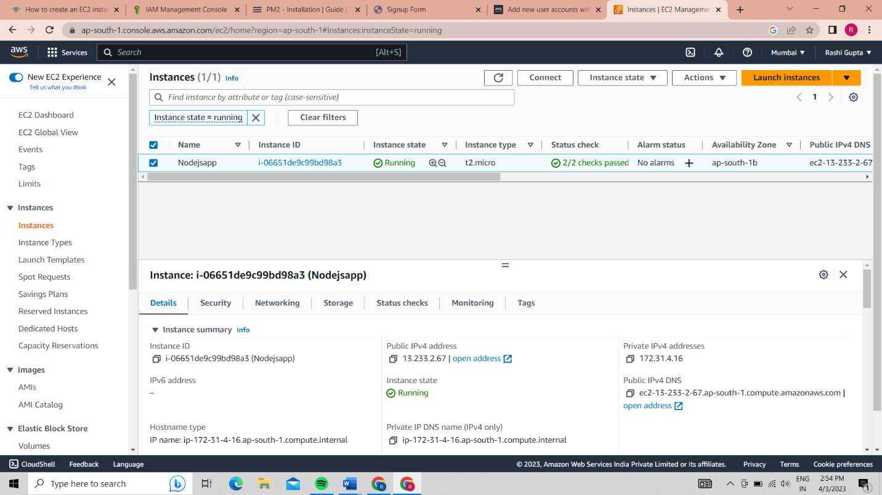
LAUNCH INSTANCE
Download puTTy
puTTy is an SSH and telnet client.It is a open source software that is available with source code
it will save as pem* extension
Access puTTY-
STEP 1-Open puTTy key generator
STEP 2-load the pem* key file and save as a private key
STEP3- open puTTy configuration and write you public id address which was generated in ec2 instance

Slide 15
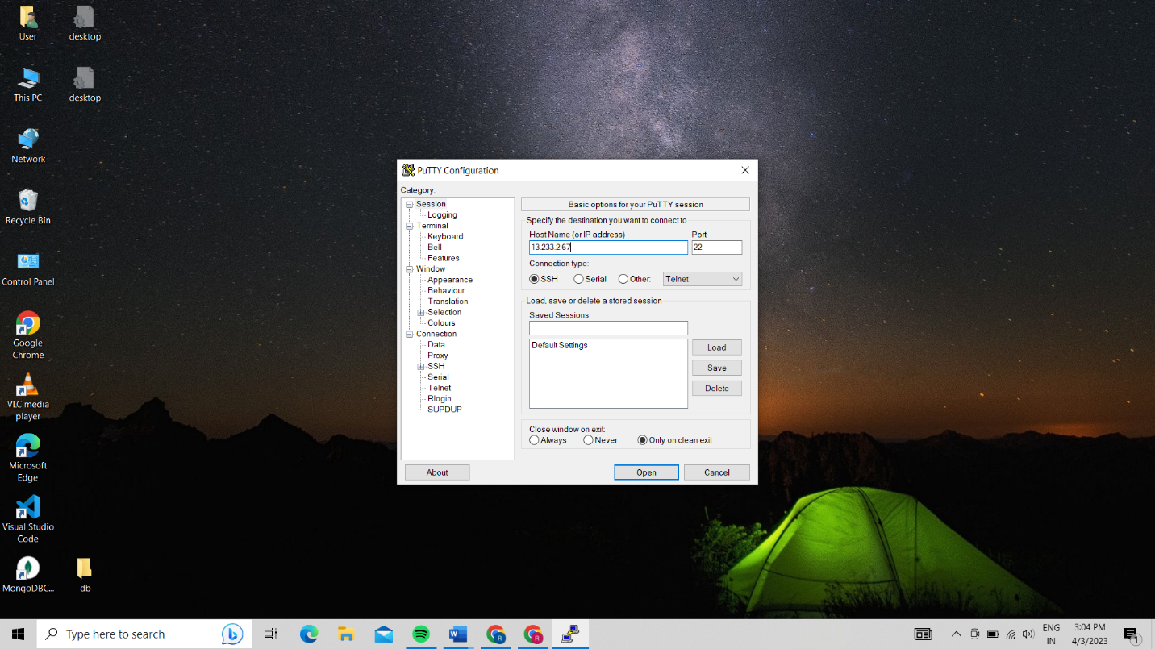
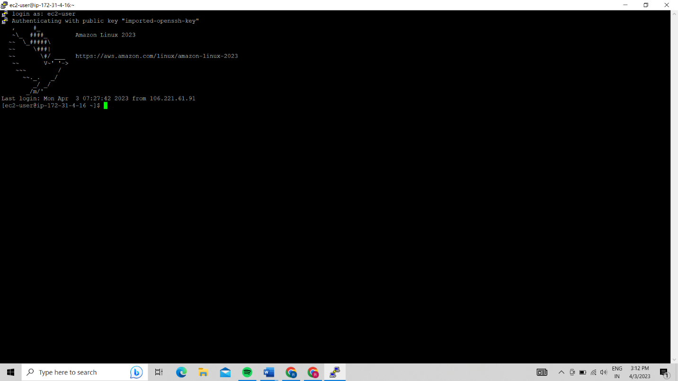
STEP4-For Authentication we browse for .*ppk which is downloaded in the desktop.
STEP5- open the terminal for ec2 public ip address

Slide 16
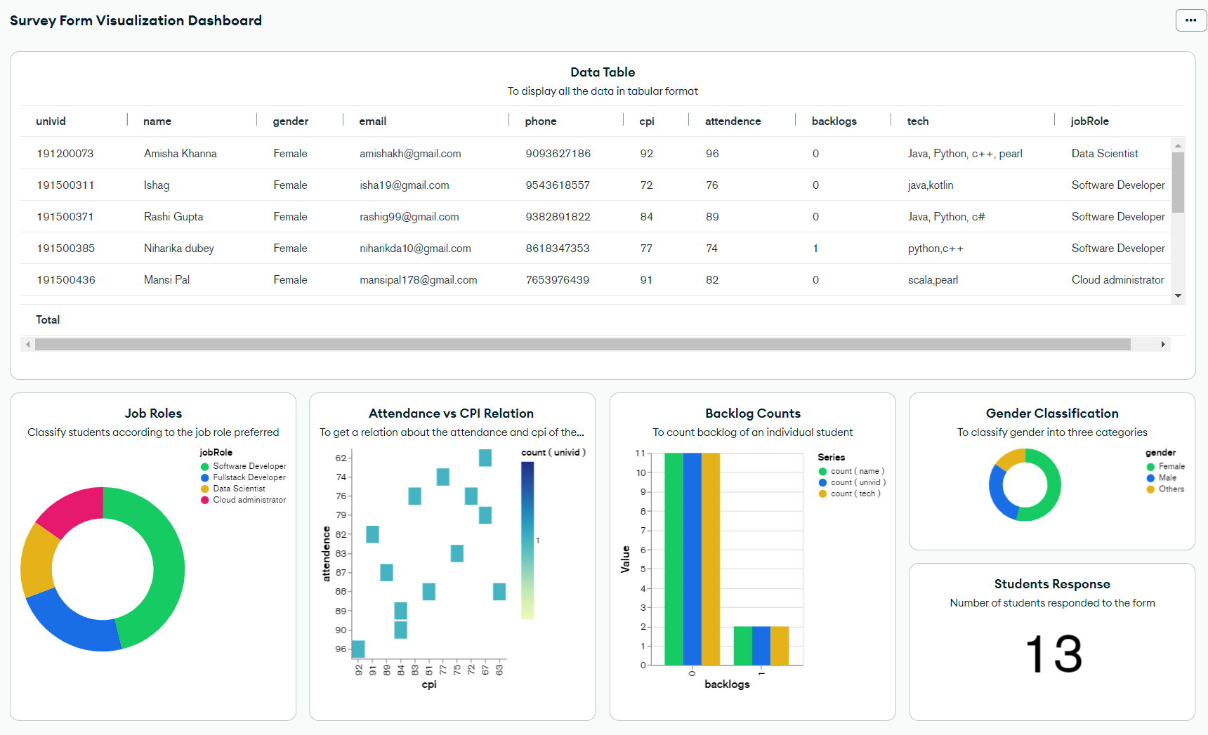
Summary Visualisation Dashboard

Slide 17
Thank You

