Slide 1
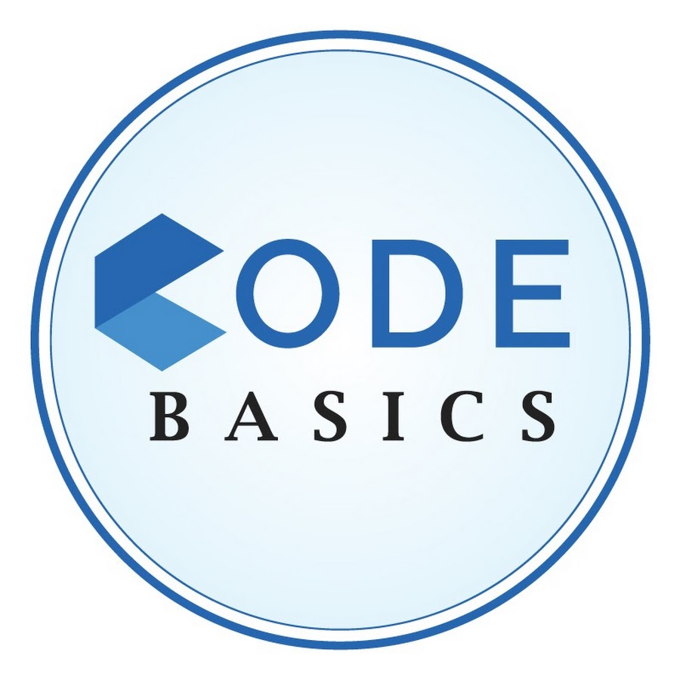


Telangana Growth Analysis
Rashi Singla

Slide 2
Content
Introduction
Goals and Objectives
Preliminary Research
Secondary Research
Insights and Recommendation
Presentation Title

Slide 3
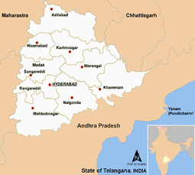
About Telangana
Telangana is India’s youngest state and was born on June 2, 2014, as the 29th state of India.
The most beautiful thing about the state is , it shows good blend of culture and traditions with peaceful co-existence of different religions.
Telangana is one of the economically developing states of India.
Agriculture and related industries are more developed here.
Apart from this , Telangana has also been developing in areas like communication , Pharmacy , software development & many more.
The state has seen rapid economic growth in recent years, and is now one of the fastest growing states in India.

Slide 4



Goals And Objective
Objective 1
Objective 2
Objective 3
Analyze Trends and Pattern With in a Department
Identify Growth Opportunities and area needing attention
Overall Growth of the State Through Insights.

Slide 5


Preliminary Research

Slide 6
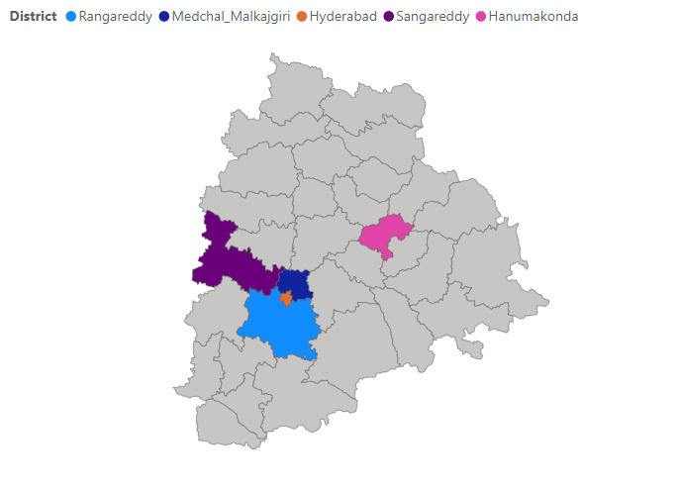
How does the revenue generated from document registration vary across districts in Telangana? List down the top 5 districts that showed the highest document registration revenue growth between FY 2019 and 2022.
Rangareddy has the highest document registration revenue growth followed by Medchal_Malkajgiri then Hyderabad.
It shows that there is a lot of economic activity happening in the state, and that people are investing in property and other assets. This is a good indicator for future growth.

Slide 7
How does the revenue generated from document registration compare to the revenue generated from e-stamp challans across districts? List down the top 5 districts where e-stamps revenue contributes significantly more to the revenue than the documents in FY 2022?
The Top 5 District are contribute to e-stamps revenue. This Is because these district is more urbanized and have the highest no. of property Registration.
The increasing use of e-stamp challans is a positive development for the economy of Telangana. It makes it easier and more convenient for people to pay stamp duty and registration fees, and it also helps to reduce corruption.

Slide 8
Is there any alteration of e-Stamp challan count and document registration count pattern since the implementation of e-Stamp challan? If so, what suggestions would you propose to the government?
Suggestions :
Make the system more user – friendly.
Reduce the number of steps involved in process.
Provide more clarity on fees and charged involved.
Make the system more secure.
Promote the use of e-stamp challans through awareness champaign.
Yes, there has been a significant alteration in the e-stamp challan count.
The no. of e-stamp challans issued has increased significantly.
The number of document registrations has also increased, but not as significantly as the number of e-Stamp challans.
The average value of e-Stamp challans has increased.

Slide 9
Categorize districts into three segments based on their stamp registration revenue generation during the fiscal year 2021 to 2022.
We Can categorize districts into 3 segments
Highest Revenue – Most Developed and Highest Level of economic activity
Medium Revenue – Relatively Developed and Lower level of economic activity
Low Revenue – Least Developed and Lowest level of economic activity

Slide 10
Investigate whether there is any correlation between vehicle sales and specific months or seasons in different districts. Are there any months or seasons that consistently show higher or lower sales rate, and if yes, what could be the driving factors? (Consider Fuel-Type category only)
Top 5 Districts that shows maximum sales:
Hyderabad - 1 M
Medchal Malkajgiri - 992 k
Ranga Reddy - 926 k
Sanga Reddy – 275 k
Nizamabad – 236 k
There is a Positive co-relation between the vehicle sales and months/season in diff. district
The months consistently shows higher sales rate are March, June, October because of Financial Incentive ,Increased demand and Good Weather.
The months consistently shows lower sales rate are December , April, July because of Holiday season, Financial constraints and bad Weather.

Slide 11
How does the distribution of vehicles vary by vehicle class (Motorcycle, Motorcar, Autorickshaw, Agriculture) across different districts? Are there any districts with a predominant preference for a specific vehicle class? Consider FY 2022 for analysis.
Hyderabad is the district with the highest number of vehicles registered in all four vehicle classes. This is because Hyderabad is the most populous district in Telangana and it is also the most developed district

Slide 12
The number of motorcycle registrations has increased in districts. This is because motorcycles are the most affordable and fuel-efficient mode of transportation.
The number of autorickshaw registrations has increased in the urban districts. This is because autorickshaws are a popular mode of transportation for short distances.
The district with the predominant preference of Agriculture Vehicle is Nalgonda & Siddipet. Nalgonda has the highest number of agriculture vehicles registered, which is a reflection of the agricultural nature of the district.

Slide 13
List down the top 3 and bottom 3 districts that have shown the highest and lowest vehicle sales growth during FY 2022 compared to FY 2021? (Consider and compare categories: Petrol, Diesel and Electric)
The top 3 districts are Hyderabad, Ranga Reddy, and Medchal-Malkajgiri. This shows that these districts are the most attractive for vehicle sales in Telangana.
Factors:
Presence of a large population
The availability of infrastructure and
The economic conditions of the district.
The bottom 3 districts are Wanaparthy, Rajanna Sircilla and Kumurambheem. This shows that these districts are the least attractive for vehicle sales in Telangana.
Factors:
The lack of infrastructure
The poor economic conditions of the district and
The low population density.

Slide 14
FY | 2021 | 2022 | GR%
Diesel | 21k | 20k | -5.26%
Electric | 9k | 20k | 122.22%
Petrol | 229k | 231k | 0.92%
Top 3 District
Hyderabad
The growth in vehicle sales is higher in Hyderabad than in other districts.
The growth in electric vehicle sales is higher than the growth in petrol and diesel vehicle sales in all district. This could be due to a number of factors, such as
The increasing awareness of the environmental benefits of electric vehicles.
The government's push for the adoption of electric vehicles.
FY | 2021 | 2022 | GR%
Diesel | 27k | 28k | 1.61%
Electric | 7k | 13k | 93.5%
Petrol | 201k | 200k | -0.7%
Medchal_Malkajgiri
FY | 2021 | 2022 | GR%
Diesel | 25k | 28k | 12.7%
Electric | 6k | 14k | 130%
Petrol | 184k | 200k | 8.8%
Rangareddy

Slide 15
FY | 2021 | 2022 | GR%
Diesel | 1834 | 1723 | -6.06%
Electric | 34 | 81 | 138.2%
Petrol | 10112 | 6779 | -32.9%
Bottom 3 District
Kumurambheem
Overall, the data shows that there is a growing interest in electric vehicles in Telangana. This is a positive trend, as electric vehicles are more environmentally friendly than petrol and diesel vehicles. The government should continue to promote the adoption of electric vehicles in order to reduce pollution and improve air quality.
FY | 2021 | 2022 | GR%
Diesel | 2219 | 1954 | 11.94%
Electric | 362 | 416 | 14.9%
Petrol | 14287 | 8743 | -38.8%
Rajanna Sircilla
FY | 2021 | 2022 | GR%
Diesel | 2686 | 2745 | 2.1%
Electric | 146 | 154 | 5.4%
Petrol | 13584 | 9641 | -29.02%
Wanaparthy

Slide 16
List down the top 5 sectors that have witnessed the most significant investments in FY 2022.
The state's focus on attracting investments in the manufacturing sector, and the presence of a large number of engineering companies in the state.
Sector | Investment In Cr.
Engineering | 1877.45
Pharmaceuticals and Chemicals | 2,181.63
Plastic and Rubber | 5855.61
Real Estate Industrial Parks and IT Buildings | 2127.30
Solar And Other Renewable Energy | 2052.99
TOTAL | 14094.98
50% of Bulk Drug exports of India happens from Telangana.
20 % pharma exports from Hyderabad.
1/3rd vaccines produced globally are from the state.
The state's focus on attracting investments in the manufacturing sector, and the presence of a large number of plastic and rubber companies in the state.
The real estate and IT Building sector has received Third-most significant investments. This is due to the state’s growing economy and the increasing demand for real estate and IT Space. In fact, Hyderabad has emerged as a new IT Hub, giving stiff competition to Bengaluru for the country’s Top IT Destination.

Slide 17
List down the top 3 districts that have attracted the most significant sector investment during FY 2019 to 2022? What factors could have led to the substantial investments in these particular districts?
Top 3 Districts that have attracted the most significant sector investment
Factors
A strong economic base
A favorable business environment
A skilled workforce
A good transportation network
Access to key markets
Pro – Business Policies
Availability of infrastructure.
Proximity to other major cities.

Slide 18
Is there any relationship between district investments, vehicles sales and stamps revenue within the same district between FY 2021 and 2022?
Districts | Investment in cr. FY 21 | Investment in cr. FY 22 | Vehicle Sales FY 21 | Vehicle Sales FY 22 | Stamps Revenue FY 21 | Stamps Revenue FY 22
Rangareddy | 23M | 25M | 4.2B | 4.6B | 643 T | 762T
Sangareddy | 7M | 7M | 1.4B | 1.5B | 141T | 178T
Medchal Malkajgiri | 5M | 6M | 5.7B | 6.2B | 468T | 589T
Peddpalli | 3M | 3M | 1.6B | 1.8B | 4T | 5T
Mahabubnagar | 3M | 3M | 3.3B | 3.6B | 8T | 9T

Slide 19
Highlights: Yes, there is potential co-relation between districts investment , vehicles sales and stamps revenue within the same districts. 1. Investments: Increased investments in a district can lead to increased economic activity, which can lead to increased vehicle sales. This is because more people will be able to afford vehicles, and there will be more demand for goods and services that require transportation. 2. Vehicle Sales: Increased vehicle sales can lead to increased demand for stamps. This is because vehicles are subject to registration fees, which are paid using stamps. 3. Stamps Revenue: Increased stamps revenue can lead to increased investments in a district. This is because the government can use the revenue from stamps to fund projects that can attract investments, such as infrastructure development and education. However, it is important to note that there is no guarantee that these relationships will always hold true. There are many other factors that can affect vehicle sales, stamps revenue, and investments, such as the overall economic conditions, the policies of the state government, and the availability of infrastructure.

Slide 20
Are there any particular sectors that have shown substantial investment in multiple districts between FY 2021 and 2022?
There are few sectors that have shown Substantial investment in multiple districts between FY 21 & 22.
In Plastic & Rubber sector the total investment is 8k Cr. Also is increase year by year.
In Pharmaceuticals Sector the total investment of 9k Cr. It is the highest Investment in all the sectors.
And in the same way the total investment in Engineering , Food Processing & Real Estate is 3k cr. , 2k cr. & 4k cr. Resp.

Slide 21
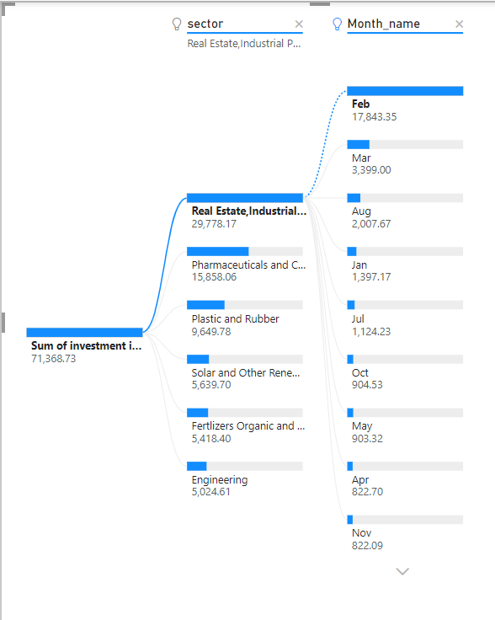
Can we identify any seasonal patterns or cyclicality in the investment trends for specific sectors? Do certain sectors experience higher investments during particular months?
Yes, there are some seasonal patterns and cyclicality in the investment trends for specific sectors. Some sectors tend to experience higher investments during particular months.

Slide 22
1. Real Estate , IT Buildings sectors – Month of Feb or March & April to June.
Factors:
Starting of Financial Year.
Mainly Businesses Planning their budget for the year and they may be looking to invest in new projects or hire new employees.
2. Fertilizers , Organic & inorganic sector – Month of Dec.
Factors:
The start of rabi season.
The availability of Subsidies.
The end of financial year.

Slide 23
Secondary Research

Slide 24
What are the top 5 districts to buy commercial properties in Telangana? Justify your answer.
The large number of businesses and industries.
These areas is also expected to see significant growth in the coming years, making it a good investment destination.
The commercial properties in these areas are in high demand and offer good returns on investment.
Top 5 Districts
Hyderabad
Rangareddy
Medchal_Malkajgiri
Kukatpally
Gachibowli
Factors:
Demand
Location
Infrastructure
Cost
Future Potential

Slide 25
What are the specific locational advantages of the top 5 districts for commercial property investment?
The Locational Advantages of top Districts:
The presence of government institutions: The presence of government institutions, such as government offices and educational institutions, can attract businesses and people to the district, increasing the demand for commercial properties.
The availability of amenities: The availability of amenities, such as hospitals, malls, and restaurants, can make the district more attractive to people.
The cost of land: The cost of land can vary from district to district. Investors should consider the cost of land when making an investment decision.
The future development plans: The district's future development plans can affect its locational advantage. Investors should consider the district's future plans when making an investment decision.

Slide 26
What significant policies or initiatives were put into effect to enhance economic growth, investments, and employment in Telangana by the current government? Can we quantify the impact of these policies using available data?
Policies & Initiatives
THE IMPACT OF THIS POLICIES
TS - Ipass
TS – Bpass
Rythu Bandhu
Kalyana Lakshmi and Shaadi Mubarak
The TS-iPASS system has helped to attract over Rs. 1 lakh crore in investments to Telangana since its launch.
The Rythu Bandhu scheme has helped to increase the income of farmers in Telangana by an average of 25%.
The Kalyana Lakshmi and Shaadi Mubarak schemes have helped to reduce the number of child marriages in Telangana by over 50%.

Slide 27
What are the key drivers of economic growth in Telangana?
IT & ITES
Agriculture
Manufacturing
Tourism
Telangana is home to a large number of IT and ITES companies, including Infosys, Wipro, and TCS.
These companies have helped to create a large number of jobs and boost the state's economy
Telangana is an agricultural state and the agricultural sector contributes significantly to the state's economy.
The state govt. has taken steps to improve the agricultural sector, such as providing irrigation facilities and crop diversification.
The manufacturing sector is also growing in Telangana.
The state government has set up a number of industrial parks and has offered incentives to attract investments in the manufacturing sector
Telangana is a tourist destination and the tourism sector is growing.
The state government has taken steps to promote tourism, such as developing infrastructure and improving connectivity.

Slide 28
What are the challenges to sustained growth in Telangana?
Infrastructure
Skills gap
Poverty
Inequality
Climate change
The state still needs to invest in infrastructure, such as roads, railways, and airports.
This will help to improve the connectivity of the state and make it easier for businesses to operate in the state.
There is a skills gap in the state. This means that there are not enough skilled workers to meet the demand of businesses.
The state needs to invest in education and training to address this challenge.
There is still poverty in the state.
The state government needs to implement policies to reduce poverty and improve the living standards of the people.
There is inequality in the state.
The state government needs to implement policies to reduce inequality and ensure that everyone has an equal opportunity to succeed.
Telangana is vulnerable to the effects of climate change.
The state government needs to take steps to mitigate the effects of climate change and adapt to the changes that are already happening.

Slide 29
Insights:
Telangana has made significant progress in the last 5 years, but there is still room for improvement.
There is less investment in R&D and Infrastructure.
The state is well-positioned to capitalize on the growing demand for IT, manufacturing, and healthcare services.
The state needs to focus on improving its agricultural sector and reducing poverty.
The government should not only focus on developing Hyderabad, but also on developing tier-2 and tier-3 cities.

Slide 30

Recommendations:
The Telangana government should continue to promote the use of e-stamp challans.
The government should invest in improving the infrastructure in rural districts.
The government should focus on promoting sectors that are driving the economic growth of the state, such as IT and ITeS, Electronics, and Automobiles.
The government should develop policies to attract more investments and create jobs in the state.
The government should provide incentives to businesses to set up shop in Telangana.
The government should improve the quality of education.

Slide 31
How can these insights and recommendations be implemented?
Public-private partnerships
Climate change mitigation
Government policies
Education and training
Social programs

Slide 32




Thank you

