Slide 1
CORONAVIRUS & World Economy
By Team:- ANONYMOUS 4.0
JANISHA SETHI
MRIGYA REINEU
RASHI ARORA
HIMANSHI KATARIA

Slide 2
TABLE OF CONTENTS
1. Introduction
2. Effects of Covid-19 on Economy
3. Reducing the effects
4. Conclusion

Slide 3
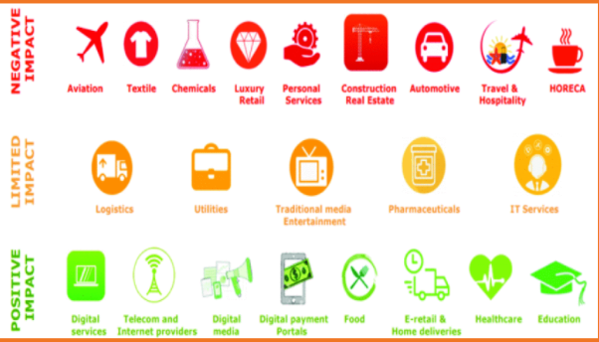
INTRODUCTION
Coronavirus (Covid -19) has affected the world economy as it has had a negative impact as well as positive impact on different kind of industries.

Slide 4
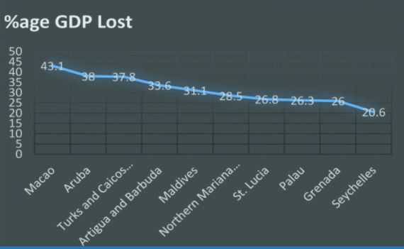
How Covid-19 Affected Tourism
Everything in today's emerging world is done online. From shopping groceries online to making payment via Gpay, Paytm etc.
Countries which were majorly dependent upon the tourism sectors are facing major economics problems due to declining of GDP.

Slide 5
Effect of Covid-19 on World Economy
Travel & Tourism industry is an integral pillar of the “Make in India” program. The sector plays a significant role as an economic multiplier in creating jobs at a rapid rate.
The tourism industry is undergoing one of its biggest existential crises. Spinning under the pandemic’s colossal blow, nearly 30% of inbound tour operators in India may shut their shops permanently
The tourism sector, which contributes 7% of India’s annual GDP, comprises hotels, homestays, holiday homes and more.
The tourism and travel sector employs millions of Indians started bouncing back after the first wave but did they know that Covid would be back for 2nd round of devastation.
The restrictions due to the second wave have again crippled the tourism sector, which was struggling to recover from the initial losses suffered by businesses in 2020. Many smaller establishments may not be in a position to resume their businesses again after the second wave subsides. This is likely to have a devastating impact on households incomes as unemployment will rise.

Slide 6
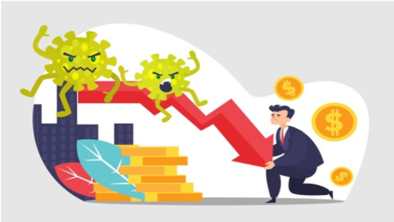
The Economic impact of COVID-19 on hospitality (one of the first industries to get slammed) is a tale told only in astronomical numbers. With scant passengers rattling around inside empty airplanes, hotels abandoned, and thousands of weddings hospitality is losing an average of $534 million in earnings and over 12,000 jobs every day.

Slide 7

How we wish to reduce the effect!
We have created a website for you which helps to find places less crowded with covid-19 considering that the user is also covid-free.

Slide 8
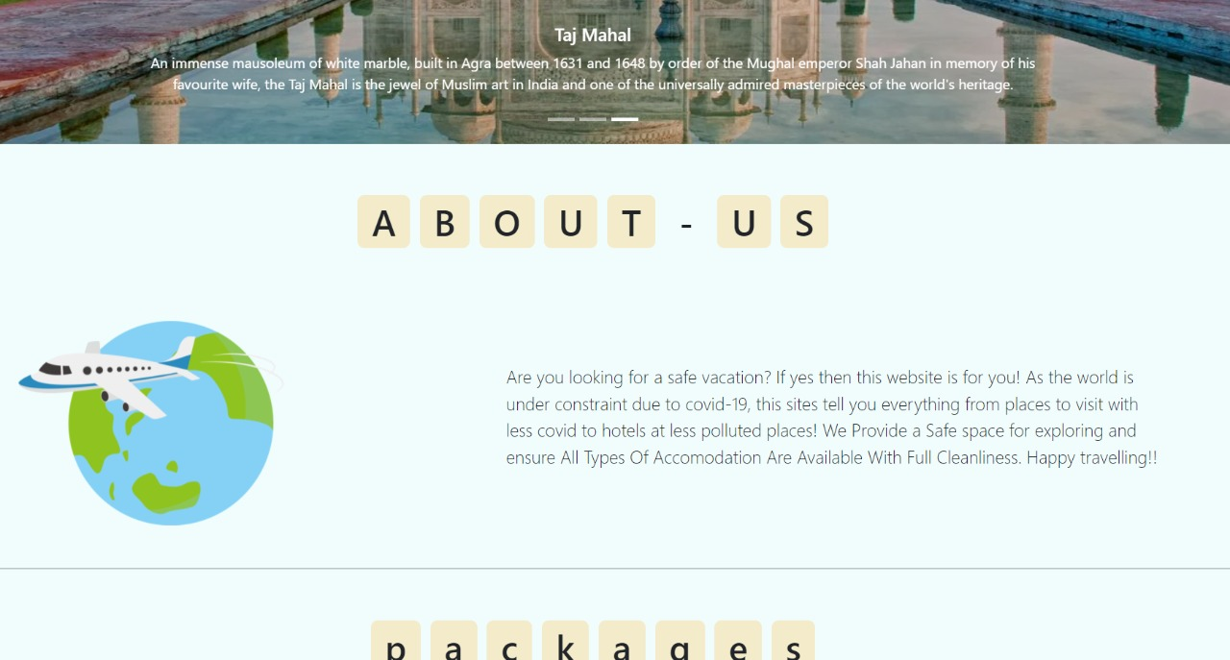

Slide 9
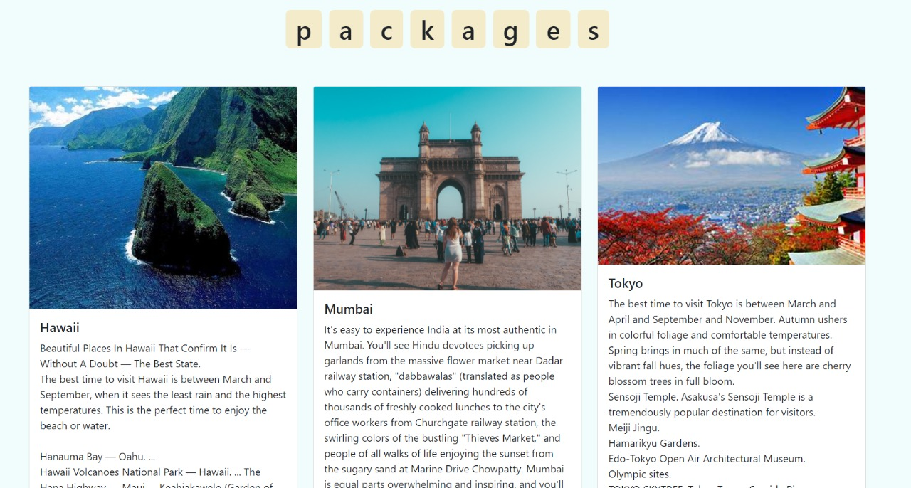
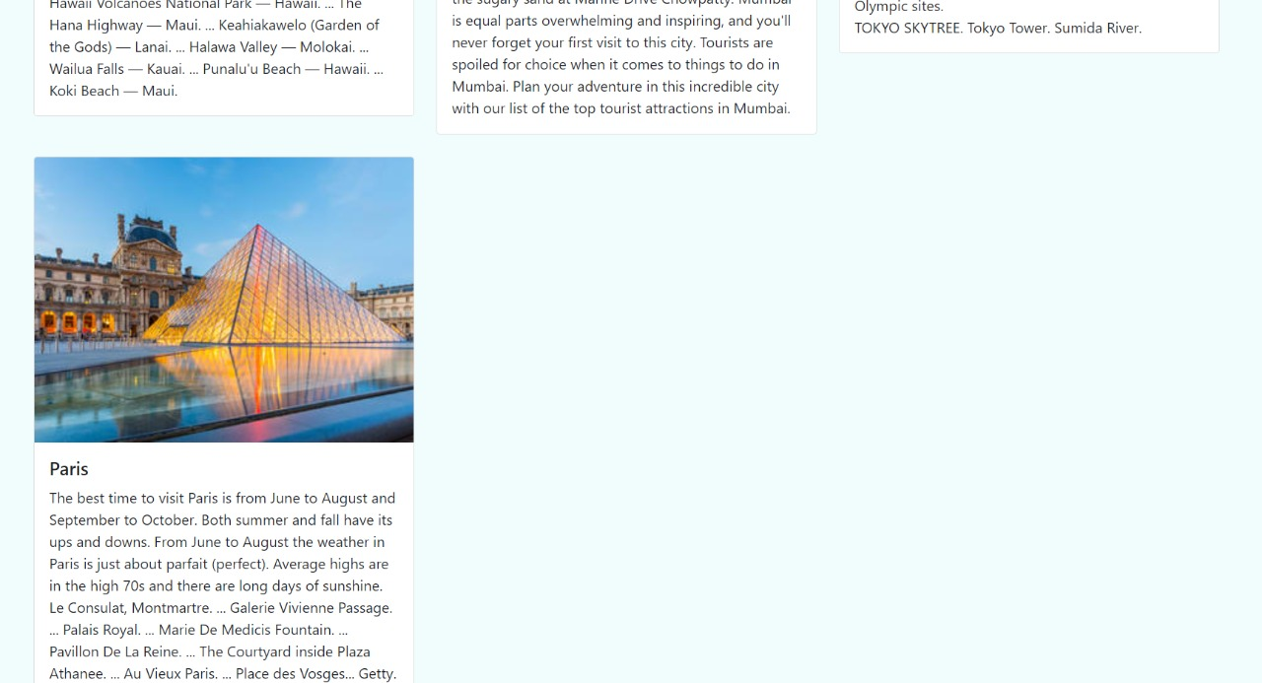

Slide 10


Slide 11


Slide 12
NUMBER OF CASES
 | CONFIRMED | DEATHS
CHINA | 80,866 | 3,213
ITALY | 24,747 | 1,809
IRAN | 13,978 | 724
SPAIN | 8,700 | 297
SOUTH KOREA | 8,236 | 75
After China, there are 24,000+ reported cases in Italy, the second- highest globally

Slide 13
SYMPTOMS
HIGH FEVER
TIREDNESS
DRY COUGH
The body temperature can exceed 37.3 Celsius degrees or 99 Fahrenheit degrees
The body feels completely tired and without energy to perform normal tasks
Irritation and constant coughing without expelling any mucus

Slide 14

CLINICAL TRIAL
CLINICAL TRIAL
CALL
ANALYSIS
TREATMENT
RECOVERY
Call the designated phone number
You are given a test, and it is then analyzed
The doctor prescribes a treatment
You are cured from the disease

Slide 15
METHODS OF PREVENTION
HANDS
DISTANCE
FACE
COUGH
BREATH
DIRECTIONS
Wash your hands with an alcohol-based sanitizer or with soap and water
Keep a distance of at least 1 meter between yourself and anyone who coughs or sneezes
Try your best not to touch your face, your eyes, your nose and your mouth
Cover your mouth and your nose with your bent elbow or a tissue when coughing
Seek medical attention if you have difficulty breathing and a high fever
Always follow the directions of your national or local health authorities

Slide 16
RESEARCH AND PUBLICATIONS
About 80% of people recover from this disease without needing special treatment
Antibiotics do not work against coronavirus

Slide 17
CONCLUSIONS
The novel coronavirus can be transmitted in all areas, regardless of temperature or weather. The best thing is to follow the prevention measures

Slide 18
THANK YOU

