Slide 1

Group 0501_16:
Ajinkya Gutti
Hetu Shah
Rashi Tandon
Sragdhara Pattanaik
Vrushal Kamtikar
(13th Dec 2017)

Slide 2
Relevant Information from the best of sources: U.S news Bloomberg Economist Financial Times Poets & Quants Master in Data Science Best Masters Higher Edu Blog Kylsonwang Blog topUniversities top MBA
Effectively helping students map career path in top business programs like:
MBA
MIS
MSBA

Slide 3
Mission statement for the client:
To provide our prospective students with rankings and relevant information of US universities
Use major journals for the following programs – MBA, MS in Information Systems and MS in Business Analytics.
Mission objectives for the client:
Fair and valuable ranking information
Offering a hassle-free experience
Average GRE, GMAT, GPA score of admitted students
Average fees and salary of graduates
Available in one place and just a few clicks away.

Slide 4
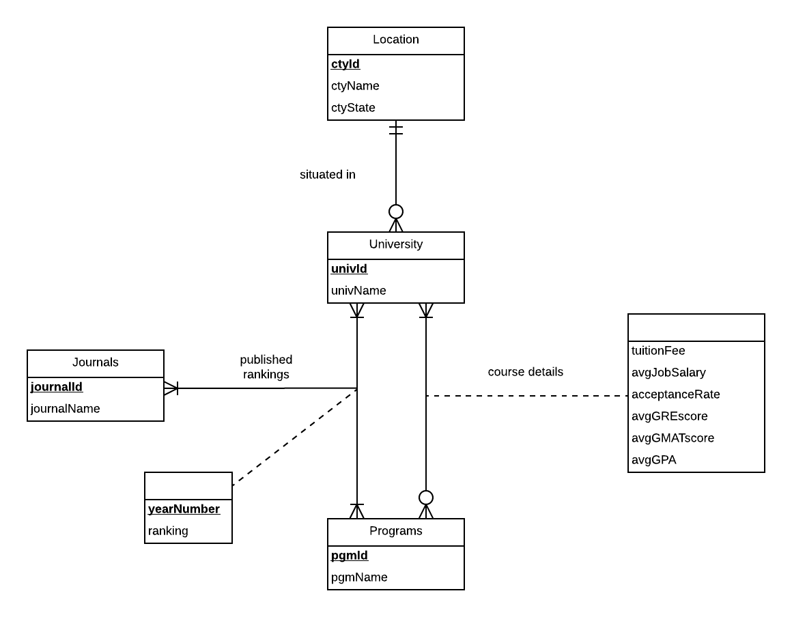

Conceptual Database design:
ER DIAGRAM

Slide 5
Logical Database Design
University (univId, universityName, ctyId)
Location (ctyId, ctyName, ctyState)
Program (pgmId, pgmName)
Journal (journalId, journalName)
PublishedRankings (universityId, programId, journalId, yearNumber, ranking)
CourseDetails (universityId, programId, tuitionFee, avgJobSalary, acceptanceRate, avgGREScore, avgGMATScore, avgGPA)

Slide 6
PHYSICAL DATABASE DESIGN
CREATE
TABLE [CollegePool.University]
(
univId VARCHAR(10) NOT NULL,
univName CHAR(55) NOT NULL,
ctyId VARCHAR(10),
CONSTRAINT pk_University_univID PRIMARY KEY (univID),
CONSTRAINT fk_Location_cityID FOREIGN KEY (ctyID)
REFERENCES [CollegePool.Location] (ctyID)
ON DELETE NO ACTION ON UPDATE CASCADE
);
CREATE TABLE[CollegePool.Location]
(
ctyId VARCHAR(10) NOT NULL,
ctyName CHAR(15),
ctyState CHAR(15)
CONSTRAINT pk_Location_cityID PRIMARY KEY (ctyID)
);

Slide 7
SAMPLE BUSINESS TRANSACTIONS

Slide 8
What are the universities for Master’s in Information Systems in descending order of average GRE score?
SELECT cd.univId, u.univName, cd.pgmId, cd.avgGREscore
FROM [dbo].[CollegePool.CourseDetails] cd JOIN [dbo].[CollegePool.University] u
ON cd.univId = u.univId
WHERE pgmId = 'MSIS'
ORDER BY cd.avgGREscore DESC
Business Transaction 1

Slide 9
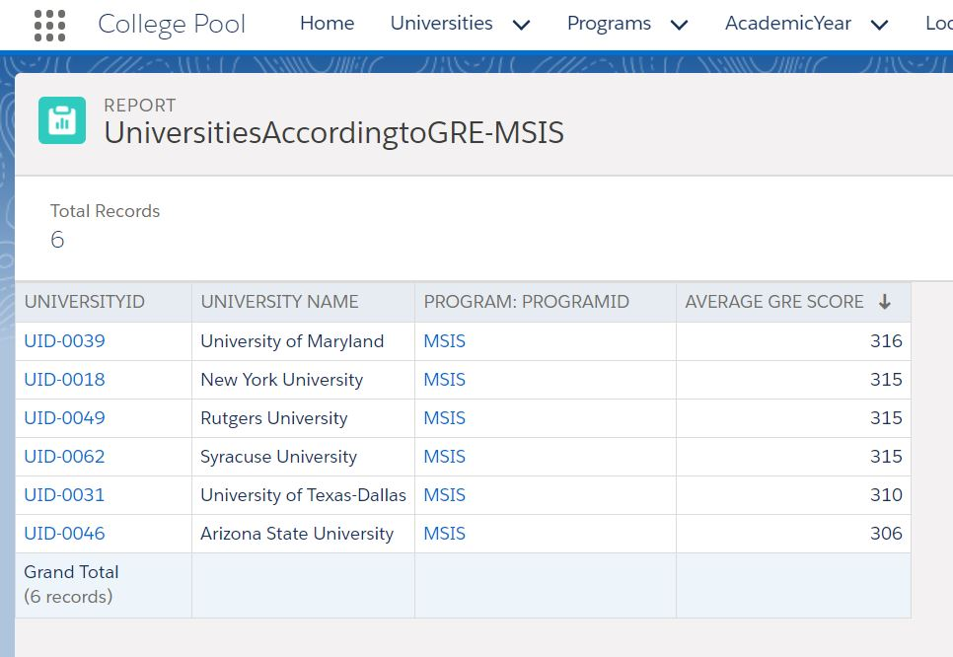
Business Transaction 1 (contd.):

Slide 10
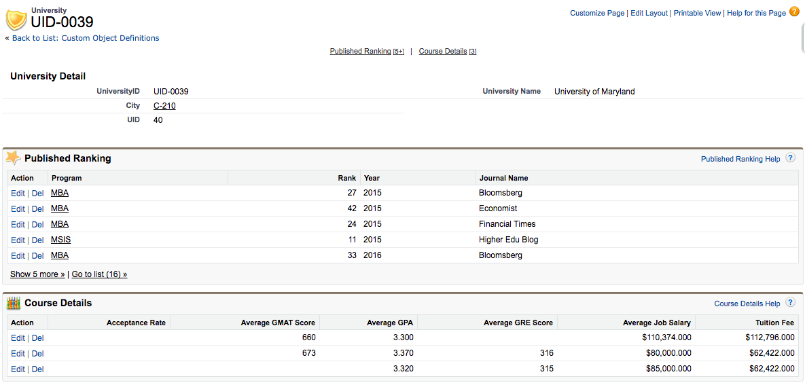
Business Transaction 1 (contd.):

Slide 11
What are the top 10 for MBA according to Journal ‘Poets & Quants’ for the Year 2016?
SELECT TOP 10 pr.ranking, u.univName, l.ctyName, l.ctyState, pr.pgmId, j.journalName, pr.yearNumber
FROM [dbo].[CollegePool.PublishedRankings] pr JOIN [dbo].[CollegePool.University] u
ON pr.univId = u.univId
JOIN [dbo].[CollegePool.Location] l
ON u.ctyId = l.ctyId
JOIN [dbo].[CollegePool.Journal] j
ON pr.journalId = j.journalId
WHERE pr.pgmId = 'MBA'
AND j.journalName = 'Poets & Quants'
AND pr.yearNumber = 2016
ORDER BY pr.ranking ASC
Business Transaction 2

Slide 12
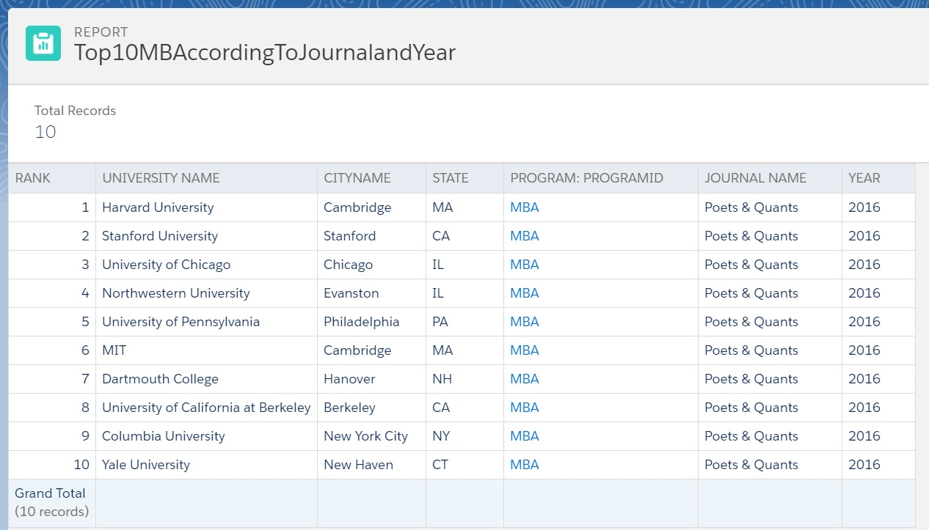
Business Transaction 2 (contd.):

Slide 13
Business Transaction 3
What are the top MBA Universities according to ‘U.S. News’ and the Cities they are situated in for 6 popular States-
California, New York, Pennsylvania, Washington D.C., Georgia & Texas?
SELECT u.univName, l.ctyName, pr.ranking
FROM [dbo].[CollegePool.PublishedRankings] pr
JOIN [dbo].[CollegePool.University] u
ON pr.univId = u.univId
JOIN [dbo].[CollegePool.Location] l
ON u.ctyID = l.ctyId
WHERE pgmId = 'MBA' AND ctyState = 'CA' AND pr.journalId = 'J05'
ORDER BY pr.ranking ASC

Slide 14
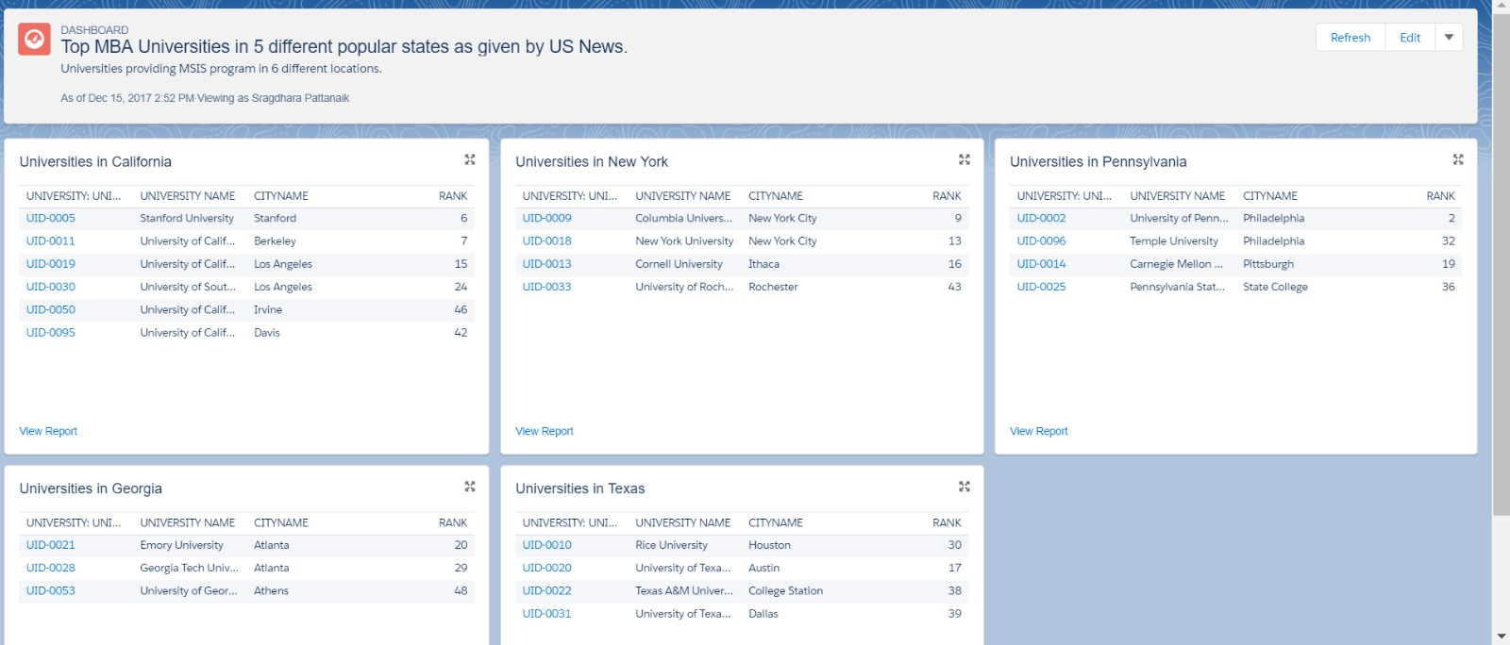
Business Transaction 3 (contd.):

Slide 15
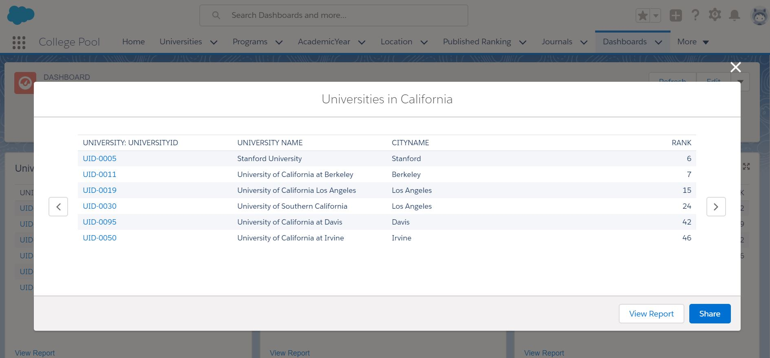
Business Transaction 3 (contd.) :

Slide 16
What are the top universities based on Rank from different Journals for Year 2017?
SELECT u.univName, pr.ranking
FROM [dbo].[CollegePool.PublishedRankings] pr JOIN [dbo].[CollegePool.University] u
ON pr.univId = u.univId
JOIN [dbo].[CollegePool.Journal] j
ON pr.journalId = j.journalId
WHERE pgmId = 'MBA' AND journalName = 'US News'
AND pr.yearNumber = 2017
ORDER BY pr.ranking ASC
Business Transaction 4

Slide 17

Business Transaction 4 (contd.):

Slide 18
Thank you!

