Slide 1



RSOC-2026
GROUP-33
Domain :– Cyber Security
Problem Statement Title:- Automated API Security Scanner
Team Leader Name: - Rashi Mishra
Group No:- 33
Team Name:- Tech _Titans
Members:- Niharika Saner
Mohit Singh
Pravin Lanje
Nagpur | Pune | Jalgaon | Amravati | Pandhura | Bhandara

Slide 2

IDEA TITLE
Synthia Flux
Automated API Security Scanner🔒
Protecting APIs, Securing Data
• SYNTHIA FLUX is an automated API security scanner. • Users can paste an API URL to scan for vulnerabilities. • The system analyzes the API and detects security risks. • It generates a detailed security report after scanning. • Helps developers identify and fix security issues early.
GROUP-33
Nagpur | Pune | Jalgaon | Amravati | Pandhura | Bhandara

Slide 3
FEASIBILITY AND VIABILITY
• SYNTHIA FLUX is feasible using web technologies like HTML, CSS, JavaScript, PHP, and MySQL. • The system can scan API URLs and analyze responses. • APIs are widely used, so the idea has real-world importance. • One challenge is handling complex API structures. • There may be false positives or incorrect vulnerability detection. • Scanning many APIs can cause performance issues. • Different API authentication methods may create compatibility problems. • Using better scanning algorithms can improve accuracy. • Regular updates and testing can reduce errors. • The project is scalable and useful for improving API security.
GROUP-33
Nagpur | Pune | Jalgaon | Amravati | Pandhura | Bhandara

Slide 4
IMPACT AND BENEFITS
The SYNTHIA FLUX platform provides several benefits for developers and organizations.
• Detects API security vulnerabilities automatically • Helps prevent data breaches and unauthorized access • Provides risk classification such as Critical, High, Medium, and Low • Generates clear and easy-to-understand security reports • Improves security awareness among developers • Saves time compared to manual API security testing
GROUP-33
Nagpur | Pune | Jalgaon | Amravati | Pandhura | Bhandara

Slide 5
RESEARCH AND REFERENCES
Research
• Studied common API vulnerabilities and security risks • Analyzed methods for automated API vulnerability detection • Reviewed API security testing tools and techniques • Researched secure API development practices
References
• Google Cloud API Security Best Practices • Research papers on API vulnerability scanning • Cybersecurity blogs and technical documentation
GROUP-33
Nagpur | Pune | Jalgaon | Amravati | Pandhura | Bhandara

Slide 6
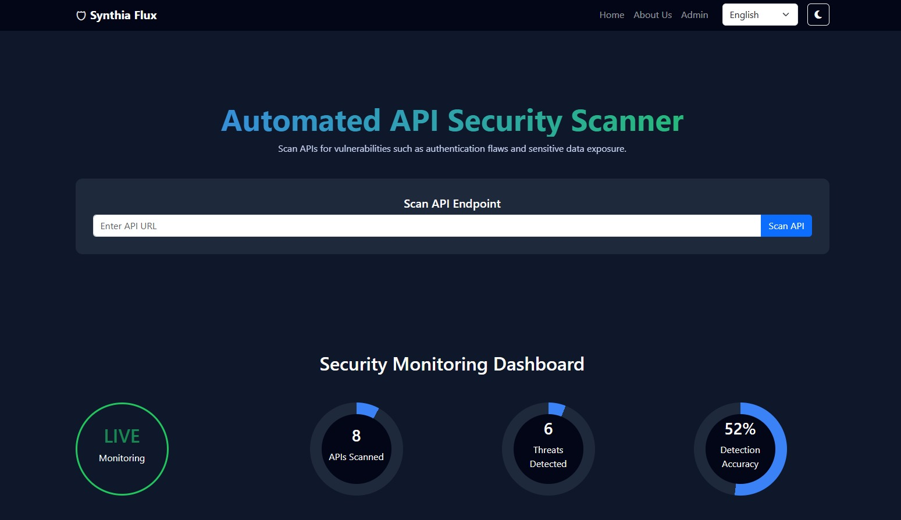
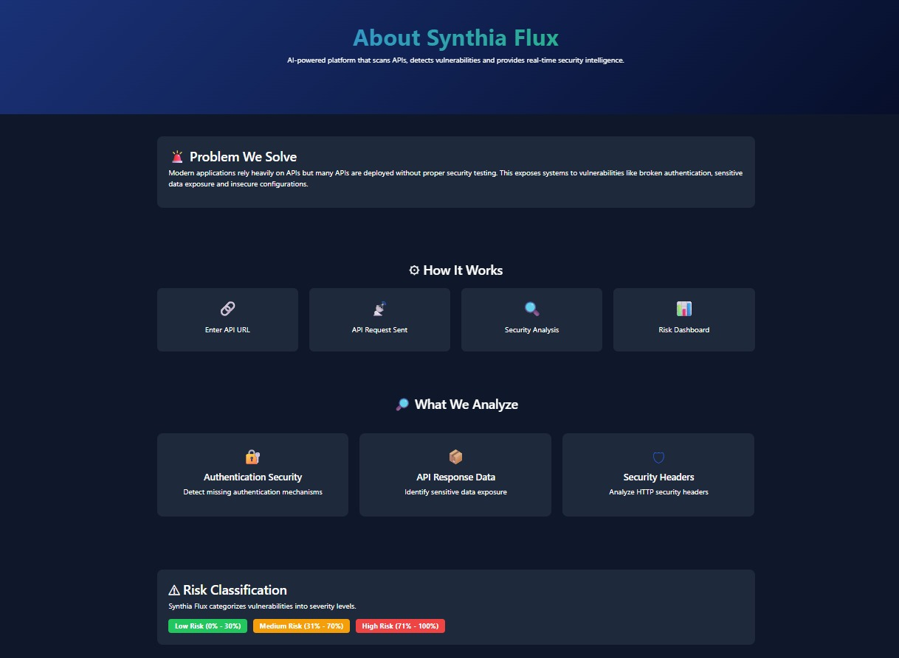
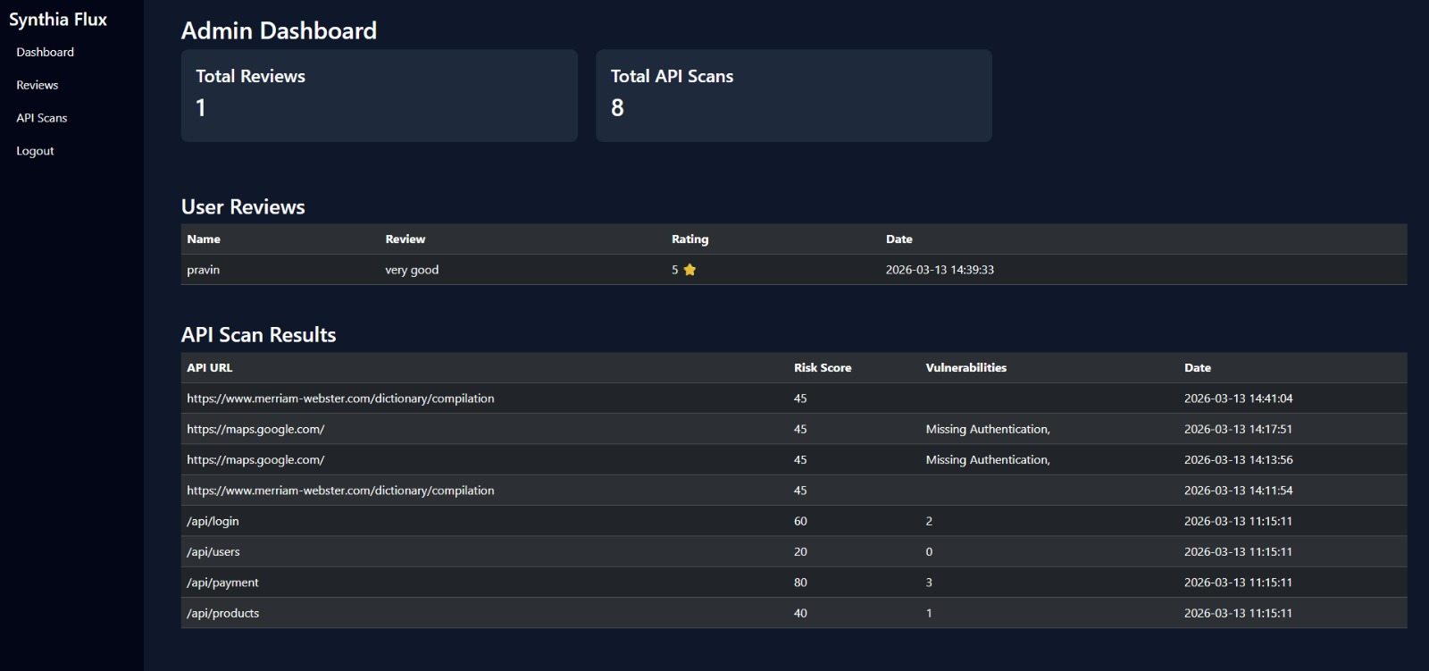
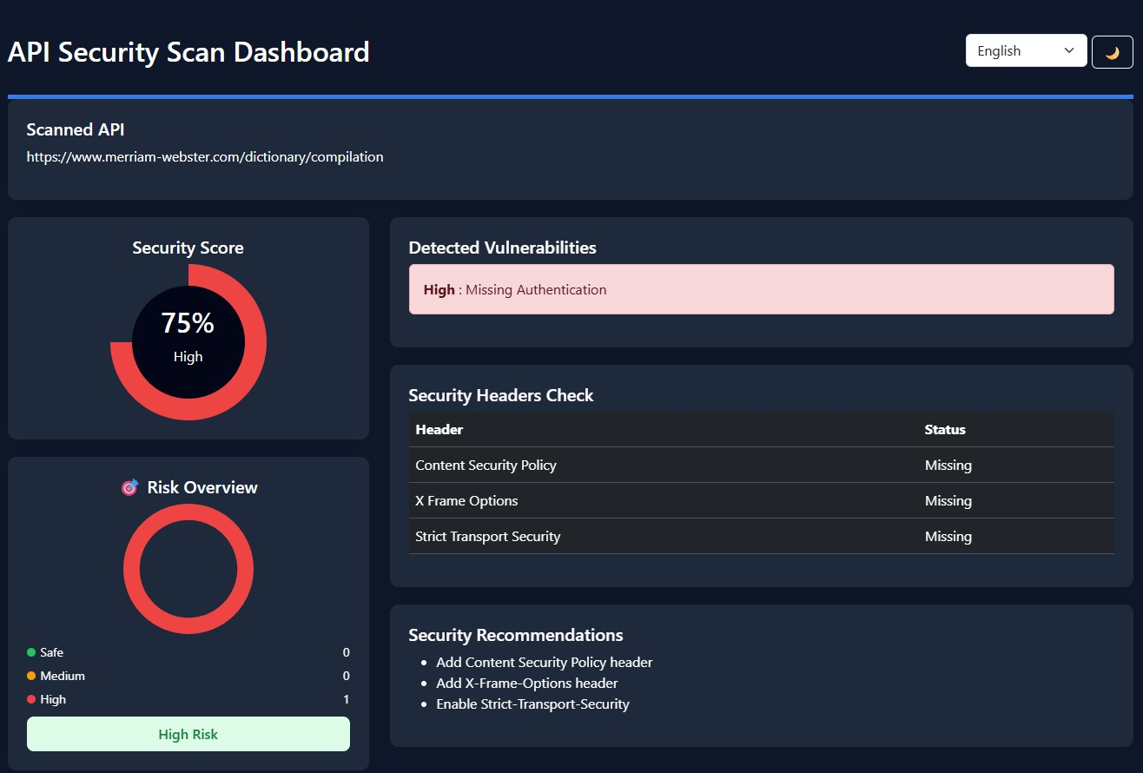
GROUP-33
Nagpur | Pune | Jalgaon | Amravati | Pandhura | Bhandara

