Slide 1
Failed Banking Transaction Analysis
Using Google Cloud Platform (GCP) for Scalable Data Processing
Presented by:
Mohamed Razeeth M
May-25

Slide 2
Abstract
This project focuses on building a scalable data pipeline to ingest, process, and analyze banking transaction data collected from multiple branches across various cities.
The primary objective is to identify failed transactions from daily operational data, consolidate and cleanse this data using PySpark on a Google Cloud Dataproc cluster, and store the results in a Cloud SQL (MySQL) database.
The processed data is then integrated with BigQuery for advanced querying and connected to Looker Studio for interactive visualization and insightful reporting.
This end-to-end pipeline enables efficient monitoring of transaction failures and supports data-driven decision-making for banking operations.

Slide 3
What I Did in the Project:
Data Ingestion & Storage
Data Processing with PySpark on Dataproc
Failed Transaction Filtering
BigQuery Integration
Data Visualization
Data Sources
15 daily CSV files (from 3 cities × 5 branches)
Contains transaction metadata (ID, branch, timestamp, status, reason, amount, etc.)
Dirty/inconsistent data (missing values, duplicates)

Slide 4
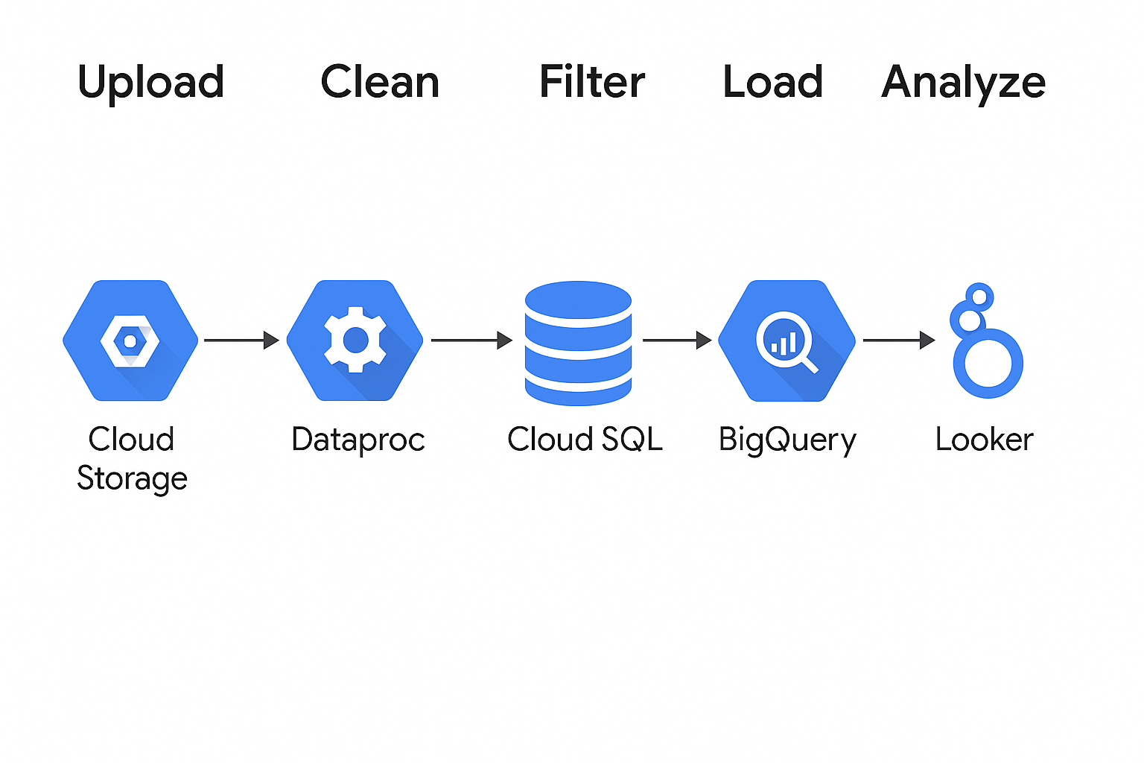
Architecture Diagram
Upload → Clean → Filter → Load → Analyze
Include arrows between GCS → Dataproc → Cloud SQL → BigQuery → Looker

Slide 5
Step 1 – Data Ingestion
Created a Cloud Storage bucket to store raw transaction files: gsutil mb gs://your-bucket-name/
Organized files under an input/ folder inside the bucket.
Uploaded all branch-wise CSV files using: gsutil cp /local/path/*.csv gs://your-bucket-name/input/
Files ready for processing via PySpark on Dataproc.

Slide 6
Step 2 – Data Cleaning with Dataproc
Created a PySpark job to process transaction CSV files.
Read all CSVs from: gs://my-bucket-rashid/data/*.csv
Removed null values and blank rows using: dropna(), trim(col(column)) != ""
Saved cleaned data to: gs://my-bucket-rashid/cleaned-banking-transactions-data/
Ready for filtering failed transactions in the next step.

Slide 7
Step 3 – Extract Failed Transactions
Loaded cleaned data from GCS and run pyspark job to get the failed transaction csv.
Upload this failed transaction csv into cloud sql and connect with bigquery
Saved result as a separate table for analysis.
Used Looker Studio to build failure insights dashboard.

Slide 8
Step 4 – Analysis in Looker
Transaction failed for each branch
failed product-category count
Percentage of transaction failed by mode
count of each product failed by mode
Percentage of transaction failed

Slide 9
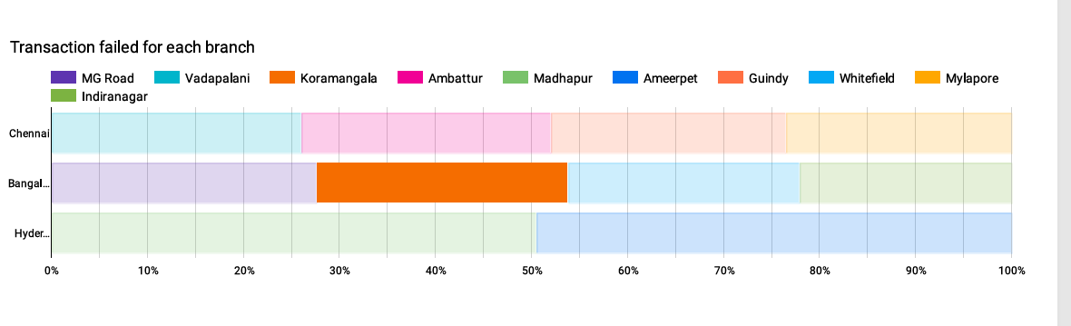
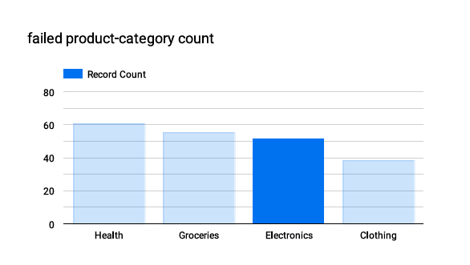

Slide 10
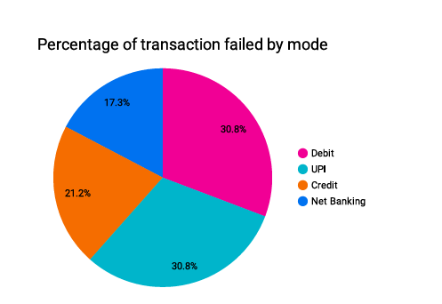
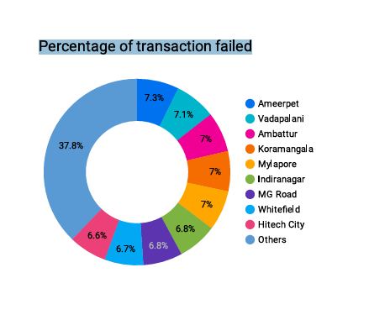
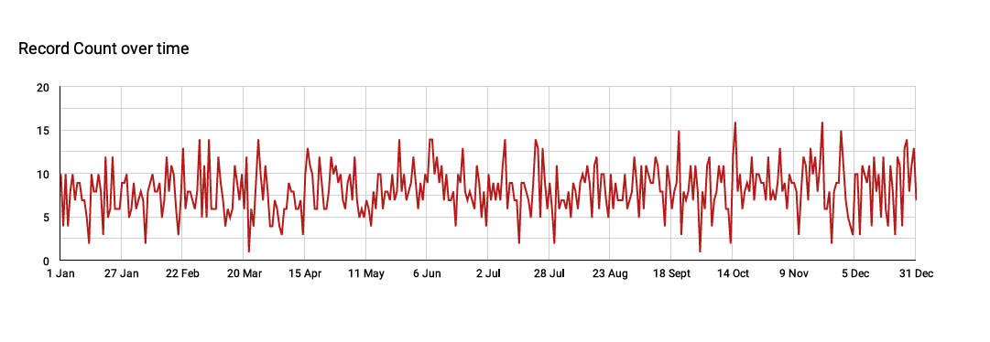

Slide 11
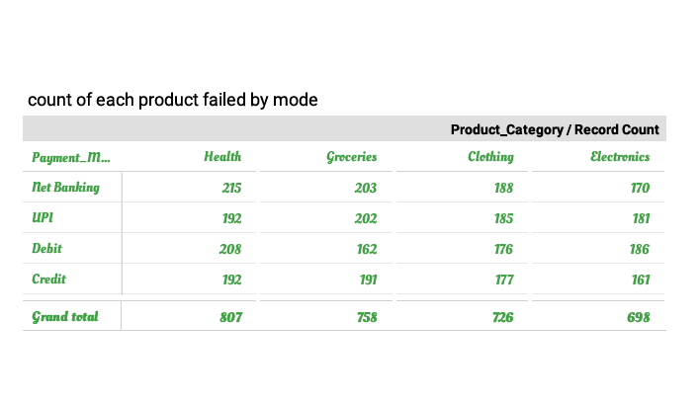

Slide 12
THANK YOU

